Slide 1
Children’s Surgery and NSOAPs
Jamie Anderson, Yasmine Yusef, Neema Kaseje, Doruk Ozgediz, Dan Poenaru, Walt Johnson, Emmanuel Ameh
Global Initiative for Children’s Surgery (GICS)

Slide 2
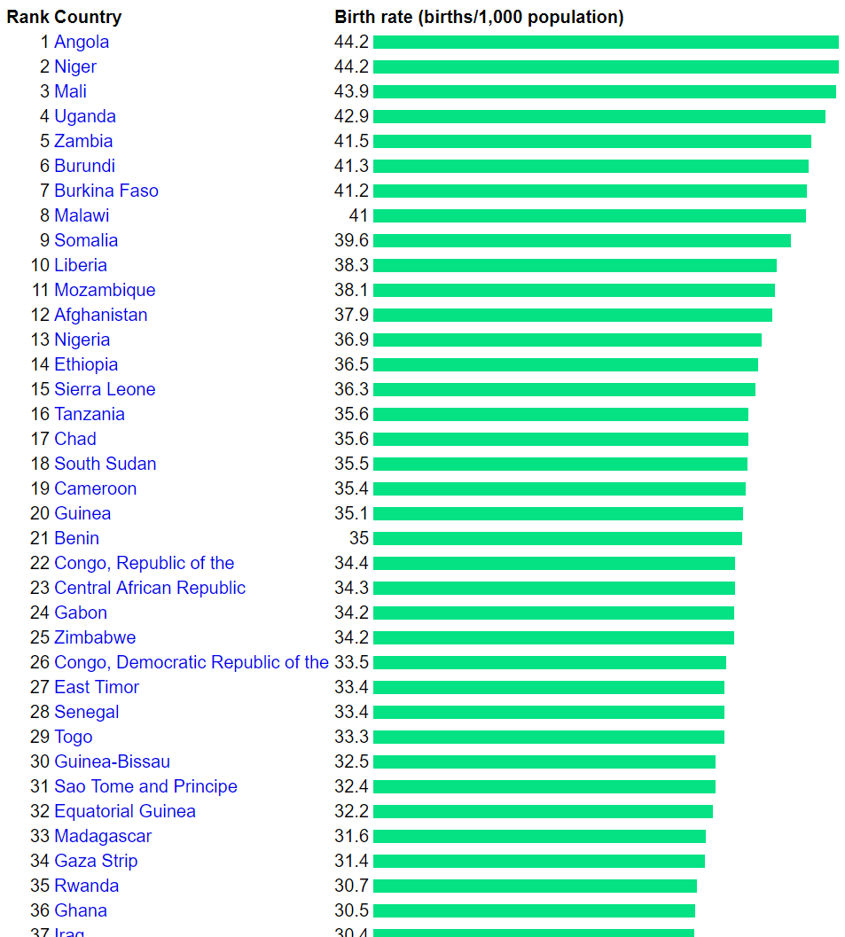
Demographics for Children in LMIC’s
5 billion people lack access to safe, affordable surgical and anaesthesia care when needed:
May translate to >2 billion children without access to safe, affordable surgical and anaesthesia care when needed:
Situation may actually be worse, as the workforce for children’s surgery is seriously limited compared to adults
Demographic | LMICs | United States
% of Population <15 years | 31 – 50% | 19%
% of Population <18 years | >50% | 23%
Birth rate | 3 – 4.4% (SSA) | 1.3%
www.indexmundi.com

Slide 3
Child Health Metrics in LMIC’s
U5 Mortality in LMICs
Increase
GBD 2015 Child Mortality Collaborators
Lancet 2016; 388: 1725–74

Slide 4
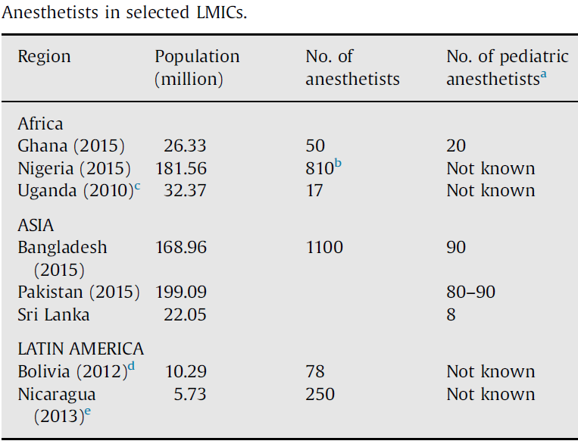
Children’s Surgical Workforce Density in LMIC’s
Krishnaswami S et al. Sem Pediatr Surg 2016; 25: 32 - 42
Data on other specialty children’s surgical workforce density in LMICs is limited

Slide 5
Burden of Surgical Diseases in Children in LMIC’s
Surgical conditions account for 6 – 15% of paediatric admissions in SSA
Survey of 4 LMICs (0 - 18 years)
11 - 28% had a surgical need
42 - 70% of them had at least one unmet need
85% of children may require surgical care
by age of 15years
Bickler SW, et al. Bull WHO 2002;80:829-835
Butler EK et al. PLoS ONE 2017; 12(3): e0170968. doi:10.1371/journal.pone.0170968
Bickler SW, et al. Bull WHO 2002;80:829-835

Slide 6
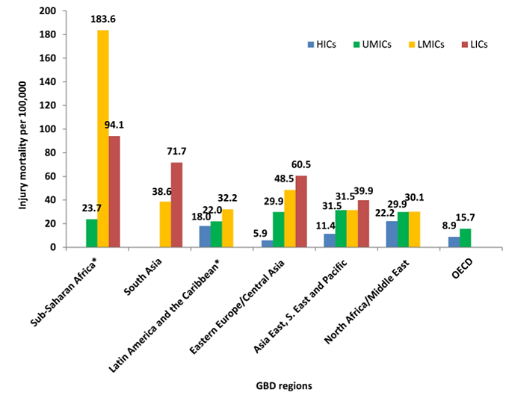
Burden of Surgical Diseases in Children in LMIC’s
Injury mortality in children in these countries is outrageously high
Khan UR, et al. Arch Dis Child 2015;100(Suppl 1):s29–s33
Paediatric conditions requiring surgery carry the risk of life-long disability and higher risk of mortality given that the conditions arise during the years of critical development
Injury mortality rates for children 1–4 years by GBD region and country income groups

Slide 7
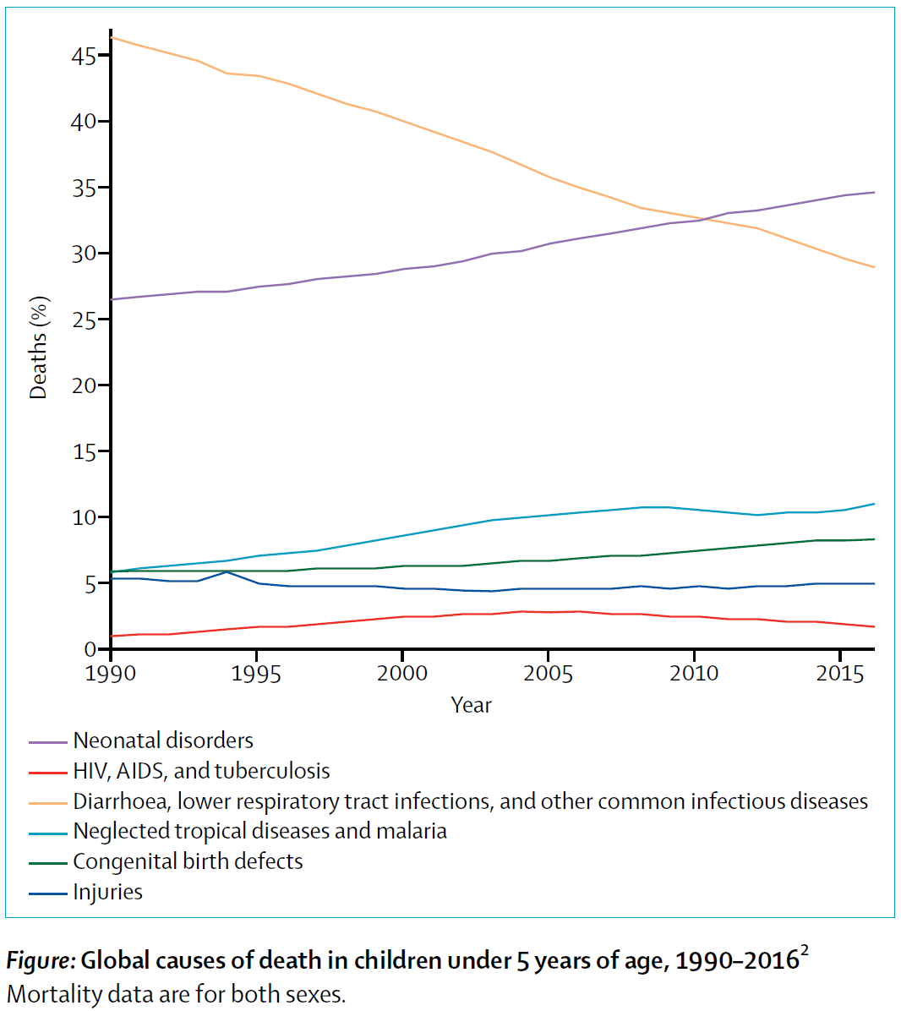
Burden of Surgical Diseases in Children in LMIC’s
Leading 30 causes of global under-5 deaths for both sexes combined
GBD 2015 Child Mortality Collaborators
Lancet 2016; 388: 1725–74
Notes:
We have plans that address mostly adult needs, but how does the newborn survive to reach adulthood when the risk of dying from a surgical condition before age of 5years is so high?

Slide 8
Burden of Surgical Diseases in Children in LMIC’s
Cost-Effectiveness Ratios of Pediatric Surgical Procedures
Findings show that many areas of children's surgical care in LMICs:
Are extremely cost-effective
Provide substantial societal benefits
Are an appropriate target for enhanced investment
UHC and Child-related targets of SDGs cannot
be met in LMICs without scaling up children’s surgical care
Several children’s surgical procedures should be
considered Essential Surgical Procedures
They offer considerable economic value
Saxton AT et al. Economic Analysis of Children's Surgical Care in Low- and
Middle-Income Countries: A Systematic Review and Analysis. PLoS ONE 2016; 11(10): e0165480. doi:10.1371/journal.pone.0165480

Slide 9
Current Realities for Children’s Surgery in LMICs
Child health plans/policies in LMICs
Little or no inclusion of children’s surgery
Data and information
Robust and reliable data lacking (until recently)
No Bellwether procedures for children
Adult Bellwethers (C-Section, Open #, Laparotomy):
Ability to provide these may translate to availability of infrastructure, human resources, quality/safety measures for children’s surgery
Lack of children’s surgery infrastructure (often only available at referral level hospitals)
However, Children’s Medical Care exists at all levels of healthcare
LCoGS
Children’s surgery not specifically addressed
WHA Resolution 68/15
Children’s surgery not specifically addressed
No widely accepted children’s surgical assessment tool

Slide 10
Current Realities for Children’s Surgery in LMICs
Children have No Voice and No Vote (Re: policy makers and politicians)
Past experience has shown that where/when -ever children are not clearly included in programmes:
They get easily forgotten
Notes:
Re: experience with plans for cancer care in some countries….do children have cancer?

Slide 11
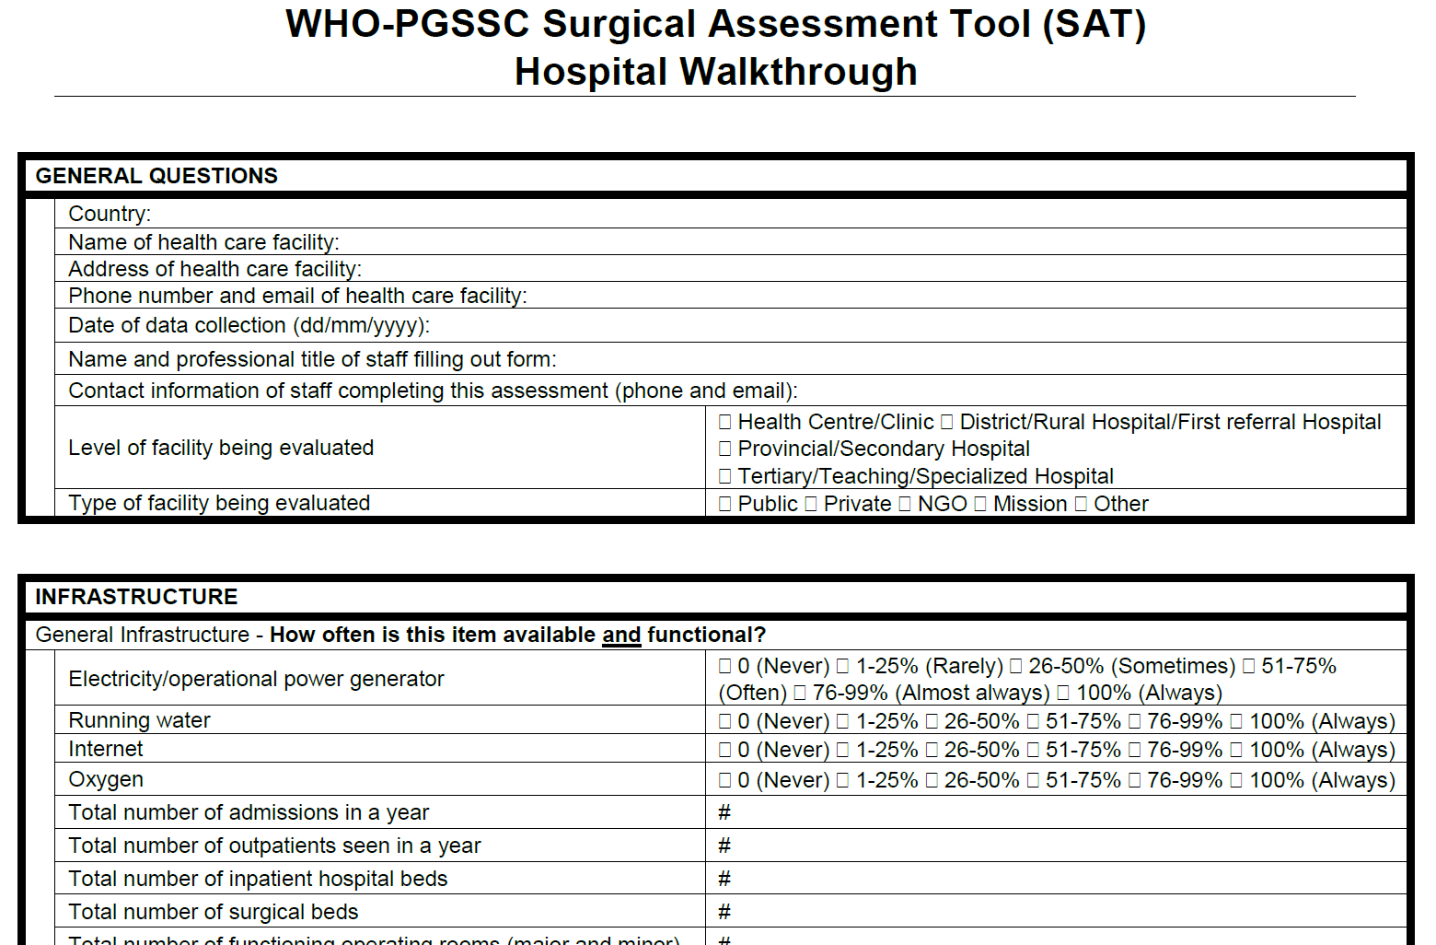
Current Realities for Children’s Surgery
NSOAP Process
Children’s surgery not specifically included in baseline assessment
No children’s surgery in SAT
No questions on children’s surgery in qualitative interview tool
May be difficult to plan for children’s surgery
Notes:
So, if we don’t collect baseline data on children, how do we plan for then in the NSOAP?
Do we just work on assumptions or extrapolate?

Slide 12
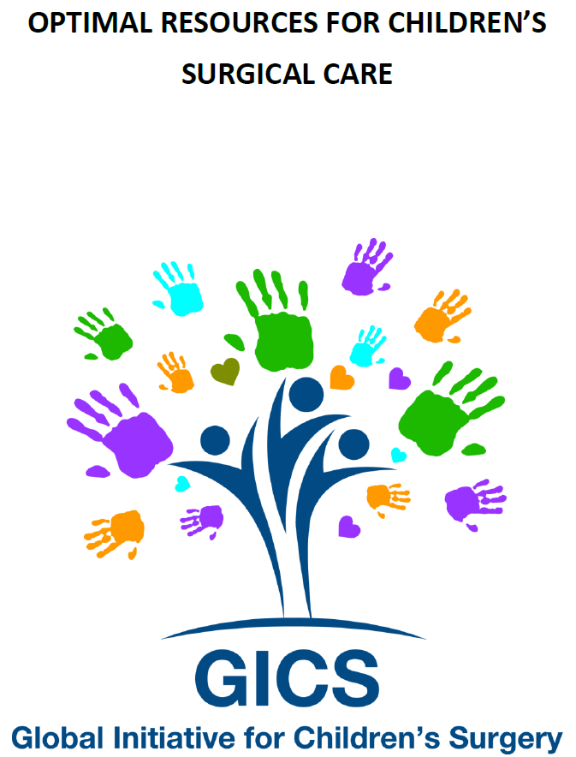
Global Initiative for Children’s Surgery (GICS)
GICS passionately believes that every child must have access to safe surgical care
Mission is to define and promote Optimal Resources for Children’s Surgery in resource-poor regions
www.globalchildrenssurgery.org

Slide 13
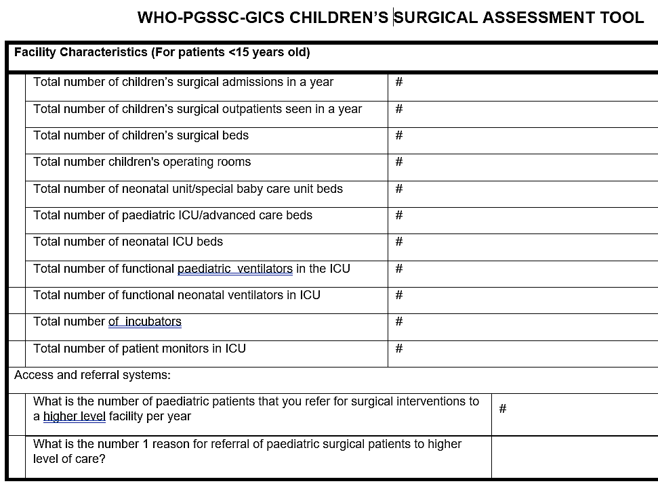
Incorporating Children’s Surgery into NSOAP
Modified the SAT to address children’s surgery in NSOAP
Piloted in Nicaragua & South Sudan (Modified/updated based on feedbacks)
Recommend:
Incorporate into SAT for baseline assessment to ensure children’s surgery is captured
There are more comprehensive children’s surgery assessment tools
Optimal Resources for Children’s Surgery Care (OReCS)
GAPS
More suitable for as stand-alone tools for comprehensive assessment of children’s surgery

Slide 14
Incorporating Children’s Surgery into NSOAP
Infrastructure
Need to have children’s specific/friendly infrastructure and equipment
Efforts of GICS
Supplement to OReCS (with details)
Collaborating with Kids Operating Room (Kids OR: www.kidsor.org)
Recommendation on National Children’s Hospital
Advanced care
Training
Standards
Research
Advocacy

Slide 15
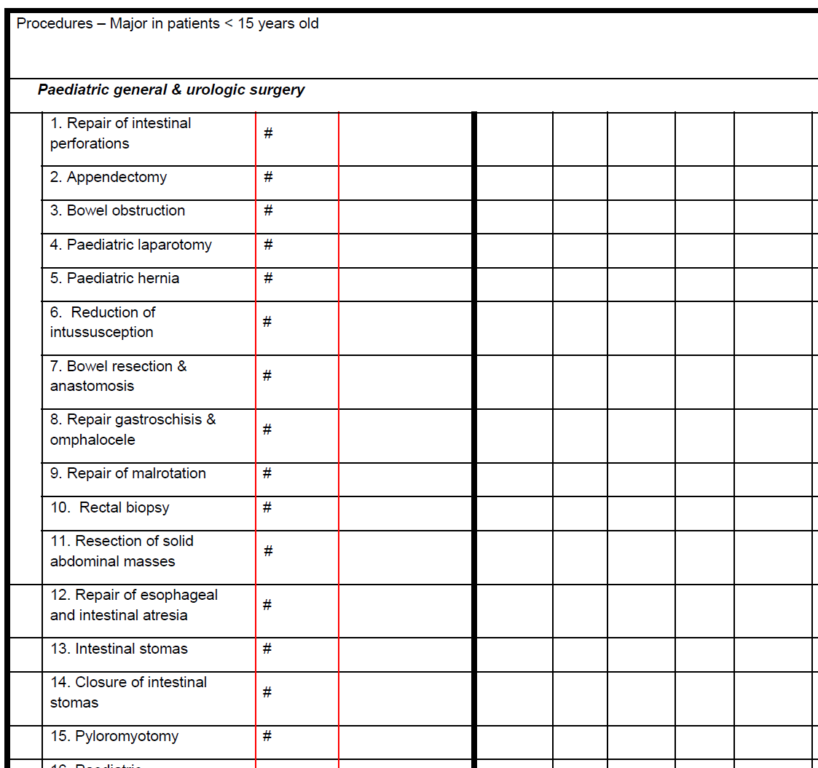
Incorporating Children’s Surgery into NSOAP
Children’s Surgical Procedures (Based on OReCS)
Although no children’s Bellwethers, there are common essential children’s surgical procedures at various levels of surgical care
Notes:
Pending when we have clear Bellwethers for Children, countries embarking on NSOAP should collect information on these procedures to help with planning, implementation and evaluation

Slide 16
Incorporating Children’s Surgery into NSOAP
Volume/Quality/Safety of Children’s Surgery

Slide 17
Incorporating Children’s Surgery into NSOAP
Human Resources for Children’s Surgery

Slide 18
Incorporating Children’s Surgery into NSOAP
Human Resources for Children’s Surgery
What about nursing care?
XNot currently part of SAO
Experience from NSOAP-Nigeria, WACS Surgical Plan & GICS
NSOANP (?NNSOAP)
Notes:
What nurses told us
What SAOs feel
Without including nursing in the name of the plan, there’s concern that:
They will be left behind
We cannot achieve the level of quality and safety that is desired

Slide 19
Incorporating Children’s Surgery into NSOAP
Financing of Children’s Surgery
More than ever, we need to work with donors and groups interested in children’s surgery and child health
Financing of specific aspects of children’s surgery (e.g. Kids OR)

Slide 20
Incorporating Children’s Surgery into NSOAP
Create National Children’s Surgical Plan within NNSOAPs
Need for National Children’s Surgery Coordinator
Need for Children’s Surgery Desk at MoHs (in addition to Surgery Desk)
Inclusion in country’s National Child Health Plan/Policy
Inclusion in existing (and any new) Maternal and Child Health programmes
Notes:
If there’s distinct National Children’s Surgical Plan section within NNSOAPs, it would facilitate integration into other existing child health and MCH plans and plocies

Slide 21
Incorporating Children’s Surgery into NSOAP
In Addition to NSOAP Efforts
Advocacy/Selling Points
MoH and it’s relevant child health/family health departments
Identify relevant stakeholders
Bring these stakeholders together to discuss/plan for children’s surgery
Prioritize children’s surgery within ALL existing child health framework/programmes
‘Piggyback’ on other essential service strengthening
Encourage institutional, regional (within country) national stakeholders meeting for children’s providers (Should not wait for surgical plan to do this)
Birth Defects
Trauma and Injuries
Children’s Cancer
Infectious Diseases (Surgical complications)

Slide 22
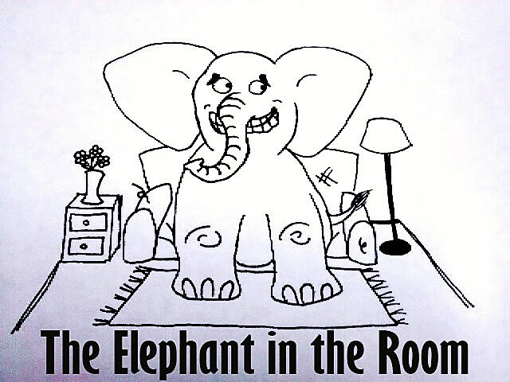
Financing Children’s Surgical Care in LMICs
How can children’s surgery be funded?
How do we leverage in-country funding?
What is the role of external funding?
‘Everybody’ loves children
Children are fundable
Funding of children’s surgery can actually help to galvanize funding for surgical care

