Slide 1
Best buys in global surgery
Mark G. Shrime, MD, MPH, PhD, FACS
Assistant Professor | Global Health and Social Medicine
Assistant Professor | Otolaryngology
Research Director | Program in Global Surgery and Social Change
22 March 2018

Slide 2
Disclosures
GE Foundation Safe Surgery 2020
Damon Runyon Cancer Research Foundation

Slide 3
Outline
Cost-effectiveness
Buying for high value

Slide 4
Outline
Cost-effectiveness
Buying for high value

Slide 5
Measuring value
Value is “bang for your buck”
$$Value= \frac{Outcome}{Cost}$$

Slide 6
Measuring value
Value is “bang for your buck”
$$CE= \frac{Cost}{Outcome}$$
Catastrophic expense
Lives saved
QALYs
DALYs
HALE
Happiness

Slide 7
The two questions
Shopping spree
Competing choice

Slide 8
The shopping spree
Empty shopping cart
Item | Cost | Happiness | C/H
Toilet paper
Cereal
DVD
Wine
Ice cream

Slide 9
The shopping spree
Empty shopping cart
Item | Cost | Happiness | C/H
Toilet paper | $2
Cereal | $4
DVD | $10
Wine | $15
Ice cream | $4

Slide 10
The shopping spree
Empty shopping cart
Item | Cost | Happiness | C/H
Toilet paper | $2 | 2
Cereal | $4 | 3
DVD | $10 | 5
Wine | $15 | 3
Ice cream | $4 | 10

Slide 11
The shopping spree
Empty shopping cart
Item | Cost | Happiness | C/H
Toilet paper | $2 | 2 | $1
Cereal | $4 | 3 | $1.33
DVD | $10 | 5 | $2
Wine | $15 | 3 | $5
Ice cream | $4 | 10 | $0.40

Slide 12
The shopping spree
Empty shopping cart
Item | Cost | Happiness | C/H
Ice cream | $4 | 10 | $0.40
Toilet paper | $2 | 2 | $1
Cereal | $4 | 3 | $1.33
DVD | $10 | 5 | $2
Wine | $15 | 3 | $5
Budget: $10

Slide 13
The shopping spree
Empty shopping cart
Item | Cost | Happiness | C/H
Ice cream | $4 | 10 | $0.40
Toilet paper | $2 | 2 | $1
Cereal | $4 | 3 | $1.33
DVD | $10 | 5 | $2
Wine | $15 | 3 | $5
Total spend
WTP = $1.33
Budget: $10

Slide 14
The shopping spree
Empty shopping cart
Item | Cost | Happiness | C/H
Ice cream | $4 | 10 | $0.40
Toilet paper | $2 | 2 | $1
Cereal | $4 | 3 | $1.33
DVD | $10 | 5 | $2
Wine | $15 | 3 | $5
Total spend
$4
WTP = $1.33
Budget: $10

Slide 15
The shopping spree
Empty shopping cart
Item | Cost | Happiness | C/H
Ice cream | $4 | 10 | $0.40
Toilet paper | $2 | 2 | $1
Cereal | $4 | 3 | $1.33
DVD | $10 | 5 | $2
Wine | $15 | 3 | $5
Total spend
$4
$6
WTP = $1.33
Budget: $10

Slide 16
The shopping spree
Empty shopping cart
Item | Cost | Happiness | C/H
Ice cream | $4 | 10 | $0.40
Toilet paper | $2 | 2 | $1
Cereal | $4 | 3 | $1.33
DVD | $10 | 5 | $2
Wine | $15 | 3 | $5
Total spend
$4
$6
$10
$20
$35
Budget: $10

Slide 17
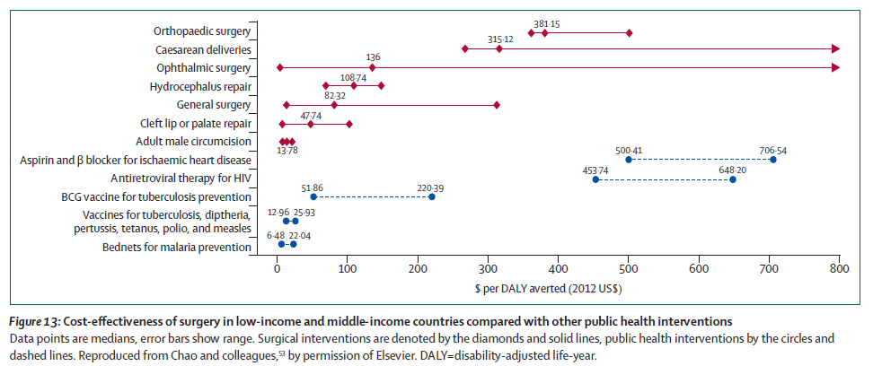
Is surgery cost-effective?
Notes:
In addition to the reasons previously discussed…

Slide 18
The shopping spree
Empty shopping cart
Item | Cost | Happiness | C/H
Toilet paper | $2 | 2 | $1
Cereal | $4 | 3 | $1.33
DVD | $10 | 5 | $2
Wine | $15 | 3 | $5
Ice cream | $4 | 10 | $0.40

Slide 19
The health system shopping spree
Item | Cost/DALY
Malaria | $6.48
Childhood vaccines | $12.96
Cleft lip and palate | $47.74

Slide 20
The health system shopping spree
Item | Cost/QALY
Malaria | $6.48
Childhood vaccines | $12.96
Cleft lip and palate | $47.74
Tuberculosis | $51.86
Acute abdomen | $82.32

Slide 21
The health system shopping spree
Item | Cost/QALY
Malaria | $6.48
Childhood vaccines | $12.96
Cleft lip and palate | $47.74
Tuberculosis | $51.86
Acute abdomen | $82.32
… | …
Ischemic heart disease | $500.41
Total health budget

Slide 22
The health system shopping spree
What should the health system cover?
Item | Cost/QALY
Malaria | $6.48
Childhood vaccines | $12.96
Cleft lip and palate | $47.74
Tuberculosis | $51.86
Acute abdomen | $82.32
… | …
Ischemic heart disease | $500.41
Total health budget

Slide 23
This exercise is irrelevant.

Slide 24
This exercise is irrelevant.

Slide 25
Shopping spree:
should we provide surgery?

Slide 26
Shopping spree:
should we provide surgery?
How

Slide 27
Competing choice:
should we provide surgery?
How

Slide 28
Outline
Cost-effectiveness
Buying for high value

Slide 29
Outline
Cost-effectiveness
Buying for high value

Slide 30
Competing choice
Value is “bang for your buck”
$$CE= \frac{Cost}{Outcome}$$

Slide 31
Competing choice
Value is incremental “bang for your buck”
$$CE= \frac{Cost}{Outcome}$$

Slide 32
Competing choice
Value is incremental “bang for your buck”
$$ICER= \frac{Cost_{a}−Cost_{b}}{Outcome_{a}−Outcome_{b}}$$

Slide 33
Competing choice in global surgery
How should we provide surgery?
Removal of user fees?
Task-shifting / task-sharing?
Both?

Slide 34
ICER
Health benefits
Status quo

Slide 35
ICER
Status quo
Financial risk protection

Slide 36
Conclusion
Average cost-effectiveness is irrelevant
Incremental cost-effectiveness studies are rare but growing
Pick the research that answers the question you want to ask
Should your health system treat a condition?
How should your health system treat it?

Slide 37
Questions?

