Slide 1
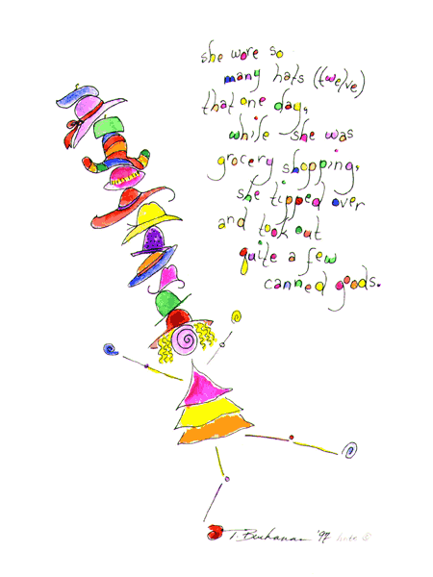
Jannicke Mellin-Olsen
Conflicts of Interest:
President Elect WFSA
Past President European Board of Anaesthesiology
Consultant Anaesthesiologist Bærum Hospital, Norway
→Many hats but not involving money

Slide 2

Global Anaesthesia and Surgery
“Surgery is the neglected stepchild of global health.”
  Paul Farmer
“Anaesthesia is his invisible friend.”
  Craig McClain
Notes:
Over the last two decades, we’ve made good gains with respect to management of communicable diseases but the role of anaesthesia and surgery in LMIC has largely been ignored.

Slide 3
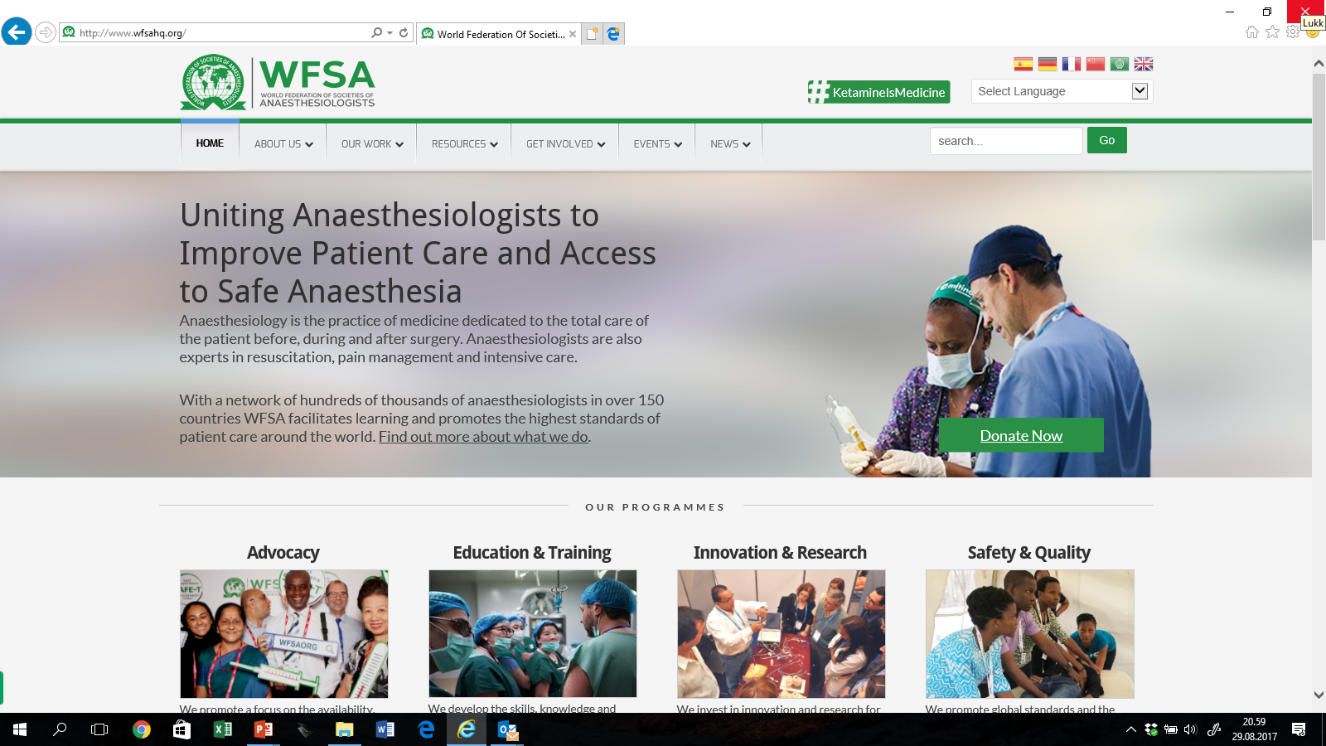

Slide 4
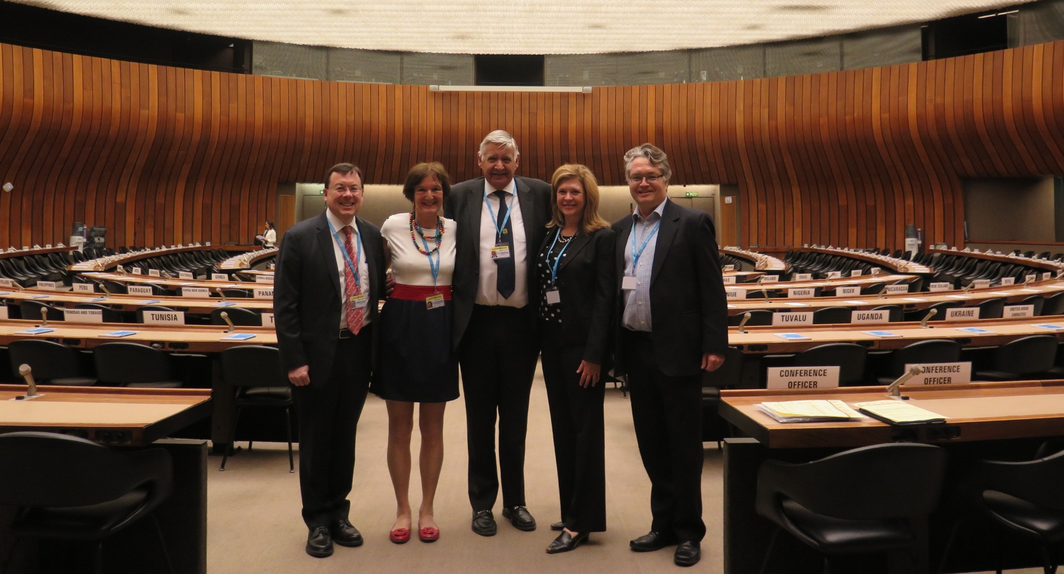
21 May WHA resolution A 68/31 on "Strengthening emergency and essential surgical care and anaesthesia as a component of universal health coverage".

Slide 5
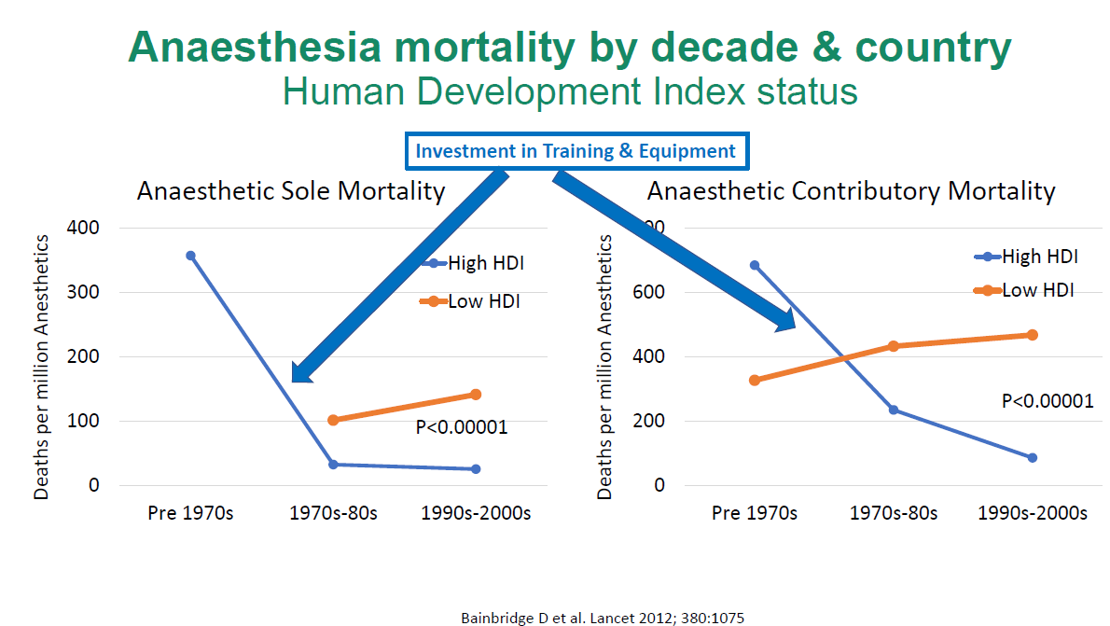

Slide 6
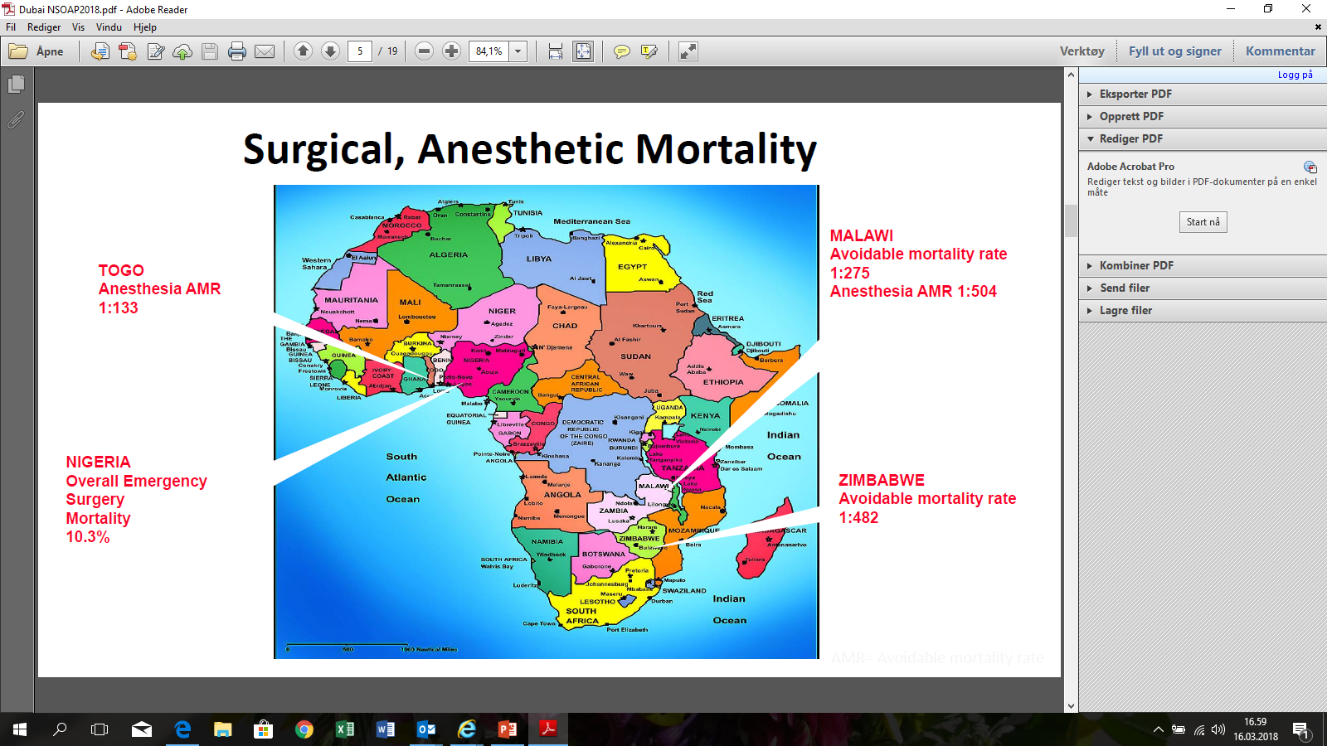

Slide 7
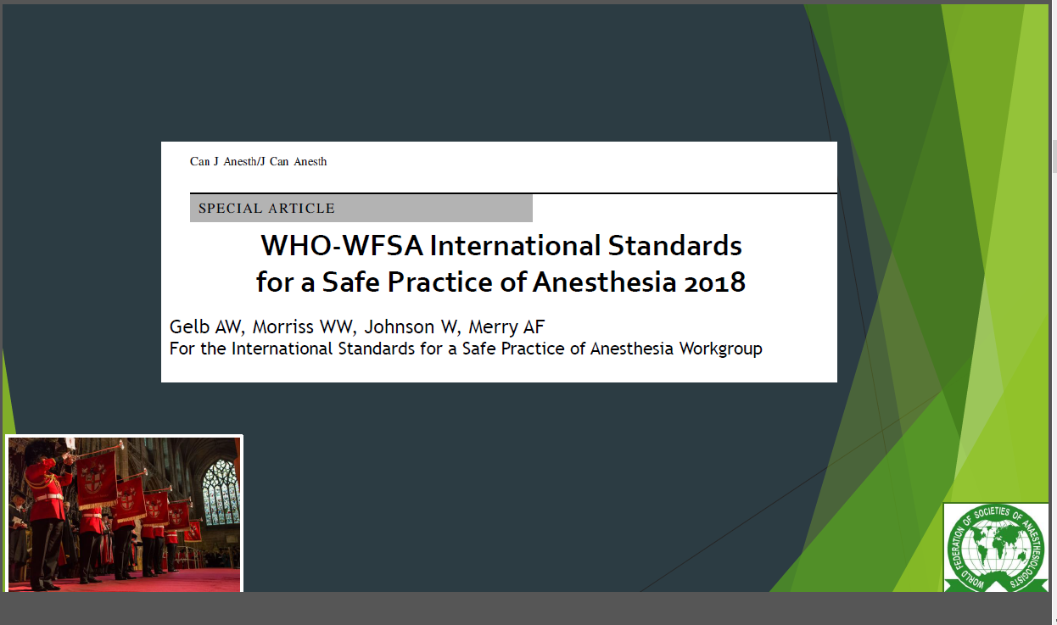

Slide 8
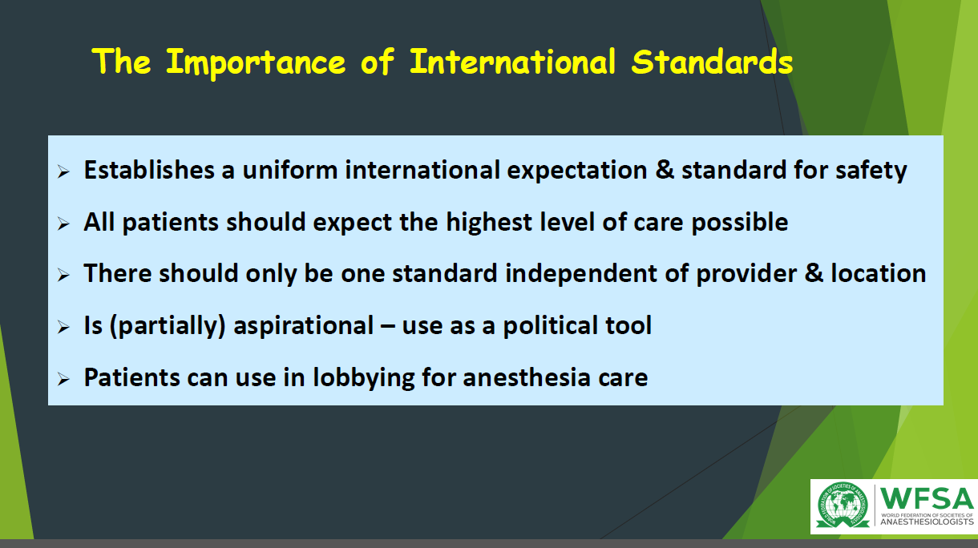

Slide 9
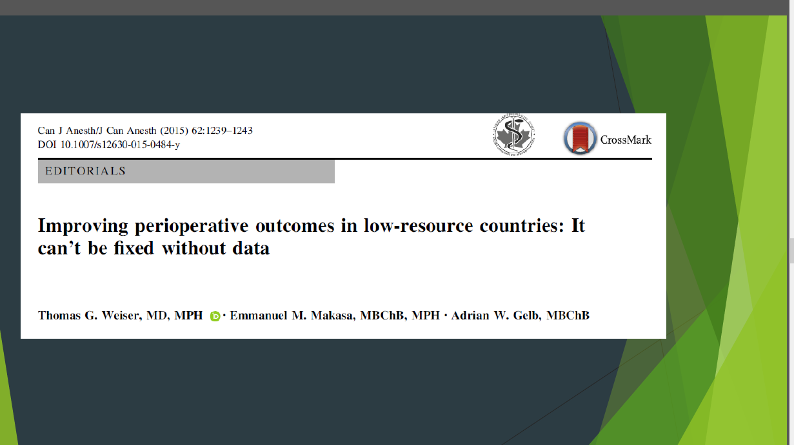

Slide 10
Global Surgical Workforce
Notes:
Need to double the surgical workforce over next 15 years.

Slide 11
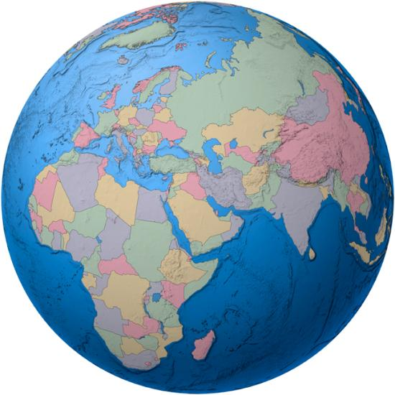
Survey Aims
The WFSA Global Anesthesia Workforce Survey.
Kempthorne P, Morriss WW, Mellin-Olsen J, Gore-Booth J. Anesth Analg. 2017 Sep;125(3):981-990
To obtain detailed information on the global anaesthesia workforce
  Physician Anaesthesia Providers (PAPs)
  Non-Physician Anaesthesia Providers (NPAPs)
  Numbers
  Distribution
  Training
To set up an online workforce map

Slide 12
What Workforce Density?
LCGS Target: 20 SAO providers per 100,000
How many PAPs (anaesthesiologists) are needed?
  Development of anaesthesia services – leaders and teachers
  Delivery of patient care
Interim target: At least 5 PAPs per 100,000
  First step towards adequate provider numbers

Slide 13
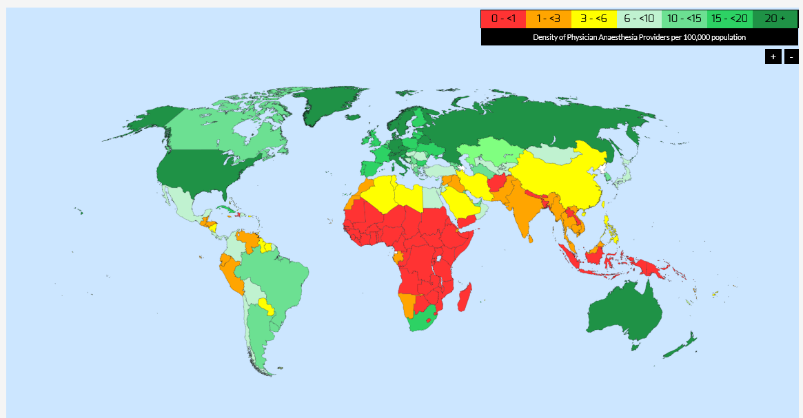
www.wfsahq.org/workforce-map
Information from 153 countries
97.5% of the world’s population
Massive workforce disparities
  Between WHO regions
  Between WB income groups

Slide 14
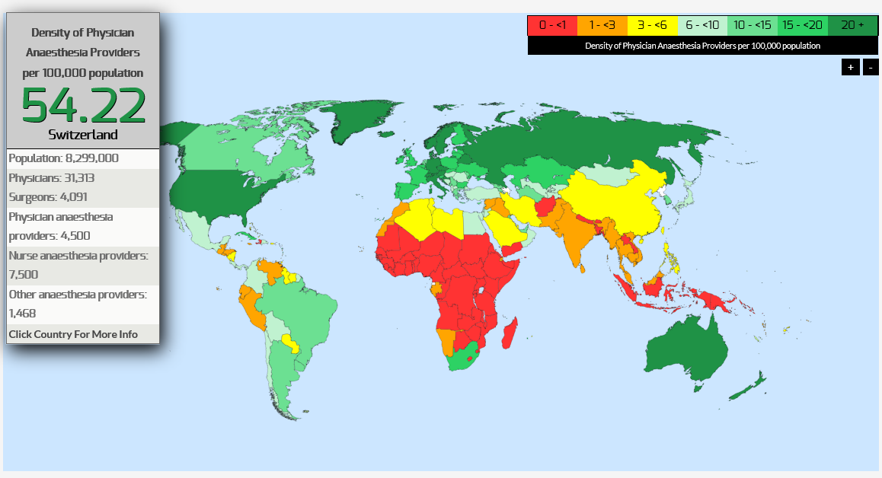

Slide 15
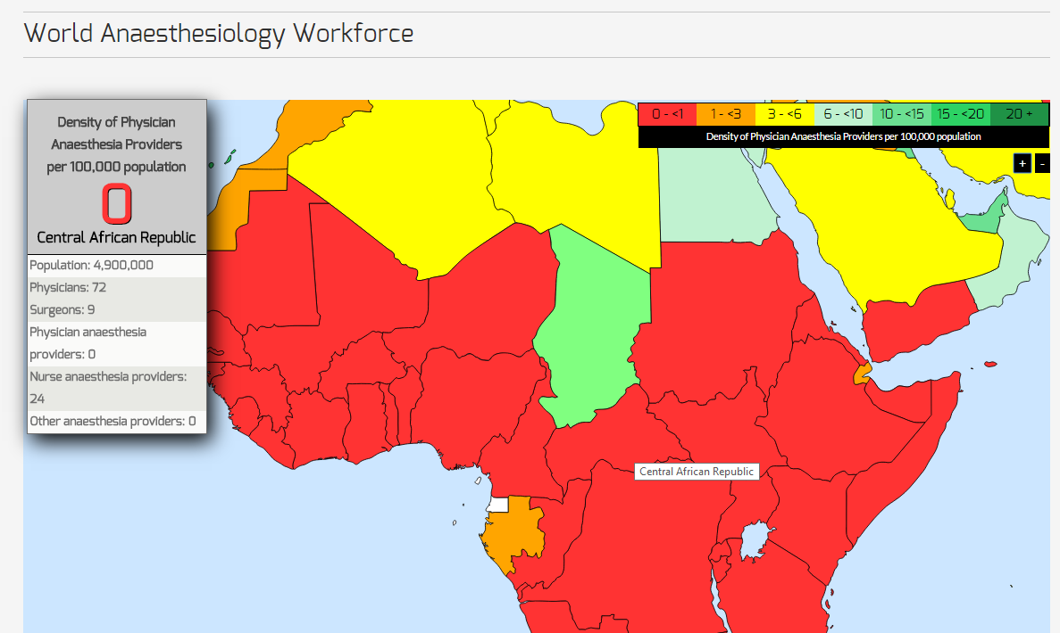

Slide 16
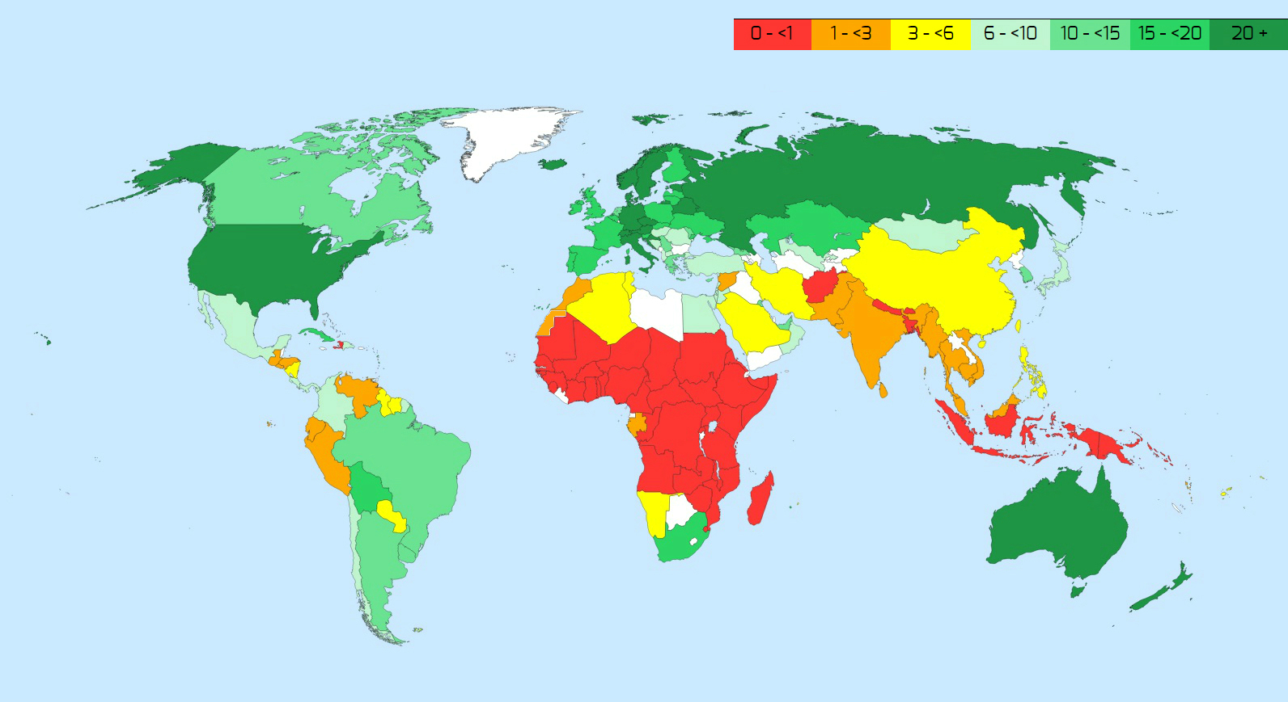
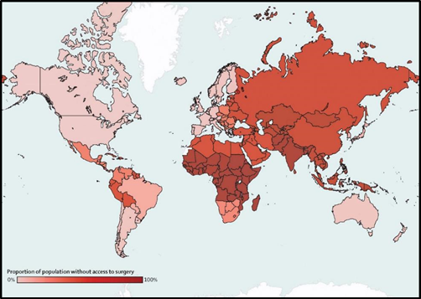

Even when NPAPs are included: 70 countries had a total anesthesia provider density <5/100,000.
>136,000 additional PAPs needed immediately to achieve a minimum density of 5<100,000 in all countries.

Slide 17
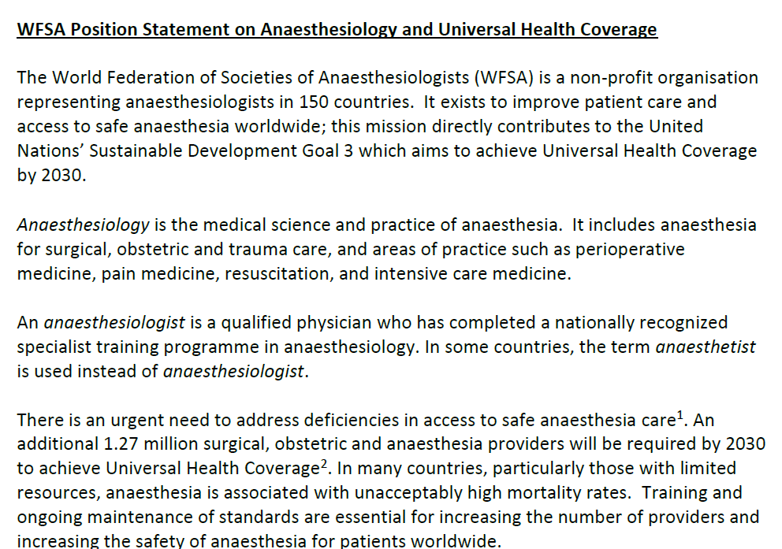
WFSA Position Statement
Anaesthesiology and UHC
  Both PAPs and NPAPs will be required to achieve UHC
  PAP (anaesthesiologist) leadership is essential
Unanimous support from member societies

Slide 18
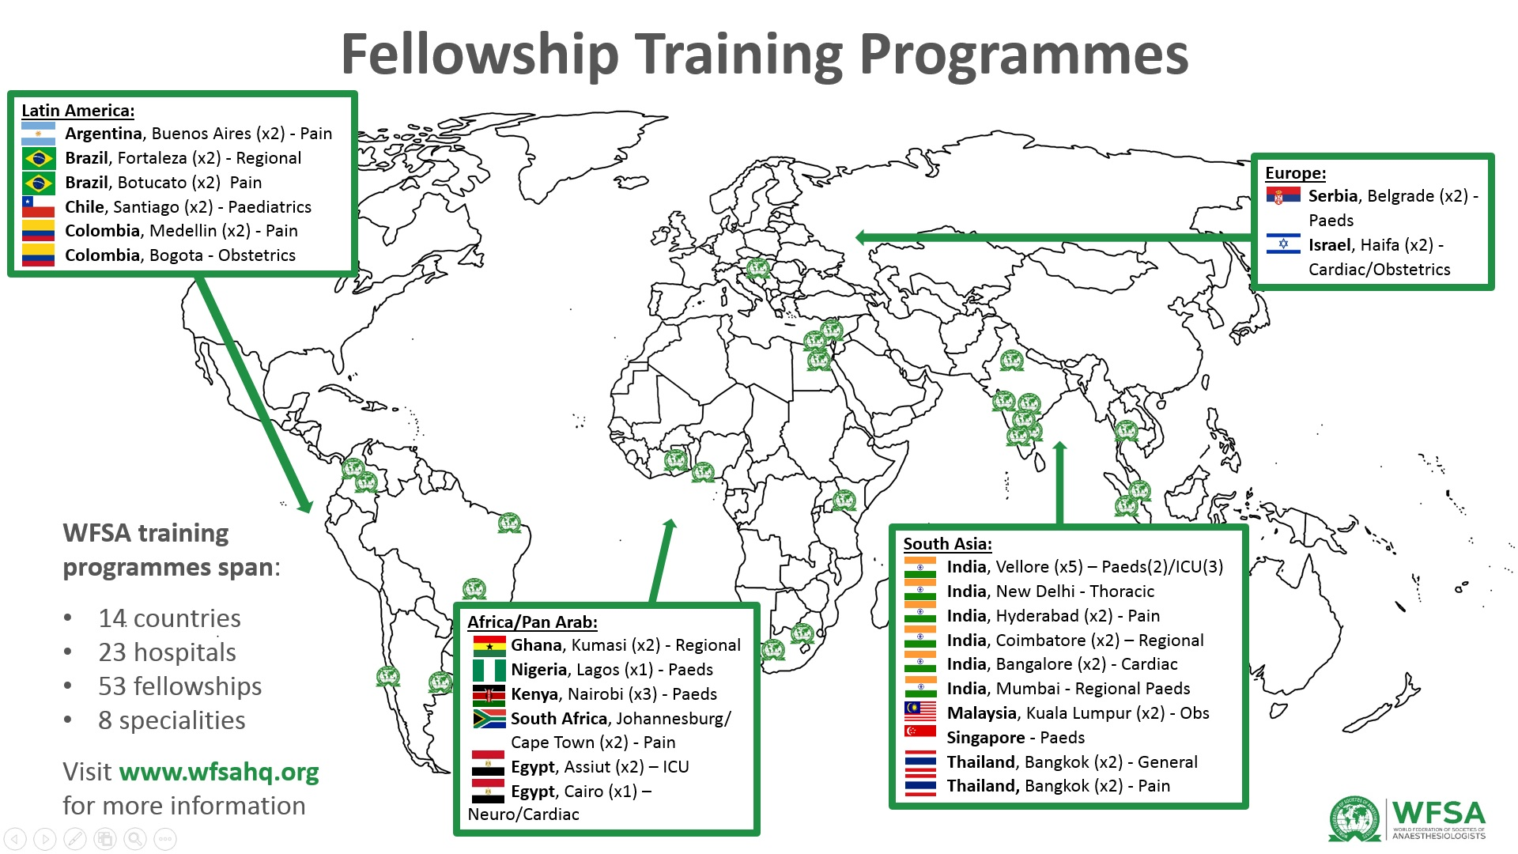
EDUCATION & TRAINING

Slide 19


Slide 20
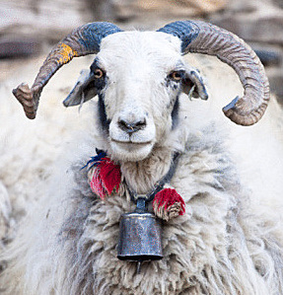
The Essential Anaesthesia Provider
Bellwether Operations
Caesarean section
Laparotomy
Treatment of open fracture
The Essential Anaesthesia
Machine

Slide 21
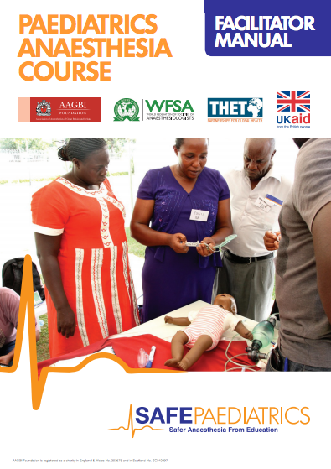

WFSA has partnered with Laerdal GH and Masimo to deliver further SAFE Obstetrics courses from 2017.
Notes:
And it is for this reason that the AAGBI, along with the WFSA have developed the SAFE courses. SAFE stands for Safer Anapest from Ed. In 2011 the obstetric anaesthesia course was piloted and in 2014, the SAFE Paed courses was started”
FUNDED & SUPPORTED by THET and UK Aid, although, where poss., with local government funding as well

Slide 22
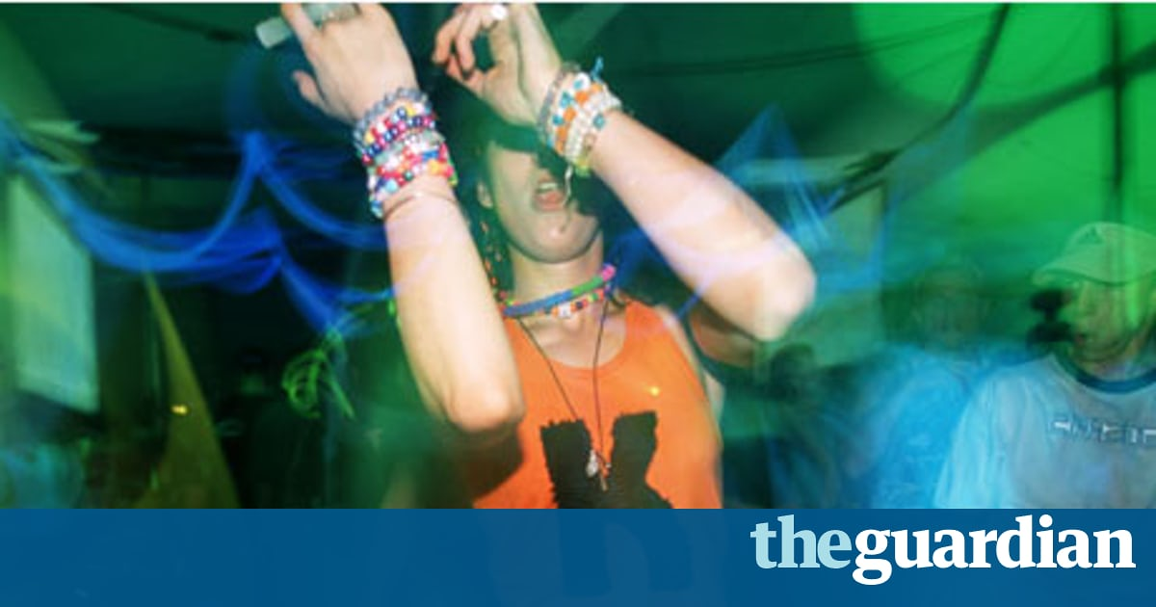
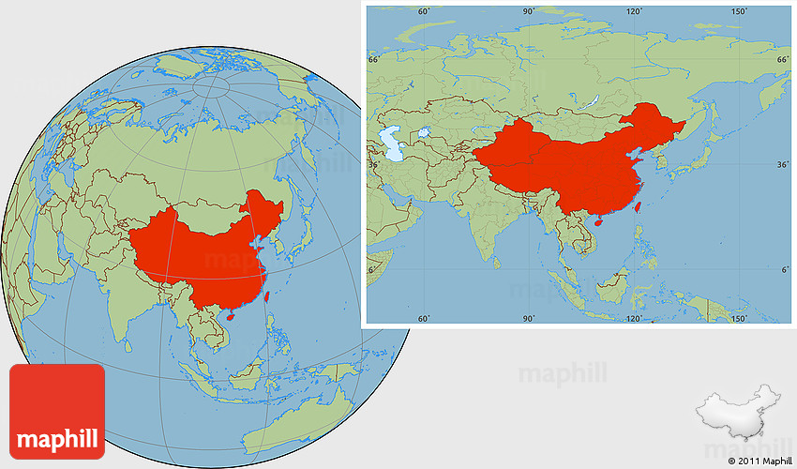
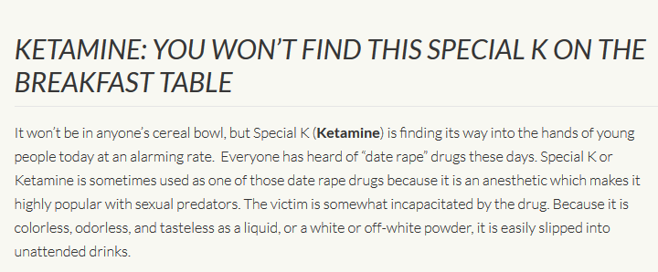

Slide 23

Is it possible to ensure the availability of Ketamine for medical use if labelled as a controlled drug?
The example of morphine:

Slide 24
Morphine – the India experience
“In November, 1985, India enacted the Narcotic Drugs and Psychotropic Substances Act..
The resulting string of procedures to acquire opioids and narcotics for scientific or medicinal purposes is dizzyingly complex: up to six licenses are required for every consignment of morphine.
Many hospitals and medical schools have reacted by simply not stocking morphine. Most manufacturers, which are subject to the same legal restrictions, in turn have stopped producing it, and over the years, since the N.D.P.S. Act came into force, treatment for acute pain in India has greatly diminished.
Data from the International Narcotics Control Board and World Health Organization shows that medicinal use of morphine dropped by ninety-seven per cent in the country after the law was enacted, from seven hundred kilograms in 1985 to a low of eighteen kilograms in 1997.”
The New Yorker, December 2013

Slide 25
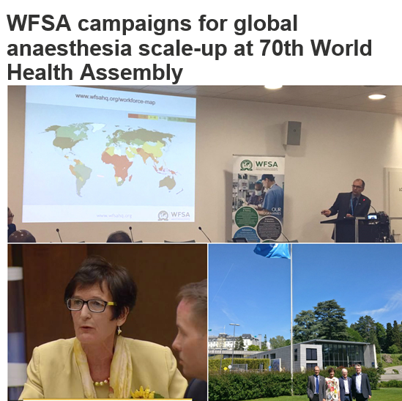
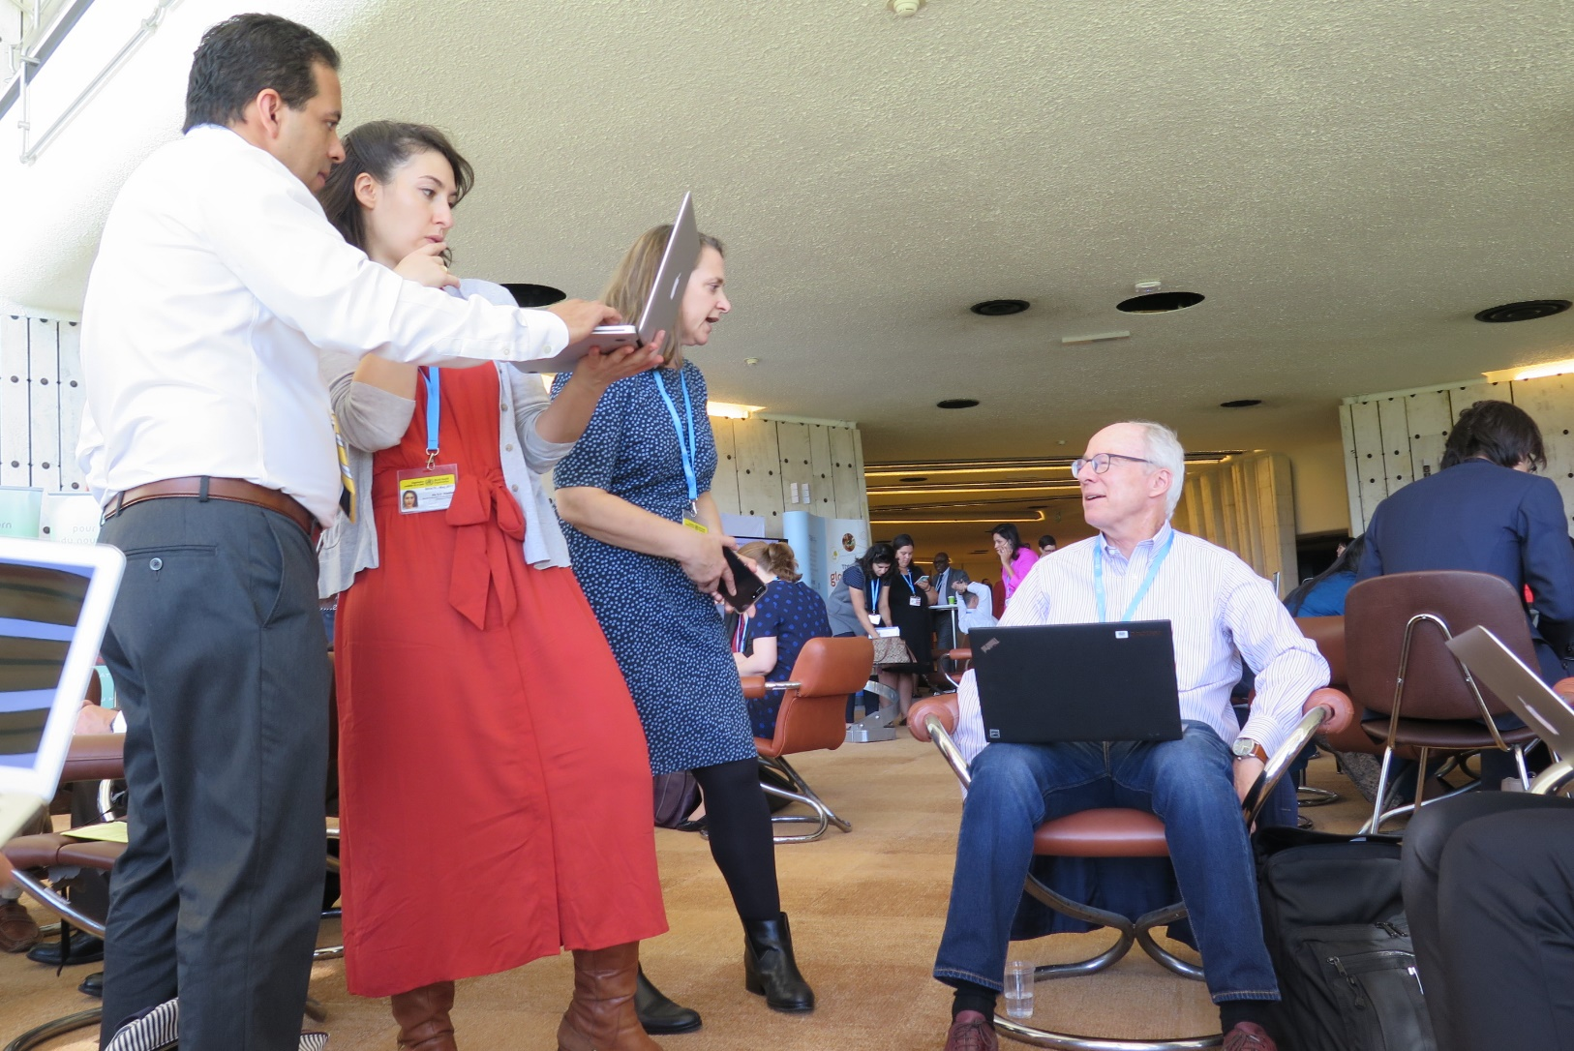
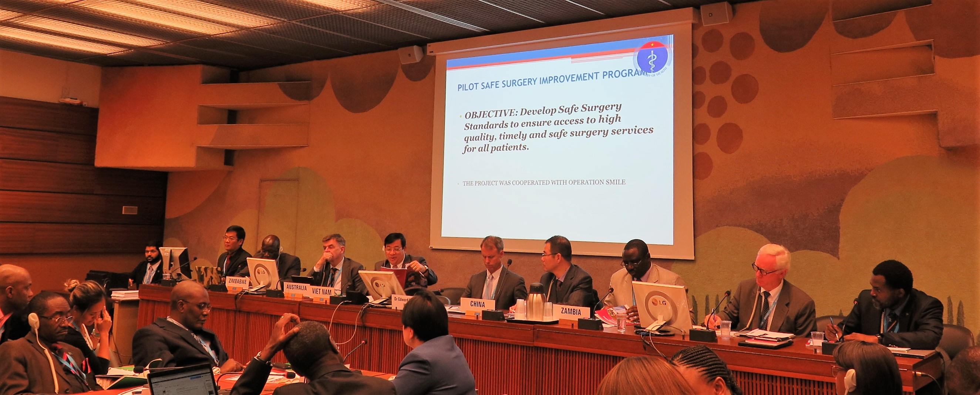

Slide 26


SAFE-T SUMMIT 2018
13th April 2018, London UK
1-day patient safety event to core metrics of The Lancet Commission: Global Surgery 2030
World renowned speakers including Dr Atul Gawande, Mr Tore Laerdal, Dr John Meara and Dr David Whitaker
Lectures, group discussions
Develop recommendations and identify practical ways forward
Register today:
www.rsm.ac.uk/events

Slide 27

The Role of the WFSA in reaching the Goals of the
Lancet Commission on Global Surgery
Barreiro G, Mellin-Olsen J, Gore-Booth J. Anesth Analg in press

Slide 28
SAFE OR
Co-publish
Basic training guidelines
Essential Surgery?
Non-physician providers?
Standards LMHIC

Slide 29
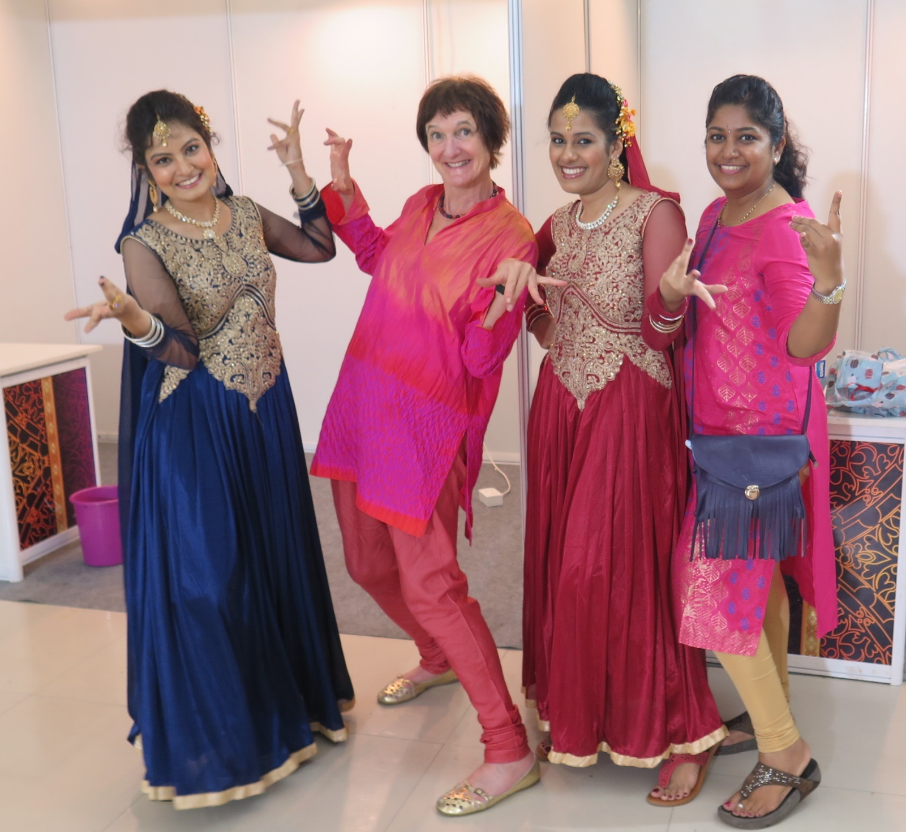




THANK YOU
www.wfsahq.org
jannicke@Mellin.no
linkedin.com/company/WFSA
facebook.com/WFSAorg
twitter.com/WFSAorg

