Slide 1
Surgical, OBSTETRIC AND ANAESTHESIA
Planning Workshop
Dr Walt Johnson
Lead, Emergency and Essential Surgical Care Programme

Slide 2
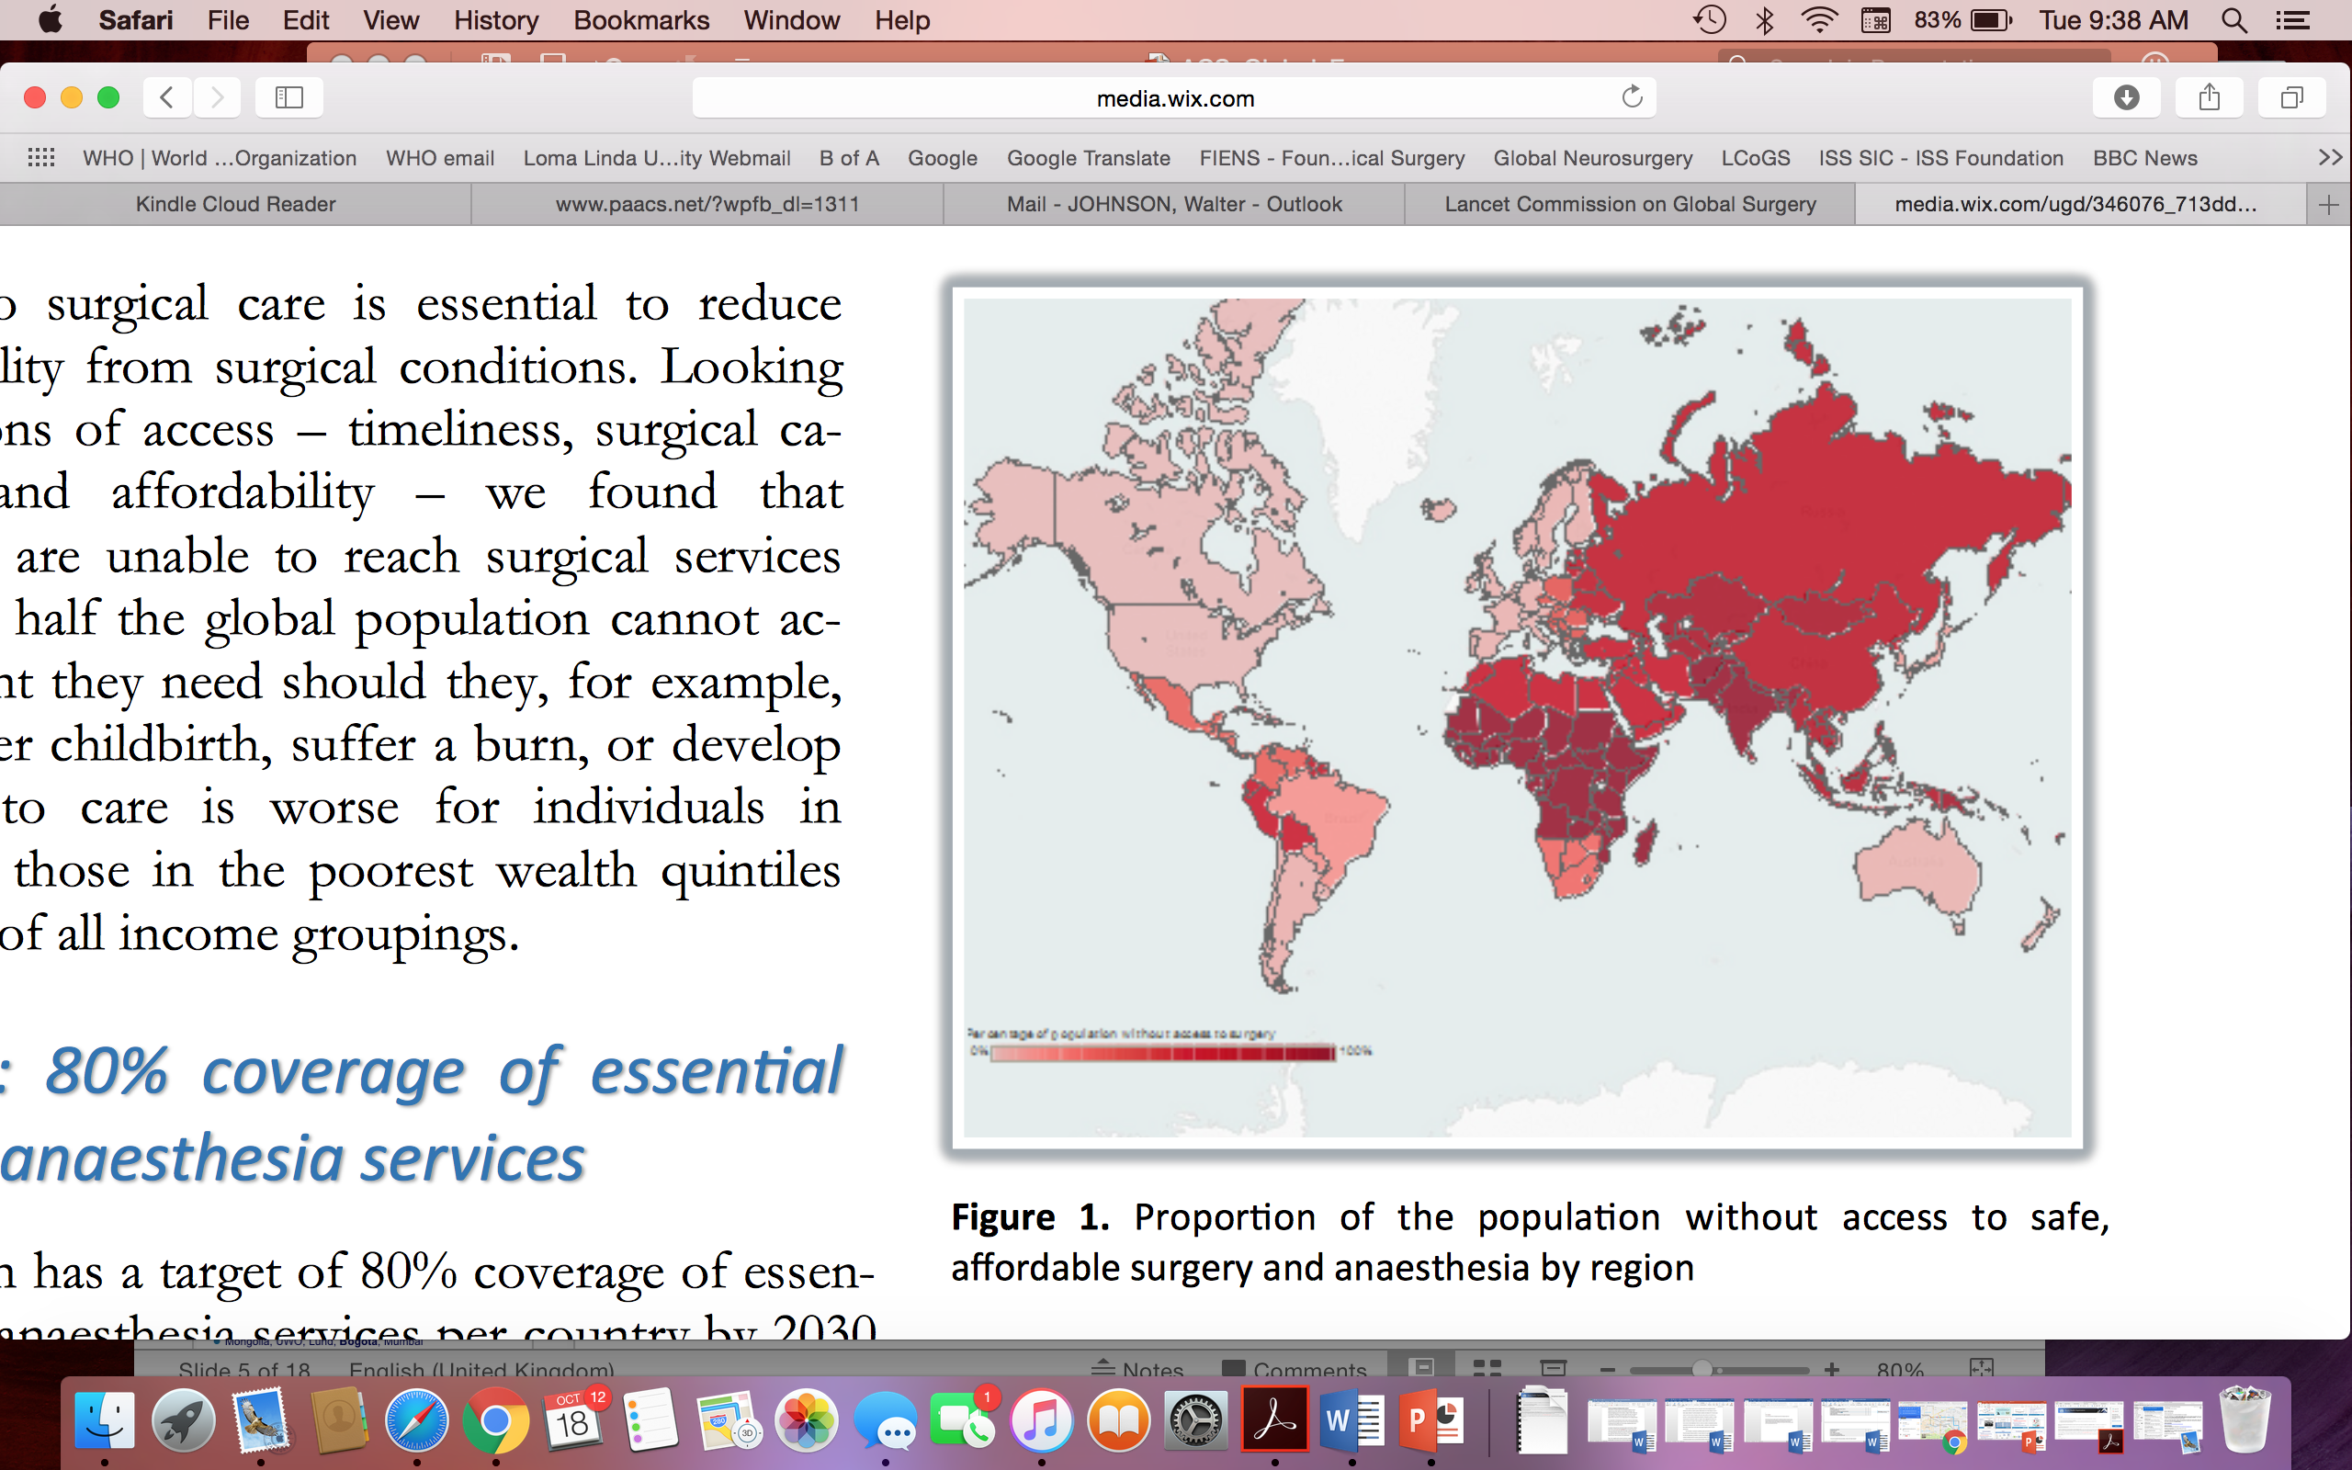
Global Surgical Need
5 Billion People

Slide 3
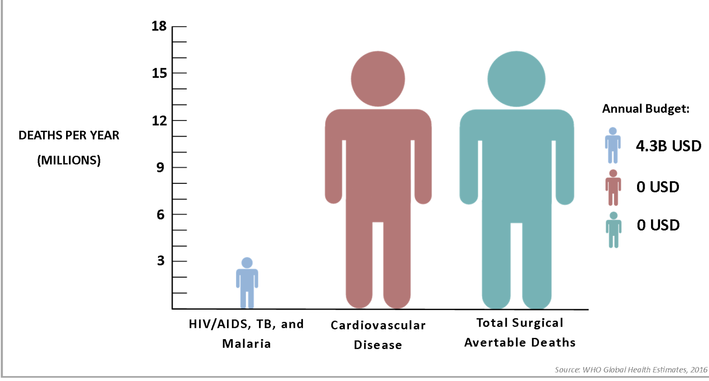
Proportionate Need
5 B

Slide 4
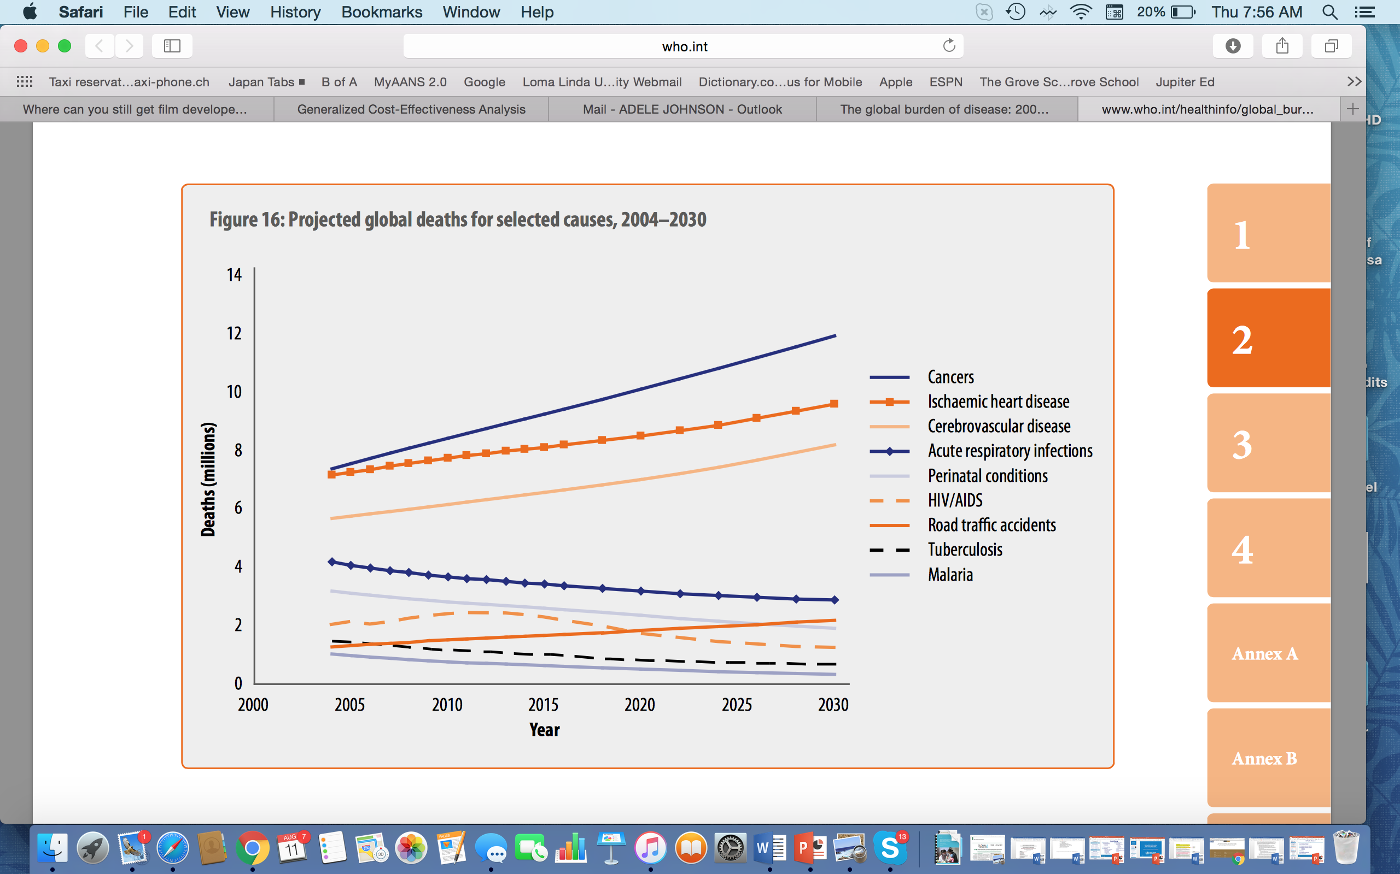

Slide 5
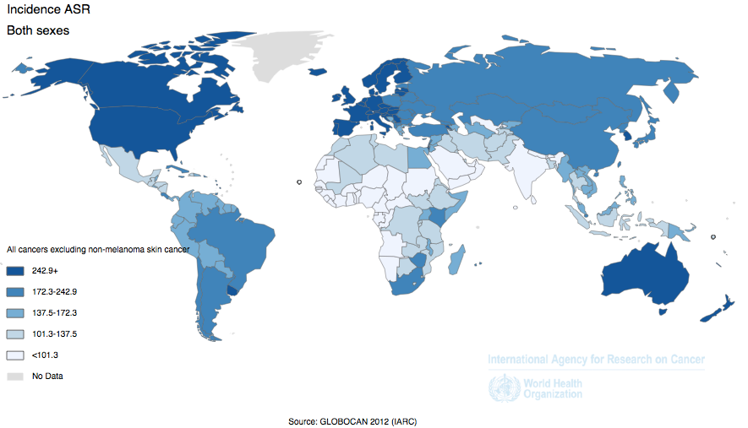
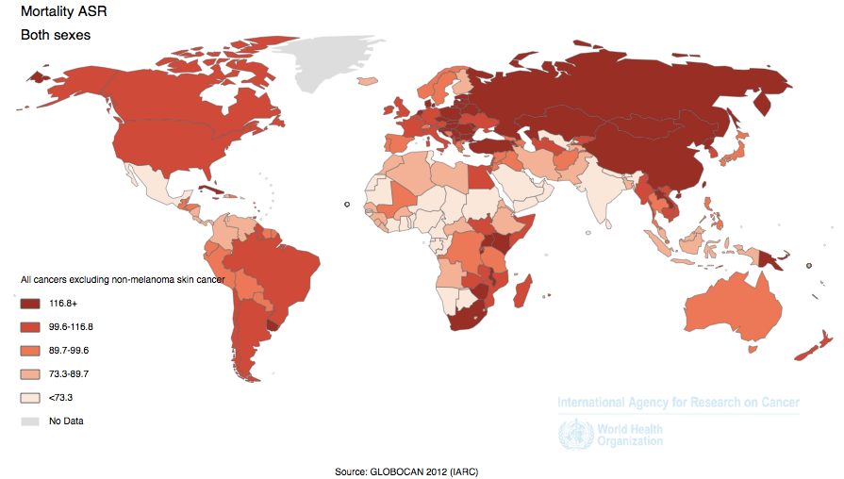
WHY CANCER MATTERS
Incidence
  Lifetime risk: 1 in 2.5 HIC, 1 in 7 Africa
  Africa: incidence greater than HIV
Mortality
  #2 cause of death globally
  Mortality rate: > 70% diagnosed in sub-Saharan Africa
Mortality: > 8.7 mil death each year
IARC. Globocan. Online
Notes:
Number of people diagnosed with cancer will increase 70% in the next two decades
AFRO –
TB – 229 236
HIV – 1120 1297
Malaria – 389 414
CANCER- 521 1100

Slide 6
POLITICAL PRIORITIZATION
Importance of surgeons in cancer control
  Greatest need with Highest impact at Lowest cost
Surgery
Systemic therapy
60-85%
30-70% OS gain
20-50%
5-20% OS gain
Moderate
50-90%
Variable,
0-20% OS (solid)
Radiotherapy
Low
Variable
Need
Impact
Cost
Rossi L et al. Impact of Adjuvant Chemotherapy on Breast Cancer Survival. PLoS One. 2015 Jul 27;10(7):e0132853.
Atun R et al. Expanding global access to radiotherapy. Lancet Oncol. 2015 Sep;16(10):1153-86.
Notes:
Link to findings of LCoGS: 5 B; 143 M; etc.
Chemo:
Morgan G, Ward R, Barton M. The contribution of cytotoxic chemotherapy to 5-year survival in adult malignancies. Clin Oncol (R Coll Radiol). 2004 Dec;16(8):549-60. Review. PubMed PMID: 15630849.
https://www.researchgate.net/file.PostFileLoader.html?id=539e4272d11b8b78368b45c5&assetKey=AS%3A273544838090760%401442229580168
Rossi L et al. Impact of Adjuvant Chemotherapy on Breast Cancer Survival: A Real-World Population. PLoS One. 2015 Jul 27;10(7):e0132853.
Atun R et al. Expanding global access to radiotherapy. Lancet Oncol. 2015 Sep;16(10):1153-86.
5 billion people do not have access to safe, affordable surgical and anaesthesia care when needed. Access is worst in low-income and lower-middle-income countries, where nine of ten people cannot access basic surgical care
•143 million additional surgical procedures are needed in LMICs each year to save lives and prevent disability. Of the 313 million procedures undertaken worldwide each year, only 6% occur in the poorest countries, where over a third of the world's population lives. Low operative volumes are associated with high case-fatality rates from common, treatable surgical conditions. Unmet need is greatest in eastern, western, and central sub-Saharan Africa, and south Asia.
•33 million individuals face catastrophic health expenditure due to payment for surgery and anaesthesia care each year. An additional 48 million cases of catastrophic expenditure are attributable to the non-medical costs of accessing surgical care. A quarter of people who have a surgical procedure will incur financial catastrophe as a result of seeking care. The burden of catastrophic expenditure for surgery is highest in low-income and lower-middle-income countries and, within any country, lands most heavily on poor people
•Investing in surgical services in LMICs is affordable, saves lives, and promotes economic growth. To meet present and projected population demands, urgent investment in human and physical resources for surgical and anaesthesia care is needed. If LMICs were to scale-up surgical services at rates achieved by the present best-performing LMICs, two-thirds of countries would be able to reach a minimum operative volume of 5000 surgical procedures per 100 000 population by 2030. Without urgent and accelerated investment in surgical scale-up, LMICs will continue to have losses in economic productivity, estimated cumulatively at US $12·3 trillion (2010 US$, purchasing power parity) between 2015 and 2030.
•Surgery is an “indivisible, indispensable part of health care.”1 Surgical and anaesthesia care should be an integral component of a national health system in countries at all levels of development. Surgical services are a prerequisite for the full attainment of local and global health goals in areas as diverse as cancer, injury, cardiovascular disease, infection, and reproductive, maternal, neonatal, and child health. Universal health coverage and the health aspirations set out in the post-2015 Sustainable Development Goals will be impossible to achieve without ensuring that surgical and anaesthesia care is available, accessible, safe, timely, and affordable.

Slide 7
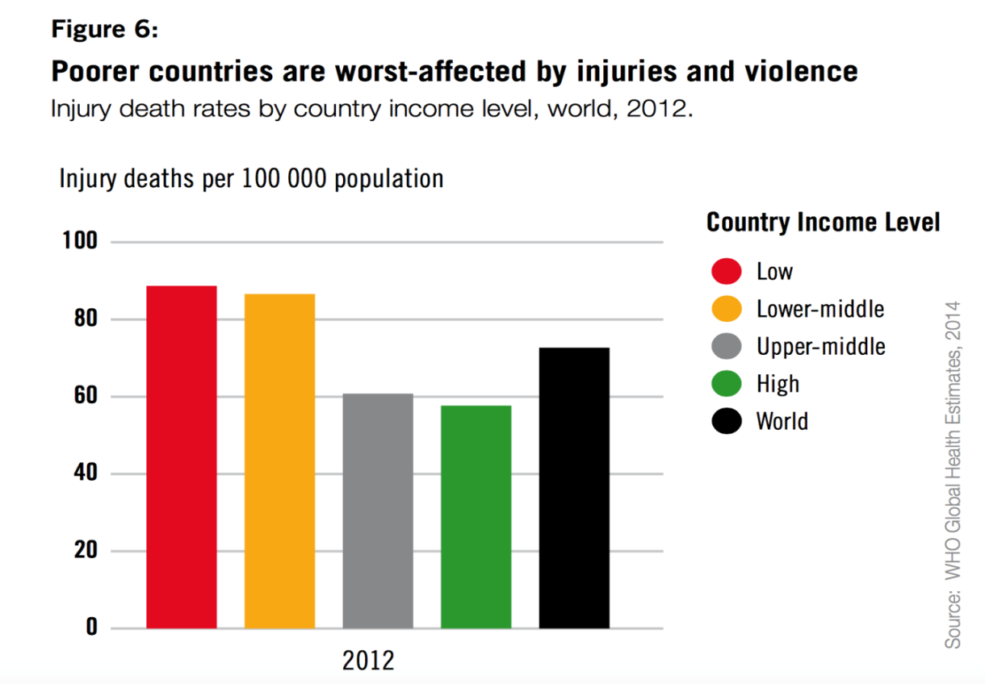
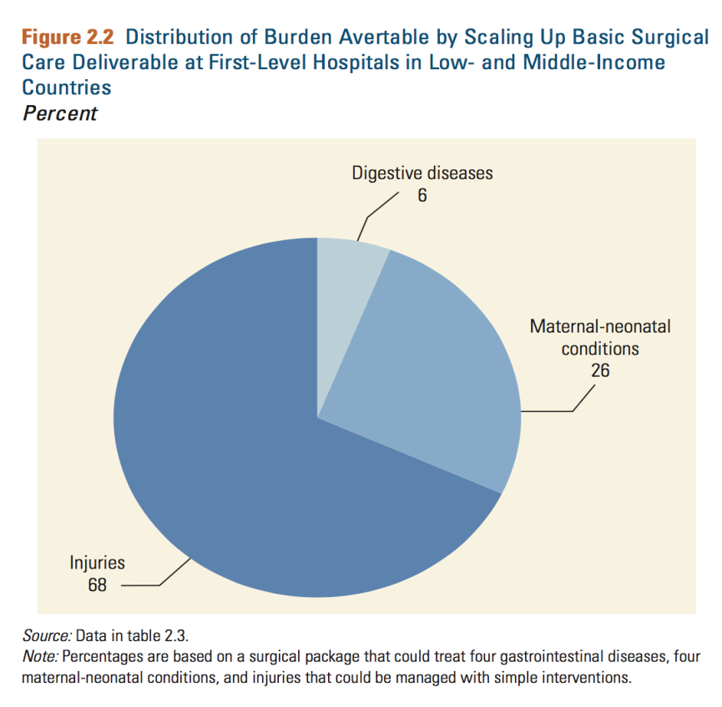
Injury Inequities
Notes:
TBI is the #1 lethal injury in every country. Yet there are no algorithms for TBI for facilities without CT or MR scanning capabilities.

Slide 8
Overview of Burns
Over 30,000 new burns globally each day; over 11 million per year (2004)
    Majority non-fatal, high morbidity
    Millions suffer burn-related disabilities & disfigurements
    Fourth most common type of trauma worldwide, following traffic accidents, falls, and interpersonal violence
Burns accounts for 180,000-300,000 deaths per year worldwide
Burden falls largely to Low & Middle-Income Countries: LMICs (70+%), HICs (30%)
  Two-thirds in Africa and Southeast Asia regions alone
  95% of fire-related burns occur in LMICs; 90% fire-related deaths in LMICs
  Burn-related deaths F > M, younger ages
Combination of effective burn prevention strategies & acute burn management badly needed
Notes:
Burns are still a major global health problem.
Fire related burns alone account for approximately 180-300,000 deaths worldwide each year. The number increases dramatically when deaths from scalding, electrical, chemical and other types of burns are included. There was a reduction of 9.9% between 2005-2015 in all age deaths (195.2-176.0 in thousands). Burns currently over 7 times higher in low- and middle-income countries than in high-income countries.
Furthermore, above the staggering number of deaths from burns every year, even more individuals are left disabled or disfigured from burns due to lack of effective preventative measures and access to acute burns management.
The burden of death and disability associated with burns is borne predominantly by Low & Middle-Income Countries, with over 95% of fire related burns and 90% fire-related deaths, occur in such settings.
In High-Income Countries, through implementation of burns prevention strategies and aggressive treatment strategies, burn related deaths & disabilities are significantly diminished.
Therefore, a combined approach of effective burns prevention strategies, as well as safe, affordable & effective emergency & essential surgical burns care is required in order to successfully reduce the burden of burns death & disabilities world wide.

Slide 9
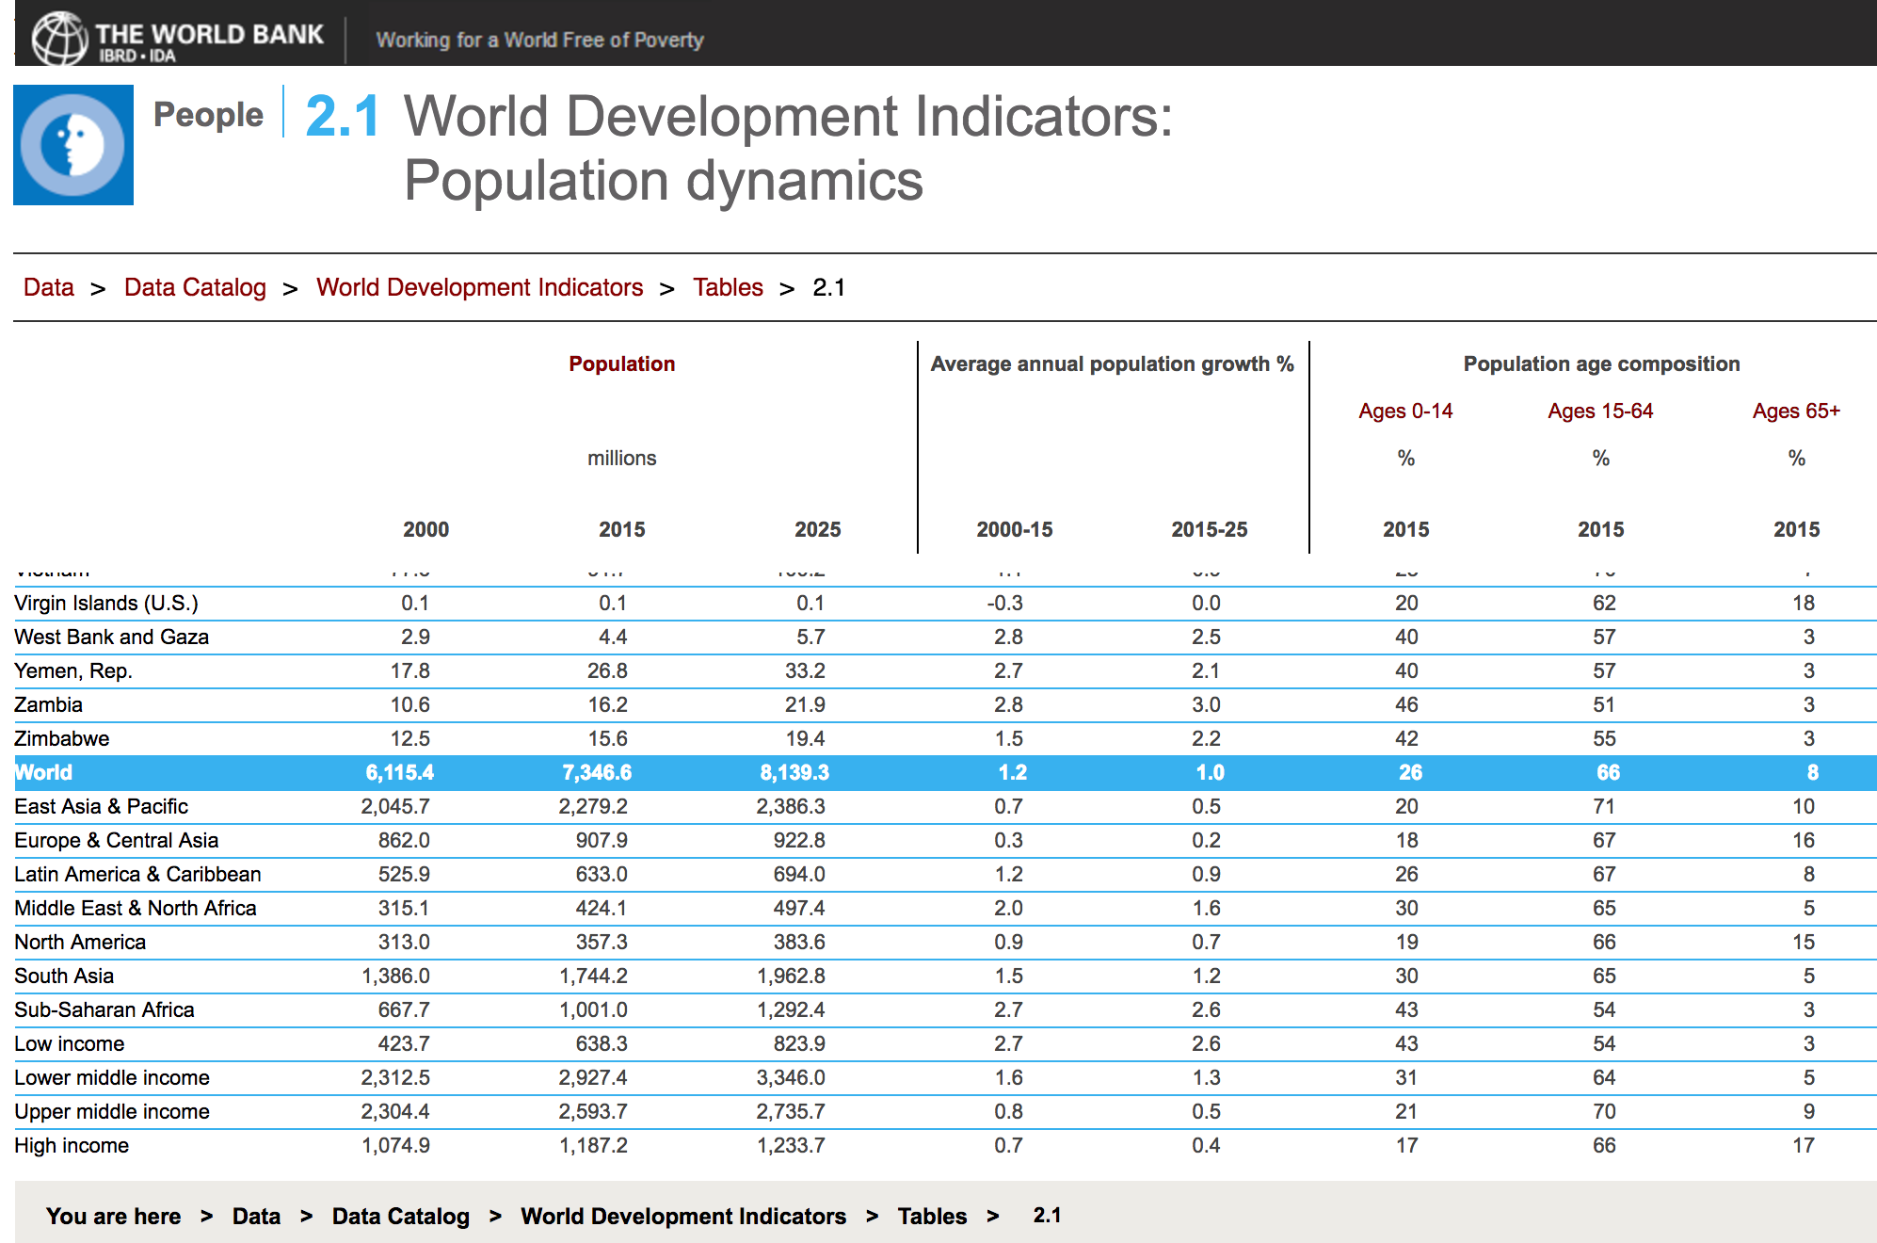
Notes:
In Continental Africa
Highest: Niger=50%
Lowest: South Africa=29%

Slide 10
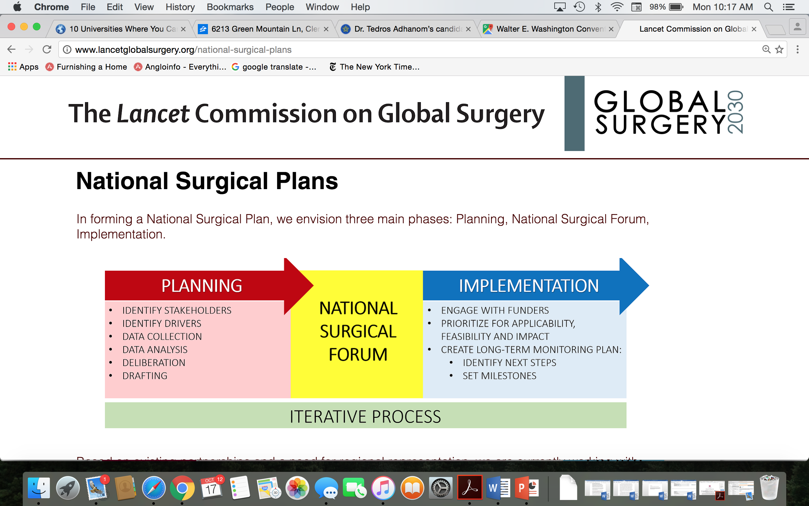
National Surgical, Obstetric and Anaesthesia Plans

Slide 11
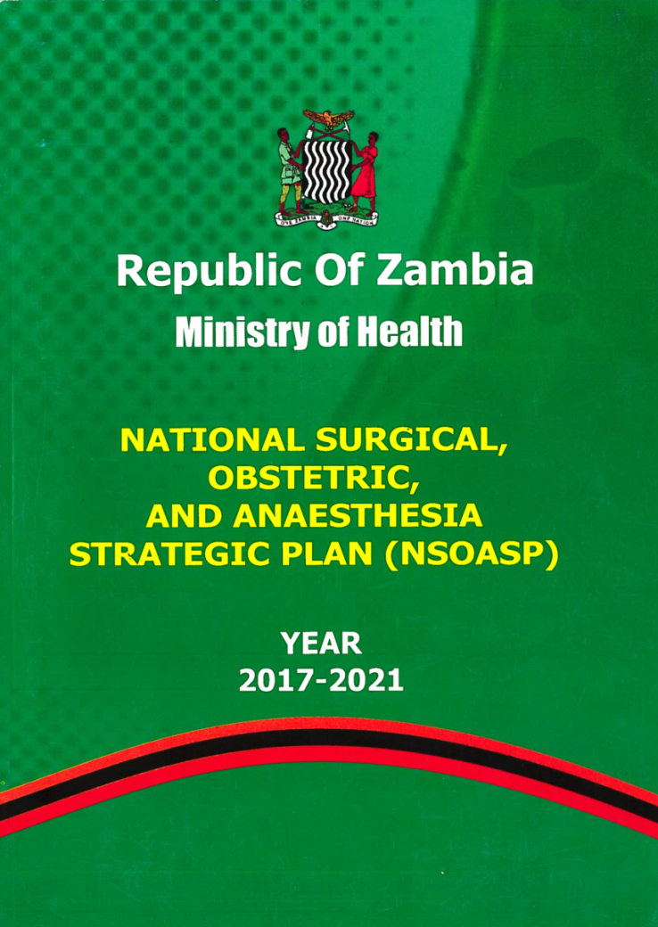
Zambia
Produced with multiple stakeholders
  Health ministry
  Surgical Society of Zambia
  DFID/THET/COSECSA
  Universities
    Medicine
    Nursing
    Anaesthesia
Included writing workshop
Fully costed/budgeted

Slide 12
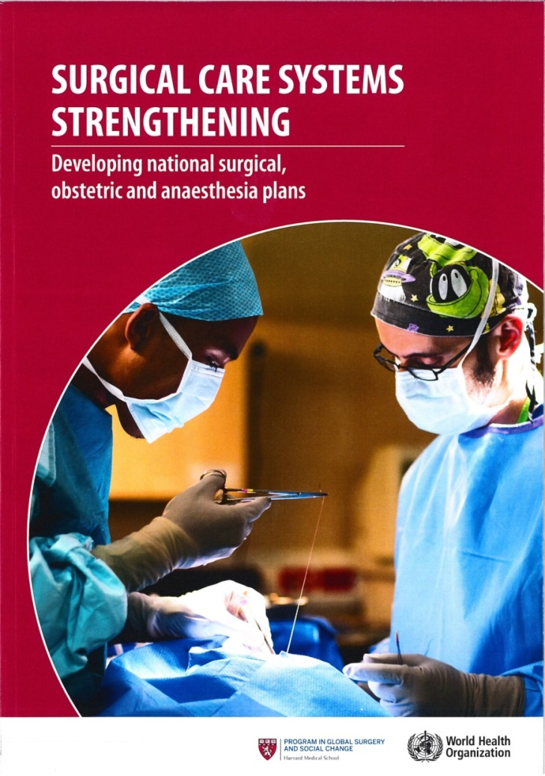
Monograph
Case Reports (MoH, EESC, PGSSC):
  Zambia
  Ethiopia
  Madagascar (Mercy Ships)
  Uganda
  South Pacific (RACS, PISA)
  Viet Nam (OpSmile)
  Brazil
  India (ARSI)
http://www.who.int/surgery/publications/scss/en/

Slide 13
NSOAP Workshop
Surgical, obstetric and anaesthesia care is indispensable in achieving many of the SDGs, including Universal Health Coverage (SDG 3.8)
This technical workshop will:
  Support country-led plans for scaling up surgical, obstetric and anaesthesia care as part of health system strengthening and healthcare service delivery
  Draw on case studies of countries at various stages of planning
  Showcase solutions for implementation
  Explore potential financing mechanisms

Slide 14
Goals and Objectives
After completion of the workshop, participants will be able to:
Initiate a NSOAP planning process by gathering and informing key stakeholders while leveraging external technical support to successfully develop a national plan.
Critically evaluate the achievability of various implementation models and tools within the context of current health system status and national commitment to health reforms.
Frame financing of NSOAP as indispensable to achieving UHC and economic development, and seek strategically aligned financing mechanisms.
Understand the key steps to developing a NSOAP
Discuss implementation options and tools
Explore innovative financing mechanisms

Slide 15
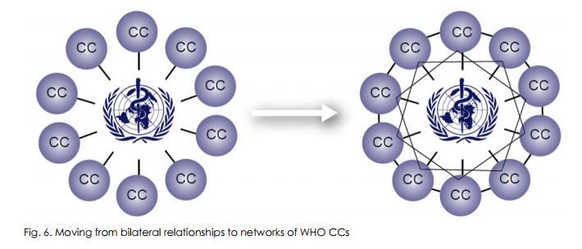
WHO CC Networks

Slide 16
NSOAP Collaboration
MoH
MoH
MoH
MoH
MoH
MoH
MoH
MoH
MoH
MoH
Consortium of Partners

Slide 17
Thank You For Your Participation!

