Slide 1
NSOAP: Theoretical Framework
Kristin Sonderman MD, MPH
Program in Global Surgery and Social Change
Harvard Medical School
Notes:
Good morning. It is a pleasure to be here with you today. This morning I would like to give you a quick overview of the NSOAP process, each step of which will be described in greater details in the sessions that follow with country examples. These steps also align with the NSOAP manual which will hopefully provide a guide for the conference and also with your country NSOAP development. So, let’s get started.

Slide 2

Theoretical Framework
INFRASTRUCTURE
Notes:
In 2015, the Lancet Commission provided a 1 page theoretical framework for NSOAP which included a few recommendations on the five domains including infrastructure, workforce, service delivery, information management and finance. Since that time, there has been a wave of NSOAPs most notably across sub-Saharan Africa, each with a slightly different process, but from these experiences a much more expanded theoretical framework and process has been established.

Slide 3
Theoretical Framework
INFRASTRUCTURE
WORKFORCE
Notes:
In 2015, the Lancet Commission provided a 1 page theoretical framework for NSOAP which included a few recommendations on the five domains including infrastructure, workforce, service delivery, information management and finance. Since that time, there has been a wave of NSOAPs most notably across sub-Saharan Africa, each with a slightly different process, but from these experiences a much more expanded theoretical framework and process has been established.

Slide 4
Theoretical Framework
INFRASTRUCTURE
WORKFORCE
SERVICE DELIVERY
Notes:
In 2015, the Lancet Commission provided a 1 page theoretical framework for NSOAP which included a few recommendations on the five domains including infrastructure, workforce, service delivery, information management and finance. Since that time, there has been a wave of NSOAPs most notably across sub-Saharan Africa, each with a slightly different process, but from these experiences a much more expanded theoretical framework and process has been established.

Slide 5
Theoretical Framework
INFRASTRUCTURE
WORKFORCE
SERVICE DELIVERY
INFORMATION MANAGEMENT
Notes:
In 2015, the Lancet Commission provided a 1 page theoretical framework for NSOAP which included a few recommendations on the five domains including infrastructure, workforce, service delivery, information management and finance. Since that time, there has been a wave of NSOAPs most notably across sub-Saharan Africa, each with a slightly different process, but from these experiences a much more expanded theoretical framework and process has been established.

Slide 6
Theoretical Framework
INFRASTRUCTURE
WORKFORCE
SERVICE DELIVERY
INFORMATION MANAGEMENT
FINANCE
Notes:
In 2015, the Lancet Commission provided a 1 page theoretical framework for NSOAP which included a few recommendations on the five domains including infrastructure, workforce, service delivery, information management and finance.

Slide 7
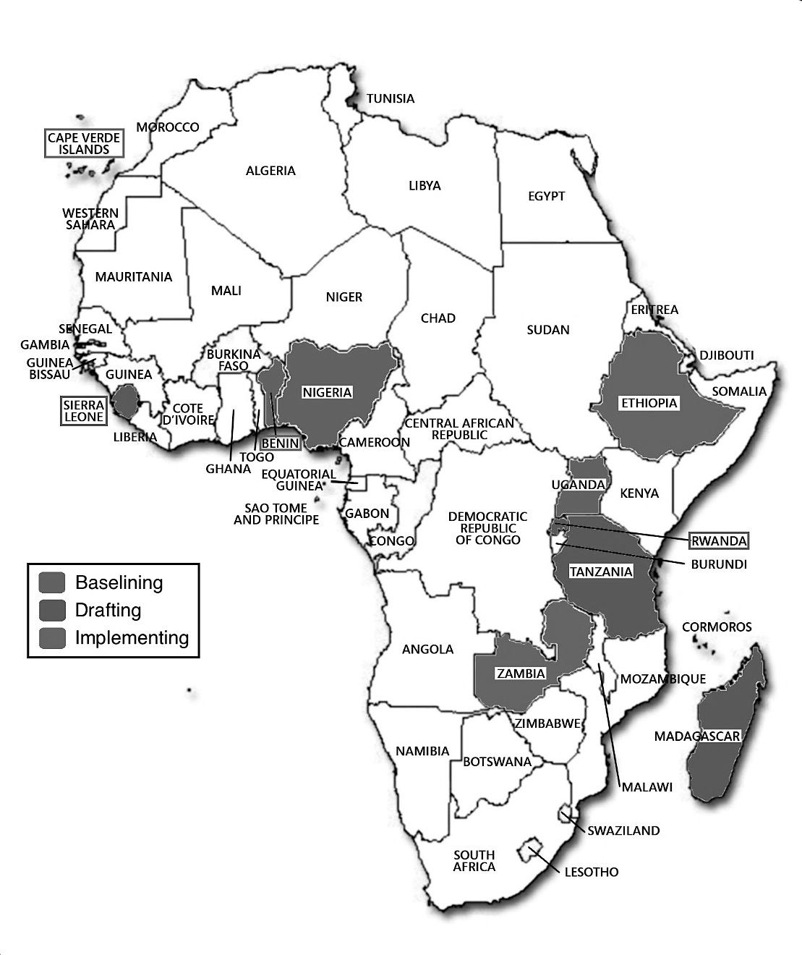

Theoretical Framework
Situational analysis and baseline assessment
Ministry Support
01
02
Stakeholder engagement and priority setting
Implementation
03
08
07
04
Governance
Drafting and validation
06
05
Costing
Monitoring and evaluation
Notes:
Since that time, (next) there has been a wave of NSOAPs most notably across sub-Saharan Africa, each with a slightly different process, (next) but from these experiences a much more (next) expanded theoretical framework and process has been established.
(next) The first step, and arguably the most important is ministry support.

Slide 8
MOH Support
Required
National Health Policy
Health vision and policy directions
Notes:
Engagement by the ministry is essential for the development of an NSOAP.

Slide 9
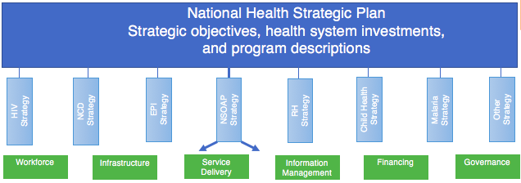
MOH Support
Required
Integration into a National Health Plan
National Health Policy
Health vision and policy directions
Notes:
With the ultimate goal being the inclusion of NSOAP into the National Health Strategic Plan (NHSP), the Ministry must be integral and completely supportive to the process.

Slide 10

MOH Support
Required
Integration into a National Health Plan
Leadership
Notes:
Further, their leadership is crucial to advise in discussions

Slide 11

MOH Support
Required
Integration into a National Health Plan
Leadership
Knowledge
Notes:
as well as provide an understanding of the health priorities of the country, the current health care landscape, financial abilities, and implementation bandwidth.

Slide 12
MOH Support
Required
Integration into a National Health Plan
Leadership
Knowledge
Policy Dialogue
National Health Policy
Health vision and policy directions
Notes:
Finally, the MOH can improve the political architecture regarding health by centralizing the policy dialogue on health sector priorities and discouraging fragmentation.

Slide 13
MOH Support
Case for NSOAP
  Capacity and quality of care lacking
5 BILLION people lack access to safe, affordable surgical and anesthesia care when needed
143 MILLION additional procedures are needed yearly to fill unmet need
33 MILLION face catastrophic expense after surgical care yearly
INVESTMENT in surgical and anesthesia care saves lives, is affordable, and promotes economic growth
SURGERY IS AN INDIVISIBLE, INDISPENSABLE PART OF HEALTH CARE
Notes:
If the MOH is not yet on board, then the first step is sharing the convincing argument for the significance of developing an NSOAP. This would include as Dr. Meara already alluded to, the capacity and quality of surgery both globally and locally, using LCOGS 5 key messages as a starting point.

Slide 14

MOH Support
Case for NSOAP
  Capacity and quality of care lacking (LCOGs and local data)
  Investment in surgery crucial to meet SDGs
Notes:
Second, the necessity of surgery to meet the Sustainable development goals.

Slide 15

MOH Support
Case for NSOAP
  Capacity and quality of care lacking (LCOGs and local data)
  Investment in surgery crucial to meet SDGs
  Investment is cost-effective
Notes:
The cost effectiveness of NSOAP

Slide 16
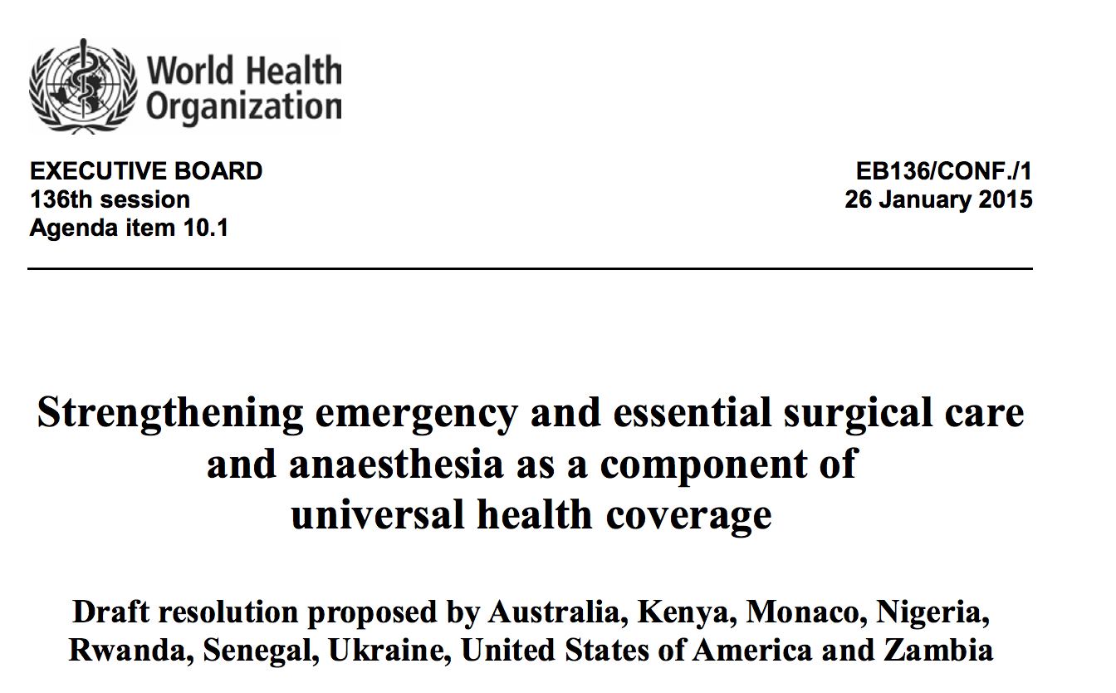
MOH Support
Case for NSOAP
  Capacity and quality of care lacking (LCOGs and local data)
  Investment in surgery crucial to meet SDGs
  Investment is cost-effective
  Emergency and essential surgery recognized component of UHC
Notes:
and the role of surgical care as a component of universal health coverage

Slide 17
MOH Support
Surgical System inputs and processes
Surgical System outputs
Surgical System outcomes
Surgical Outcomes
Case for NSOAP
  Capacity and quality of care lacking (LCOGs and local data)
  Investment in surgery crucial to meet SDGs
  Investment is cost-effective
  Emergency and essential surgery recognized component of UHC
  Coordination and optimization of surgical, obstetric, and anesthesia system strengthening
Notes:
And finally, the role that NSOAP has in providing coordination and optimization of surgical, obstetric and anesthesia care through health system strengthening which ultimately improves outcomes. The 2nd chapter of the NSOAP manual dives deeper into making a case for NSOAP for your reference and use.

Slide 18
NSOAP Process
Situational analysis and baseline assessment
Ministry Support
01
02
Stakeholder engagement and priority setting
Implementation
03
08
07
04
Governance
Drafting and validation
06
05
Costing
Monitoring and evaluation
Notes:
The next step involves a thorough situational analysis to define the baseline state of surgical, obstetric, and anesthesia care.

Slide 19
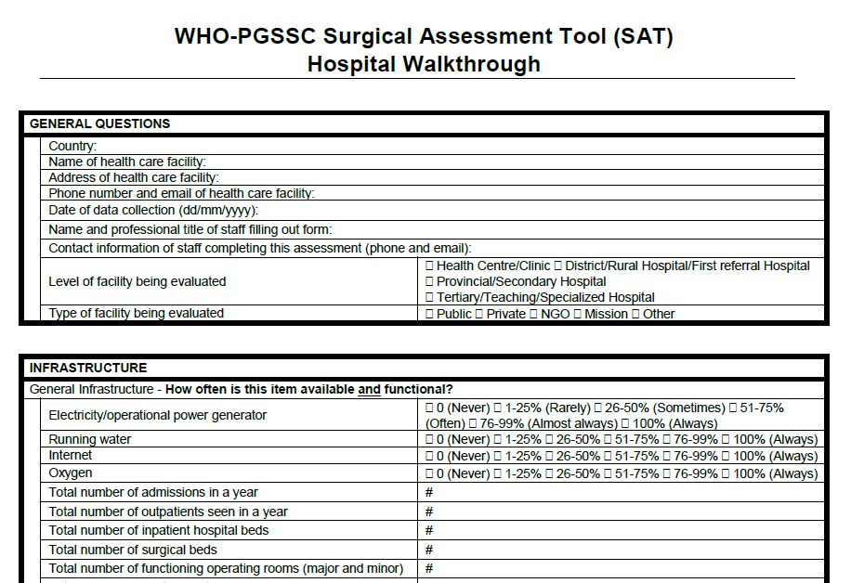
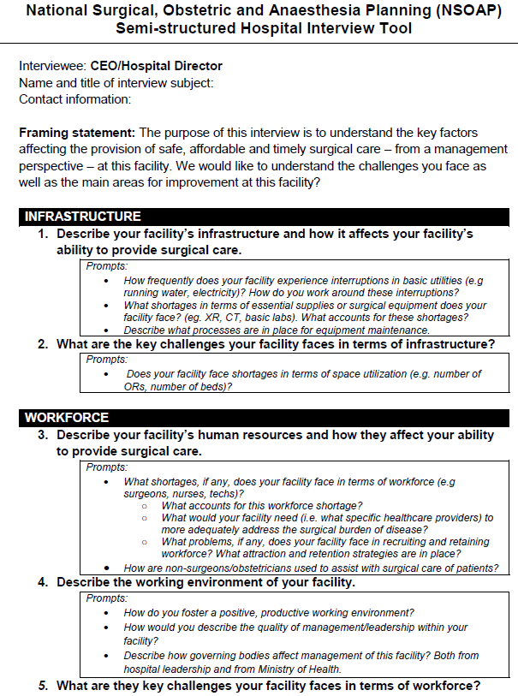
Situational Analysis and Baseline Assessment
Hospital assessments
Notes:
This can be accomplished through on-the-ground hospital assessments

Slide 20
Situational Analysis and Baseline Assessment
Hospital assessments
Literature reviews
Notes:
literature reviews

Slide 21
Situational Analysis and Baseline Assessment
Hospital assessments
Literature reviews
Analysis of current country-wide data
2HR
ACCESS
SURGICAL VOLUME
SAO/100,000
5000 procedures per 100,000 population
80% coverage essential
services
20 SAO providers per 100,000
population
POMR
IMPOVERISHING
EXPENDITURE
CATASTROPHIC
EXPENDITURE
100% countries tracking POMR
100% protection
100 % protection
Notes:
and analysis of established country-wide data. Dr. Albutt will discuss some of the baseline assessment tools to assist in this step later on Followed by Prof Rwamasirabo from Rwanda who will describe the Rwanda process of baselining.
LCOGs recommends at least the documentation of 6 indicators for accurate assessment of a surgical system as well as country comparisons and accountability.

Slide 22
NSOAP Process
Situational analysis and baseline assessment
Ministry Support
01
02
Stakeholder engagement and priority setting
Implementation
03
08
07
04
Governance
Drafting and validation
06
05
Costing
Monitoring and evaluation
Notes:
Baseline assessments is followed by stakeholder engagement and priority setting

Slide 23
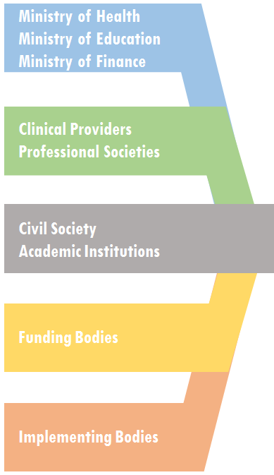


Stakeholder Engagement
Representative Stakeholders
Notes:
More unique to the NSOAP process, is the encouragement for a broad group of stakeholders including clinical providers, professional and civil societies, academic institutions, funders, and implementers. Each stakeholder brings a unique set of expertise to aide in priority setting discussions.

Slide 24
Stakeholder Analysis
Power
Interest
Notes:
A stakeholder analysis prior to these meetings can assist with identifying power dynamics and how to mitigate them. Dr. Citron and Dr. Sarah from Tanzania will discuss in greater detail stakeholder engagement.

Slide 25
Priority Setting
Service Delivery
Workforce
Finance
infrastructure
Information Management
Governance
Committee Meetings
    Review situational analysis
    Set priorities
    M&E plan
    Governance
NSOAP Draft
Stakeholders
Notes:
Next, for priority setting, the stakeholders can be divided into the expanded 6 major domains of NSOAP which align with the 6 building blocks of a health system, which include infrastructure, service delivery, workforce, information management, finance and governance. (next) Each group then discusses the situational analysis, sets priorities, develops an M&E plan as well as governance strategy for that domain (next) The output from these meetings becomes the essence of the NSOAP draft

Slide 26
Committee Meetings
Infrastructure
Surgical facilities
Service Delivery
Standard procedure lists
Perioperative services
Workforce
SOA providers
Governance
Information Management
Finance
Equipment
Blood products
Supply chain
Pharmacy
Radiology
Referral systems
Mentorship
Distribution
Training
Subspecialty expansion
General physician training
Indicator collection
Registries
Quality improvement
Research capacity
Private sector reporting
Universal health coverage
Budget allocation (hospital and national level) to surgical services
Terms of engagement and legal regulation of partners
Coordination of activities
Mandate for implementation
Accountability
Stakeholders
Notes:
Each domain covers a wide breadth of topics pertinent to health system strengthening. For infrastructure, this includes discussion of facilities number and distribution, equipment and management, blood products, supply chain. Under service delivery, the establishment of standard procedure lists for different levels of facilities, perioperative services, and referral system improvement. Workforce discusses the distribution and number of providers as well as the current training strategy, subspecialty expansion, and possibly general physician training for certain procedures. Information management focuses on data quality and management. Finance, includes the current state of universal health coverage and specifics on budget allocation to surgical, anesthesia and obstetric services. And finally governance, establishes the coordination of efforts and responsibility and accountability needed for implementation.

Slide 27
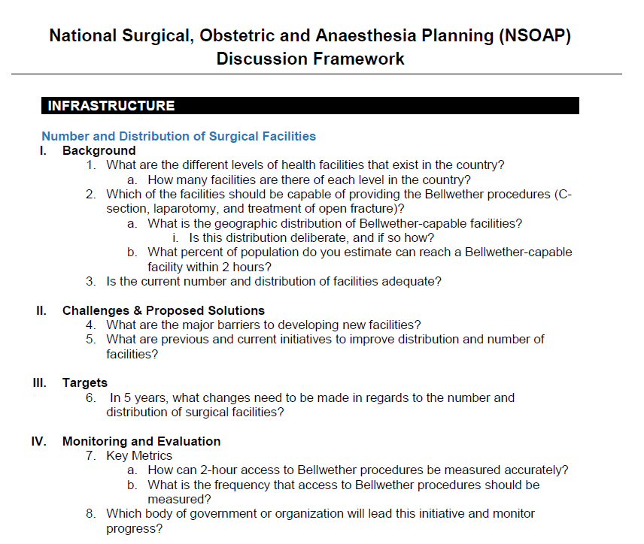
Committee Meetings
Infrastructure
Surgical facilities
Service Delivery
Standard procedure lists
Perioperative services
Workforce
SOA providers
Governance
Information Management
Finance
Equipment
Blood products
Supply chain
Pharmacy
Radiology
Referral systems
Mentorship
Distribution
Training
Subspecialty expansion
General physician training
Indicator collection
Registries
Quality improvement
Research capacity
Private sector reporting
Universal health coverage
Budget allocation (hospital and national level) to surgical services
Terms of engagement and legal regulation of partners
Coordination of activities
Mandate for implementation
Accountability
Stakeholders
Notes:
To guide these discussions, a "Discussion Framework" has been created for each domain. As an example, for infrastructure, when looking at specifically the number and distribution of surgical facilities, (next) the discussion framework walks through the current baseline situation, (next) challenges and proposed solutions, (next) set targets for the coming years, (next) and a monitoring and evaluation plan.

Slide 28
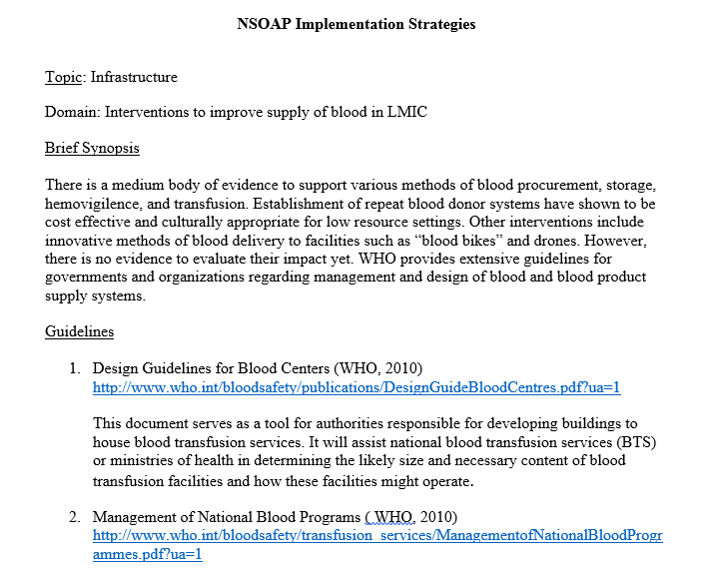
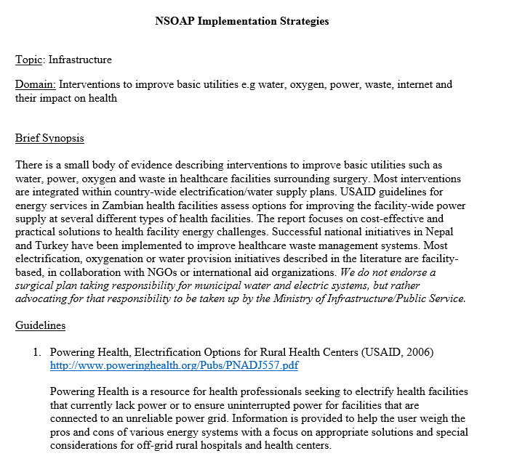
Committee Meetings
Evidence based implementation strategies
  Infrastructure
    Minimum OR equipment
    Interventions to improve equipment maintenance
    Hospital supply chain
    Improve supply of blood
    Improve basic utilities
Stakeholders
Notes:
Regarding implementation strategies, there is already a significant amount of guidelines, recommendations and successful projects found within the literature, and we have tried to compile and organize these by domain to further support these discussions and adoption for the given context. So for under infrastructure, in line with some of the more common obstacles in this domain, we have created these strategy documents for OR equipment, equipment maintenance, supply chain, and basic utilities.

Slide 29

Committee Meetings
Evidence based implementation strategies
  Infrastructure
  Workforce
    Workforce redistribution and rural retention
    Interventions to increase number of SAO specialists
    Improve skills of surgical providers
    Increase ancillary staff
    Increase hospital management staff
Stakeholders
Notes:
For workforce, we have distribution and retention of providers, skill acquisition, and hospital management.

Slide 30

Committee Meetings
Evidence based implementation strategies
  Infrastructure
  Workforce
  Service Delivery
    Interventions to improve inter-hospital referrals
    Pre-hospital transport
    Implementation of checklists around SAO care
    Decentralization vs. centralization
    Critical care initiatives
Stakeholders
Notes:
Under service delivery strategies to improve referral systems, prehospital transport, quality checklists and critical care initiatives.

Slide 31

Committee Meetings
Evidence based implementation strategies
  Infrastructure
  Workforce
  Service Delivery
  Information Management
    Information management systems successful in LMICs
    CME programs in SAO specialties and task shifters
Stakeholders
Notes:
and finally successful information management systems and continued medical education programs.

Slide 32
NSOAP Process
Situational analysis and baseline assessment
Ministry Support
01
02
Stakeholder engagement and priority setting
Implementation
03
08
07
04
Governance
Drafting and validation
06
05
Costing
Monitoring and evaluation
Notes:
Following these discussions, the next step is drafting and validation.

Slide 33
Drafting and Validation
Formation of NSOAP Draft
Based on committee meetings conclusions and recommendations
Completed by policy writers, familiar with language
Notes:
A compilation and prioritization of the committee discussions is written and utilized as the first draft. Early involvement of policy writers is important in order to facilitate ease of inclusion into the national health plans. Drafting should include identification of the gaps and challenges from the baselining situation analysis, the goals to be achieved by the NSOAP, and the proposed solutions and activities to each of these goals. Desmond will discuss in greater details more pearls for this step followed by Dr. Nthele from Zambia who will describe the process Zambia went through in drafting and costing their NSOAP

Slide 34
Drafting and Validation
Formation of NSOAP Draft
Based on committee meetings conclusions and recommendations
Completed by policy writers, familiar with language
Writing Workshop or Forum
All stakeholders meet to discuss and edit the proposed NSOAP
Notes:
Once the draft is complete, it can be reviewed by the broad group of stakeholders for further clarification, prioritization and strategizing.

Slide 35
NSOAP Process
Situational analysis and baseline assessment
Ministry Support
01
02
Stakeholder engagement and priority setting
Implementation
03
08
07
04
Governance
Drafting and validation
06
05
Costing
Monitoring and evaluation
Notes:
As part of the committee meeting discussions and the first draft, there should be a focus on a well flushed out monitoring and evaluation strategy.

Slide 36

Monitoring and Evaluating
Notes:
The prior NSOAP work creates a framework to guide the operational planning and management strategy for M&E. M&E is crucial to show progress and improvement, as well as cost-effectiveness of the plan. M&E can also highlight the activities or initiatives that are struggling, that may need more support and attention. Ethiopia’s plan has a brilliant M&E as well as governance structure which we will hear more about tomorrow.

Slide 37
NSOAP Process
Situational analysis and baseline assessment
Ministry Support
01
02
Stakeholder engagement and priority setting
Implementation
03
08
07
04
Governance
Drafting and validation
06
05
Costing
Monitoring and evaluation
Notes:
Once the draft is complete, and all activities agreed upon the plan must be costed.

Slide 38
Costing
Assemble
Define cost objects
Determine cost base
Attribute cost to cost objects
Notes:
The steps involved in costing include assembly of available costing information, defining the cost objects and quantities required, determining the cost base, and finally attributing cost to the cost objects. This should obviously be done within the Ministry of Finance to align with the current budget scheme and for the appropriate allocation of funds. A strategic and thoughtful costed plan will also aide in discussions with funding bodies, implementation partners, and create more aid advocacy and appropriate utilization. Tomorrow there will be in-depth discussions on different financing mechanisms and resources to address this topic.

Slide 39
NSOAP Process
Situational analysis and baseline assessment
Ministry Support
01
02
Stakeholder engagement and priority setting
Implementation
03
08
07
04
Governance
Drafting and validation
06
05
Costing
Monitoring and evaluation
Notes:
Finally, there needs to be thought and attention to how the plan will be governed and implemented.

Slide 40

Governance
Roles and responsibilities
Accountability
Notes:
As you all are more than aware, Governance involves understanding the organizational structure and mechanisms needed to achieve the objectives laid out in the NSOAP. It provides roles and responsibility to stakeholders and establishes accountability. The governance of NSOAP again should parallel that of the national health strategic plan and be intertwined to the governance strategy already in place.

Slide 41
Governance
Roles and responsibilities
Accountability
Dept. within the MOH
NSOAP coordinators
Data access and utilization
Notes:
There also needs to be a decision in regards to where within the MOH the NSOAP will sit, and further, consideration for full time staff members dedicated to NSOAP for successful implementation. Establishing a clear chain of responsibility from the facility level through the district and regional levels to the Ministry of Health will be required to ensure successful and accountable implementation. Strategies must be in place such that the responsible actors at each of these levels can have access to the necessary monitoring and evaluation data to guide decision making.

Slide 42

Implementation
Notes:
The exact process of implementation is yet to be determined but Ethiopia and Zambia to name a few are paving the way. The magnitude of the health system building detailed within these plans will require an “all hands-on deck” approach with commitments from a breath of stakeholders including MOH, providers, funding bodies, private and public sector and industry.

Slide 43
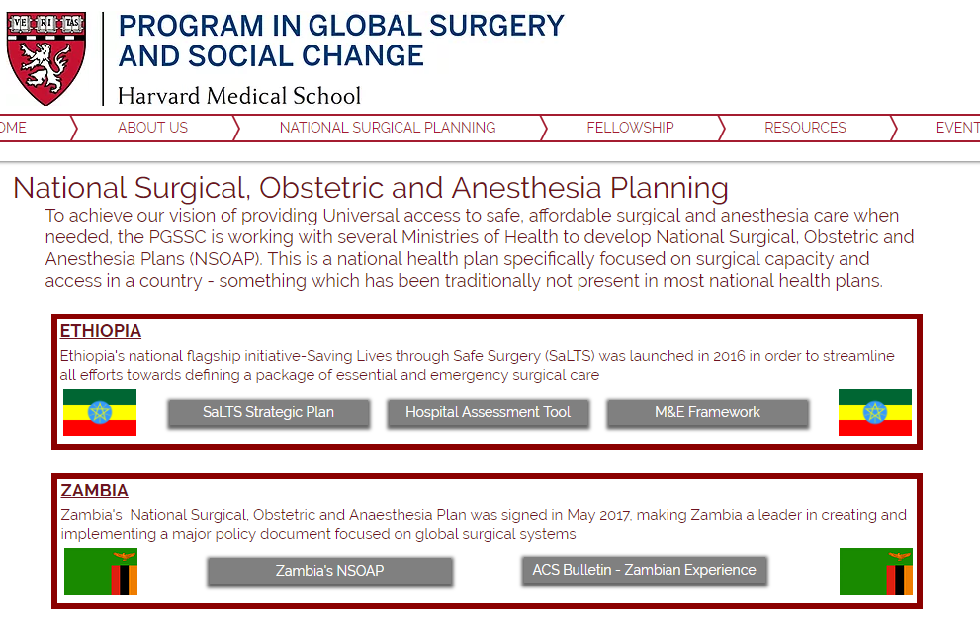


Dissemination
Local
International
https://www.pgssc.org/national-surgical-planning
Notes:
As more plans are successfully created, it will be important for these plans to be shared at both the local and international level. (next)
At the local level, this includes distribution within both the public and private health sector, medical academic institutions and within the community so that the strategic framework set forth by the NSOAP is unified in thought and execution.
At the international level, these plans can help guide other countries and spur conversation on common barriers and possible solutions.
Both Ethiopia and Zambia plans are public for this reason, and can be found on the PGSSC website together with the other mentioned tools.

Slide 44
General Considerations
NSOAP lead team (local champion, MOH, professional societies)
Set a timeline
Utilize already created tools to streamline the process
Stay connected
Notes:
I just want to end with a few pearls in regards to the process as a whole. First, there should be consideration of having a NSOAP lead team made up of a small group of individuals (including local champion, MOH representative, and SOA society representatives) that will serve together as the leaders of the plan and will drive the process along together as a unit. (next)
Given the potential complexity and magnitude of this process, it can be useful to set a timeline and stick to it, as it is easy to get bogged down at each of these steps. (next)
That being said, there are many NSOAP tools to assist and streamline the process. (next)
and finally, it is important that international communication and support remains a high priority to share the burden of struggle and the joys of success.
Thank you.

Slide 45
https://www.pgssc.org/national-surgical-planning

