Slide 1
Baseline Assessment Case Study: Rwanda
Emile Rwamasirabo, MD, FCS (ECSA)
Consultant Urological Surgeon
King Faisal Hospital, Kigali, Rwanda

Slide 2
RWANDA NSOAP
Ministry of Health
Rwanda Surgical Society
Rwanda Society of Obstetricians and Gynecologists
Rwanda Society of Anesthesiologists
Program in Global Surgery and Social Change
Notes:
Background about how NSOAP started, timing, March 2017

Slide 3
RWANDA Health Facilities
Population: 12 million
Hospitals:
520 health centres
36 district hospitals
3 provincial hospitals
3 regional referral hospitals
4 national referral hospitals
Insurance coverage
CBHI: 90% (pyramidal referral system to the top)
Conventional insurance: 10%
Notes:
Background about how NSOAP started, timing, March 2017

Slide 4
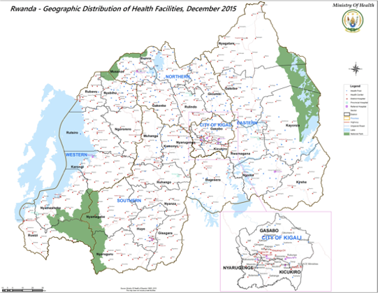
RWANDA Health Coverage
Notes:
Background about how NSOAP started, timing, March 2017

Slide 5
RWANDA NSOAP: Purpose
Improve surgical care as an essential component of Rwanda’s healthcare system
Rwanda has improved maternal mortality and infant mortality rates
Surgery remains a neglected part of healthcare system
Increase access to timely, safe, and affordable surgical care for all Rwandans

Slide 6
RWANDA NSOAP: Objectives
Analyze the current surgical health system
Identify and engage stakeholders
Reach consensus on the priorities of scaling up surgical care
Formulate a National Surgical, Obstetric, and Anesthesia Plan
Integrate into next Health Sector Strategic Plan

Slide 7
Situational Analysis
Establish a baseline of surgical, obstetric and anesthesia care at present
Allow for a more strategic and data-driven plan with specific objectives
Future monitoring and evaluation of initiatives and reaching of targets
Notes:
Why we chose to do a situational analysis

Slide 8
SITUATIONAL ANALYSIS
Information needed
Review existing
Baseline assessment
Notes:
Steps we took for a complete situational analysis
defined the information we wanted
Review the existing literature/ MOH data
Carried out a baseline assessment

Slide 9
INFORMATION NEEDED
Current state of 42 District Hospitals
Infrastructure
Workforce
Service delivery
Information Management
Finance
Surgical Indicators
2HR
ACCESS
SAO/100,000
SURGICAL VOLUME
80% coverage essential
services
20 SAO providers per 100,000
population
5000 procedures per 100,000 population
POMR
IMPOVERISHING
EXPENDITURE
CATASTROPHIC
EXPENDITURE
100% countries tracking POMR
100% protection
100 % protection
Notes:
We wanted to collect at least 6 surgical indicators

Slide 10
SITUATIONAL ANALYSIS
Information needed
Review existing
Baseline assessment
Notes:
1, define the information you need
2. Review the existing literature/ MOH data
3. Situational analysis

Slide 11
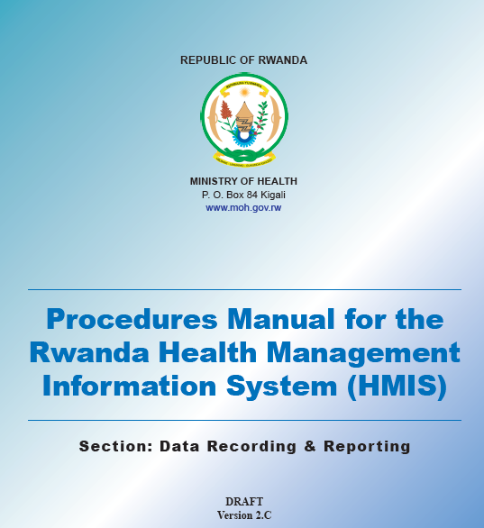
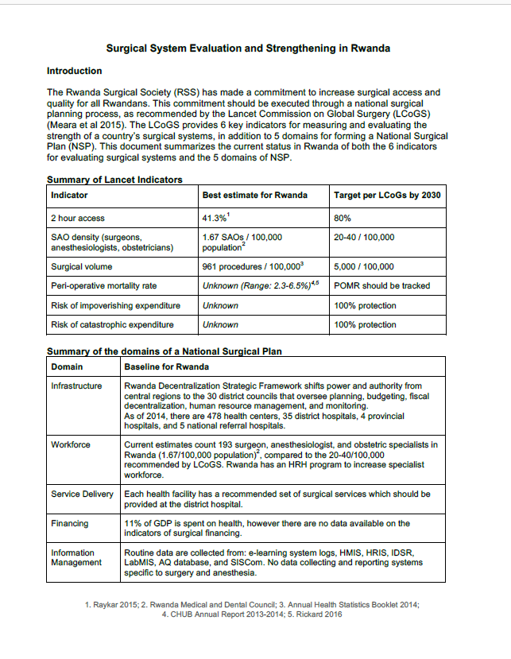
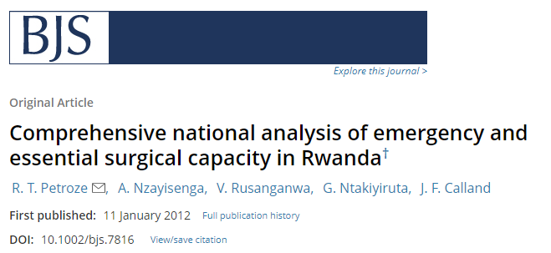
SITUATIONAL ANALYSIS
Notes:
Examples of what we used to establish some baseline information
Formulated into a report of all existing information

Slide 12
SITUATIONAL ANALYSIS
Information needed
Review existing
Baseline assessment
Notes:
1, define the information you need
2. Review the existing literature/ MOH data
3. Situational analysis

Slide 13
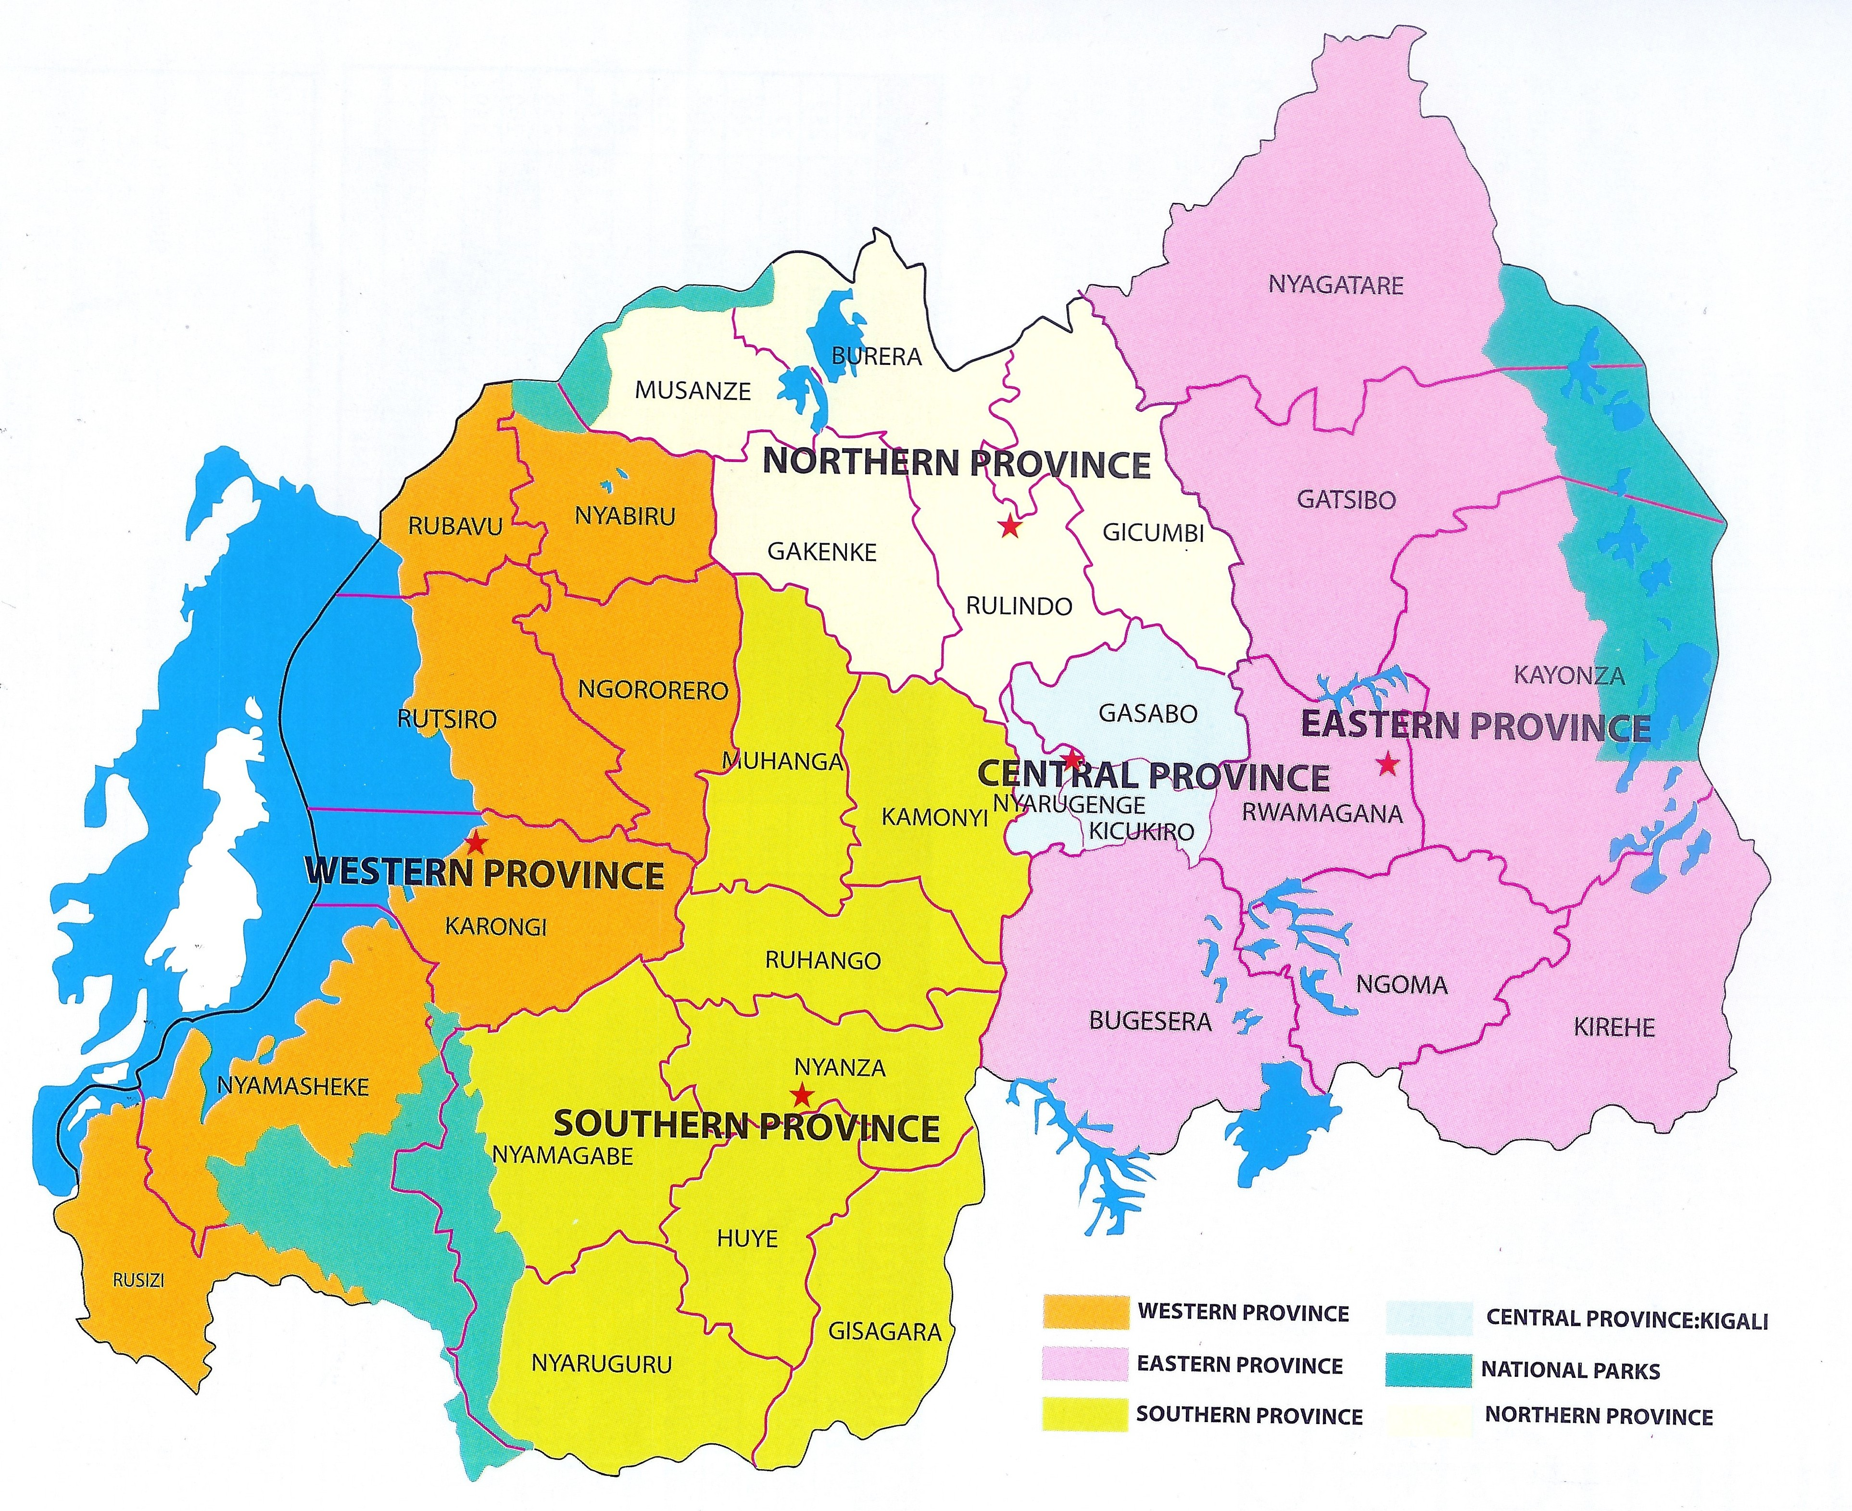
BASELINE ASSESSMENT
Plan
5 provinces
42 district hospitals
Surgery residents
paper data collection
Logistics
3 weeks
10 residents, 5 teams
Each team to a province
Notes:
Attempted electronic data collection, paper faster.

Slide 14
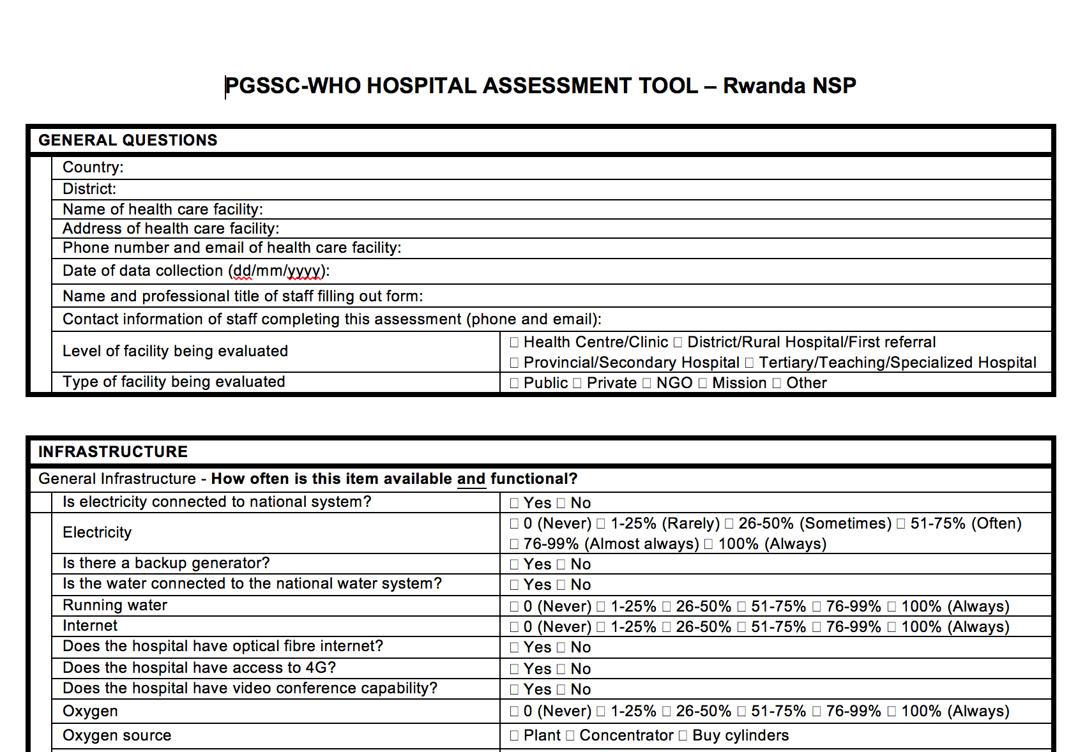
BASELINE ASSESSMENT
Infrastructure
Service Delivery
Workforce
Information Management
Financing
Notes:
Modified the PGSSC-WHO Surgical assessment tool to work in the rwanda context
Tool goes through the 5 domains: infrastructure, service delivery, workforce, information management and finance

Slide 15
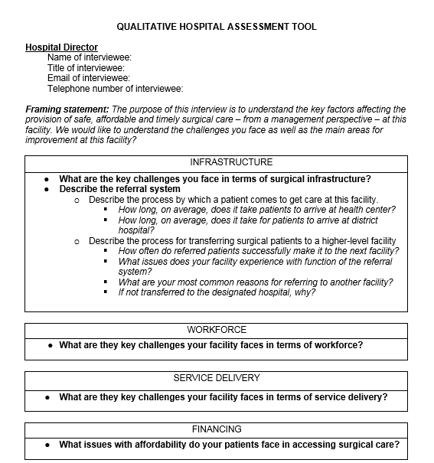
BASELINE ASSESSMENT
Hospital Director
Surgeon /General Practitioner
Anesthesia Provider
Surgical Ward Nurse
Notes:
Qualitative hospital assessment tool, with key challenges in terms of the 5 domains

Slide 16
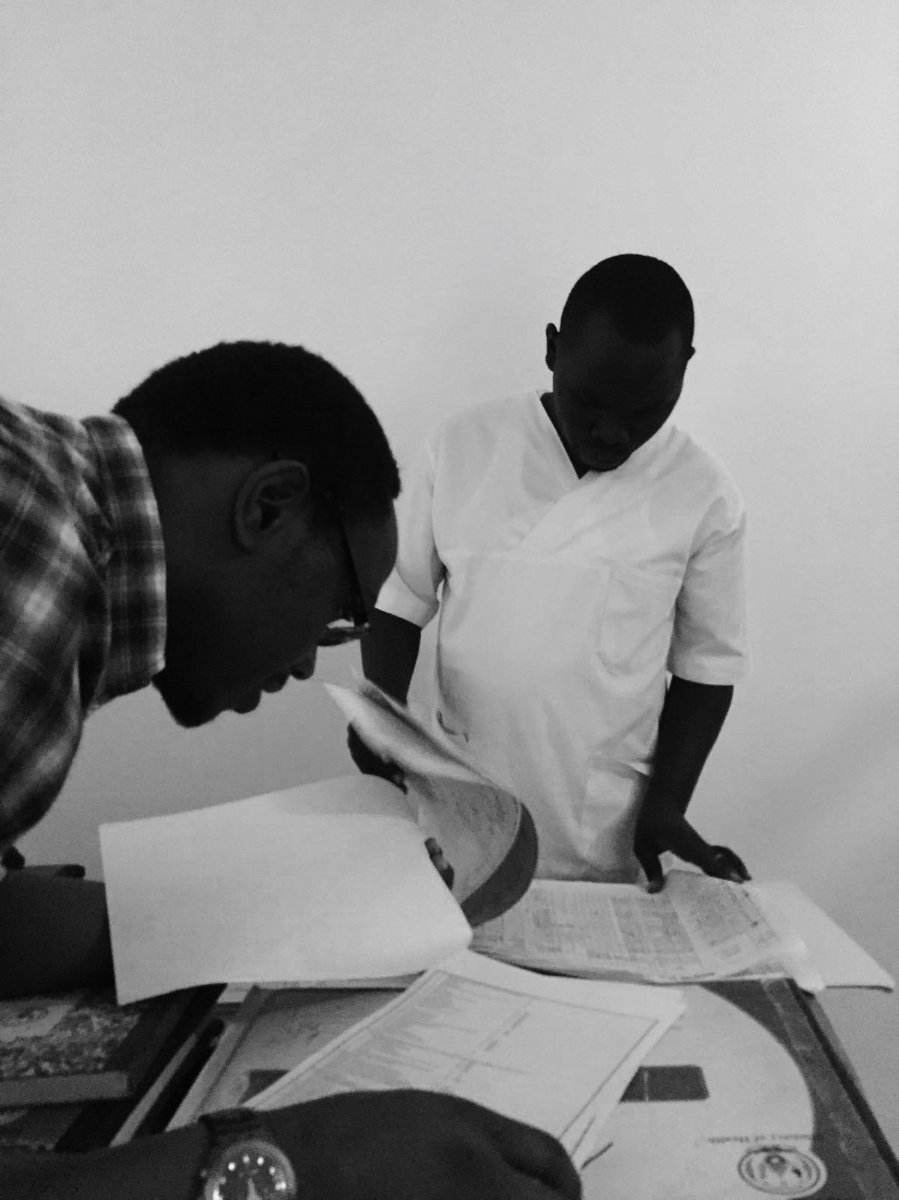
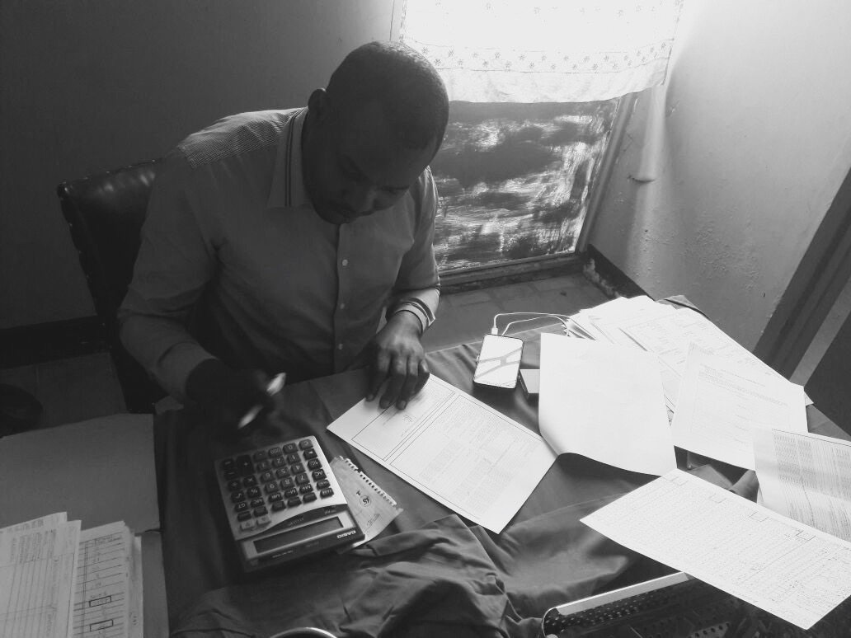
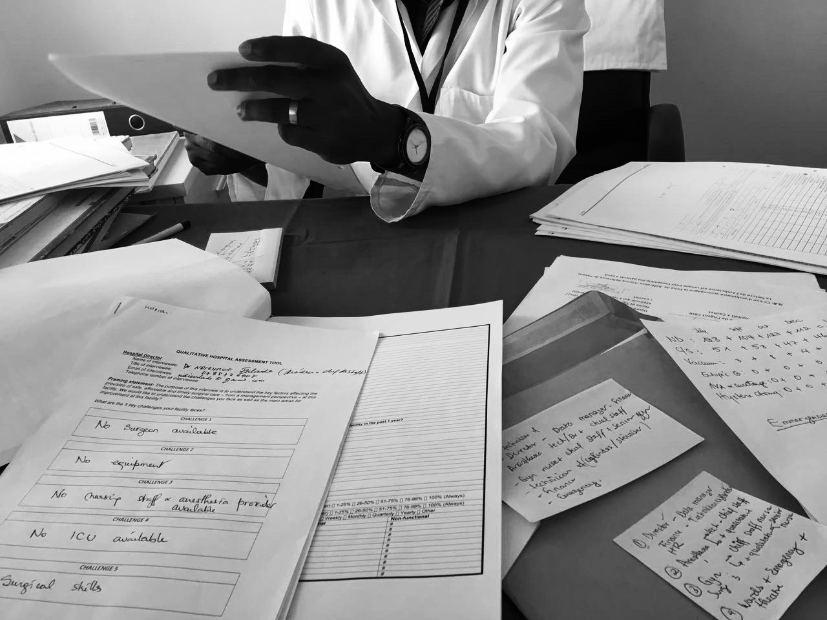
BASELINE ASSESSMENT
Notes:
Modified the PGSSC- Surgical assessment tool to Rwanda Context

Slide 17
BASELINE ASSESSMENT: RESULTS
2HR
ACCESS
SURGICAL VOLUME/ 100,000
SAO/100,000
100%
0.80
786
IMPOVERISHING
EXPENDITURE
CATASTROPHIC
EXPENDITURE
POMR
3.11
? %
10%
Notes:
Modified the PGSSC- Surgical assessment tool to Rwanda Context
-for SAO providers and surgical volume included hospitals in Kigali.

Slide 18
SURGICAL INDICATORS: 2 Hour Access
Notes:
Location of facilities capable of performing ALL bellwether facilities (District hospitals)
Access to a bellwether facility

Slide 19
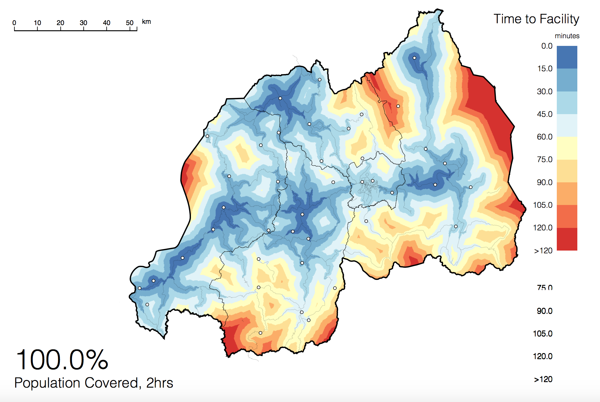
SURGICAL INDICATORS: 2 Hour Access
Notes:
With the help of Redivis, the geographical access to a hospital is within 2-hours for 100% of the population.
CAVEAT: This number was calculated using driving distance, following the speed limit to a facility that provides surgical care, taking into consideration the type of road (paved, unpaved etc)
Does NOT take into account, other modes of transportation (walking, biking, etc), road condition, availability of resources once at the hospital workforce, infrastructure, and equipment at each hospital necessary for safe surgical care therefore likely is an over-estimate.
It does suggest appropriate placement of surgical facilities to ensure access to the population.
Access to a bellwether facility
Infrastructure

Slide 20
SURGICAL INDICATORS: Surgical Volume

Slide 21
SURGICAL INDICATORS: Surgical Volume
Surgical Volume per 100,000 Population: 786

Slide 22
SURGICAL INDICATORS: Provider Density

Slide 23
SURGICAL INDICATORS: Provider Density

Slide 24
SURGICAL INDICATORS: Provider Density

Slide 25
SURGICAL INDICATORS: Provider Density
At the District Level:
9 certified full-time surgeons
Including GPs: 73 surgical providers
14 certified full-time OB/GYN
420 general physicians providing cesarean sections
2 full-time certified anesthesiologists
173 non-physician anesthesia providers

Slide 26
BASELINE: MAJOR CONCLUSIONS
Infrastructure
Appropriate distribution facilities
Almost all with water, electricity, oxygen
All hospitals 2 operating theatres, 25% non-functioning
Three facilities no access to a blood bank
Service Delivery
Bellwether capable facilities (low)
All facilities able to perform c-section, 31 perform laparotomies
High number of referrals from East and South
Quality indicators (use of WHO checklist,36% of hospitals, POMR, etc.)
Notes:
Service Delivery:
Bellwether capable facilities (low)
All facilities able to perform c-section, 31 able to perform laparotomies
High number of referrals from East and Southern province
Quality indicators: use of WHO checklist (36% of hospitals), POMR, etc.

Slide 27
BASELINE: MAJOR CONCLUSIONS
Workforce
SAO density below LCOGs target
Significant reliance on general practitioners and anesthesia technicians
Information Management:
91% have health management information system
Majority used paper charts
Low outpatient and minor surgery data
Finance:
Most patients (90%) covered by public insurance
Most hospitals reported only 1-25% of annual budget allocated to surgery or anesthesia
Notes:
With the help of Redivis, the geographical access to a hospital is within 2-hours for 100% of the population.
CAVEAT: This number was calculated using driving distance, following the speed limit to a facility that provides surgical care, taking into consideration the type of road (paved, unpaved etc)
Does NOT take into account, other modes of transportation (walking, biking, etc), road condition, availability of resources once at the hospital workforce, infrastructure, and equipment at each hospital necessary for safe surgical care therefore likely is an over-estimate.
It does suggest appropriate placement of surgical facilities to ensure access to the population.
Access to a bellwether facility

Slide 28
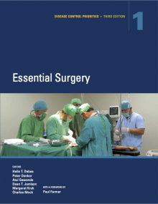
NSOAP IMPACT
Infrastructure
Identified 16 hospital to focus initial efforts
Non-functioning OT, ventilators, equipment etc.
Service Delivery
Set standardized procedure lists for each hospital level
Increase outreach surgery trips until hospitals are up to standards
Standards for perioperative documentation
Referral pathways
Increase utilization of infection control, clinical guidelines
Notes:
A few initiatives written into our plan based off our baseline assessment

Slide 29
NSOAP IMPACT
Workforce
Set desired number of SAO providers per hospital
Incentives for rural distribution
Increase number of graduating providers
Rural rotations for residents
Increase training of general practitioners and distribution
Improve certification process
Training of bellwether procedures
Information Management and Finance
Standards for data collection locally and nationally
Registries, QI projects, research capacity
Inclusion of bellwether procedures into insurance packages
Increase allocation of budget to surgery, obstetrics and anesthesia care
Notes:
A few initiatives written into our plan based off our baseline assessment

Slide 30
Lessons Learned
Identify “information needed” before reviewing data and embarking on baseline assessments
Use SAT tool for data collection to allow for country comparison and M&E
Clarify the appropriate source for the information (logbooks, word of mouth, HMIS, etc) to data collectors
Face the facts and cater NSOAP to fill the gaps
Notes:
*Face the facts-

Slide 31
Main Challenges
Funding for:
Human Resources Development: from 0,80 to 16 SAO / 100,000 in 2024
To support the increase in surgical volumes: from 786 to 2000 / 100,000 in 2024
Maintenance and procurement to ensure uninterrupted surgical delivery
Notes:
*Face the facts-

Slide 32
NSOAP UPDATE
Final validation April 2018
Launch April 2018
NSOAP already included in the 2018 - 2024 MOH Strategic Plan

Slide 33
Thank you/ Murakoze

