Slide 1
The World Bank World Development Indicators (WDI) and Global Surgery
World Bank Development Data Group (DECDG)
Emi Suzuki, PhD
Notes:
Good morning everyone. I am Emi Suzuki, from Development Data Group of the World Bank. I am honored to be here and thank you for having me here at the workshop.

Slide 2
Outline of the presentation
What is the World Bank Group?
What we do?
What is the WB’s World Development Indicators (WDI)
How we do it
More about the WDI (usage, our team)
Global surgery indicators
What the data show
Future of the global surgery indicators
Notes:
Today I was asked to talk about the Global Surgery Indicators and the World Bank’s World Development Indicators. So here is the outline of my presentation.
I would like to talk about:
What is the World Bank Group?
What we do?
What is the World Bank’s World Development Indicators (WDI)
How we do it
More about the WDI (usage, our team)
Global surgery indicators
What the data show
Future of the global surgery indicators

Slide 3
What is the World Bank Group?
Unique global partnership
Consists of five institutions
To end extreme poverty and to promote shared prosperity
189 member countries, staff from 170+ countries, offices over 130 locations
Notes:
So, what is the World Bank Group? Very quickly.
The World Bank Group is a unique global partnership. It is one of the world’s largest sources of funding and knowledge for developing countries. It consists of five institutions working for sustainable solutions that reduce poverty and build shared prosperity in developing countries. We have 189 member countries, staff from more than 170 countries, and offices in over 130 locations. The headquarters are located in Washington DC, in the USA.

Slide 4
What does the WBG do?
Development Projects (over 12,000 projects)
Knowledge and Innovation (e.g. Open Data, Open Knowledge Repository)
Products and Services (through policy advice, research, and TA)
Notes:
What does the World Bank Group do?
We work on development projects. We have funded over 12,000 development projects through traditional loans, interest-free credits and grants, since 1947.
We also work on knowledge and innovation. Our access to information policy was the catalyst for initiatives such as Open Data and the Open Knowledge Repository. My department largely works on this area.
We also work on Products and Services. We offer support to developing countries through policy advice, research and analysis, and technical assistance.

Slide 5
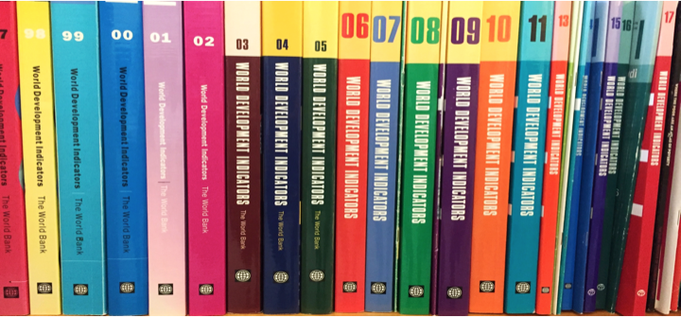
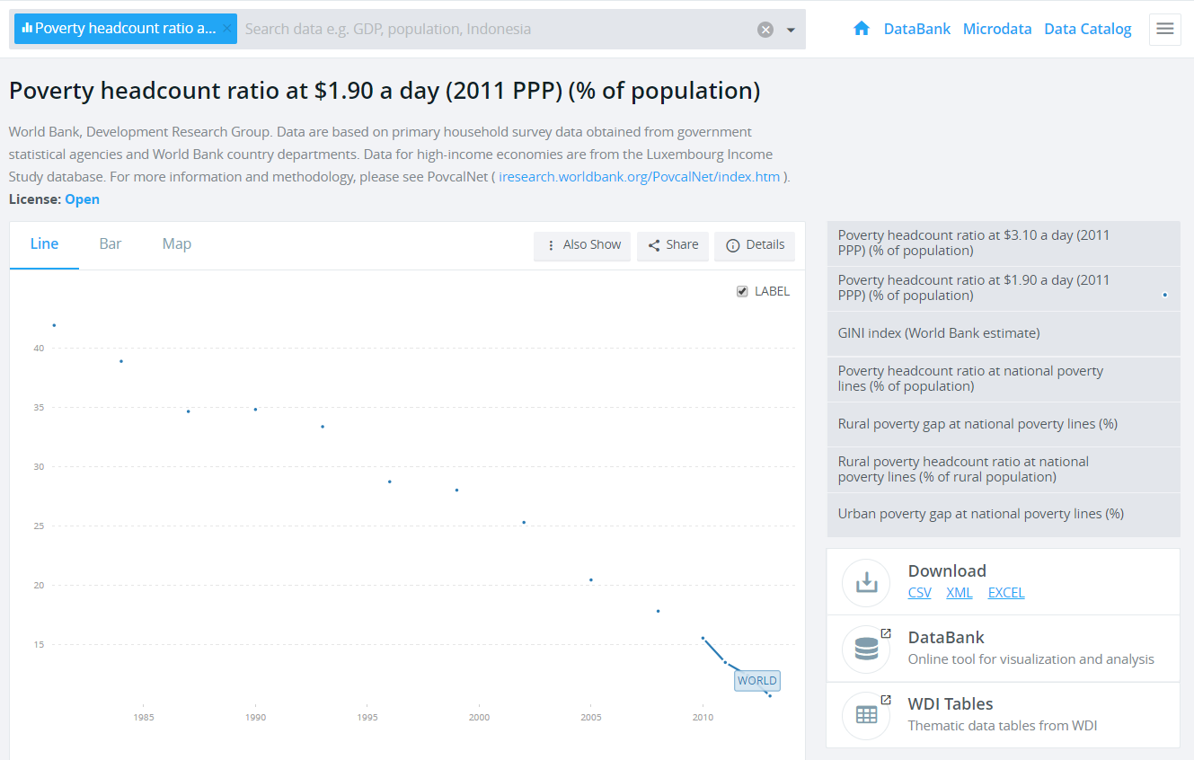
What is the World Development Indicators (WDI)?
Notes:
My department – Development Data Group - works on the knowledge products, including our publication called World Development Indicators - WDI.
WDI is the main source of data behind the World Bank’s Open Data Initiative, and the World Bank’s most widely used knowledge resource.
Originally it was a compilation of tables produced as an annex to the 1978 World Development Report
Initially it was a print publication but it has gradually evolved into a digital-only-product
It’s the World Bank’s most widely used knowledge resource
It attracts approximately 20 million visitors per year just from the Data Site, with more people accessing the data republished in other locations
The WDI database is updated quarterly, and WDI book is published in April every year. The latest WDI book is WDI 2017.

Slide 6
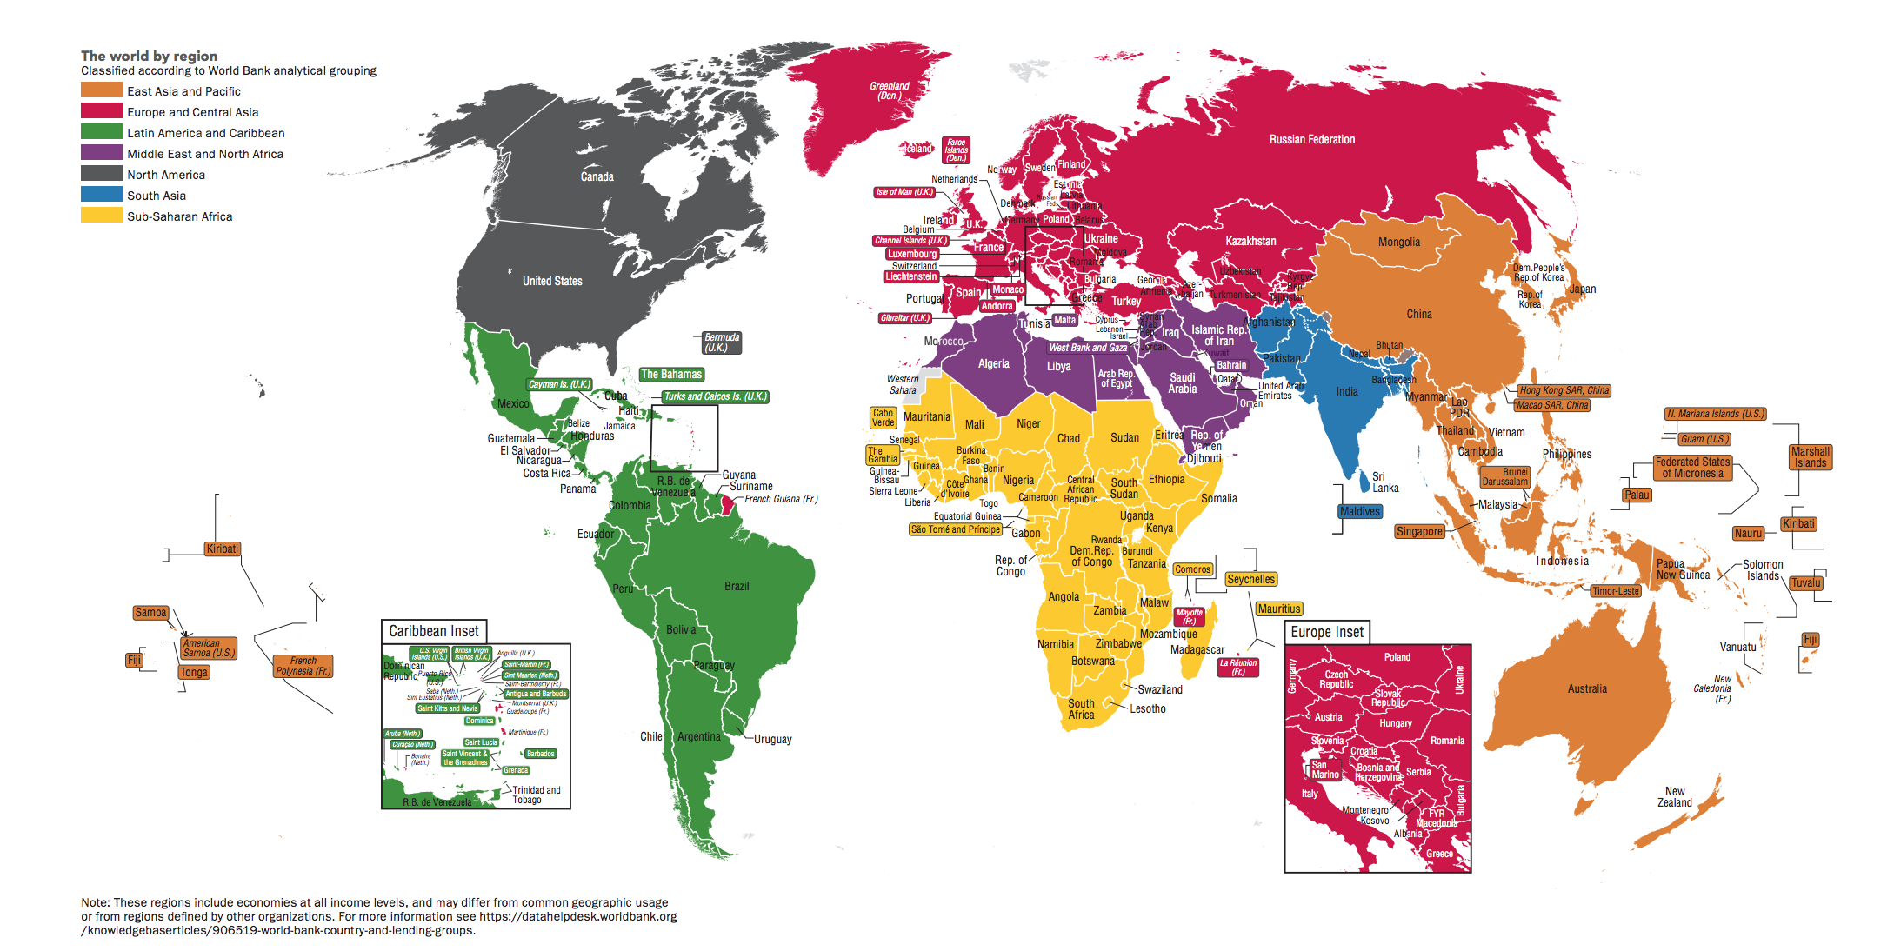
WDI: Global Coverage - 217 Countries/Economies
Notes:
We cover 217 countries and economies, that is nearly all countries. We produce country level data, as well as grouped data such as regions and income groups, and global level data.
We group countries by 7 regions as you can see in the colour here. We also have 4 major income categories, that are Low income, Lower-middle income, Upper-middle income, and High income.

Slide 7
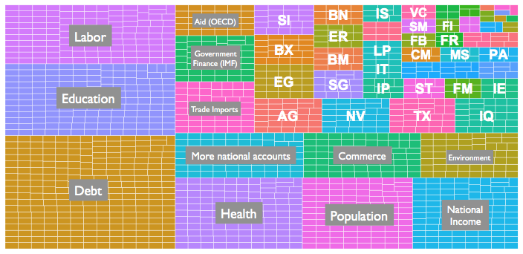
Data Coverage: 1500+ Indicators
Each small box is an indicator, these are grouped by first two letters of the indicator code which is thematic
Notes:
The WDI has more than 1500 indicators.
Each small box is an indicator and these are grouped by topics here. We have indicators for topics such as Debt, Health, Population, National accounts, Education, Labour, Environment, and so on.
The coverage varies by time, space, and topic, and there are some minimum thresholds for inclusion in the WDI.

Slide 8
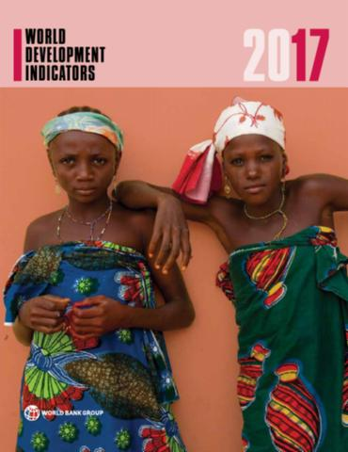
Criteria for Inclusion of indicators in WDI
Development relevance
Good data coverage – across the world, and over time (trend data if possible)
Comparability across countries and across time (consistent definitions and methodology)
Good reliable source with regular updates
Notes:
So, these are the criteria for inclusion of indicators in the WDI. These are:
-development relevance;
-good data coverage across the world and over time; We want trend data if possible.
-comparability across countries and time; and
-good, reliable source with regular updates.

Slide 9
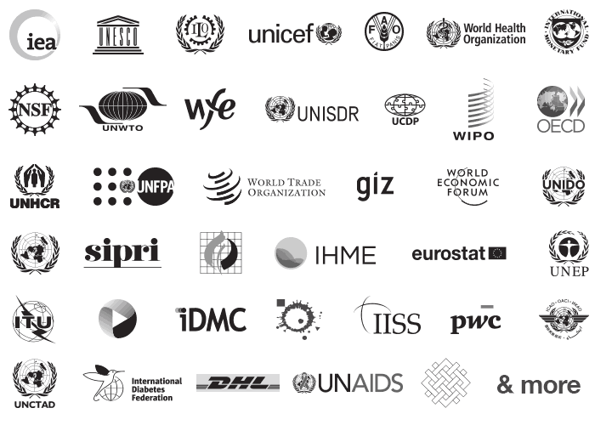
Data Sources: 50+ International Organizations
Producing WDI data involves:
50+ international organizations
200+ NSOs
WB country economists from 150 countries
WDI indicators are updated quarterly (July, September, December and April)
⅔ of the data come from external partners
Sources include admin data, academia & household surveys
Notes:
Producing WDI is only possible with the help of over 50 international organizations, more than 200 national statistical offices and the experts in the World Bank country offices, Global Practices and Cross Cutting Solution Areas of the World Bank.
More than ⅔ of data are coming from external partners
Data are from a mix of international agencies producing statistics, such as United Nations and WHO
Some are coming from administrative sources, or academia, and some are derived from Household Surveys.

Slide 10
WDI Data Management Process
Acquire
Curate
Disseminate
acquire data from multiple sources in manual or automatic fashion
conduct quality control (using data quality checklists), document and aggregate data.
conduct World Bank-wide data review
disseminate online in presented form / API / query / bulk download
Notes:
How we do it? Here shows Simplified 3-step Process (acquire / curate / disseminate)
- We acquire data from multiple sources in manual or automatic fashion,
- We put it into a working version where documentation, aggregation, and QA takes place. We go through World Bank-wide data review annually.
- Then we disseminate online in presented form, API, query, and bulk download

Slide 11
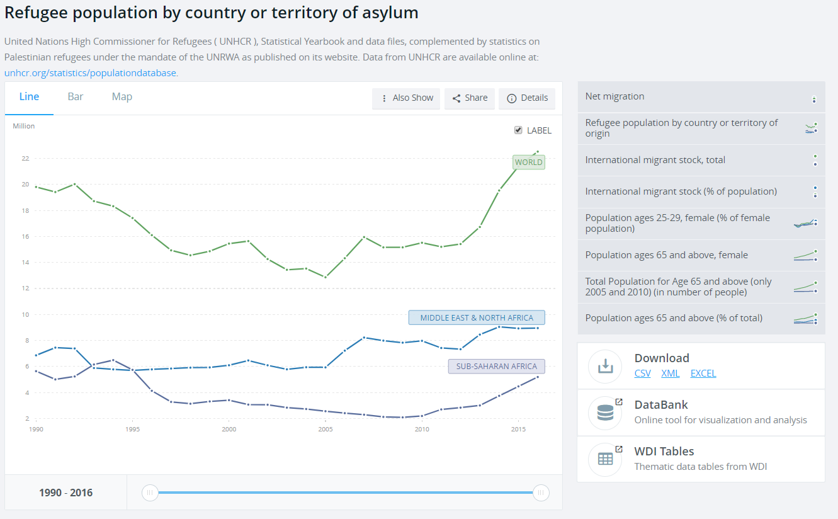
WDI Data: Refugee Populations
Data acquisition and quality control process:
Acquired from UNHCR
Loaded into internal “Data Collection System” software
Combined with UNRWA data
Checked for discontinuities and outliers
Aggregated into Bank regions
Published and made available on WDI website
Notes:
For example, here’s WDI data on refugee populations. How did it get here?
We acquired data from UNHCR through a manual spreadsheet
We transformed and loaded into an internal system
We combined with data from UNRWA to account for data for Palestinians
We checked for discontinuities and outliers
We aggregated into World Bank-regions and groups, and
We published and made it available on data.worldbank.org, and in all related WDI products.

Slide 12
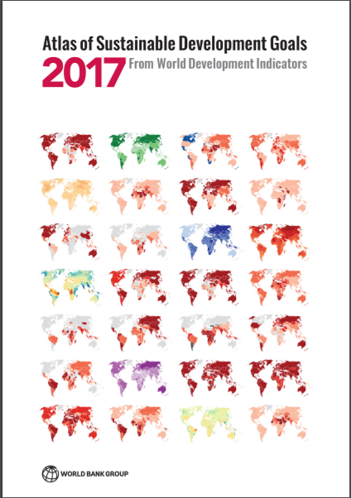
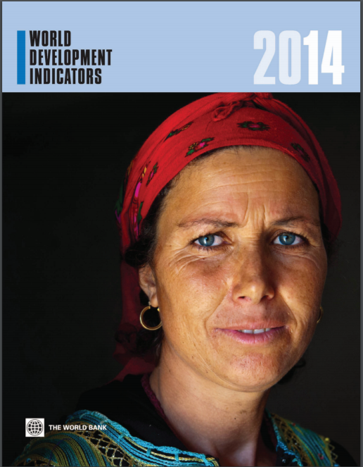
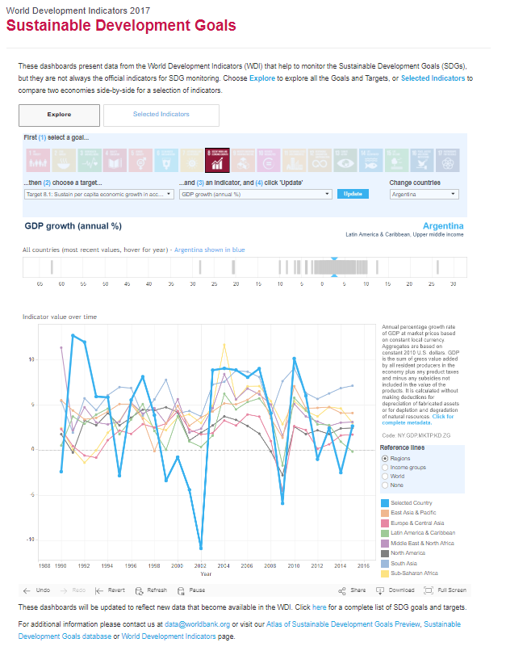
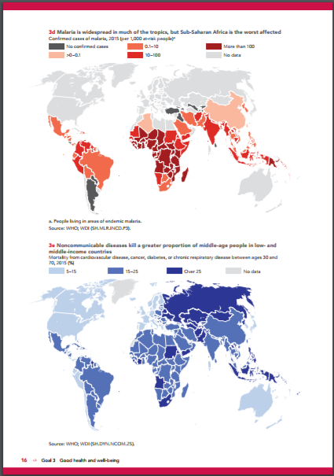
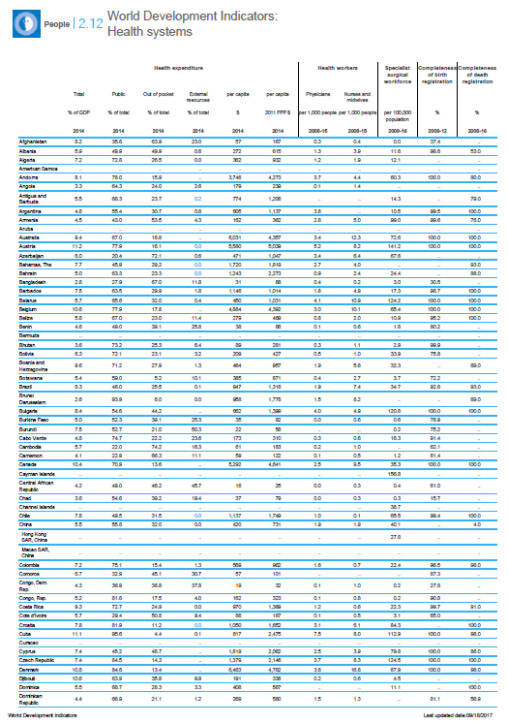
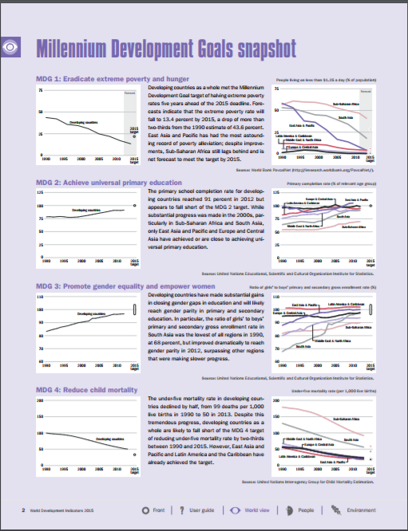
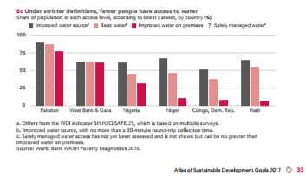
WDI Over Time
Notes:
WDI has been published as an annual compendium for many years with thematic tables and commentary.
It tracked the MDGs, and now tracking SDGs, through SDG online dashboard and SDG Atlas.

Slide 13
WDI Usage Statistics
Channel | “Views” (‘000s) | Unique users (‘000s)
Book (incl. print & OKR pdf) |  | 65
Bulk download | 345 | 75
Tables online | 1,500 | 500
Databank (WDI only, = 50% total) | 9,300 | 1,500
data.worldbank.org | 80,000 | 30,000 20-40,000
API data queries | 80,000
Google infobox | 80,000 (17-170,000)
Notes:
Here are some WDI usage statistics. These are approximate statistics, annualized basis, but without guarantees! But probably order of magnitude is correct.
Majority of views are from online sources, such as APIs, data.worldbank.org and the databank query tool.

Slide 14
Global Surgery 6 Indicators
Notes:
So, Global Surgery Indicators. As we know, these are the 6 Global Surgery Indicators:
The geographic accessibility of surgical facilities
The density of specialist surgical providers (SAOs)
The number of surgical procedures provided per population
Perioperative mortality rates
The risk of impoverishing expenditure
The risk of catastrophic expenditure

Slide 15
Global Surgery Indicators and WDI
June 2015: Global surgery team and WDI team met and agreed to work towards publishing the global surgery indicators
November 2015: Global surgery data were shared with the WDI team
April 2016: World Development Indicators 2016 published the 4 surgery indicators (2 indicators were not published due to low data coverage)
April 2017: Data for 2 of the 4 indicators were updated in World Development Indicators 2017
Notes:
We now have global surgery indicators in WDI. So, how this happened?
In early 2015, the WDI team was contacted by the global surgery team.
In June 2015, the Global Surgery team and WDI team met, and we agreed to work towards publishing the global surgery indicators in the WDI.
In November 2015, we received data from the Global surgery team.
In April 2016, we were very pleased that we published 4 of the 6 global surgery indicators in the WDI.
One year later in April 2017, data for 2 of the 4 indicators were updated.

Slide 16
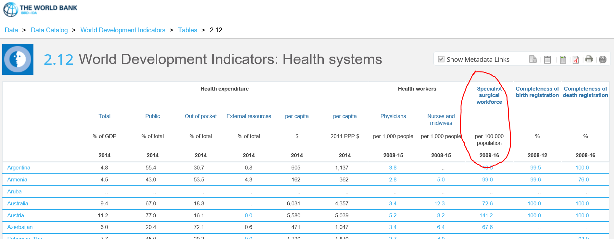
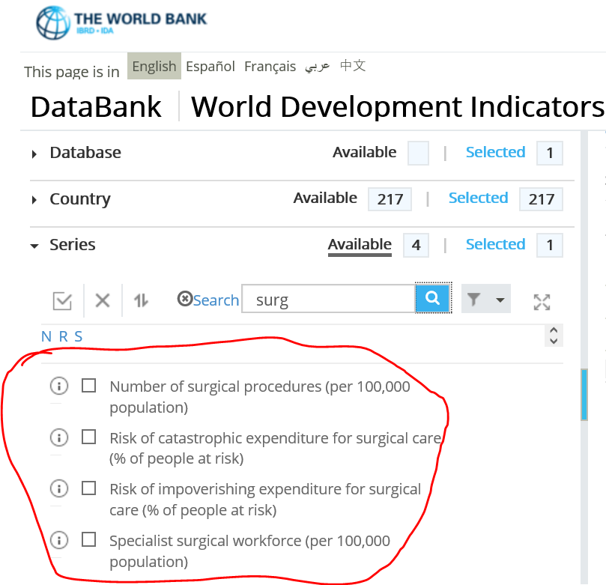
Global Surgery Indicators in the WDI
Notes:
The global surgery indicators are here in the WDI database, as well as the WDI online table.

Slide 17
Data coverage of the 6 global surgery indicators
 |  | WDI 2016 |  | WDI 2017
 |  | # countries covered | % | # countries covered | %
1 | Access to timely essential surgery * | 14 | 6% | - | -
2 | Specialist Surgical Workforce Density | 173 | 80% | 173 | 80%
3 | Surgical Volume | 184 (modelled) | 85% | - | -
 |  | 33 (country data)* | 15% | 58 | 27%
4 | Perioperative Mortality Rate * | 19 | 9% | - | -
5 | Risk of Impoverishing expenditure | 186 | 86% | - | -
6 | Risk of Catastrophic expenditure | 186 | 86% | - | -
* Not published in WDI
Notes:
Here shows some coverage of the global surgery data in WDI 2016 and WDI 2017.
1. Access to timely essential surgery had data for 14 countries, which 6% of all countries. Due to the low coverage, the data were not published in the WDI.
2. Specialist surgical workforce density had good coverage. 173 countries, 80% of countries had data. More data points were added in WDI 2017, but # of countries covered are the same.
3. Surgical volume data were produced using a model first. The modelled estimates covered 184 countries, and the empirical country data covered 33 countries. Therefore, the modelled estimates were used for WDI 2016. In WDI 2017, more country data were collected and added, and we switched from modelled data to country data in WDI 2017. The coverage is currently 58 countries.
4. Perioperative Mortality rate had data for 19 countries which is 9% of all countries. Due to low coverage, the data were not published in the WDI.
5 & 6. The financial risk protection data were modelled estimates, and we have data for 186 countries.

Slide 18
Global Surgery Indicator 2: Density of specialist surgical providers by income groups
Large discrepancy across income groups
1 SAO in LIC vs 70 SAOs in HIC
Notes:
Although there were challenges in data collection, the analysis of these data shows astonishing results. This can send a strong message to the world.
We calculated and published averages by income groups.
The data show huge discrepancy across the income groups.
The surgical workforce is extremely small in low income countries that is 1 SAO provider per 100,000 population on average, while there are 70 SAO providers per 100,000 population in high income countries.
*****
The indicator 3 – surgical volume does not have enough data points to calculate grouped data by all income groups. Because we only calculate grouped data if the 66% or more population is covered.

Slide 19
Global Surgery Indicator 5: Risk of impoverishing expenditure when surgery is required
Large discrepancy across income groups
87% in LIC vs 2% in HIC
Notes:
This is Financial risk indicator No. 5. It also shows huge discrepancy across the income groups. The 87% of people in low income countries are at risk of becoming poor due to out of pocket payment for surgical and anesthesia care when surgical care is needed. Only 2% of people are at risk in high income countries.

Slide 20
Global Surgery Indicator 6: Risk of catastrophic expenditure when surgery is required
Large discrepancy across income groups
73% in LIC vs 5% in HIC
Notes:
This is for catastrophic expenditure. Very similar picture. 73 % of people are at risk in low income countries whereas 5% of people are at risk in high income countries.

Slide 21
Need reliable data and better coverage
Better data coverage that are comparable across the world
Generation of time trend data that are comparable across time
Good reliable source with regular updates (annual or biannual)
Notes:
But because the Global Surgery indicators are still new, we still need to work hard on it.
I would love to see the following to happen in near future.
First, better data availability that are comparable across the world.
Secondly, generation of time trend data that are comparable across time
Third, data should come from good reliable source with regular updates

Slide 22
For reliable data with good coverage, strong data collection / reporting system is needed
Health facility
MoH / NSO
(Review, dissemination)
International Organization (Review, dissemination)
Transparency is needed at all levels. Metadata is important.
Notes:
This picture is very simplified, but this shows general and ideal data flow of global surgery indicators. We really need stronger data collection and reporting system.
The country level data should be collected first at health facility level, and then Ministry of Health or National Statistical Office should collect the data.
Then the country level data should be collected by or should be reported to international organizations, such as WHO. The data should be reviewed, cleared, and disseminated by the international organizations.
Transparency is needed at all levels. Metadata is very important.

Slide 23
For reliable data with good coverage, strong data collection / reporting system is needed
Standard definition and comparable methodology should be used for comparability across time and across countries for global monitoring
Notes:
Same definition and comparable methodology is important for comparability across time and across countries for global monitoring.

Slide 24
Wish list for Global Surgery Indicators in WDI
Notes:
Specifically here is what I hope to see in the global surgery indicators to be kept in the WDI in coming years.
I am going to talk about this by each indicator.

Slide 25
1. Access to timely essential surgery
Better country coverage needed (at least nearly half of countries - 100 countries). Currently the coverage is too low (14 countries)
Clear definitions of “access”
Regular updates (Not just one time study) using consistent definition and methodology across countries and time. Great to have time series data. (Consider a working group?)
Notes:
First, Access to timely essential surgery.
No 1. We definitely need more data. We would like to have data for at least half of the countries to be included in the WDI. Currently we have data only for 14 countries.
No.2. It will be good to have very clear definition, especially what do you mean by access. Is it just a distance from a health facility? Or you want to consider something else?
No. 3. For all the indicators, we would need regular updates. We do not include indicators only from one time study. We would like them to have consistent definition and methodology across countries and time. Also it is great to have time series data whenever possible.
Probably a working group may be needed for this.

Slide 26
2. Specialist surgical workforce density
Already good coverage (173 countries)
Clearer definitions of SAOs, “who are working”
Great to be comparable with WHO’s health workforce data
Regular updates using consistent definition and methodology across countries and time. Great to have data points over time. (WHO/Global surgery team)
Notes:
Second, SAO density.
First, This indicator already has good country coverage, which is great.
Second, Your definition could be clearer. The current definition is “Number of specialist surgical, anaesthetic, and obstetric physicians who are working”. It may be good to be clear about what do you mean by “working”. Do you want to include SAOs who are doing clinical work only? How about SAOs who do research only? How do you want to count the SAOs who work part-time? How about the SAOs who were trained in the country but working outside the country? It will be good to use clear and standardized definitions and classifications of SAOs across countries, and across time.
No. 3. The current data are not necessarily comparable with WHO’s health workforce data. It would be good to be comparable with WHO’s health workforce data.
Again we will need regular updates using consistent definition and methodology across countries and time. It will be good to have more data points over time. I think it will be great if WHO and global surgery team could collaborate on this.

Slide 27
3. Surgical volume
Better country coverage needed (at least nearly half of countries - 100 countries). Currently the coverage is too low (58 countries)
Definition looks clear.
Currently various data sources - need to use standard definition (MoH/NSO).
Regular updates using consistent definition and methodology across countries and time. Great to have time series data. (WHO?)
Notes:
The 3rd indicator, Surgical volume.
This indicator needs better country coverage. Currently we have data only for 58 countries.
The definition of the indicator looks clear to me.
But the current data come from very different sources in addition to Ministry of Health, such as academic papers. So I am not sure if the definitions used by these papers are consistent. It will be good to have data originally from Ministry of Health or National Statistical Office that use standard definitions.
We will need regular updates. I wonder if WHO could help with this indicator using the existing data collection system.

Slide 28
4. Perioperative mortality rate
Better country coverage needed (at least nearly half of countries - 100 countries). Currently the coverage is too low (19 countries)
Clearer definitions? – What to include as “procedures”? Time limit from the procedure (e.g. 30 days)?
Regular updates using consistent definition and methodology across countries and time. Great to have time series data. (MoH/NSO - WHO?)
Notes:
The 4th indicator, Perioperative mortality rate.
This also needs better country coverage. Currently we have data only for 19 countries.
As a non-medical lay person, it seems the definition could be a bit clearer. It will be good to specify what should be included as “procedures”. Also I wonder if you want to limit the time since procedure. For example, may be within 30 days?
We will need regular updates. I wonder if Ministry of Health or National Statistical Office could collect these data from health facilities, and WHO could collect the data from the governments using the existing data collection system.

Slide 29
5 & 6. Protection against impoverishing /catastrophic expenditure
Updates needed (near future)
Currently estimates are only for 2014. Great to have trend estimates (e.g. 2000 and 2016)
Current data are modelled estimates. Great to include country empirical data when become available
Notes:
The 5th and 6th indicators, financial protection indicators.
These indicators have good country coverage. 186 countries have data.
But the data were not updated since April 2016, so we would love to have updates in the near future. We often stop publishing an indicator from the WDI if there are no updates for more than 3 years or so.
Also, currently, the estimates are only for one year for 2014. So, if possible, it will be great to have trend estimates. You may not need annual estimates, but for example, how about estimates for 2000 and 2016? Because people are very interested in seeing trends. They want to know if it is getting better or worse.
These indicators have modelled estimates. It will be great to have empirical country data when data become available.

Slide 30
Thank you
data.worldbank.org
Notes:
So these are my views.
And we are very happy to continue to collaborate strongly with the global surgery community and WHO on these very important part of global health.
Thank you very much!

