Slide 1
LCoGS indicators
Dr Andy Leather
Director, Centre for Global Health & Health Partnerships
King’s College London
Notes:
With thanks to Isobel Marks, Hampus Holmer and Justine Davies for helping me prepare this talk.

Slide 2
Outline
data collection prior to LCoGS
LCoGS indicators
data collection processes
latest update

Slide 3
Workforce data
most of the currently available data on surgical workforce were originally compiled in 2014 and published in 2015
data were compiled to form the WHO Global Surgical Workforce Database
this was the culmination of years of work attempting to collect surgical data, and the final breakthrough came when data were finally collected by WHO, with support from Lund University
thousands of individuals were contacted – clinicians, academics, professional societies and ministries
official reports and publications were also searched

Slide 4
Holmer H, Lantz A, Kunjumen T, Finlayson S, Hoyler M, Siyam A, Montenegro H, Kelley ET, Campbell J, Cherian MN, Hagander L. Global distribution of surgeons, anaesthesiologists, and obstetricians. Lancet Glob Health 2015; 3 Suppl 2: S9-11.
Notes:
The original global surgical workforce data

Slide 5
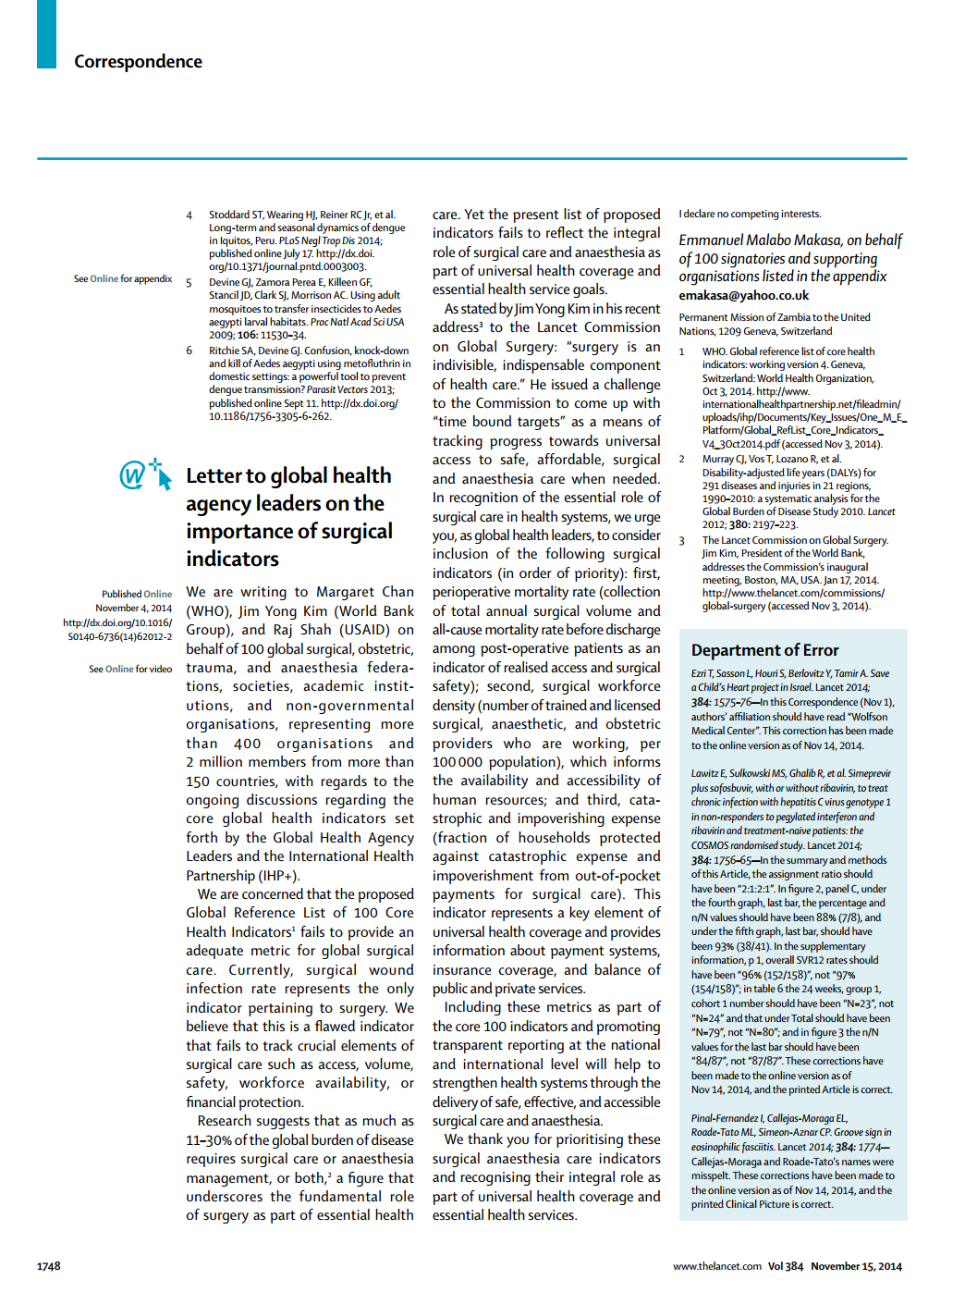
“Letter to global health agency leaders on the importance of surgical indicators”
– E Makasa & over 100 organizations

Slide 6
Lancet Commission
Indicators

Slide 7
Lancet Commission on Global Surgery
Meara JG, Leather AJ, Hagander L, et al. Global Surgery 2030: evidence and solutions for achieving health, welfare, and economic development. Lancet (London, England) 2015; 386(9993): 569-624.

Slide 8
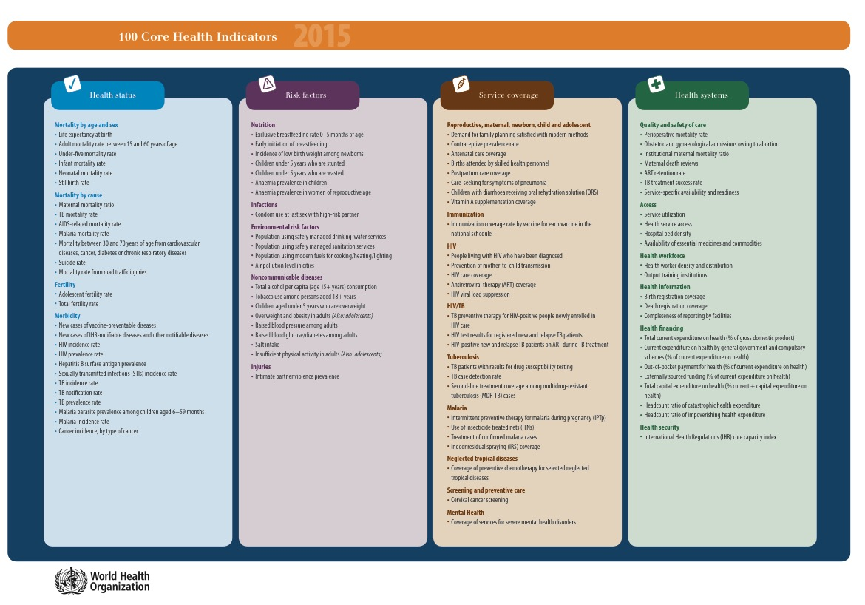
POMR
Surgical Volume
2h Access
SAO Density
Impoverishing Expenditure
Catastrophic Expenditure
Notes:
When the list came out in 2015, the 6 LCoGS indicators were reflected

Slide 9
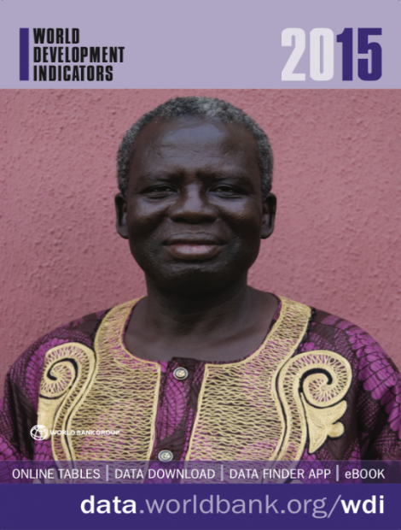
THE WORLD DEVELOPMENT INDICATORS
Notes:
The World Bank is a major player in country-level data management. And their annual World Development Indicator publication (known as the WDIs) are very influential.
The primary World Bank collection of development indicators, compiled from officially-recognized international sources.
It presents the most current and accurate global development data available, and includes national, regional and global estimates.
From agriculture, infrastructure, economic development to education to gender equity, trade, health.

Slide 10
the challenge to PGSSC!
Willing to consider inclusion of surgical indicators within the WDI
Need data on >1/2 of the World Bank’s 215 countries or independent economies
Major data release: April 2016
  DEADLINE: November 2015

Slide 11
PGSSC: global indicator initiative
Develop contacts in all 215 countries
Write and translate communications with clear data asks
Develop an online data management system
Train a team of associates to manage relationships and data
Clean data, provide summary data to all contributors, and report to World Bank

Slide 12
COUNTRIES WITH DATA AVAILABLE
Two Hour Access
Perioperative Mortality
Impoverishing Expenditures
14
16
186*
SAO Density
Surgical Volume
Catastrophic Expenditures
176
184*
186*
*Modeled data
Preparedness
Delivery
$ Impact

Slide 13
Methods
Indicator 1
List of hospitals performing Bellwether procedures obtained; plotted in GIS
Hospitals’ 2-hour catchment areas defined based on road networks (OpenStreetMaps)
Approximate road speeds estimated based on type of roadway
  Primary (100 km/h), secondary (50 km/h), tertiary (30 km/h) or no roadway (5 km/h)
Estimated population in the resultant catchment area retrieved from the WorldPop
Number of people within 2 hours of a facility divided by the total population of each country

Slide 14
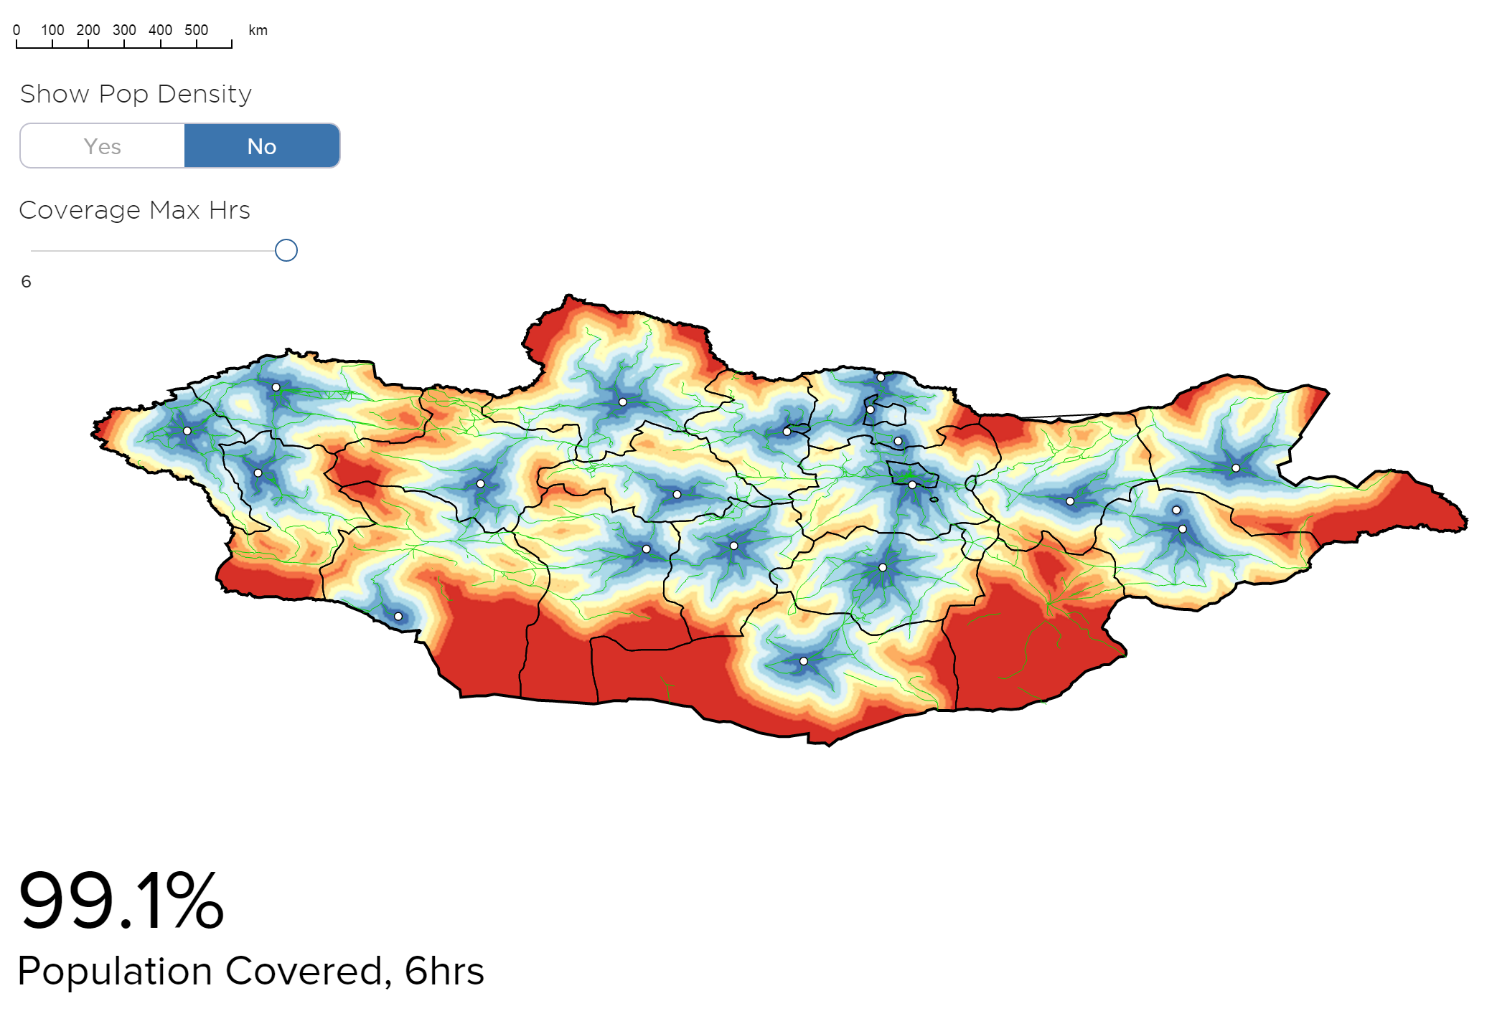
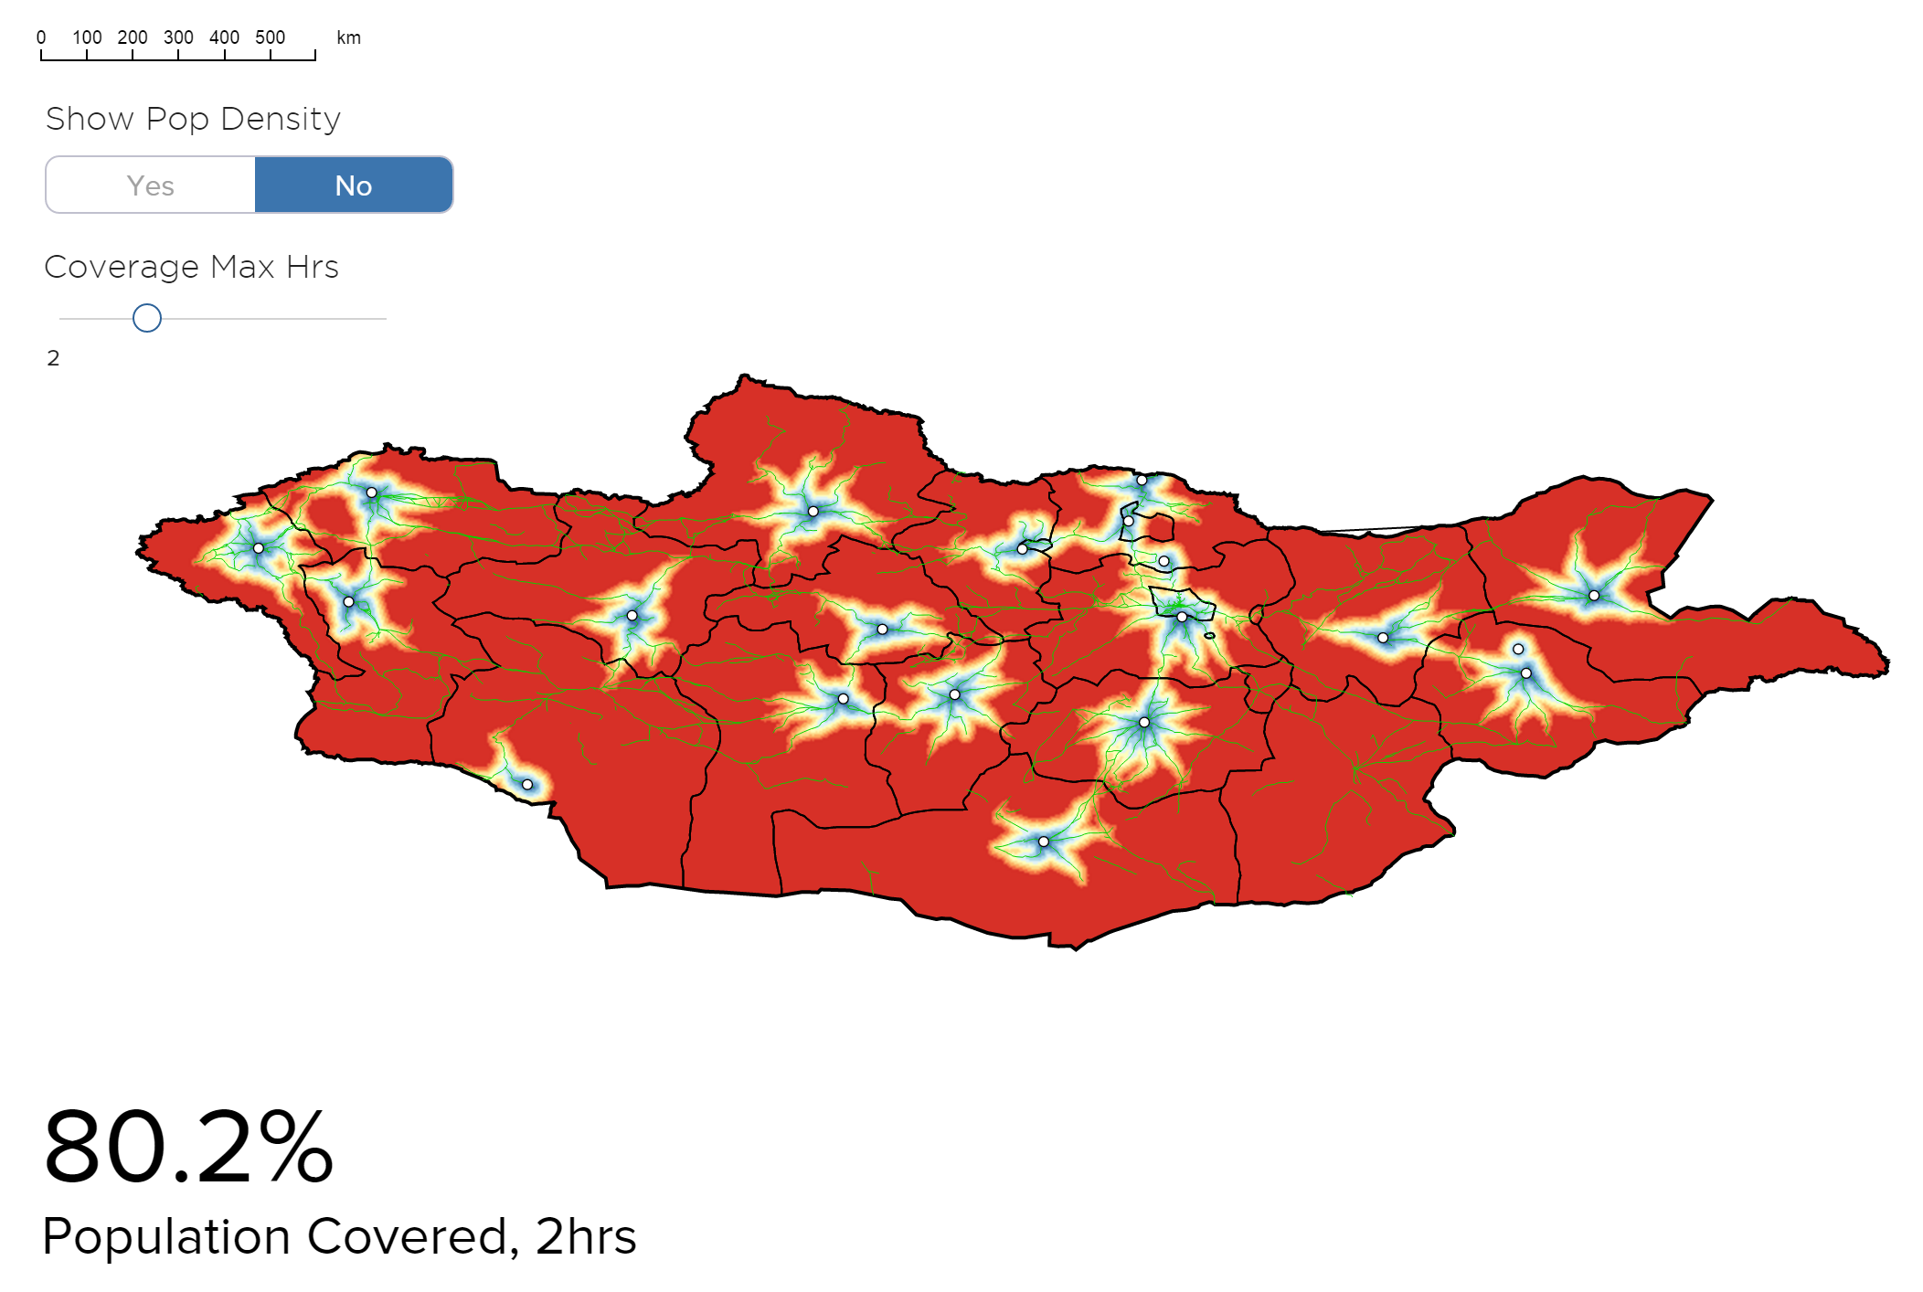
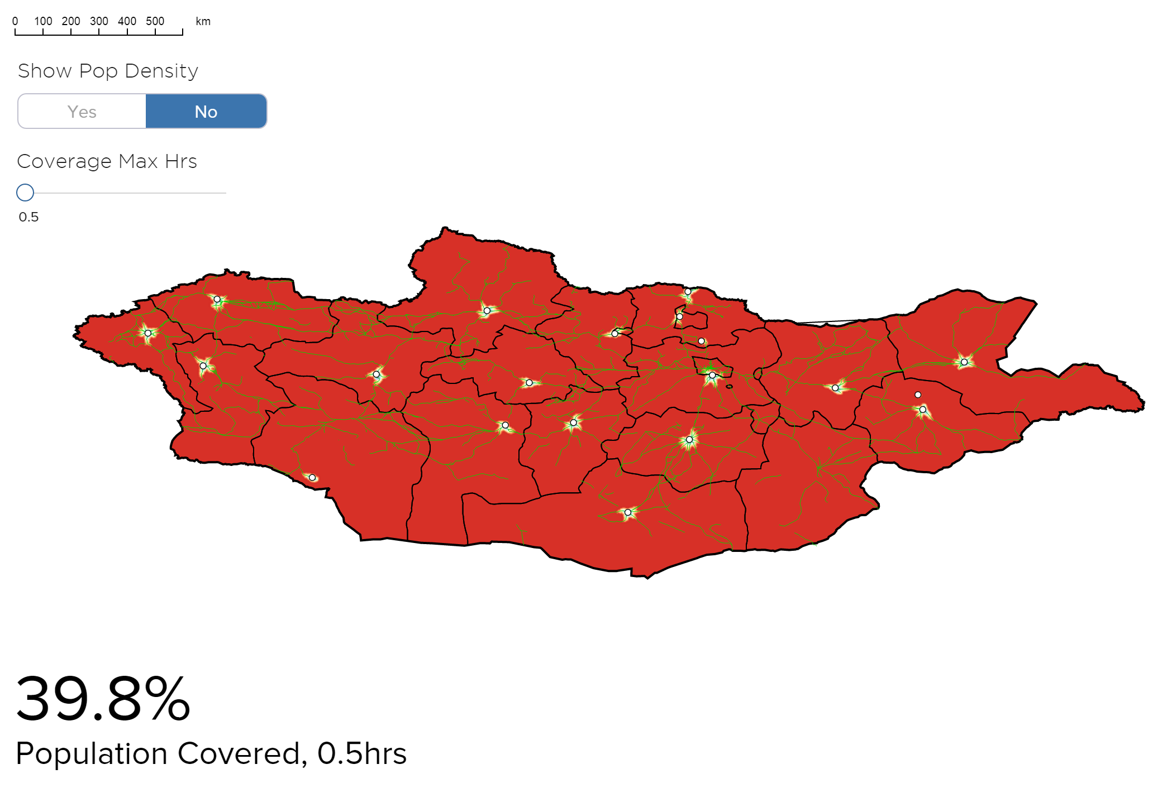


Two Hour Access
EXAMPLE: MONGOLIA
14

Slide 15
Indicator 1
→ 2-hour access much lower when considering safety standards and “essential surgery”
Esquivel MM, Uribe-Leitz T, Makasa E, Lishimpi K, Mwaba P, Bowman K, Weiser TG. Mapping Disparities in Access to Safe, Timely, and Essential Surgical Care in Zambia. JAMA surgery 2016; 151(11): 1064-9.

Slide 17

WDI Global Surgery Indicator Collection 2.0
Notes:
Round 2 involved 20 people from 17 countries and 8 months.
Incredible Herculean effort – could not have done it without their leadership and hard work.
Andy Leather, Justine Davies, Tom Weiser etc…

Slide 18

Concept of data collection round 2
Often, experience within international institutions is only available for young professionals from high-income countries, or backgrounds
We in InciSioN believe that the opportunity to participate in and contribute to international ventures ought to be shared between those of all nations, thus devising the concept of the ‘virtual internship’

Slide 19
The Virtual Internship
Work opportunities
Opportunities to take part in data collection and learn new skills, without having to pay for travel or wrestle with visas
Educational opportunities
Online lectures by experts in different subjects
Networking
“Meeting” like-minded people from around the world

Slide 20
The Process
A call was put out across InciSioN and IFMSA for students to apply
Out of 250 applicants from 70 countries, 10 were selected, based on language and regional representation.
This team underwent an online training program over a two weeks
Over a 6 month period, Ministries of Health were contacted directly, and online statistical databases as well as academic journals were searched

Slide 21














Notes:
Nationalities of everyone involved in the project

Slide 22
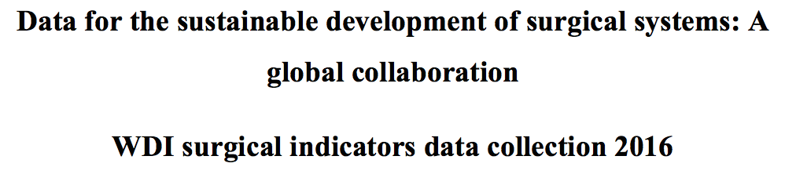
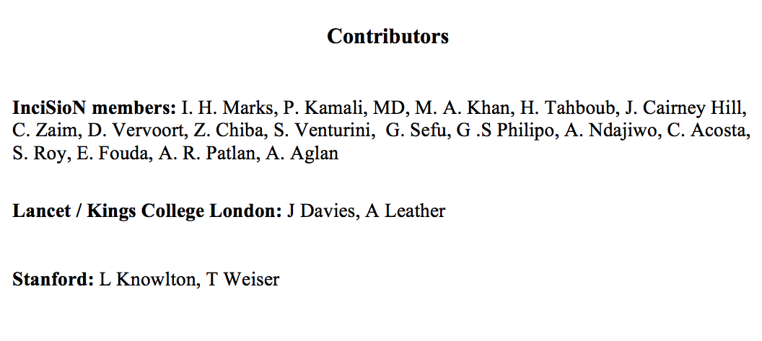

Slide 23
Countries Providing Data
Indicator | 2016 Collection | 2017 Collection
Indicator 1: 2h Access to a surgical facility | 14 | 33
Indicator 2: Surgical workforce density | 176 | 71
Indicator 3: Surgical volume | 184 | 61
Indicator 4: Perioperative mortality | 16 | 29
Indicator 5: Protection against impoverishing expenditure for surgical care | 186* | 16
Indicator : Protection against catastrophic expenditure for surgical care | 186* | 16
* Includes modeled data
Notes:
Huge effort yielded 4 in first round, another huge effort re-collected 2 indicators.
This leads us to wonder, what will happen in 2018 or 2019 if we don’t change our tactics?
Having academic institutions collect this data is not going to work long term.

Slide 24
Feedback
“ It was a great experience for me, especially because I'm from Nigeria. I cherish the opportunity of working and collaborating with passionate students around the world. It has impacted me positively both personally and professionally. I want to be part of this again and again and again”
“I thoroughly enjoyed being a part of the project! It was a lot of work and there were times I did struggle to keep up but it was worth all the effort. I am humbled to have been a part of it…. Thank you very much for the opportunity. I think it is wonderful that you give students a platform to express their passion for this area and moreover to have a hand in creating change. I look forward to the differences all of us will continue to make from here on in whatever way, wherever each one of us are! Here is to global surgery!”

Slide 25
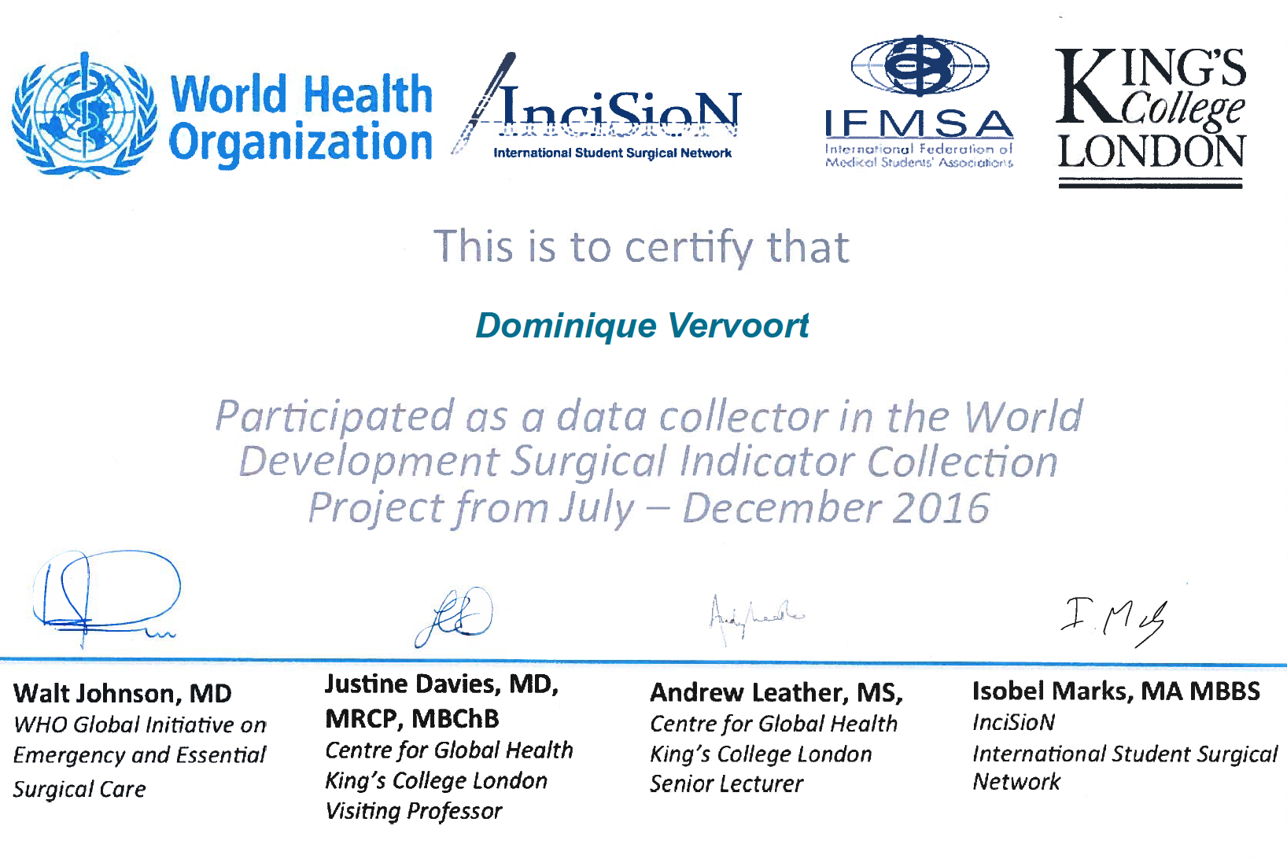

Slide 26
The Lancet Indicators – 3 years on
An attempt to review indicators’ availability, comparability and usefulness
Process in three steps:
  Compile currently available data
  Review data quality, sources and definitions used
  Critically appraise indicators based on:
    Availability of data
    Comparability between countries and over time
    Usefulness of each indicator

Slide 27
The current picture – Availability
Indicator | Number of countries*
1. Access to timely essential surgery | 26
2. Specialist surgical workforce density | 169
3. Surgical volume | 72
4. Perioperative mortality | 31 (10 using proposed definition)
5-6. Protection against impoverishing and catastrophic expenditure | 0
* Number of WHO member states with non-modelled data from 2010-2016
→ Excludes non WHO-members, modelled data and older data

Slide 28
The current picture – Comparability
Indicator | Definitional challenges
1. Access to timely essential surgery | What is a hospital performing surgery? What is a 2-hour catchment area?
2. Specialist surgical workforce density | What is a surgical provider?
3. Surgical volume | What is a surgical procedure?
4. Perioperative mortality | What is a post-operative death?
5-6. Protection against impoverishing and catastrophic expenditure | What is impoverishing and catastrophic? Who is protected? What is the cost of an operation?
→ Major challenges still exist

Slide 29
The current picture – Usefulness
Work remains regarding the usefulness of each indicator, weighing together availability and comparability, as well as real-world use of the indicators by ministries and international bodies

Slide 30
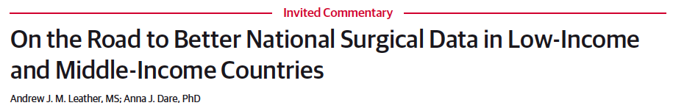

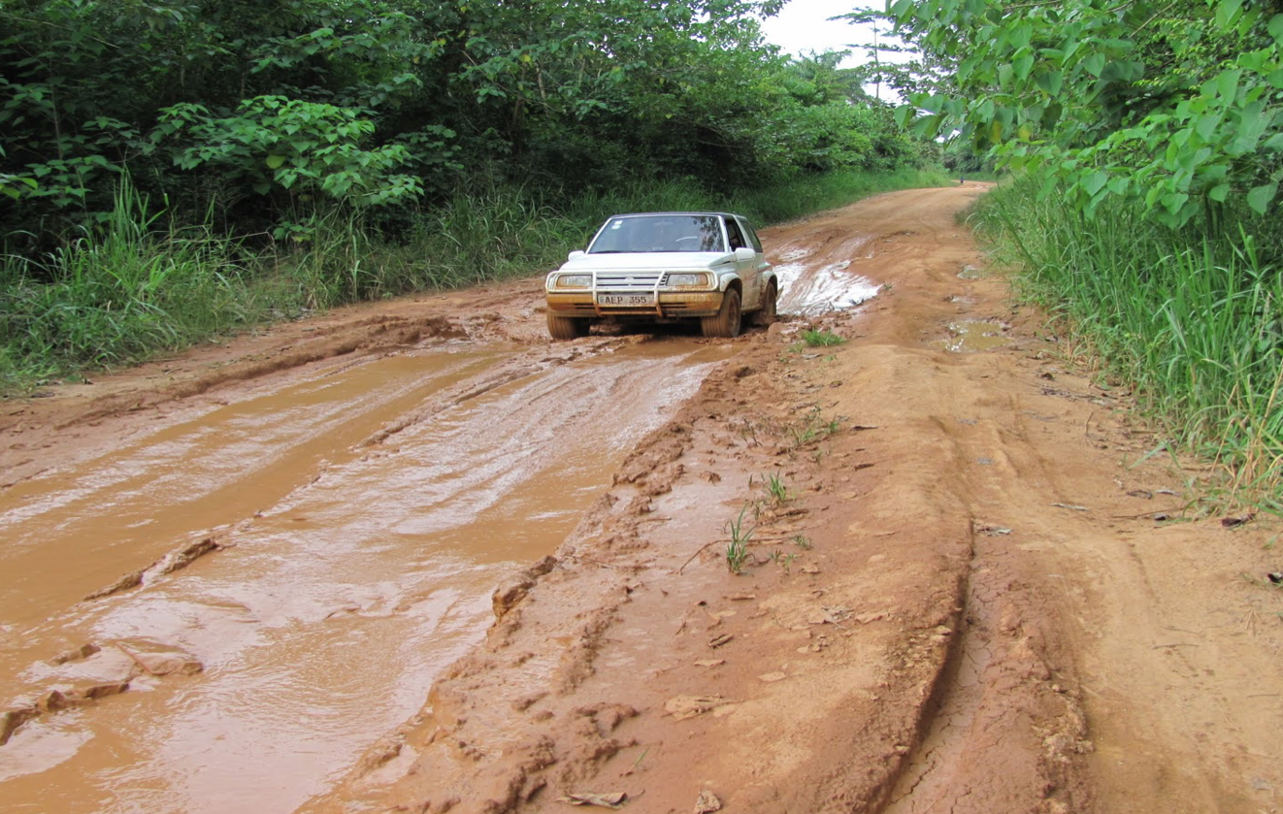
155 hospitals in Ghana
123 Bellwether Procedures
95 (72.2%) no capability
24 (19.5): 1-11 of each BP
4 (3.3%): at least 12 of each
5 identified for scale-up

Slide 31
Next steps
Incorporating data collection within primarily WHO (with World Bank as a key data repository)
Developing mechanisms to review and improve indicators, alongside other Global Health and SDG indicators currently in use

