Slide 1
Lessons from National Health Strategic Plans in Africa for NSOAP Development
Martin Ekeke Monono, MD, FRCS (Ed)
Team Leader, Health Policies, Strategies and Governance
World Health Organization (WHO) Regional Office for Africa in Brazzaville

Slide 2
Outline
WHO AFRO Role
History
Framework & Formulation of National Health Strategic Plans (NHSPs)
Case Study of NHSP
Lessons for NSOAP Development in AFRO and Beyond

Slide 3
AFRO Role
Regional Level
Convening role:
Regional Committee, statutory endorsement;
Sharing of experiences between countries
Advocacy in other international for a
Development of technical documents-guidelines for various stages of process
National Level
Technical support during development of plan: evidence generation; analysis, costing ,M&E
Convening role for inclusion of all major stakeholders (including civil society, programmes and partners)
Brokering and negotiation especially with regard to the definition of priorities and balance between programmatic and system aspects of the plan
Advocacy for one plan, one budget and one report

Slide 4
Role of National Health Policies
National health policies, strategies, and plans (NHPSPs) play an essential role in defining a country's vision, priorities, budgetary decisions and course of action for improving and maintaining the health of its people
Glossary:
NHP – National Health Policy
NHSP – National Health Strategic Plan
NHPSP - National health policies, strategies, and plans

Slide 5
History of NHPSPs
2000: RC50: “Health-for-All for the 21st Century in the African Region: Agenda 2020” (AFR/RC50/R1):
Member States to ensure the translation of regional policy into sound and innovative national health policies (NHPs) supported by realistic health strategic plans and corresponding implementation frameworks.
2010: WHO - A Framework For NHSPs
2010: Guide for developing a NHP and NHSP
Main objective: provide policy-makers, health planners, health systems managers and the main actors in the public and private sectors with a useful guide for developing national health policies and national health strategic plans.
2017: Framework of Actions for health System Development for UHC in the context of UHC

Slide 6
Framework of NHSP Components
Impact
Allow all to live in good health and promote healthy lives at all ages
Results
Through Universal Health Coverage (UHC) and related social targets (poverty, nutrition, etc)
Deliverables
Access, quality, demand, and resilience of essential services
Resources & Processes
Health financing & information

Slide 7
NHSP Formulation
Situation Analysis
Development of NHP
Development of NHSP
NHSP Implementation
Implementation Monitoring & Evaluation

Slide 8
NHSP Outline (1) 2010

Slide 9
NHSP Outline (2)

Slide 10
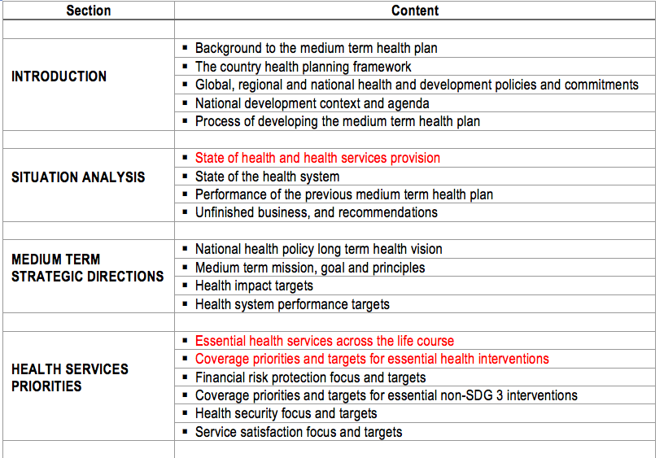
Medium Term Health Plan (2) 2017

Slide 11
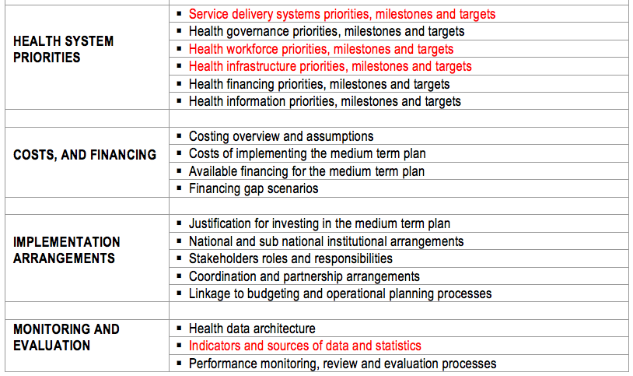
Medium Term Health Plan (2)

Slide 12
National Strategy Quality Assessment Components
Situation analysis, and coherence of strategies and plans with this analysis (known as 'programming')
Process through which national plans and strategies have been developed
Financing projections and strategies; financial management and auditing
Implementation and management arrangements
Results, monitoring, review and dialogue mechanisms

Slide 13
NHSP Facility Assessments (1)
Notes:
Explicit mention of emergency care and referral mechanism

Slide 14
NHSP Facility Assessments (2)
Notes:
Explicit mention of fully functioning operating theatres and infection prevention and control.

Slide 15
Lessons for NSOAPs
UHC and SDGs give unprecedented opportunities to advocate for SOA services
Professionals should be involved in strong advocacy for SOA services to be included as priorities in health development
Provide evidence on related conditions
Epidemiology
Economic and social consequences
Gains resulting from adequate attention given to these problems
Participate in national health planning process to ensure inclusion of SOA in key stages of the process
Situation analysis
Priority setting and strategic directions
M&E

Slide 16
Conclusion
Surgery, Obstetric and Anesthetic services constitute an indispensable contributor to attainment of UHC.
The professionals in these fields must be at the forefront of advocacy and planning initiatives to ensure they occupy their rightful place and receive the attendant investments required to provide invaluable services to those in need.

Slide 17
Questions?

