Slide 1

Global Surgery Implementation Showcase
Connection, Collaboration & Networking
www.theg4alliance.org
Notes:
Good morning, my name is Dr. Bob Lane and I am the president of the International Federation of Surgical Colleges. I am also a director of the Global Alliance for Surgical, Obstetric, Trauma and Anaesthesia – The G4 Alliance for short – a network of over 85 implementing organizations working around the world to improve surgical care.
I am pleased to be chairing this session on behalf of the G4 Alliance along with my colleague Dr. Lubna Samad, Director of the Indus Hospital Research Institute.

Slide 2

Session Outline
This session will showcase opportunities for networking and collaboration to support scaling up of surgical, obstetric, and anaesthesia care at the national level.
Interactive lighting round presentations from implementing organizations (NGOs and social enterprises) that will feature examples of successful collaborations supporting national surgical planning and implementation.
  Participants will learn about different strategies for supporting implementation of NSOAP with an emphasis on collaboration and networking.
  Open discussion and Q&A
  We welcome your input and engagement!
Notes:
This morning’s session will focus on connection, collaboration and networking.
We will be joined by representatives from 10 implementing organizations who will be showcasing examples of successful collaborations supporting national surgical planning and implementation.
Today’s session will begin with an overview of the G4 Alliance.
Following this, we will move into lighting presentations by organizations showcasing areas where they have partnered to support country efforts. Specific examples of skills, expertise, programs, tools and resources will be provided.
Finally, we will be hosting an open discussion with participants. Our goal will be to identify country needs and to foster partnerships and collaborations to support the NSOAP process.

Slide 3
The G4 Alliance
OUR MISSION
The G4 Alliance is committed to advocating for the neglected surgical patient and is driven by a mission of providing a collective voice for increased access to safe, essential and timely surgical, obstetric, trauma and anaesthesia care as part of universal health coverage.
OUR VISION
Universal access to quality surgical, obstetric, trauma and anaesthesia care.
OUR GLOBAL TARGET
Safe Surgical and Anaesthesia Care for 80% of the World by 2030.
Notes:
The G4 Alliance is committed to advocating for the neglected surgical patient and is driven by a mission of providing a collective voice for increased access to safe, essential and timely surgical, obstetric, trauma and anaesthesia care as part of universal health coverage.
OUR VISION is Universal access to quality surgical, obstetric, trauma and anaesthesia care.
And the global target endorsed by our 85 + member organizations is: Safe Surgical and Anaesthesia Care for 80% of the World by 2030.

Slide 4
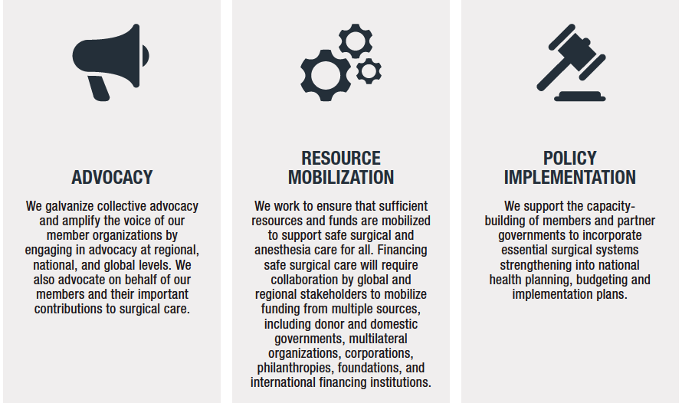
G4 Alliance Pillars
Notes:
The G4 Alliance is guided by 3 core pillars:
Advocacy: We galvanize collective advocacy and amplify the voice of our member organizations by engaging in advocacy at national, regional, and global levels.
Resource Mobilization: We work to ensure sufficient resources and funds will be mobilized to support safe surgical and anaesthesia care for all. Financial
Policy Engagement: We support capacity-building of members and of national governments to incorporate policies that support strong surgical systems and the integration of all aspects of surgical care as part of health systems

Slide 5
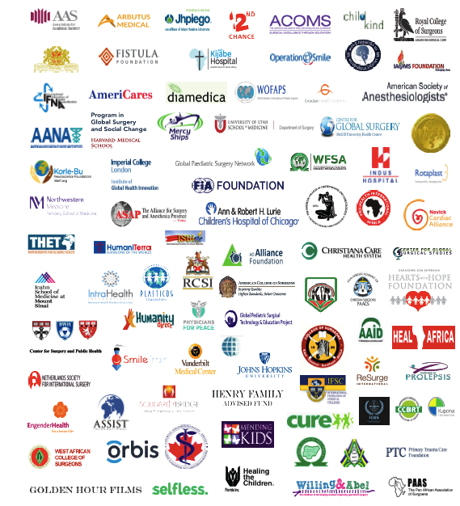
Our Member Network
Our Network
  85+ Member Organizations
  Representing 300+ organizations
  160 countries in 6 continents
Members Include:
  Academic Institutions
  Professional Societies
  Social Enterprises
  Non-profits/NGOs
  Public and Private Sector Organizations

Slide 6
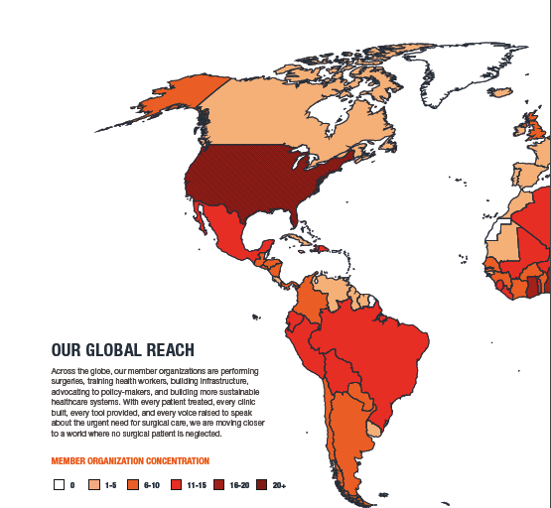
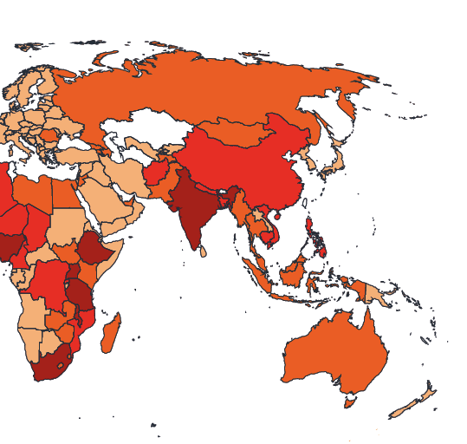
Our Global Reach

Slide 7
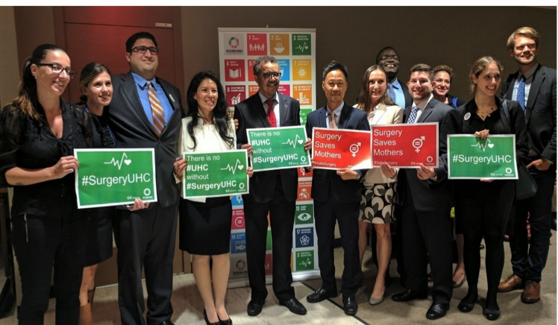
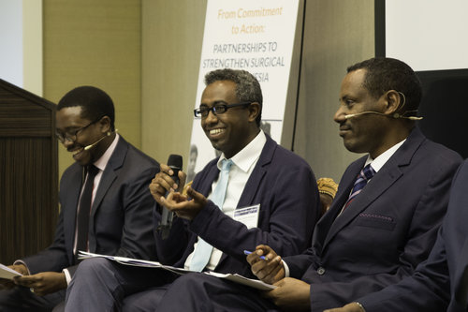
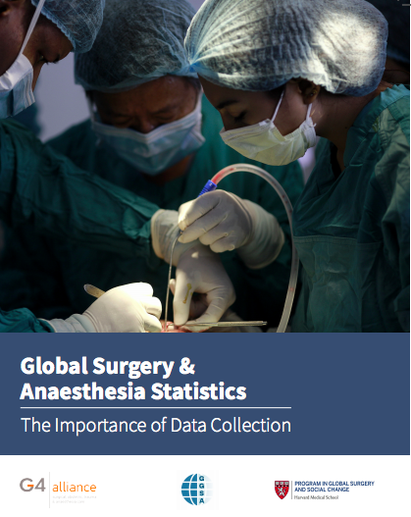
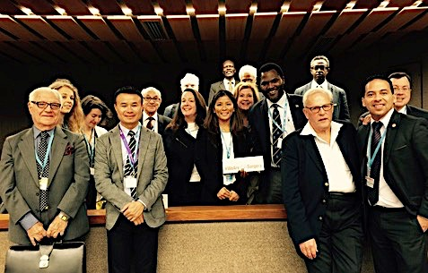
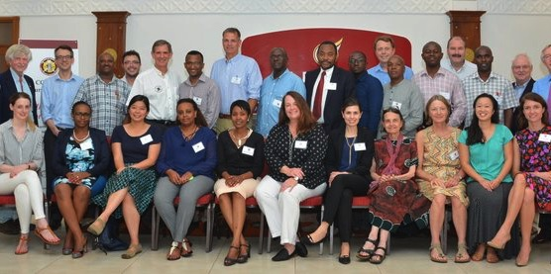
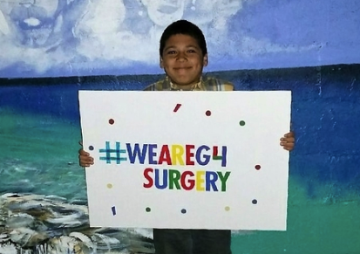
A Track Record of Global Advocacy & Engagement

Slide 8
The Implementers
Participating Organizations:
International Federation of Surgical Colleges (IFSC)
College of Surgeons of East, Central and Southern Africa (COSECSA)
World Federation of Societies of Anaesthesiologists (WFSA)
Indus Health Network
Smile Train
Assist International
Safe Surgery 2020
Arbutus
Diamedica
3rd Stone Design

Slide 9
Implementation Showcase
Notes:
Good morning, my name is Dr. Bob Lane and I am the president of the International Federation of Surgical Colleges. I am also a director of the Global Alliance for Surgical, Obstetric, Trauma and Anaesthesia – The G4 Alliance for short – a network of over 85 implementing organizations working around the world to improve surgical care.
I am pleased to be chairing this session on behalf of the G4 Alliance along with my colleague Dr. Lubna Samad, Director of the Indus Hospital Research Institute.

Slide 10

The International Federation of Surgical Colleges:
Supporting surgical training & education in sub-Saharan Africa
Robert Lane
President, IFSC
www.theifsc.org
rhslane@gmail.com

Slide 11
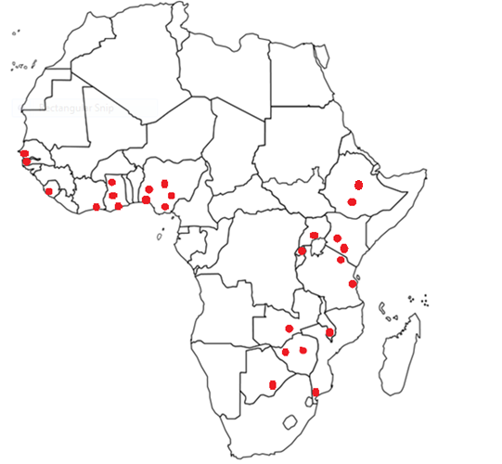
Surgical Training & Education
109 Courses/Workshops in 16 countries
in sub-Saharan Africa since 1999
  Basic Surgical Skills …………………………………………546
  Colorectal Skills………………………………………………..26
  Management of Surgical Emergencies…………………….126
  Anastomosis Workshops………………………………….. …72
  Train the Trainers (for appropriate Courses)………… 426
  Theatre Nurse Training Courses……………………………683
  TOTAL TRAINED……………………..1,879

Slide 12
Surgical Training & Education
The advantage of our Courses is that a large number of participants
can be trained at the same time and to the same standard despite
their previous level of training or experience.
Train the Trainer courses always undertaken to provide sustainability.
This training is recognised by both COSECSA and WACS.
A full report is submitted after each event.
Feedback from both trainers and trainees has been highly commendable.

Slide 13
Surgical Training & Education
  IFSC supports each country in having a dedicated Surgical Training Centre endorsed by the Ministry of Health.
  IFSC Courses / Workshops are freely available to countries, in order to build surgical capacity particularly at Level 1 facilities.
  IFSC can assist countries if there is not a clear understanding of existing data management capabilities and the ability to scale up processes for a NSOAP.

Slide 14


COSECSA
An innovative model of training Surgeons for Rural Hospitals
Prof Pankaj Jani
President, COSECSA
http://www.cosecsa.org
president@cosecsa.org | pjani53@gmail.com

Slide 15


Autonomous College
Registered in each country
Independent financial structures and auditing

Slide 16
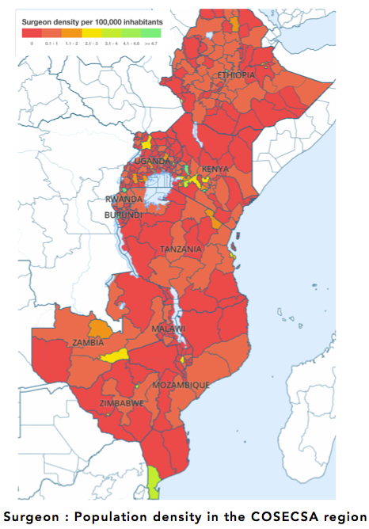


106 Accredited hospitals
(Training at 66 hospitals)
66% of COSECSA accredited training hospitals are based outside capital cities.

Slide 17

Standardized Curriculum across 19 Countries
MCS – 2 Yrs : Reg. by 28th Feb.;
6 Months Gen Surg with Emergencies
and 6 Months Ortho with trauma
3 Mandatory courses – BSSkills and Trauma +
BSSc – E- Prog. (Modular 3 hrs Per week – from April)

Slide 18
Standardized Curriculum
FCS – Gen. Surg
- Ortho
- Urol
- Paeds
- Plastic and Reconst.
- Neuro (4 Yrs)
- Orl
- C/Thoracic
- Paeds Ortho.

Slide 19
Current Trainees in Various Programs
COSECSA has 506 trainees for both MCS and FCS from all its member countries.
Trainees by Specialty
Programme | Total
FCS GS | 96
FCS NEURO | 16
FCS ORL | 2
FCS ORTHO | 70
FCS PAED | 17
FCS PAED ORTHO | 7
FCS PLAS | 10
FCS URO | 11
MCS | 278
Grand Total | 507

Slide 20
COSECSA ACHIEVEMENTS
Graduated 261 specialist surgeons
550 Current surgical trainees
290 Trainers of whom 28 are Master Trainers
1128 Members and Fellows
106 Accredited training hospitals
Regional suite of short courses
Comprehensive e-learning platform
Bespoke surgical electronic logbook
Advocacy for essential surgery in Africa
Establishment of Women in Surgery Africa

Slide 21
Thank you
president@cosecsa.org
pjani53@gmail.com

Slide 22

World Federation of Societies of Anaesthesiologists (WFSA)
Aaliya Ahmed
Programme Manager, WFSA
https://www.wfsahq.org/
programmes@wfsa.org
Notes:
Smile Train
Assist International
Safe Surgery 2020
Arbutus
Diamedica
3rd Stone Design

Slide 23


WFSA Vision & Mission
Our Vision - Universal access to safe anaesthesia.
Our Mission - To unite anaesthesiologists around the world to improve patient care and access to safe anaesthesia and perioperative medicine.
How we do that - The WFSA is the foremost global alliance of anaesthesiologists, specialist physicians dedicated to the total care of the patient before, during and after surgery. We deliver our mission through programmes that are implemented together with national, regional and specialty anaesthesiology societies. We also work with other organisations that share our objectives, including, but not limited to, the World Health Organisation, governments, non-governmental organisations, specialist medical organisations, academic institutions, patient groups, hospitals, and industry.
Safe anaesthesia and perioperative care are essential for safe surgery, and we welcome partnerships aimed at strengthening health systems and achieving universal health coverage.

Slide 24
The WFSA Today
Current WFSA members
Countries interested in becoming members
There are more than 140 societies in our Federation covering more than 150 countries

Slide 25
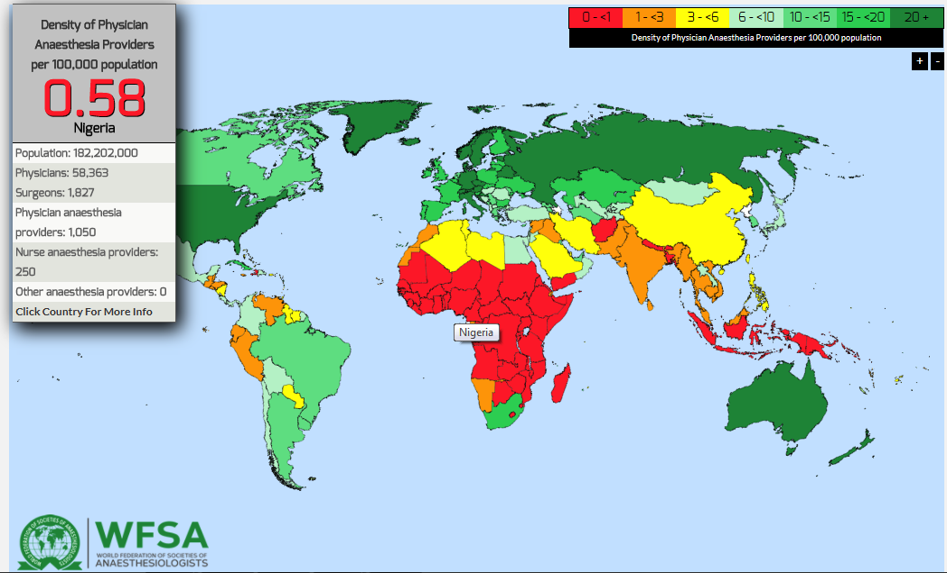
WFSA Workforce Map
Data gathered for 153/197 countries representing 97.5% of global population.
77 countries reported a PAP density of <5; particularly low densities in African & SE Asia regions.
NPAPs make up large part of global anesthesia workforce, especially in countries with limited resources. Even when NPAPs are included, 70 countries had a total anesthesia provider density of <5 per 100,000.
Using current population data, over 136,000 additional PAPs would be needed immediately to achieve a minimum density of 5 per 100,000 population in all countries.

Slide 26
WFSA & NSOAP’s
‘Anaesthesia universally identified by all cadres as the most acute problem preventing safe
surgical care’(Tanzania NSOAP 2017).
‘1.1.1 Establish and strengthen the provision of quality essential and emergency surgical, anaesthesia, obstetric and critical care services at national, zonal, regional, district and health center levels’ (Tanzania NSOAP 2017).
The WFSA’s flagship fellowship programme supports PAP’s from LMIC’s to gain specialist anaesthesia training.
Our scholarships programme supports PAP’s from LMIC’s to build professional networks and make links with regional, global AP’s, industry and academics.
Providing textbooks and online resources such as ATOTW, our virtual library and recently coordinating bursaries for an online ‘Essential Anaesthesia’ course.
WFSA has expanded and enhanced the SAFE package of courses including global monitoring and improved evaluation and impact assessment.

Slide 27
WFSA & Collaborations & Partnerships
‘3.1.1 Level 1 Facility 1. Establish and strengthen the provision of quality essential and emergency surgical services a. Implement Lifebox, use of the WHO Checklist, SafeObs, and SafePeds training programs’ (Zambia NSOAP 2017).
SAFE Obstetric Anaesthesia has now trained 1,969 anaesthesia providers in 26 countries.
Bangladesh, Benin, Burkina Faso, Colombia, Congo, Ethiopia, Fiji, Ghana, India, Ivory coast, Honduras, Kenya, Liberia, Madagascar, Malawi, Mozambique, Nepal, PNG, Rwanda, Samoa, Sierra Leone, Swaziland, Tanzania, Uganda, Zambia, Zimbabwe
SAFE Paediatric Anaesthesia has now trained 888 anaesthesia providers in 9 countries.
Bangladesh, Benin, Cameroon, Ethiopia, India, Madagascar, Uganda, Zambia, Malawi, Kenya, Guatemala

Slide 28
WFSA Collaborations & Partnerships
As the global federation of national anaesthesia societies, the WFSA has a wide reaching access to individual providers, societies and local & regional partners. All of the WFSA’s work is to support national surgical and anaesthetic strengthening, some current projects include…
Ethiopia – Funded by Assist International to work with the ESA to roll out SAFE Obstetric Anaesthesia courses in 2 regions in Ethiopia, provide ‘Essential Anaesthesia’ kits and recruit ‘SAFE Fellows’ in country to provide ongoing physician led support. MoH have now funded 3 additional SAFE courses in Oromia with plans for other regions.
Telangana, India – Working with the ISA to gather data on anaesthesia capacity at state level using AFAT, and implementing training and providing fellowships and scholarships in response. Developing a template for this project to be replicated.
Tanzania – Working with SATA and key training institutions such as KCMC/BMC to roll out SAFE Obstetric anaesthesia courses and recruit SAFE fellows to mentor trainees. Working with behavioural scientists on a multi-country study in Nepal, Bangladesh, Zimbabwe & Tanzania to assess clinical behaviour change as a result of attendance on a SAFE course.
Kenya - In 2016/17 WFSA worked with the KSA to roll out SAFE Obstetric Anaesthesia courses in each region (Central, NE, NW, Coast & Nairobi x 2) over half of all PAP’s were trained and the final course was held for the graduating class of CO’s at the KMTC.
WFSA continues to expand our extensive fellowship programme, providing specialty training for PAP’s from LMIC’s with new fellowships this year in Mexico, Nigeria & Morocco.

Slide 29

Indus Hospital
Indus Health Network
Dr. Lubna Samad
Program Director Global Surgery
http://www.indushospital.org.pk/
lubna.samad@irdresearch.org
Notes:
Smile Train
Assist International
Safe Surgery 2020
Arbutus
Diamedica
3rd Stone Design

Slide 30
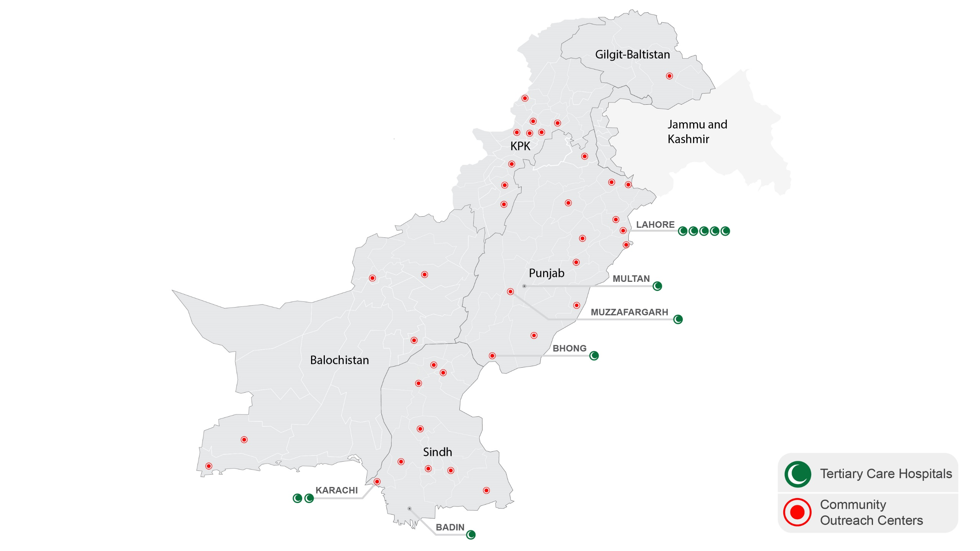
Indus Health Network
Free of cost care
EMRS
USD 170 Million annual operating budget

Slide 31
Public and Private Partnerships
USD 170 Million annual operating budget
92% of funds raised in Pakistan

Slide 32






Center for Essential Surgery & Acute Care
Advocacy
Capacity Building
Program Implementation
Research
Pehla Qadam
Clubfoot program
Surveillance of Surgical
Site Infections
Safe Circumcision
Program
Certification Program in Emergency Medicine
Lancet Indicators - National Data Collection
Vascular Anomalies Center

Slide 33

Smile Train
Mohamed Fakhreldin
Chief Programs Officer, Smile Train
https://www.smiletrain.org/
mfakhreldin@smiletrain.org
Notes:
Assist International
Safe Surgery 2020
Arbutus
Diamedica
3rd Stone Design

Slide 34

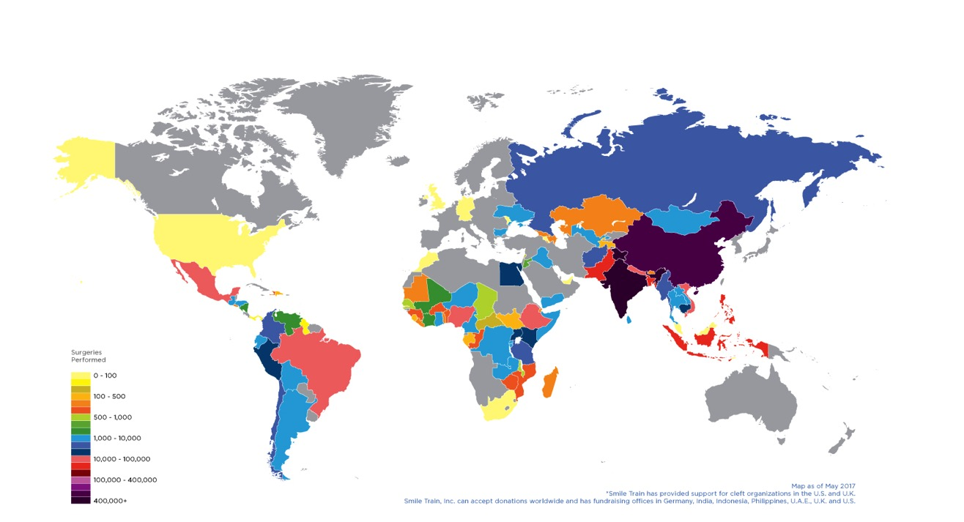
Our Global Footprint
Text
Notes:
Our model of local capacity building has been based on a hospital partnership model, whereby for nearly 20 years we have invested in local health systems and hospital partnerships to build the capacity of local providers across the developing world to offer safe, high-quality, sustainable, year-round patient care.
Through this sustainable model we have been able to support more than 1.4 million surgeries for children suffering from cleft around the world. This map where the surgeries have been taking place.

Slide 35
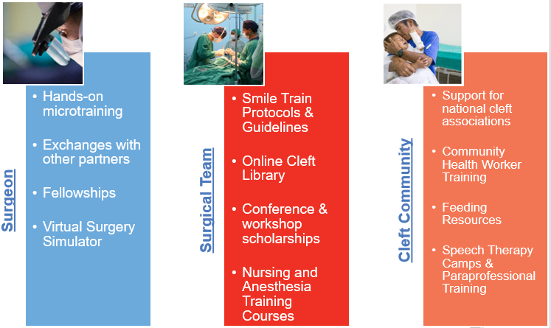
Smile Train Training
Text
Notes:
The barriers to care vary greatly from health system to health system, and our focus is to work with our local partners to understand and remove their barriers to offering safe, high-quality cleft lip and palate surgery. Similarly, we recognize that even when safe care is available, the cost to poor patients is often catastrophic and therefore unobtainable.
We offer a variety of grants to support our partners and facilitate their ability to provide safe, high-quality care at no cost to poor patients. This includes funding a portion of the costs of surgery (which is used to cover essential surgical equipment and supplies, staff time, facility costs, etc); offering education and training opportunities to surgeons, anesthesia providers, nurses and other essential staff (as seen in this infographic); small grants to fund patient awareness and mobilization; small scale equipment grants to fund essential equipment for safe surgical delivery (such as anesthesia machines, instrument sets and patient monitoring equipment).

Slide 36
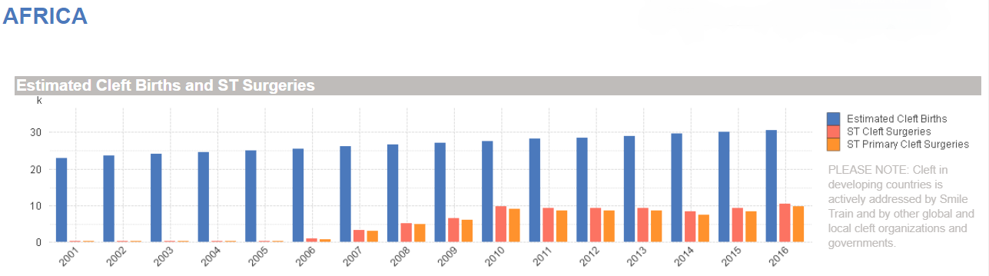
Smile Train in Africa
Notes:
One of the places where Smile Train’s programs are growing the fastest is the Africa continent, however there is still significant work to be done based on the estimated cleft births and number of treatments being performed.
Smile Train is founded on the strength of partnership. We are proud to have more than 1,100 partner hospitals around the world and many other partners that make our work possible.
Smile Train was one of the founding partners of the Lifebox Foundation, investing in their initial efforts to deploy pulse oximeters and surgical safety checklists across our partner network. We are currently partnering with COSECSA to support short courses in cleft lip and palate surgery and fellowships in plastic surgery in Africa. We are working with WFSA to offer Safe Pediatric Anesthesia courses for practitioners in Ethiopia, Rwanda, DR Congo, Burundi, Kenya, Uganda and Madagascar, and fellowships in Pediatric Anesthesia at the University of Nairobi. We offer similar capacity building initiatives in other regions around the world. We have trained more than 1,000 nurses from more than 24 countries in essential post-operative management and safe surgical care, using a Smile Train program developed by our partners in Uganda. And we have leveraged the more than 1 million unique surgical records in our online database to facilitate research and inform knowledge on access to safe surgical and anesthesia care with a number of groups, including the Program in Global Surgery and Social Change at Harvard Medical School.
I would be eager to speak with those of you who might be interested in partnering with Smile Train for cleft children.

Slide 37
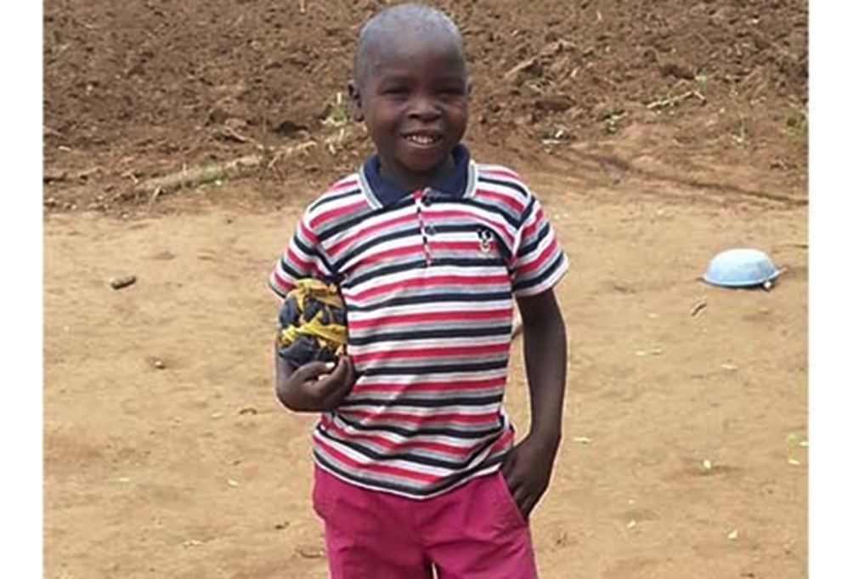
Thank You
Text
Notes:
This is a photo of our on millionth patient, Osawa Owiti, who was treated at one of our partner hospitals in Uganda but one of our strong African partner teams.
Thank you.

Slide 38

Assist International
Cheri Reynolds
Director of Program Development, Assist International
https://www.assistinternational.org
creynolds@assistinternational.org

Slide 39

Assist International
Assist International is a humanitarian organization that focuses on global health, as well as orphaned and vulnerable children.
Since our founding in 1990 our Global Health focus includes:
65 countries
500 health-related projects
Innovations to impact and strengthen health systems
Under the Safe Surgery 2020 initiative, we work closely with ministries of health, academics, and other NGOs to provide access to safe, affordable surgery, with a special focus on preventing maternal and child deaths.

Slide 40









Safe Surgery 2020 Innovations Partnership
Leadership
Training safe surgery champions to drive improvements at a facility level
Measurement & Feedback
Capture data to evaluate & improve
People
Build the capacity of surgeons, nurses, & staff
Processes
Implementation of checklists, monitoring, & quality management
Equipment
Availability of fundamental equipment & supplies
Infrastructure
Stable & reliable Infrastructure

Slide 41
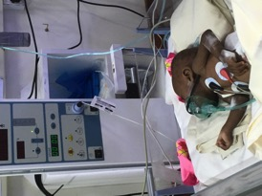
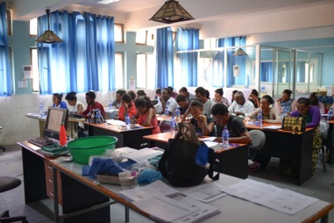
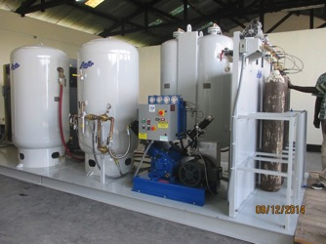
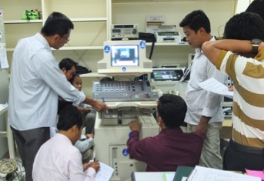
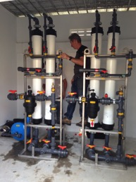
Innovations that Impact Surgery
WFSA SAFE OB Anesthesia
ImPACT Anesthesia Pre-Service Training
SPECT Sterilization of Medical Equipment Training
Oxygen Public Private Partnership
HTM/BMET Hands-on Training
Safe Water in Healthcare Facilities

Slide 42

Health System Strengthening Results
How We Measure Success
Health System Strengthening Results with GE Foundation since 2016
Work Force Development
1720 trained
Population Catchment Served
40M
Countries Served
13
Healthcare Facilities
235
Number of people impacted
Significance of the impact
Program sustainability
Program scalability
Number of countries served
Reputational excellence

Slide 43

Safe Surgery 2020
Erin Barringer
Interim Director, Safe Surgery 2020
http://www.safesurgery2020.org/
erin.barringer@dalberg.com

Slide 44

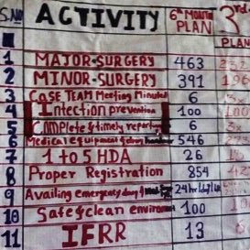
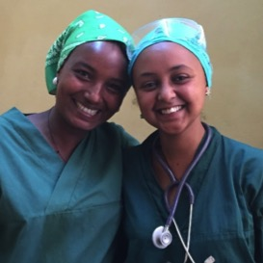
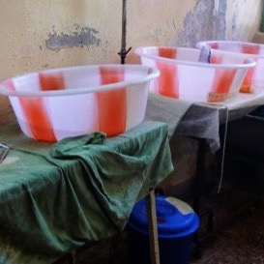
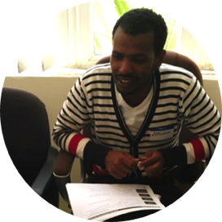
Safe Surgery 2020 envisions a world where everyone, everywhere has access to safe surgical care
We bring together innovations, global expertise & local experience in 4 key areas:
1. We act as advocates and advisors as countries to conduct national surgical planning.
2. We develop and support cohorts of local surgical leaders who will transform surgery.
3. We test and scale innovations in workforce development.
4. We measure and share what works – and what doesn’t – to engage the global surgery community.
4

Slide 45


















We are a multi-partner initiative and partner closely with country governments to bring about change
Made possible by…
Country partners…
Lead partners…
Implementing partners…
4

Slide 46
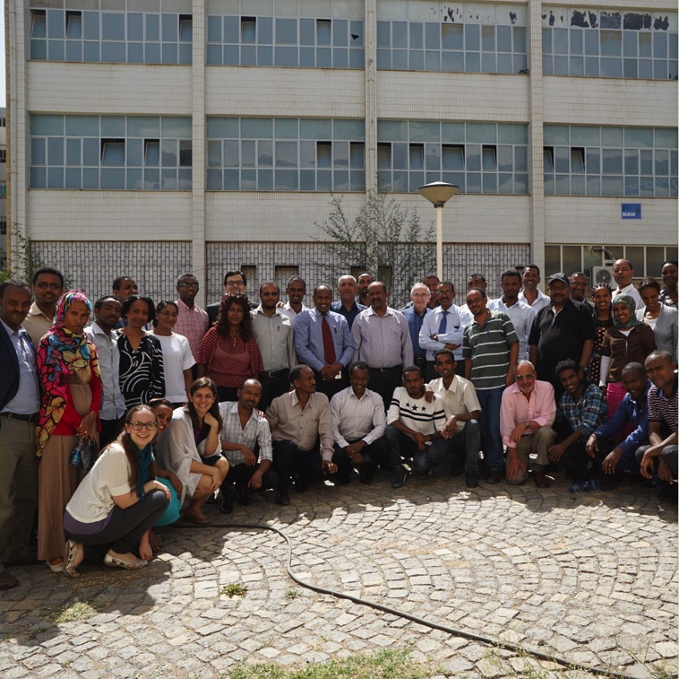
Our work to date in Ethiopia
National Surgical Planning to develop the Saving Lives Through Surgery (SaLTS) strategy
Workforce Development Innovations, including anesthesia and BMET training
Innovative Infrastructure Development, such as the development of a self-sustaining private-public partnership medical oxygen plant
Leadership Transformation Program to spark transformation through team-based leadership training and ongoing mentorship
Monitoring and Evaluation to support the FMOH to develop and use KPIs

Slide 47




Our impact to date in Ethiopia: 2 years. 10 hospitals. 650+ leaders trained.
In the operating room…
In the hospital…
Results from specific hospitals
In the community…
In the country…
527 Hospital staff trained on sterilization and infection prevention
130 Surgical leaders and mentors developed
10 new machines provided
50%+ Increased volume of surgical services
1/3 Reduction of surgical mortality in six months
78% Reduction in referrals
2 New oxygen plans created via a public-private partnership for a medical oxygen plant
Saving Lives Through Surgery
Collaborated with the Federal Ministry of Health to help develop national plan
1,000 more leaders will complete the leadership program via FMOH scale-up

Slide 48
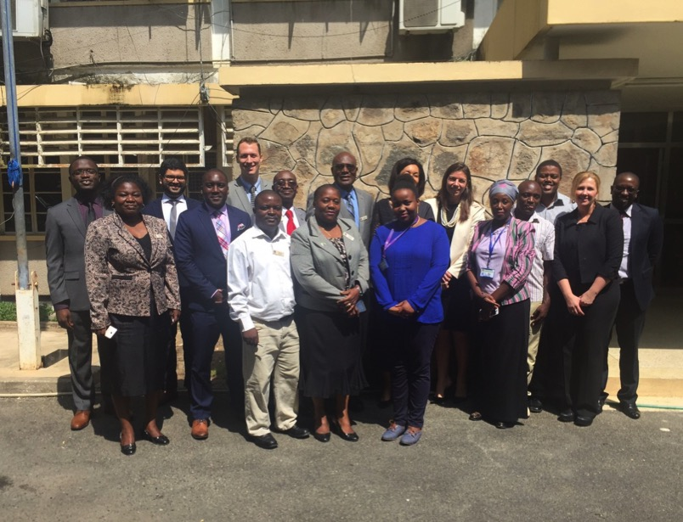
Our work to date in Tanzania
National Surgical Obstetrics and Anesthesia Plan (NSOAP) support for Ministry of Health and PORALG
Plans to roll out workforce development innovations and leadership transformation program at facilities in Mara and Kagera regions to address critical challenges in order to enhance access and quality of surgical and anesthesia care

Slide 49

Arbutus
Elise Huisman
Co-Founder and Director, Clinical, Arbutus
https://www.arbutusmedical.ca
Elise.huisman@arbutusmedical.ca

Slide 50

Arbutus Medical
Vision
Safe Surgery for everyone, everywhere
Mission
Developing safe, affordable, and reliable surgical equipment for use in low-resource settings.
Notes:
There is nearly one cellphone for every single human on this planet. That is close to 7.4 billion cellphones. Yet, there are still 5 billion people without access to safe surgery. By providing surgeons with the tools they need, we can help provide the best possible care for patients who need it most. Join us in providing safe surgery for all.

Slide 51



Area of Focus - Orthopaedics
Measuring and improving access to orthopaedic implants and surgical tools
Notes:
Baseline allows all parties to track progress of initiatives
Data to drive continued awareness & advocacy campaigns
Data to set priorities for equipment procurement, education/course/workshops, etc.
Network development for each stakeholder’s program growth
Promote the importance of local research: continue execution of survey & train more researchers

Slide 52
Project Outline
Phase I: Survey-based data collection
Baseline survey and data collection
Scope: COSECSA, AOAF network of surgeons
Phase II: Drill Cover training & implementation
Focus: a couple of specific hospitals
Intervention sites prioritized using survey baseline
Phase III: Comprehensive long-term monitoring
Follow-up training provided where needed
Outcomes measurement at select sites (if feasible)

Slide 53
Importance & Opportunities
Importance
Data to drive continued awareness & advocacy campaigns
Data to set priorities for equipment procurement / education / courses / workshops
Opportunities
Country representatives
Uniform methods
Expanding to other surgical specialties

Slide 54

Diamedica
Rachel Currie-Cathey
Head of Sales and Marketing, Diamedica
http://www.diamedica.co.uk/english/
r.currie-cathey@diamedica.co.uk
Notes:
Indus Hospital Research Center
Smile Train
Assist International
Safe Surgery 2020
Arbutus
Diamedica
3rd Stone Design

Slide 55

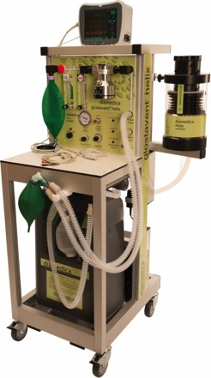
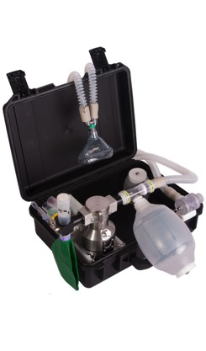
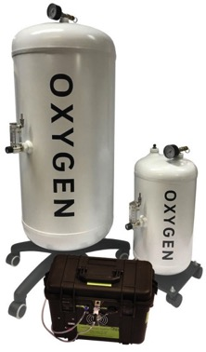
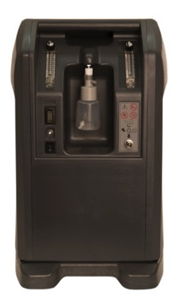
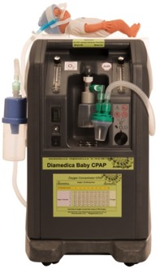
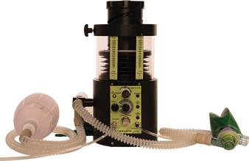
Safe Anaesthesia and respiratory
solutions for limited resource settings
Anaesthesia
Glostavent Range
Oxygen Supply and Storage
Reservoir System
Concentrators
Intensive Care and Pain Management
Baby CPAP
Ventilators
www.diamedica.co.uk

Slide 56

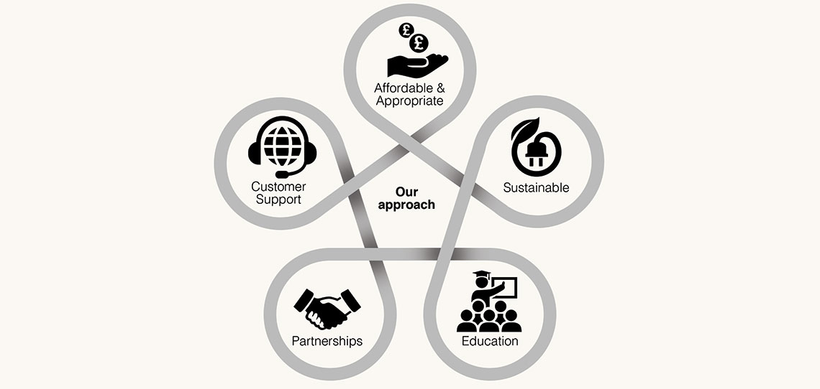

Slide 57






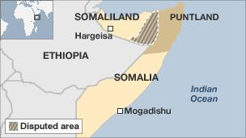
Partnerships for Progress - Somaliland
Safe Anaesthesia for Somaliland
SANSOM
Training
3-day CME course
34 anaesthesia technicians
First CME programme for anaesthesia in the country
Focus on obstetric and paediatric surgical patient
Data Collection
Tablets: Data collection, patient record keeping and anaesthesia library
Equipment Kits
Training on equipment use and maintenance

Slide 58
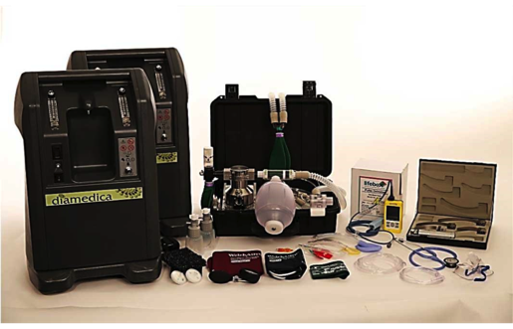
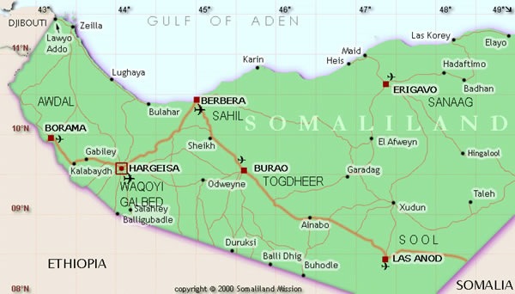
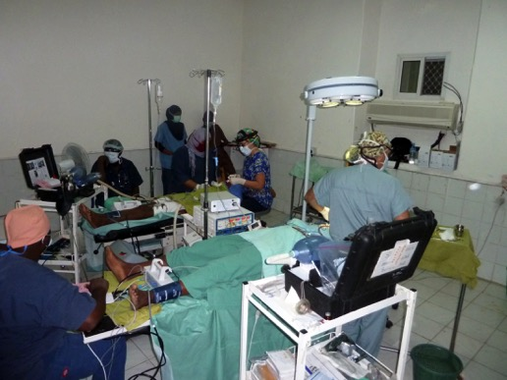
Partnerships for Progress - Somaliland
SANSOM Anaesthesia Equipment Kits
Delivered and installed in 10 locations

Slide 59


Partnerships for Progress - Uganda
Reducing Neonatal Mortality - Uganda
Globally, neonatal mortality remains the major barrier to reducing under five mortality
Nearly all neonatal deaths occur in low-income countries
39% of them occur in sub-Saharan Africa
It is estimated two-thirds of these deaths could be prevented
Diamedica Baby CPAP awards:
AAGBI Innovation Award
Africa Healthcare 2018 Medical Technology Breakthrough of the Year
Africa Healthcare 2018 Outstanding Contribution to Medical Technology
Diamedica Baby CPAP used in 35 countries
WHO: 8 Country programme
www.diamedica.co.uk

Slide 60
Partnerships for Progress - Uganda
Staged implementation of a two-tiered hospital based neonatal
care package in a resource-limited setting in Eastern Uganda
BMJ Global Health Feb 2018
Location:
Mbale Regional Referral Hospital
Serves 4.5m people in Eastern Uganda
Has nearly 10,000 deliveries/year
Strategy:
Used WHO Recommended Quality of Care Framework to build strategy for quality improvement
12 interventions were designed to improve infrastructure, equipment, protocols and training
Implemented low cost hospital based neonatal care package over 18 months
Results:
Neonatal mortality decreased from 48% to 21%
Further reduction to 11%
Recommendations: A dramatic impact on mortality can be made through modest and cost effective interventions
www.diamedica.co.uk

Slide 61
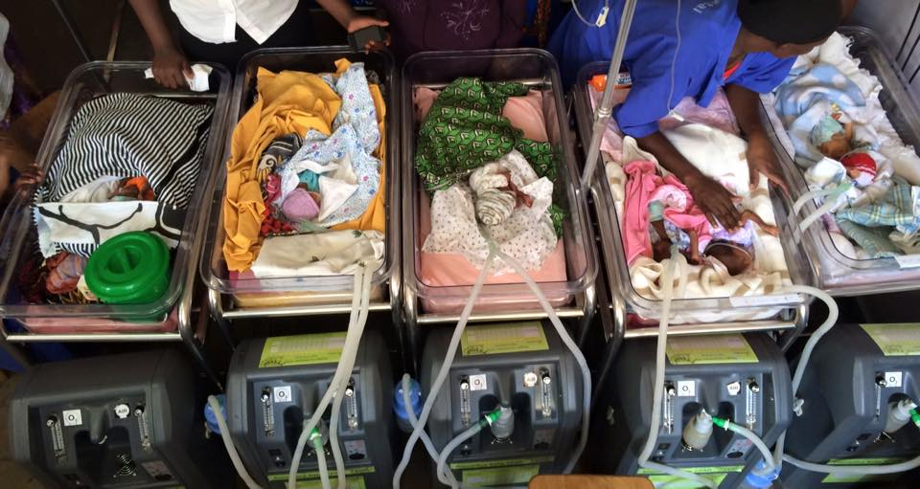
Partnerships for Progress - Uganda
Mbale: Investment in Appropriate Technology for Neonatal Care
Lifebox: Oxygen saturation monitoring
Diamedica:
  3 Oxygen concentrators installed with flow splitters (0-2.5l/min) to deliver to individual infants using nasal cannulae
  3 CPAP machines, used not only for their robust and low cost nature but also for their ability to blend oxygen and air. Vital for minimising retinopathy
Brilliance: phototherapy by LED
www.diamedica.co.uk

Slide 62


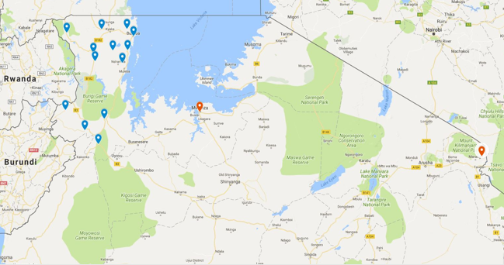


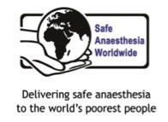
11,000 women die in Tanzania each year due to complications in pregnancy and childbirth
66,000 babies do not survive the first month of their life
Partnerships for Progress - Tanzania
Tanzania Safe Obstetric Anaesthesia Kagera Refresher Course
Remote, poor and largely rural area
1,600 kilometers from Dar es Salaam
Population of around 2.6 million

Slide 63

Partnerships for Progress - Tanzania
Safe Obstetric Anaesthesia Kagera Refresher Course
Conclusions
Need for continuous local refresher courses to cover safe obstetric anaesthesia and other subject areas
Expansion - not all hospitals/clinics attended
Lack of access to anaesthetic equipment, drugs and nurses
Disseminate to other regions
Need local champion
Need anaesthesia related morbidity statistics for evaluation
Programme
Pre-evaluation survey
3 day training course
16 participants
Faculty: local and international
Follow up visits
Successes
Increased knowledge
On-site hospital visits
Helped form networks among nurse anaesthetists from Kagera region, felt less isolated

Slide 64
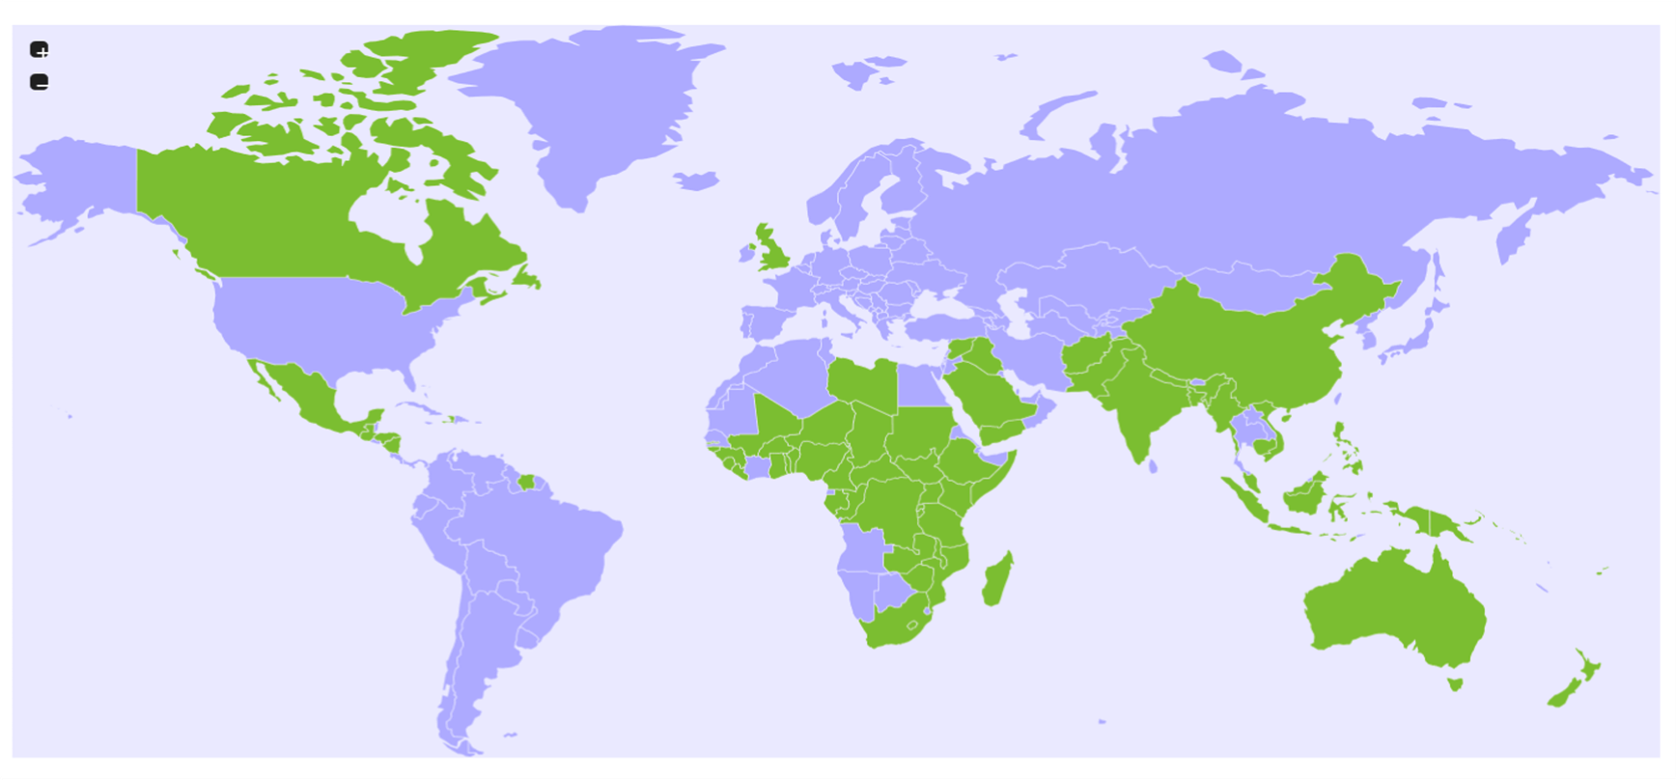
Equipment operating in 70 countries, across five continents
Partnerships for Progress
Partnerships for Progress
Somaliland - Safe Anaesthesia for Somaliland
Uganda - Staged implementation of a two-tiered hospital based neonatal care package in a resource-limited setting in Eastern Uganda
More than 1,000 anaesthesia machines sold, used in over 4 million surgical interventions
www.diamedica.co.uk

Slide 65

3rd Stone Design
Robert Miros
CEO, 3rd Stone Design
http://www.3rdstonedesign.com
robert@3rdstonedesign.com

Slide 66

3rd Stone Design
3rd Stone Design is a product design, development and deployment company. We specialize in global health applications. Our capabilities run from concept design and front end product development, to detailed engineering and transfer to manufacture, to ultimate production, distribution and sale. We have products in use in 38 countries - 20 in Africa.
We collaborate with Global Health partners through design of new products, commercial development or refinement of existing products, and design of business structures to facilitate broad dissemination of technical solutions.

Slide 67


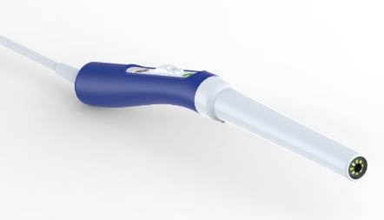
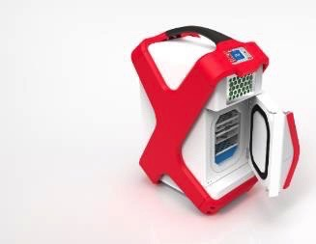


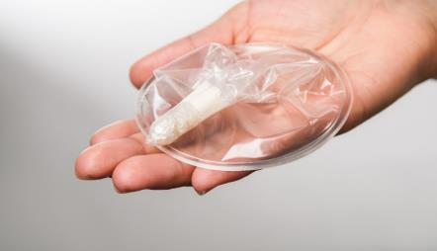
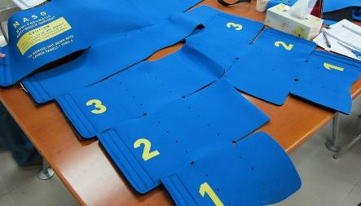
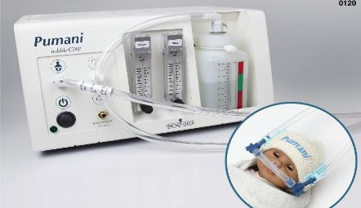
DoseRight
Syringe Clip
Athoria
Colposcope
Vaccine Refrigerator
NASG
Woman’s Condom
bCPAP
Examples of Global Health Devices developed by 3rd Stone Design.
All products are intended for production at large scale and most have already achieved global impact.

Slide 68


Portable Colposcopy – A Current Focus
Pocket Colposcope
Success
Radically redesigned colposcope enables improved care pathways and methods of examination.
Dramatically reduced cost of device opens up markets closed to this technology previously.
8 clinical sites globally, gathered over 500 patients’ exam data in less than a year with first generation product.
Challenges
To achieve maximum impact will require changes in care paradigms and staffing requirements.
Multiple implementation partners needed for fast results.

Slide 69
Questions for G4 Alliance
How can we help?
Connection, Collaboration & Networking
www.theg4alliance.org
Notes:
We welcome questions and feedback from the audience.
Over the past day we have invited you to submit any questions or comments to help guide this session and our discussion.
Our implementers will also be available to meet with you one-on-one throughout the course of the day. We also invite you to contact them directly following this workshop to further explore opportunities for collaboration and engagement. You can find their contact information in the packets we have distributed. Or you can also contact the G4 Alliance team online.
-Review of questions from audience and questions/comments submitted via post-its (?)

