Slide 1
NATIONAL SURGICAL PLAN IN FRAGILE STATES
BY
DR. ISAAC OLUFEMI SMALLE
COORDINATOR OF THE NATIONAL SURGICAL FORUM
MINISTRY OF HEALTH AND SANITATION
SIERRA LEONE

Slide 2
Outline
Introduction
What makes Sierra Leone a Fragile state
Key Health and socio-economic indicators in Sierra Leone
Current state of Surgery in Sierra Leone
Developing a National Surgical, Obstetrics and Anesthesia Plan in Sierra Leone
  Key stakeholders
  Ministry engagement
  Background analysis
  Financing strategies
Challenges

Slide 3
Introduction
States with a weak capacity to carry out basic state functions such as service delivery
Approximately two billion people live in fragile and conflict-affected situations (FCAS)
Number is forecasted to increase
Over 80% of the ‘extreme poor’ live in FCAS

Slide 4
What makes Sierra Leone a Fragile State
Ten years of brutal civil war ended 18 years ago
Political and ethnic division among its people
Corruption is endemic
Ebola outbreak in 2014 more than 3000 lives lost
Environmental instability……Landslide in 2017 killed over 1000 people
Other endemic diseases present with occasional outbreaks
Weak workforce and infrastructure in most institutions

Slide 5
Some Health and Socio-economic indicators in S/Leone
Population: 7,000,000 people (approx.)
MMR: 1360/ 100,000 live births
Poverty head count ratio: 51.7%
Doctors density/1000 persons: 0.024
Life expectancy: 50.1 years
Government expenditure on health: 11.09% of GDP
61.6% of health services are paid for out of pocket

Slide 6
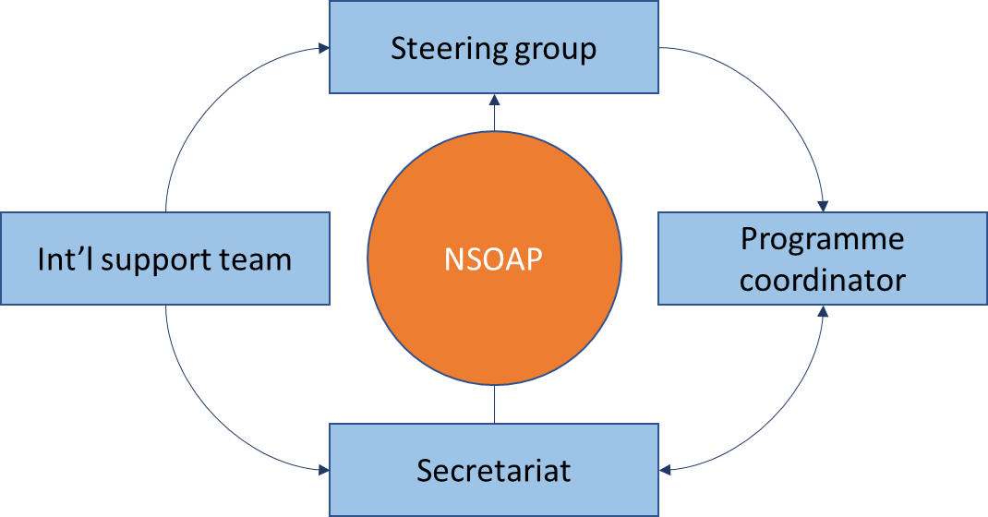
Developing a NSOAP- Key stakeholders

Slide 7
Developing NSOAP – Engaging Ministry of Health
Engage Ministry of health at every stage of development of the plan
The National Surgical forum is a component of the Directorate of Hospitals
Involve all other Directorates e.g PHC,RCH, DPC, DPPI, NCD during the development of the plan
Integrate other relevant strategic documents eg. HRH strategy into the plan
A specific person in charge to link up with the ministry is important
Ensure the plan is signed by the Minister of Health and the Director General of medical services before implementation

Slide 8
Some background analysis in the Sierra Leone NSOAP
25% of all households has at least a surgical condition requiring consultation
25% of deaths may have been averted by surgery
20% of patients admitted to hospital require surgical interventions
400 operations are performed per 100,000 population each year
93% of surgical needs are unmet
83% of caesarean sections are unmet
About 300,000 Sierra Leoneans face significant shame, or disability to work due to surgical diseases
Between 2015 to 2030 a cumulative $4.76 billion in lost gdp is expected
Nearly $ 2 billion will be lost from trauma related conditions in the same period

Slide 9
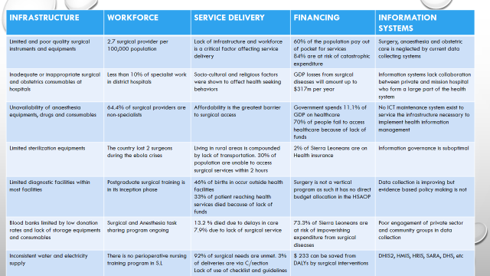
Some background analysis in the Sierra Leone NSOAP

Slide 10
Current opportunities
WORKFORCE | INFRASTRUCTURE | SERVICE DELIVERY | FINANCING | INFORMATION MANAGEMENT
Undergraduate training for doctors, nurses, pharmacist and other allied professionals available in country | All districts in sierra Leone has at least one hospital. There is a regional hospital in each region | National ambulance service | Free health care initiative | Current information management systems in Sierra Leone eg. DHIS, HMIS, IDSR, HRIS, etc
Postgraduate training through the acquisition of accreditation from the WAPMC has commenced The Sierra Leone College of Health Specialties is in its inception phase | Ongoing infrastructural improvement in components of the USLTHC to make them fit for specialist training | Free Health care initiative | Sierra Leone Health insurance scheme | Ongoing routine data collection by DHIS
Training of surgical assistance CHO and Nurse Anaesthetists ongoing through the task shifting program | Construction of 100 beds hospital in five areas in the city. | Introduction of WHO surgical safety checklist at Connaught Hospital. To be rolled out to other facilities |  | Hospital based registries. eg. Cancer registry, trauma registry, etc
HRH strategy recommend rural allowances schemes for those willing to work I rural areas | Construction of oxygen plants at Connaught and koidu hospitals | Infection prevention and control (IPC) strategy |  | Non routine data collection systems, eg. DHS, SARA
Establishment of the health service commission to facilitate employment and determine staff remuneration | A number of faith based hospital strategically located around the country providing surgical services A NGO hospital providing free trauma care in the city | Psychosocial units available in the USLTHC hospitals

Slide 11
Proposed outcomes
There is a qualified, motivated and contextually appropriate surgical, obstetric,
anaesthetic and nursing workforce is in place in all district, regional, and tertiary hospitals
Surgery, obstetric and anaesthesia services are delivered safely and effectively
There is adequate infrastructure to deliver safe surgery, obstetrics and anaesthesia
Surgical data is collected and used
Surgical, obstetric and anaesthesia services are affordable and sustainably financed
Communities are aware and informed about how to avoid surgical disease and when to
seek care
The National Surgical, Obstetric and Anaesthesia Plan is effectively implemented to
achieve the intended results

Slide 12
Financing the plan
Government supporting the surgical plan through its several finance
packages to different components of the health care
-Increase Government support to Mission Hospitals providing surgical services
-Indirect funding form local and international non-governmental organizations supporting
components of the NSOAP
-Direct NGO support to the plan
-Interventional research programs directed at components of the NSOAP
-Support from good will individuals in country

Slide 13
Challenges at governmental level
Funding
Composition of the working group
Meeting timelines
So many activities to prioritize
Competing interest with other public health programs
New concept

Slide 14
Conclusion
Fragile states continue to increase worldwide
There is a huge population at risk
Developing NSOAPs in such states is challenging
The Lancet commission framework is very useful in these setting
Funding and implementation is an issue
Sierra Leone is still in process of developing its plan

Slide 15
Thank you

