Slide 1
Macroeconomics of Global Surgery:
The Cost of Doing Nothing
Blake Alkire, MD, MPH
Program in Global Surgery and Social Change, Harvard Medical School
Attending Otolaryngologist, Massachusetts Eye and Ear

Slide 2
Notes:
Before I discuss the commissions work, I’d like to start by briefly touching on the relationship between a population’s health and economic growth. Economists have studied this particular relationship for decades and subsequently produced confusing diagragms.
In lieue of dissecting these flow charts, I would like to go over just a couple of ways in which poor health can negatively affect an economy.

Slide 3






Economic Welfare
Health Expenses
Consume
Save
Utility
Disease
Leisure Time
Good Health
Notes:
The economic burden of disease can mean very different things depending upon the economic perspective of a study.
One possible perspectivec is based upon so-called welfare economics, which is interested in an individual or group of indivualds standard of living or general prosperity.
According to this perspective, our econnomic welfare depends upon our ability to consume goods and services, do what we want to do in our spare time, and health status. These all contribute to increasing our levels of utility.
Disease or injury decreases our ability to consume, have fun, and our health status directly, and through other indirect pathways such as out of pocket health expenditures.
it refers to that part of social welfare that can be fulfilled through economic activity.

Slide 4






Economic Output
Health Expenditure
Consume
Disease
Investment
Poor Health
Labor productivity
Notes:
Another completely different economic perspective is the relationship between population health and the economic output of a country..
At the macro level, the ability of households to consume goods, the resources that corporations and governments to invest in human and physical capital, and the productivity of the labor supply all show a strong correlation to GDP.
Disease oand injury can impact macroeconomic performance or by increasing how much governments have to spend on health at the expense of investments in infrastructure or education. Additionally, poor health and premature mortality also negativel affects the supply and productivity of the labor force

Slide 5

MACROECONOMIC BURDEN OF SURGICAL DISEASE IN LOW/MIDDLE-INCOME COUNTRIES
Value of Lost Output
Value of Lost Welfare
Notes:
With those two perspectives in mind, for the LCoGS, we wanted to estimate…
These studies are important as finance ministers and donors are often persuaded by these types of daya in conjunction with other data, when deciding how to allocate resources.

Slide 6
Macroeconomic Approaches
Value Lost Output
Value Lost Welfare
Market economy losses due to decreased labor supply
Measured in terms of foregone potential gross domestic product (GDP)
Includes non-market losses: how we value health
Relies on a concept known as value of a statistical life (VSL)
Notes:
The first approach is termed the value of lost output, and measures the effect of disease on the market economy. Specifically, it projects foregone gross domestic product.
The second approach is termed the value of lost welfare, and it is an assessment of non-market welfare losses, such as the value we place on good health in and of itself. This relies on a concept termed the value of statistical life, which will discuss in more depth.

Slide 7



Value of Lost Output
Capital Stock
Labor supply
Technological Progress
Notes:
At the core of the VLO model is an equation known as the cobb douglas function, which relates a countries GDP to its capital stock, labor supply and technological progress, which is production unaccounted for by capital or labor. The capital stock is the current value of fixed physical assets such as a manufacturing plant,
GDP = Value of all goods and services produced in a country
Physical Stock = Constant dollar value of a countries fixed assets, which are physical assets such as buildings that is not used up in the production of a product
Labor = Private Sector Employment
Productivity = Production unaccounted for by capital or labor (technology)

Slide 8


EPIC MODEL
Notes:
For this approach, we partnered with the WHO, which shared a model based on the cobb-douglas function which allows for us to assess for how a specific disease affects the labor supply and physical stock at the country level, and therefore how it affects gross domestic product.

Slide 9



Value of Lost Welfare
Value of a Statistical Life
  How much is an individual willing to pay to reduce risk of mortality?
Revealed Preference
Wage Data
Stated Preference
Survey Data
Notes:
I’d now like to briefly review the value of lost welfare approach, which relies on a concept termed the value of a statistical life.
Commonly used in environmental economics to perform benefit-cost analysis, although it’s use in health economics is spreading.
The core of the VSL is determining how much individuals are willing to pay to reduce his or her mortality by some small percentage, and then converting this figure to a value of a statistical life.
As a simple example, if a person is willing to pay six dollars to reduce her chance of dying this year by one in a million, their VSL is approximately six dollars/(one in a million), or six million dollars.
VSL estimates are derived from two sources: wage data that assess the difference in salaries of jobs with different risk profiles, or from survey data, in which participants are surveyed regarding their willingness to pay for mortality risk reductions.
As an example, in the U.S., the VSL is taken to be roughly 7.2 million by the EPA.

Slide 10
Foregone GDP due to disease from 2015-2030
Foregone economic welfare due to disease in 2010
Notes:
This provides an overview of our final models.
For each economic approach, we modeled five diseases that represented the vast majority of surgical disease: neoplasm, injury, maternal and neonatal disease, and digestive disease.
Data were available for 128 countries for the VLO model and 175 countries for the VSL model.
Due to the nature, The VLO modelled projected loses over a 15 year period, while the VSL modelled loses for just one year.

Slide 11
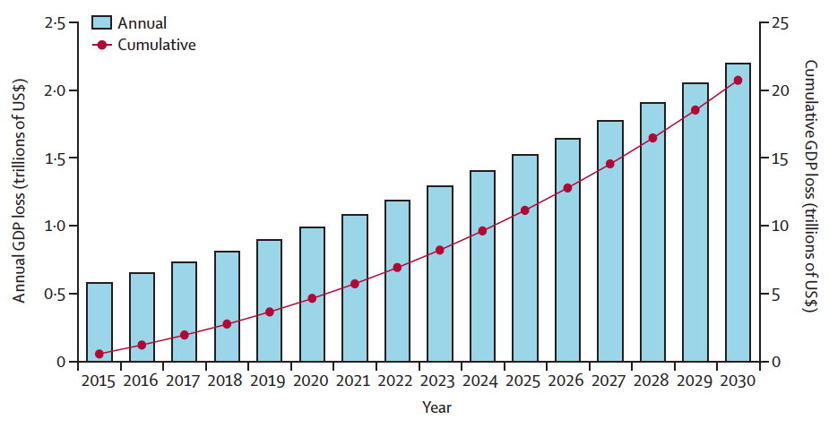
Value of Lost Output
$12.3 Trillion
Notes:
This graph represents the total global GDP losses due to the five surgical disease we studied from 2015-2030.
Globally, 22 trillion will be lost, while LMICs will loose 12.3 trillion dollars.

Slide 12
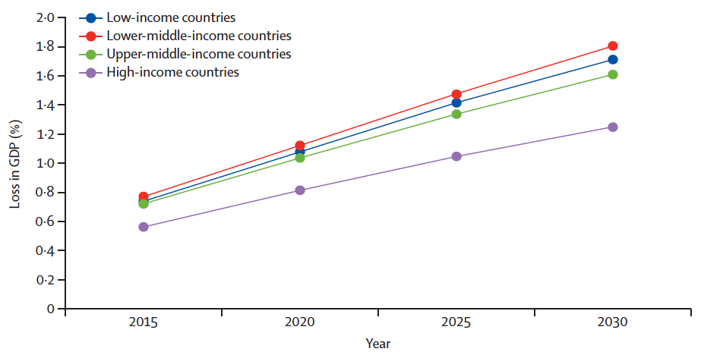
2% of GDP
Value of Lost Output
Notes:
This graph represents the total global GDP losses due to the five surgical disease we studied from 2015-2030.
Globally, 22 trillion will be lost, while LMICs will loose 12.3 trillion dollars.

Slide 13
Value of Lost Welfare
Notes:
Finally, when we look at the VLW model, we find that in terms of equivalent % of GDP, high income countries stand to lose the most, which is a function of how VSL is derived.
However, when we remove neoplasm, which currently with higher incidence in high income countries, we again find that low income countries are affected most. With the coming epidemiological transition in LMICs, we can expect LMICS to carry the weight of this burden as well.
For just one year, we found that foregone welfare losses were up to 15 trillion.

Slide 14
Value of Lost Welfare
$4 Trillion
Notes:
However, when we remove neoplasm, which currently has a higher incidence in high income countries, we again find that low income countries are affected most. With the coming epidemiological transition in LMICs, we can expect LMICS to carry the weight of this burden as well.
For just one year, we found that foregone welfare losses were up to 15 trillion.

Slide 15
Macroeconomics of Global Surgery:
The Cost of Doing Nothing
Thank you!

