Slide 1
Drafting, Validating and Costing a NSOAP
Desmond Jumbam, MSGH
Program in Global Surgery and Social Change
Harvard Medical School

Slide 2
Outline
NSOAP Drafting
Drafting overview
Key Considerations
Drafting process
Writing recommendations
NSOAP Validation
NSOAP Costing

Slide 3
Outline
NSOAP Drafting
Drafting overview
Key Considerations
Drafting process
Writing recommendations
NSOAP Validation
NSOAP Costing

Slide 4
The Drafting process
1
Stakeholder engagement and priority setting
2
Assembling the writing Team
3
Consolidating consensus priorities
6
Finalizing the plan
5
Validating the draft of the plan
4
Drafting the Plan
3/22/2018
4
Notes:
The process of drafting a National Surgical, Obstetric and Anaesthesia Plan can be divided into 6 major steps. First is stakeholder engagement and priority setting, which has already been discussed in the previous sessions. The second step is assembling the writing team, followed by aggregrating themes and priorities. The plan is then drafted and validated.
Throughout this session we will walk through each of these steps.

Slide 5
Key Considerations
1
Reflect the views of key stakeholders
This is important to ensure that contents of NSOAP reflects the reality on-the-ground and priorities of front-line providers and implementers
2
Balance opinion and evidence
Priorities and activities of the plan should be evidence-based
3
Align with Ministry of Health and other government-wide priorities
This is necessary to prevent duplication of efforts and safeguard against contradictory policies
It’s also necessary for determining the scope of the NSOAP
Notes:
Before we get into the process of NSOAP development, there are few considerations that I think are important to note before moving forward. These are considerations that are based on lessons learned from the development of other types of plans in the health sector. These considerations are important for ensuring a final document is a plan that will be adopted and implemented.
The first recommendation, which is perhaps the most important is that the plan should reflect the views of key stakeholders. The NSOAP should address the concerns of
The key to ensuring that the NHPSP is truly a living, breathing document, which is used dynamically to achieve buy-in from all stakeholders and keeping it realistic and feasible, while stillexpressing ambition for the future. Ensuring buy-in from all stakeholders is only possible when all stakeholders are adequately represented in the national health planning process, and are able to meaningfully participate. This requires a skilled MoH to convene all relevant actors and broker a decision among potentially divergent views. The final result should be a balanced and evidence-informed decision on the strategic directions for the health sector.
The second recommendation is to balance opinion of stakeholders with evidence.
Thirdly, the NSOAP should be in coherence with other ministry of health and government policies.
Should be set within the constitutional and legal framework, history and culture of the country

Slide 6
Assembling the Team
Larger team with cross-sectional representation of stakeholders
Smaller team, individual or consultant
Write the first draft
Rigorously reviewed by stakeholders
Responsibilities:
Organize stakeholder priorities and activities into a cohesive plan
Do not generate new priorities during drafting process

Slide 7
Consolidating Consensus Priorities

Slide 8
Goals and Objectives
Setting Goals
Goal: A broad statement about what the overall system is aimed to accomplish
Identifying Strategic Objectives
Strategic Objective: a statement of a desired future state, condition, or purpose, which an institution, a project, a service or a Programme seeks to achieve
G1
Increase surgical volume nationally by 2025
SO1
Increase the number of SAO providers from 0.2 to 2 per 100,000 ppl by 2025

Slide 9
Identifying Strategic Objectives: SMART
Specific: What exactly will be done and for whom and by whom?
Measurable: Is it quantifiable and can we measure it?
Achievable: Can it be done in the proposed timeframe with the resources and support available?
Relevant: Will the objective have the desired effect on desired goal or mission of the strategic plan?
Time-bound: By when will the strategic objective be attained?

Slide 10
Determining Outputs and Activities
Output: Required products and services needed to attain objective
Activities: Specific actionable items to be implemented in order to achieve a particular output
Important considerations:
Which level, organizations and groups are targeted?
What resources may be available?
Which populations, geographic areas and facility levels are targeted?
Will the activity achieve the desired output?
Who can most benefit and contribute?

Slide 11
Defining Indicators
Relevance: clear relationship between the output and the indicator
Accuracy: measures what it purports to measure
Importance: captures something that “makes a difference”
Usefulness: the results point to areas which can be changed
Feasibility: can be obtained with reasonable and affordable effort
Credibility: recommended and is being used by leading experts and organizations such as the WHO and World Bank (e.g., Lancet Global Surgery/World Development indicators)
Validity: to the extent possible has been field-tested, and used in practice
Distinctiveness: lacks redundancy and does not measure something already captured under another indicator

Slide 12
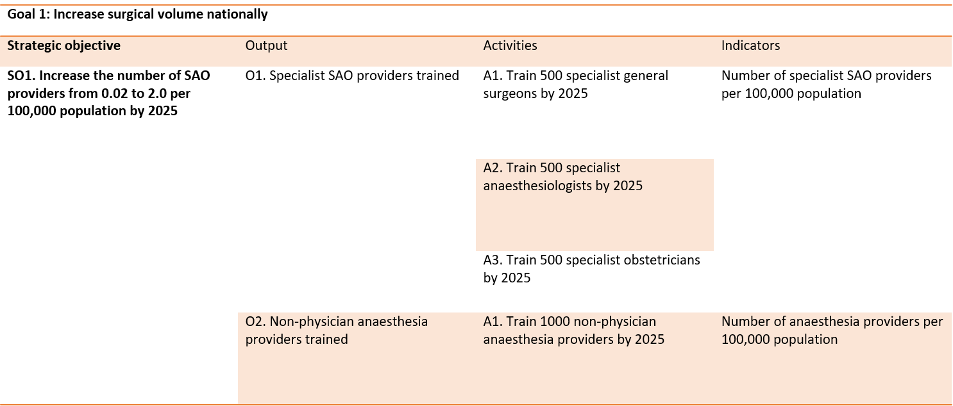
Example

Slide 13
Writing Recommendations
1
Write Simply
Use plain vocabulary
Avoid use of jargon
2
Be clear and concise
Avoid long and drawn-out discussions
3
Be objective
Contents should represent stakeholder priorities
Contents should be evidence-based
4
Present information in most suitable way
Use figures, tables, graphs and illustrations

Slide 14
Outline
Introduction
Background
Situation Analysis and Rationale
Guiding Principles, Vision and Mission
Detailed goals, strategic objectives, outcomes and activities
Governance framework
Costing
Monitoring and Evaluation framework

Slide 15
Outline
NSOAP Drafting
Drafting overview
Key Considerations
Drafting process
Writing recommendations
NSOAP Validation
NSOAP Costing

Slide 16
Validation with Stakeholders
Contents of NSOAP should be validated at different steps of the writing process
Mechanisms:
Share drafts with stakeholders for review and feedback
Organizing validation workshops

Slide 17
Outline
NSOAP Drafting
Drafting overview
Key Considerations
Drafting process
Writing recommendations
NSOAP Validation
NSOAP Costing

Slide 18
Why Cost a NSOAP?
1
Determining the cost and feasibility of implementation
2
Allows further priority setting
3
Advocate and Leverage for Domestic and external funds for implementation

Slide 19
The costing process
1
Assemble available costing information
2
Define the cost objects and quantities required
3
Determine the cost base
6
Create summary and share results
5
Validate results of the costing exercise
4
Attribute costs to the cost objects

Slide 20
Step 1: Assemble Costing Information
The first step is creating a list of items that will need to be costed in each domain
Category | Items to be costed
Workforce | Training cost and wages for: General and specialist surgeons Obstetricians Anaesthesiologists nurses
Infrastructure | Facility building costs for each hospital level Cost of surgical equipment OR equipment Ambulance and fuel cost
Information Technology | Internet and IT costs Electronic medical records purchase, installations and training

Slide 21
Step 2: Define the cost objects and quantities
Break down each activity in the implementation framework into constituent cost objects
Capital expenses
Maintenance
Installation
Shipping
Operating costs
Wages
Training costs
Determine the quantity of each item needed for each activity

Slide 22
Step 3: Determine the cost base
Assign a cost base to each cost item
Sources for cost base:
Historical costing data
Similar programs
Neighboring countries, regional or international costs
Estimation by experts
Sources of cost base should be referenced for accountability and validation

Slide 23
Step 4: Attribute costs to the cost objects
Activities | Cost object | Description of Quantity (iv) | Cost base (v) | FY 2018/19
 |  |  |  | Quantity (vii) | Estimates (v)*(vii) = viii
Ensure 100% of district hospitals meet minimum staffing recommendations for SOA service delivery | Anaesthesiologist salary | Person per year | 26,880,000 | 10 | 268,800,000
 | General surgeon salary | Person per year | 26,880,000 | 20 | 537,600,000
 | Obstetrician salary | Person per year | 26,880,000 | 20 | 537,600,000
 | OR/Critical care nurse salary | Person per year | 8,160,000 | 37 | 301,920,000
 | NTA level 8 OR/Critical care nurse salary | Person per year | 11,760,000 | 37 | 435,120,000
Review and update minimum standards for patient ambulatory care | NSOAP National Coordinator time | Person-days |  | 3 | 0
 | Per Diems | Person-days | 180000 | 60 | 10,800,000
 | Stationary and supplies | Person | 20,000 | 20 | 400,000
 | Travel | Person | 234500 | 20 | 4,690,000
 | Conference facilities and refreshments | Person-days | 60,000 | 60 | 3,600,000
 | Communication | Days | 20,000 | 5 | 100,000
 | Dissemination | Printing | 20,000 | 100 | 2,000,000

Slide 24
Step 5 & 6: Validation and Sharing
Validation
Policy and planning department
Ministry of Finance
Potential Co-funders
Summarizing costs
By year
By Domain
In relation to overall health expenditure
By source of funding

Slide 25
Thank You!

Slide 26
Aggregating Consensus Priorities

