Slide 1
NSOAP Development Process Models- Ethiopia
Hassen Beshir (MD, MPH)
Director: Health Services Quality Directorate
Federal Ministry of Health

Slide 3
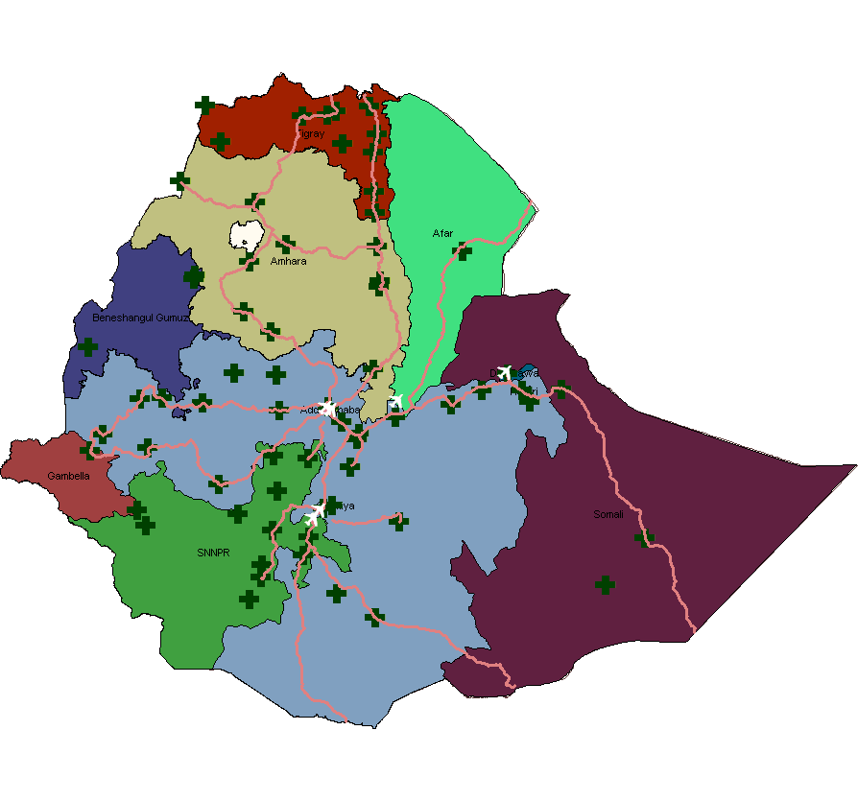
Population – 100 m
PHS Coverage - 100%
Hospitals - 411
Health Centers -3500
Health posts -17,000

Slide 4
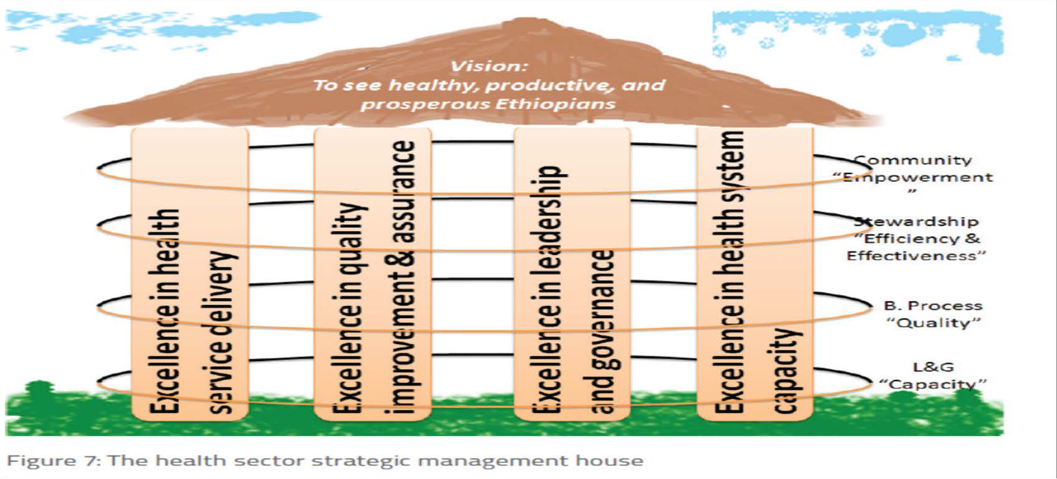
Health Sector Transformation Plan 2015/16 to 2019/20
Strategic pillars
Transformation agendas
CRC Compassionate HR
Quality and Equity
‘Woreda’ transformation
Data Revolution
National Quality strategy

Slide 5
NQS Vision and Focus
STRATEGIC FOCUS
AIM
PRIORITY AREAS
DEVELOP an integrated approach to planning, improving, and controlling quality
ACTIVATE key constituencies
DRIVE improvement in quality
SUPPORT strong DATA SYSTEMS and feedback loops
Better access
Clinical & surgical services
MNCH
Malnutrition
NCD
CD
Patients / Clients
Better Care
Lower Costs

Slide 6
Introduction- Ethiopia
200,000 operations per year
60,163 C/S per year (3.5%)
Unmet need of 5 million surgeries / year
The waiting time for surgery extends up to four years, especially in referral hospitals.

Slide 7
Why SaLTS: Surgical Workforce
Surgeons density in Ethiopia is 0.53.
The human resources problem is more acute in anesthesia providers.
Task sharing with IESO training is designed to remedy the HR shortage, and is going on actively since the past many years.

Slide 8
Surgeon per 100,000 Population
Inequitable distribution

Slide 9
Aim and Objectives
Aim
To improve equitable access to quality and safe essential and emergency surgical and anesthesia care as part of UHC
Implement a nationally coordinated national plan on surgical care
Create awareness on ESAC with different stakeholders
Improving the safety of surgical care by implementing the surgical safety check list and improving the safety culture
Implement QI and audit tool in surgical and anesthesia care
Define and implement ESAC package for all levels of the health care delivery s.
Proactively identify best practices and scale up rapidly through EHAQ
Objectives

Slide 10
Scope of SaLTS
The SaLTS initiative will be implemented in all health facilities in Ethiopia across all levels of the healthcare delivery system.
Private health facilities, although not currently members of the EHAQ, are highly encouraged to be part of this national initiative.

Slide 11
SALTS Intervention Pillars
Leadership and Governance
Human Resources
M & E
Innovation
Advocacy
Drugs medical Equipment & supplies
Quality
Infrastructure

Slide 12
Pillar one : Leadership, Management and Governance
National
FMoH / MSGD
HSQD
Project team / TWG
Regions
RHB
CRCP /Health care quality process
TWG / Champions
EHAQ
Lead and Co - Lead hospitals
Facilities
Hospital /health center CEO/clinical director/SMT
Facility team / Quality unit
OR management team / HDA

Slide 13
Activities
SaLTs leadership and management established for all levels
Leadership and mentorship training to 700 regional leads
Supportive supervision and mentorship program

Slide 14
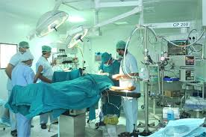
Pillar two : Infrastructure
80 Operating room blocks constructed and 290 additional blocks to be newly constructed or renovated during SaLTS implementation
Development of oxygen plants underway to be installed at two referral hospitals. Anticipated completion of two plants by June 2018

Slide 15
Pillar three: Supplies and logistics
National list of 56 essential and emergency surgical procedures and corresponding list of essential surgical and anaesthetic equipment, drugs, and consumables established. Stratified by facility level
Biomedical technician course completed for 20 trainees at Tegbaried Technical College in partnership with Addis Ababa University
Forged partnership between facilities and regional blood banks in two regions to curb blood supply issues

Slide 16
Pillar Four: Human resources
National Surgical Workforce Expansion and Anaesthesia Roadmaps designed to determine long-term surgical workforce needs and strategize solutions
Short-term anaesthesia training to upskill existing staff due to start Fall 2017
Sterilization and surgical site infection training ongoing through Lifebox’s CLEAN CUT initiative and SPECT

Slide 17
Pillar five: Advocacy and partership
National SaLTS interviews radio-broadcasted and published in local Ethiopian newspaper
International events organized to share experiences and promote SaLTS early successes, e.g. PAAS 2017, COSECSA 2017
Strong engagement of professional societies established within SaLTS National Technical Working Group
Several implementing partners identified, including GE Foundation’s SafeSurgery2020, Lifebox, SPECT, WFSA, COSECSA, and AMREF

Slide 18
Pillar Seven : Quality of surgical and anesthesia delivery
National quality training conducted on evidence-based practices and standard operating procedures
WHO Surgical Safety Checklist implemented across all facilities
Peri-operative guideline nationally standardized and finalized, and morbidity and mortality audit meetings introduced at selected sites

Slide 19
Pillar eight: Monitoring and evaluation
Surgical capacity and infrastructure hospital assessment tool adapted and finalized.
15 Key performance indicators designed and integrated into national data collection and reporting systems.
National KPI training and collection has begun. Lancet surgical indicators included within dataset.
PGSSE/MoH Parterhship in piloting the SalTS M and E indicators in two regions in the country.

Slide 20
Safe Surgery
2020 partners

Slide 21
Leadership and Mentorship Program
Implemented in two regions in the country
In partnership with SSE, MOH and RHBs

Slide 22
Innovations
Oxygen plant development
SPECT sterilisation trainings and mentorship
IFSA engagement in safe anesthesia

Slide 23
Monitoring and Evaluation
Hospital assessment tool developed and put to use.
Two publications produced
15 safe surgery indicators developed and pilot program started
Revision of national registries (OR, Anesthesia, Inpatient Ward)

Slide 25
Clean Cut
Safe Surgery based SSI reduction program launched in Jimma,

Slide 26
Key factors to success
Establishing strong leadership and ownership in government
Utilization of existing learning systems (EHAQ) for implementation,
Recognizing the importance of partnerships and collaboration, locally among the surgical professionals, government teams, and local ngos, as well as globally among the references private sector, investment partners, and external ngos,
Engaging all stakeholders from planning to execution,
Defining locally relevant and evidence-based essential surgical, obstetric, and anaesthetic care packages, and
Using early learning experiences in two regions for national scale-up.

Slide 27
Challenges
Uniformity in implementing the plan’s pillars throughout all regions in Ethiopia,
Attracting new partners and investors to continue putting the plan into action,
Ensuring robust evaluation of early results, and
Maintaining the momentum of the movement.

Slide 28
Thank you

