Slide 1

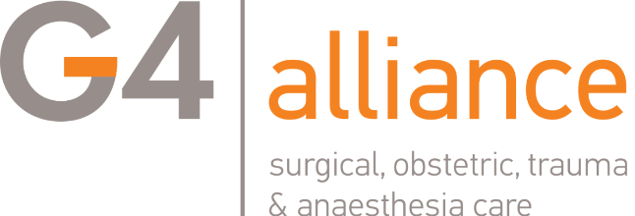
Anesthesia in NSOAPs
Adrian W Gelb
Secretary - WFSA
Prev Chair WFSA Safety & Quality of Practice
Secretary G4 Alliance Board of Directors
Distinguished Professor (Emeritus)
University of California San Francisco
adrian.gelb@ucsf.edu @AdrianGelb
Department of Anesthesia & Perioperative Care
Anesthesia Division of Global Health Equity

Slide 2
What is Global Surgery?
Definitions
Global surgery encompasses anesthesia, all surgical specialties including trauma surgery, general surgery, obstetrics & gynecology, perioperative medicine, critical emergency medicine, pain management and palliative care, rehabilitation, nursing and other health professions involved in the care of the surgical patient.
Global surgery: defining an emerging global health field
Dare, AJ et al. The Lancet, 2014; 384:2245
Notes:
Rhetorical question….?

Slide 3
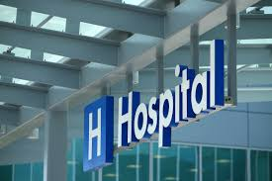
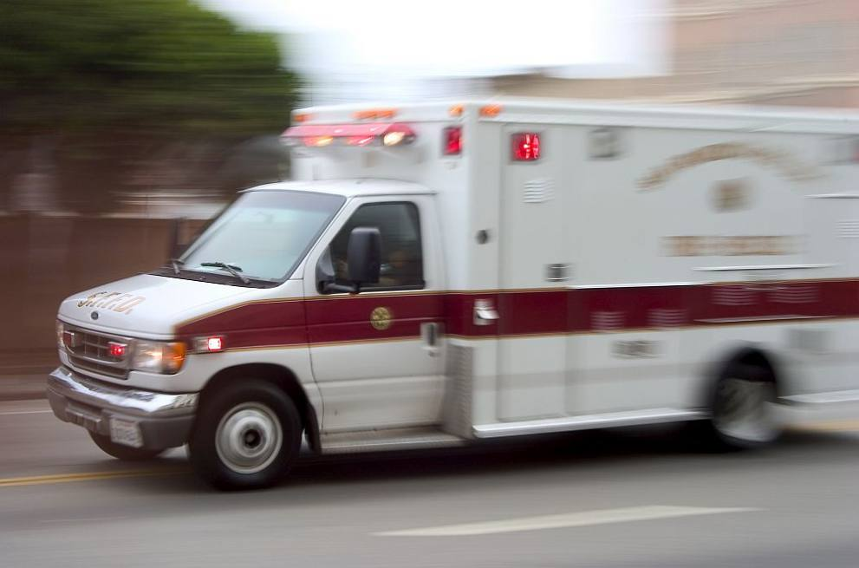


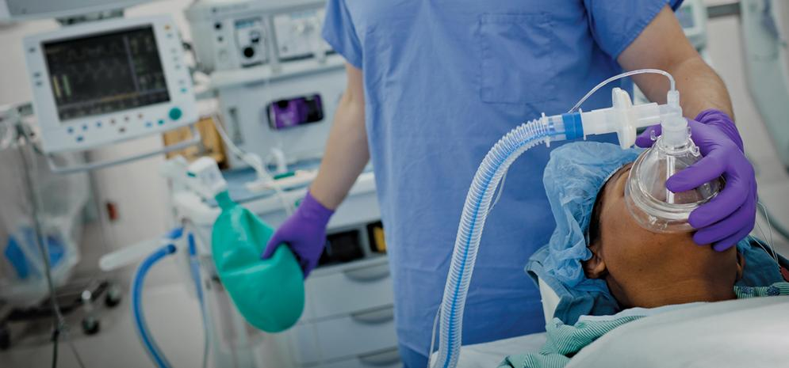
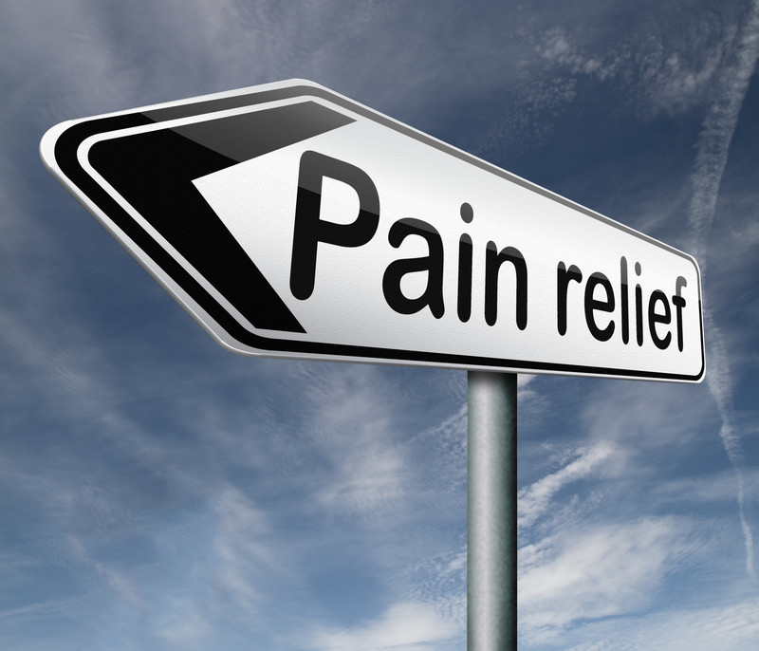
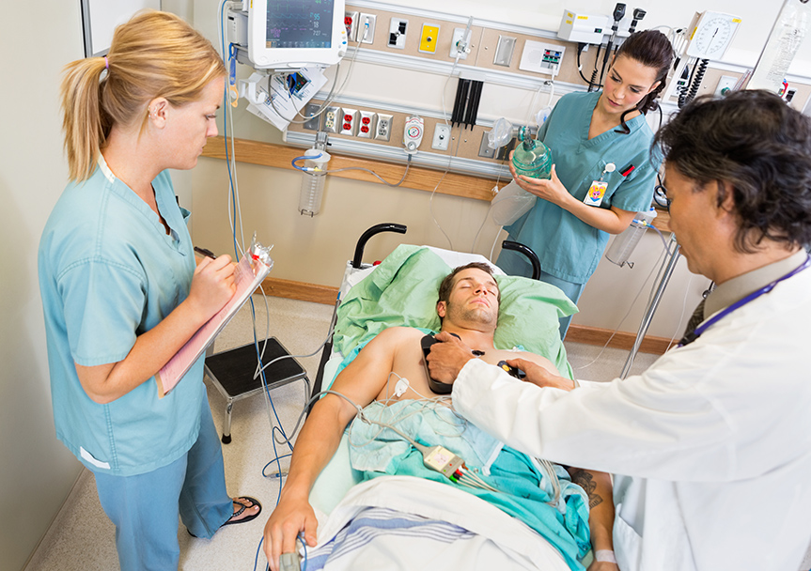
Global Surgery
is
All of These

Slide 4
Anaesthesia mortality by decade & country
Human Development Index status
Investment in Training & Equipment
P<0.00001
Bainbridge D et al. Lancet 2012; 380:1075
Notes:
Perioperative mortality has fallen in both high- and low-income countries over the last 50 years. An evaluation of avoidable perioperative mortality can provide valuable lessons to improve care; however, there is relatively little recent data from the Least Developed Countries in the world.

Slide 5
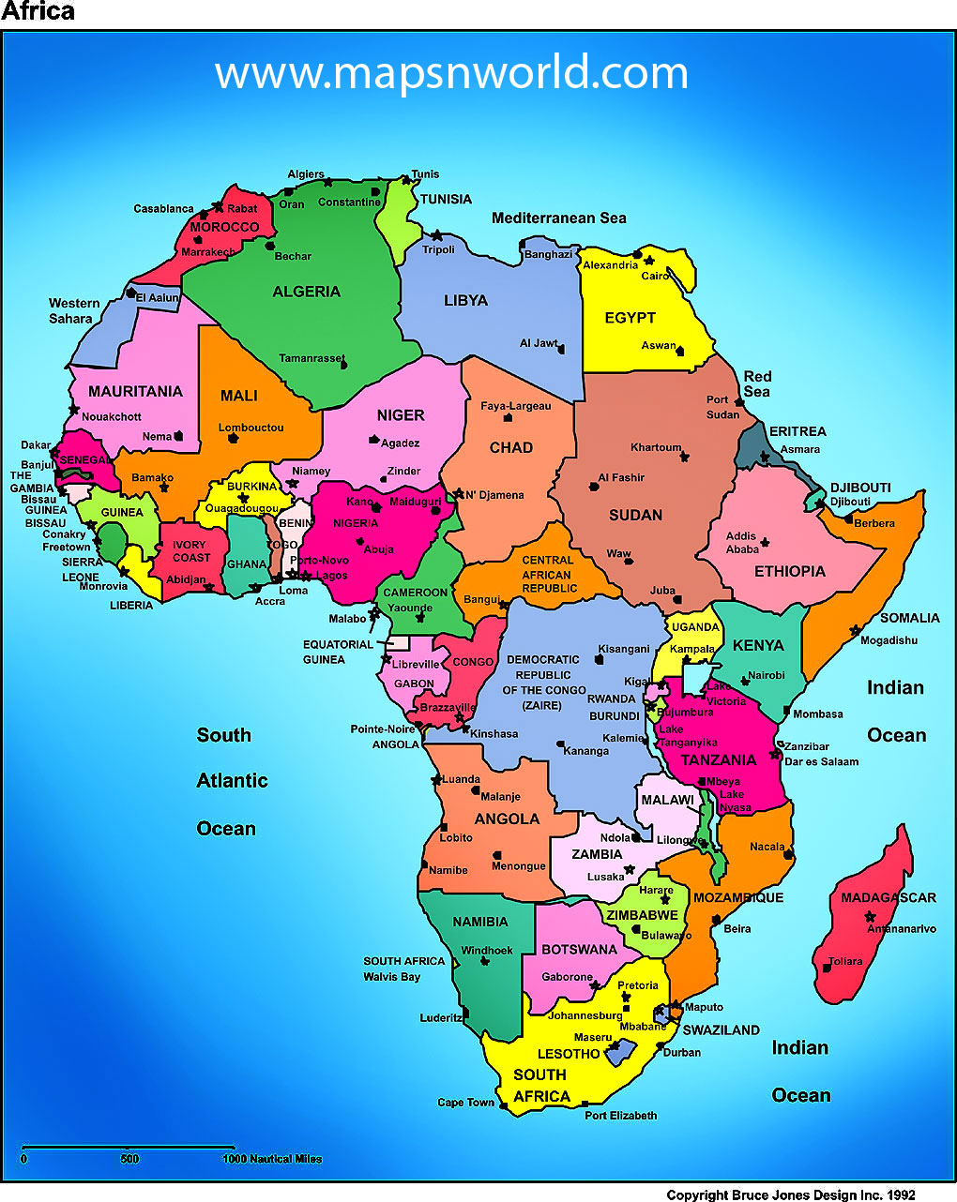
Surgical, Anesthetic Mortality
MALAWI
Avoidable mortality rate
1:275
Anesthesia AMR 1:504
TOGO
Anesthesia AMR
1:133
NIGERIA
Overall Emergency Surgery
Mortality
10.3%
ZIMBABWE
Avoidable mortality rate
1:482
AMR= Avoidable mortality rate

Slide 6
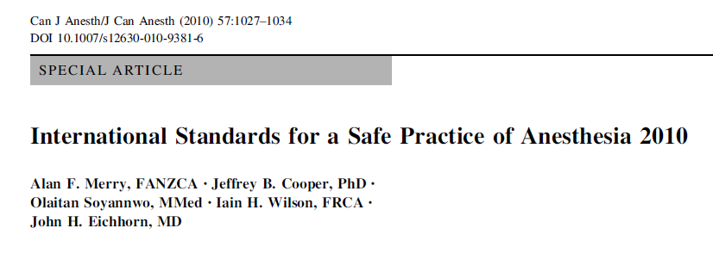


We started by developing this:
WHO-WFSA International Standards
for a Safe Practice of Anesthesia 2018
Gelb AW, Morriss WW, Johnson W, Merry AF
For the International Standards for a Safe Practice of Anesthesia Workgroup
Notes:
WFSA adopted international standards for safe practice on anesthesia in 1992. Been revised several times and updated version in press.
Intended to provide guidance and assistance to anaesthesia professionals, their professional societies, hospital and facility administrators, and governments for improving and maintaining the quality and safety of anaesthesia care.

Slide 7
The Importance of International Standards
Establishes a uniform international expectation & standard for safety
All patients should expect the highest level of safe care possible
There should only be one standard independent of provider & location
Is (partially) aspirational – use as a political tool
Patients can use in lobbying for anesthesia care
Notes:
Establishes uniform international expectation & standard for safety in anesthesia
All patients should expect the highest level of care possible—
Document States- access to safe anesthesia for essential surgery is a basic human right and should be available to all patients irrespective of their ability to pay
There should only be one standard independent of provider & location
While universally applicable, designed specifically for regions that have yet to formulate or adopt their own standards
In some settings, these standards are mandatory, in others aspirational but very useful as a political tool

Slide 9
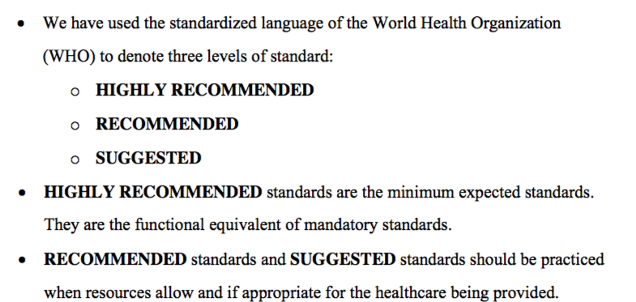
WHO’s nuanced language
Highly Recommended = Mandatory
Notes:
Three levels of recommendations
Highly recommended are minimum standards – functional equivalent of MANADATORY standards
Recommended and suggested standards should be practiced when resources allow and appropriate for healthcare being provided
In any setting, the goal is to practice to the highest possible standards

Slide 10
Highly Recommended
Trained Anesthesia Provider
Checklist
Oxygen
Capnogram
WHO Essential Medicines
Continuous pulse oximetry OR & PACU
Palpation or Display of Pulse
Tissue Perfusion by clinical exam
Non-invasive blood pressure monitoring
Pain Management
Notes:
Add WHO essential medications???

Slide 11
Good data tells you what you don’t know and
Verifies what you think you know

Slide 12
Infrastructure
Blood Product Services
Information Management
Workforce
Service Delivery
Surgical logbook
Medications & Equipment
Notes:
The WFSA has developed an online questionnaire to assesses anaesthesia capacity based on the international standards
Aim: to gather data about anaesthesia workforce, equipment, medicines and practices at facility level.

Slide 13
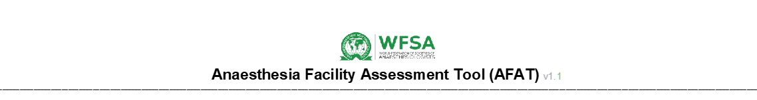

Slide 15
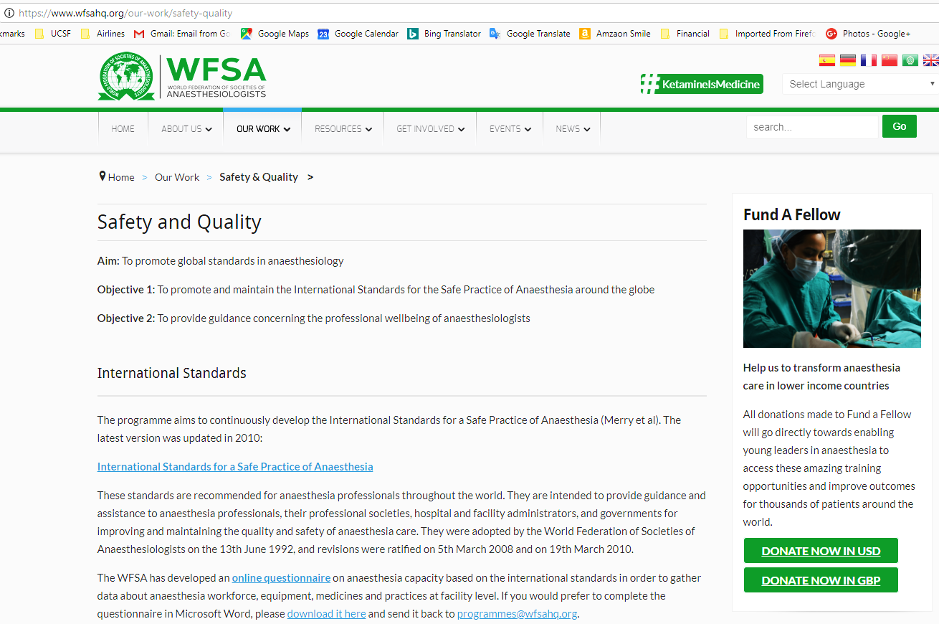
Where to get it
Free PDF available at - www.wfsahq.org/
Electronic RedCap version with secure, free storage/analysis - globalanesthesia.ucsf.edu
Components will be included in WHO Health Facility Assessment Tool
Notes:
The WFSA has developed an online questionnaire to assesses anaesthesia capacity based on the international standards
Aim: to gather data about anaesthesia workforce, equipment, medicines and practices at facility level.

Slide 16

Department of Anesthesia and Perioperative Care
Anesthesia Division of Global Health Equity
AFAT capacity assessment tools (by MOH Uganda, Guatemala, India)
Analysis of heterogeneous anesthesia training and practice models
Anesthesia workforce modeling and cost-effectiveness analysis
Scalable Free anesthesia education tools
Oximetry and capnography development for LICs
Notes:
AFAT capacity assessment tool – WORKING WITH WFSA
Analysis of heterogeneous anesthesia training and practice models – TO TRY TO UNDERSTAND WHAT IS THERE FIRSTLY, AND ALSO WHAT IS WORKING AND WHAT ISNT TO CREATE COMPETENT AND ACCESSIBLE CARE TEAMS
Anesthesia workforce modeling and cost-effectiveness analysis – ANALYSIS OF INCENTIVES STRUCTURES AND COUNTRY LEVEL WORKFORCE DATA TO CREATE MODELS THAT CAN BE MODIFIED AT THE LOCAL LEVEL TO DESIGN NATL ANESTHESIA WORKFORCE PLANS TO MONITOR AND EVALUAT THEM OVER TIME
Scalable anesthesia education tools – WORKING WITH WFSA AND PARTNERS IN UGANDA TO CREATE NEW CURRICULUM TOOLS AND ALSO CME LIKE ATOTW, NEW FOCUS ON PLATOFRMS FOR DISSEIMINATION
Oximetry and capnography development for LICs – IN THE HYPOXIA LAB AT UCSF

Slide 17

Conclusion
Anesthesia is an integral, essential, component of Surgical Perioperative Care
WHO-WFSA International Standards are the guide to Safe Practice
Improving Surgical-Obstetric-Anesthesia outcomes is a system fix
Fixing one component doesn’t fix the whole
You need good data to understand what needs fixing
The tools to get the data are available to you free
NSOAP builds the data into a plan

Slide 18





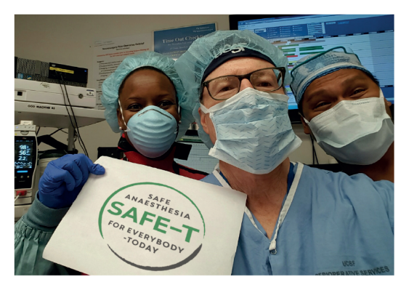
@UCSFAnesthesia
Anesthesia Division of Global Health Equity
THANK YOU
www.wfsahq.org
facebook.com/WFSAorg
twitter.com/WFSAorg
linkedin.com/company/WFSA
Email us and subscribe to our quarterly e-newsletter at: comms@wfsahq.org
April 13th 2018, London

