Slide 1
DHIS2 and Information Technology in the Surgical Space
Emile Rwamasirabo, MD, FCS (ECSA)
Consultant Urological Surgeon
King Faisal Hospital, Kigali, Rwanda

Slide 2
DHIS2
Global impact
Preferred health management information system in over 60 countries across four continents
Integrated system
Used as national health information systems for data management and analysis purposes, for health program monitoring and evaluation, as facility registries and service availability mapping, for logistics management and for mobile tracking of pregnant mothers in rural communities
Capacity building
Building a community of users and experts

Slide 3
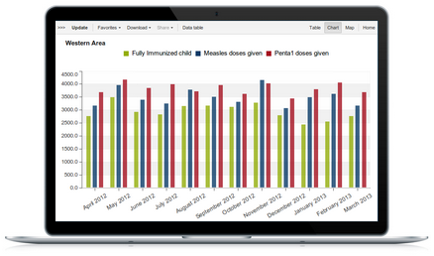
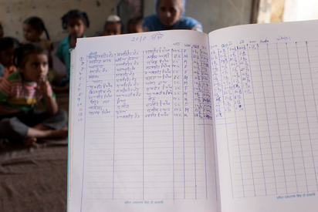
DHIS2 Capabilities
Data management and analytics
Individual data records

Slide 4
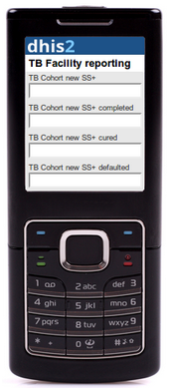
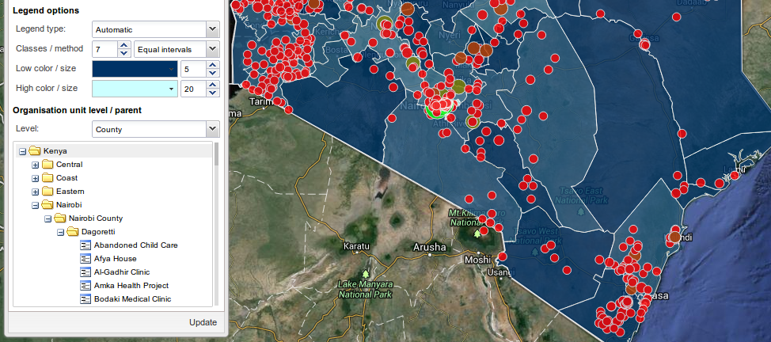
DHIS2 Capabilities
Mobile technology
Visualization

Slide 5
DHIS2 Capabilities
Open source
Internationalized & scalable

Slide 6
What is the cost?
Initial cost (Acquisition of the system)
Hosting Cost
Harmonization of Tools (Soft and hardware)
System customization
Training of Super users
Training of end users
Maintenance Cost
System administration(Local Team)
Hosting
Technical training
Local computer capability and internet access in health facilities.

Slide 7
Rwanda Experience
> 65% reduction in pages
2000
Launched HMIS (Access)
2011
- Harmonized reporting forms
- Developed SOPs
- Ended vertical system
2013
Developed Indicator Reference Manual
2015
Initiated Mobile Reporting
60% of HFs
2007
Launched HMIS (SQL)
2012
Launched HMIS (Web-based)
2014
Developed Data Warehouse
70% of HFs
100% of HFs
+1,000 users
Notes:
72 to 23 pages

Slide 8
Data Use
Which is the best intervention?
Why?
Who?
How?
Where?
Key Players in Data Driven Decision Making
Health Facilities: Coordination meetings and District Hospital Management Team (DHMT) meetings
Central Level: ISMM, planning ( Budget), and program meetings to adjust interventions
Development Partners: request data on an ad hoc basis to adjust interventions
Data Driven Decision Making in Practice
Increase in malaria cases
CHWs to focus on sensitization and testing at the household level
-Adult treatment

Slide 9
Sustainability
Issue: Turnover of M&E staff at health facilities
Mitigation Mechanisms
Standardized Training Materials: Developed standardized training materials
District Level Training: Districts are responsible for training new staff at HFs
Central Level Training: DHIS Academy (annual) that intends to build capacities of program staff and regional technicians
Trained >20 Rwandans to serve their respective programs
Gained skills on system and server management
Exposed technicians to regional experiences

Slide 10
Future Plans
Interoperability – link HMIS with other health systems, such as RapidSMS, OpenMRS, etc.
Integration of ICD10 and procedure codes
Integration of procedure costs
Mobile Phones – utilize mobile phones to view critical data
Data Warehouse – leverage the data warehouse to aggregate all health data and easily create dashboards to quickly visualize data
National Health Observatory – publish relevant health information for public use

Slide 11
Better Information, Better Decisions, Better Health

