Slide 1
Establishing NSOAP Governance and M&E
Dr. Samuel Zemenfeskudus
Health Service Quality Directorate
Ethiopian Federal Ministry of Health
Thursday, 22 March, 2018
8:30 – 9:15 A.M.

Slide 2
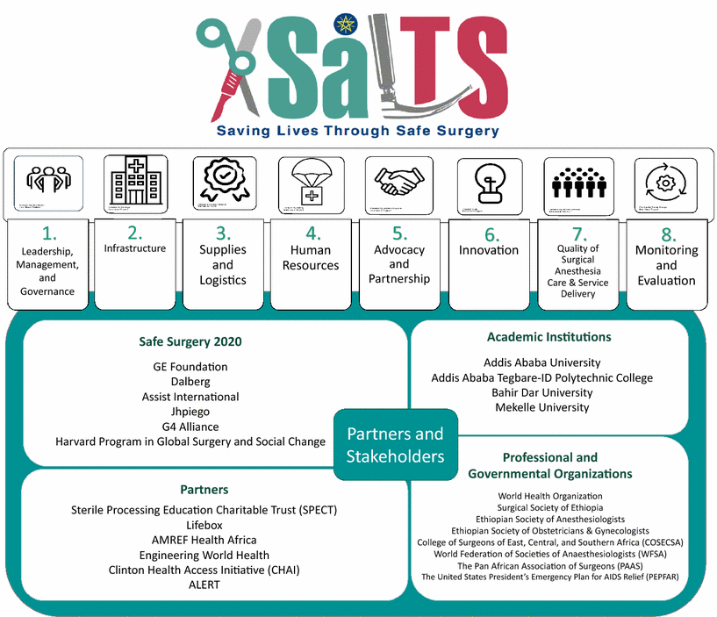
Fig. 1
SaLTS’ eight strategic pillars and implementation partners
1. Burssa D, Teshome A, Iverson K, Ahearn O, Ashengo T, Barash D, Barringer E, Citron I, Garringer K, McKitrick V, Meara J, Mengistu A, Mukhopadhyay S, Reynolds C, Shrime M, Varghese A, Esseye S, Bekele A: Safe Surgery for All: Early Lessons from Implementing a National Government-Driven Surgical Plan in Ethiopia. World J Surg 41(12):3038–45, 2017. Doi: 10.1007/s00268-017-4271-5.

Slide 3
SALTS Strategic Pillars
Leadership, Management & Governance
M & E
Human resources
Innovation
Awareness & partnership
Drugs, Medical Equipment & Supplies
Quality
Infrastructure

Slide 4
OVERVIEW
Part I: NSOAP Governance
Part II: NSOAP Monitoring and Evaluation

Slide 5
I. GOVERNANCE: OVERVIEW
NSOAP Governance
Definition
Background
Results

Slide 6
I. GOVERNANCE: Definition
Per W.H.O.:
Steering and rule-making related functions carried out by governments/decisions makers as they seek to achieve national health policy objectives that are conducive to universal health coverage.
A political process.
Involves balancing competing influences and demands.
http://www.who.int/healthsystems/topics/stewardship/en/

Slide 7
I. GOVERNANCE: Definition (cont’d)
Includes:
Maintaining the strategic direction of policy development and implementation
Detecting/correcting undesirable trends and distortions
Articulating the case for health in national development
Regulating the behavior of a wide range of actors - from health care financiers to health care providers
Establishing transparent and effective accountability mechanisms.
http://www.who.int/healthsystems/topics/stewardship/en/

Slide 8
II. GOVERNANCE: Background
Fig. 1
SaLTS’ eight strategic pillars and implementation partners
1. Burssa D, Teshome A, Iverson K, Ahearn O, Ashengo T, Barash D, Barringer E, Citron I, Garringer K, McKitrick V, Meara J, Mengistu A, Mukhopadhyay S, Reynolds C, Shrime M, Varghese A, Esseye S, Bekele A: Safe Surgery for All: Early Lessons from Implementing a National Government-Driven Surgical Plan in Ethiopia. World J Surg 41(12):3038–45, 2017. Doi: 10.1007/s00268-017-4271-5.

Slide 9
II. GOVERNANCE: Background (cont’d)
Fig. 1
SaLTS’ eight strategic pillars and implementation partners
1. Burssa D, Teshome A, Iverson K, Ahearn O, Ashengo T, Barash D, Barringer E, Citron I, Garringer K, McKitrick V, Meara J, Mengistu A, Mukhopadhyay S, Reynolds C, Shrime M, Varghese A, Esseye S, Bekele A: Safe Surgery for All: Early Lessons from Implementing a National Government-Driven Surgical Plan in Ethiopia. World J Surg 41(12):3038–45, 2017. Doi: 10.1007/s00268-017-4271-5.

Slide 10
II. GOVERNANCE: Background (cont’d)
Fig. 1
SaLTS’ eight strategic pillars and implementation partners
1. Burssa D, Teshome A, Iverson K, Ahearn O, Ashengo T, Barash D, Barringer E, Citron I, Garringer K, McKitrick V, Meara J, Mengistu A, Mukhopadhyay S, Reynolds C, Shrime M, Varghese A, Esseye S, Bekele A: Safe Surgery for All: Early Lessons from Implementing a National Government-Driven Surgical Plan in Ethiopia. World J Surg 41(12):3038–45, 2017. Doi: 10.1007/s00268-017-4271-5.

Slide 11
II. GOVERNANCE: Background
Most crucial element to surgical system reform:
Establishing strong leadership and commitment
in government at ALL LEVELS
(from FMOH → surgical teams on-the-ground)
1. Burssa D, Teshome A, Iverson K, Ahearn O, Ashengo T, Barash D, Barringer E, Citron I, Garringer K, McKitrick V, Meara J, Mengistu A, Mukhopadhyay S, Reynolds C, Shrime M, Varghese A, Esseye S, Bekele A: Safe Surgery for All: Early Lessons from Implementing a National Government-Driven Surgical Plan in Ethiopia. World J Surg 41(12):3038–45, 2017. Doi: 10.1007/s00268-017-4271-5.

Slide 12
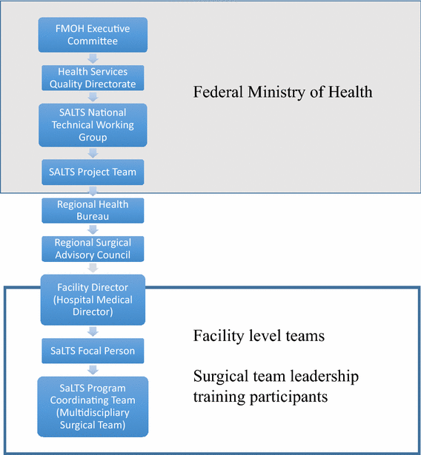
II. GOVERNANCE: Background
Fig. 2
SaLTS’ leadership structure stratified by national, regional, and facility levels
1. Burssa D, Teshome A, Iverson K, Ahearn O, Ashengo T, Barash D, Barringer E, Citron I, Garringer K, McKitrick V, Meara J, Mengistu A, Mukhopadhyay S, Reynolds C, Shrime M, Varghese A, Esseye S, Bekele A: Safe Surgery for All: Early Lessons from Implementing a National Government-Driven Surgical Plan in Ethiopia. World J Surg 41(12):3038–45, 2017. Doi: 10.1007/s00268-017-4271-5.

Slide 13
II. GOVERNANCE: Background
Approach:
Establishment of clear accountability throughout surgical hierarchy
Designated personnel responsible for implementation of SaLTS activities at each level
Hospitals organized into clusters, co-led by university hospitals and identified lead hospitals
Personnel deployed to cluster hospitals from lead facilities for mentorship & on-site training:
Physicians, residents, medical students
1. Burssa D, Teshome A, Iverson K, Ahearn O, Ashengo T, Barash D, Barringer E, Citron I, Garringer K, McKitrick V, Meara J, Mengistu A, Mukhopadhyay S, Reynolds C, Shrime M, Varghese A, Esseye S, Bekele A: Safe Surgery for All: Early Lessons from Implementing a National Government-Driven Surgical Plan in Ethiopia. World J Surg 41(12):3038–45, 2017. Doi: 10.1007/s00268-017-4271-5.

Slide 14
III. GOVERNANCE: Intervention
National Leadership and Mentorship Training
Surgical leadership training disseminated nationally to multidisciplinary facility teams
Goal: Train and empower surgical team members to:
Identify facility-level problems
Design and implement effective solutions
Leadership training followed by 9 months of supportive supervision & mentorship visits
Goal: Ensure implementation of lessons learned in training
Multi-partner initiative under Safe Surgery 2020
Jhpiego
Surgical Society of Ethiopia
Funding: GE Foundation
1. Burssa D, Teshome A, Iverson K, Ahearn O, Ashengo T, Barash D, Barringer E, Citron I, Garringer K, McKitrick V, Meara J, Mengistu A, Mukhopadhyay S, Reynolds C, Shrime M, Varghese A, Esseye S, Bekele A: Safe Surgery for All: Early Lessons from Implementing a National Government-Driven Surgical Plan in Ethiopia. World J Surg 41(12):3038–45, 2017. Doi: 10.1007/s00268-017-4271-5.

Slide 15
III. GOVERNANCE: Results
Leadership training provided to 700 regional leaders and surgical team members through program scale-up by FMOH
Early success in two regions prompted expansion to surgical teams from all regions of Ethiopia
Following national-level leadership training, one round of mentorship conducted thus far by the national project team and members of the TWG at 38 hospitals across all regions
1. Burssa D, Teshome A, Iverson K, Ahearn O, Ashengo T, Barash D, Barringer E, Citron I, Garringer K, McKitrick V, Meara J, Mengistu A, Mukhopadhyay S, Reynolds C, Shrime M, Varghese A, Esseye S, Bekele A: Safe Surgery for All: Early Lessons from Implementing a National Government-Driven Surgical Plan in Ethiopia. World J Surg 41(12):3038–45, 2017. Doi: 10.1007/s00268-017-4271-5.

Slide 16
III. GOVERNANCE: Results
Effective SaLTS leadership and management established at a national level
KEYS TO IMPLEMENTATION
Formation of the SaLTS project management team at the FMOH
Early engagement of potential stakeholders including:
Clinicians
Funders
Implementers
FMOH established and led SaLTS national TWG of >19 stakeholders
Early involvement of implementing and funding partners and creation of regional and facility SaLTS teams ensured increased capacity for implementation beyond the FMOH alone
1. Burssa D, Teshome A, Iverson K, Ahearn O, Ashengo T, Barash D, Barringer E, Citron I, Garringer K, McKitrick V, Meara J, Mengistu A, Mukhopadhyay S, Reynolds C, Shrime M, Varghese A, Esseye S, Bekele A: Safe Surgery for All: Early Lessons from Implementing a National Government-Driven Surgical Plan in Ethiopia. World J Surg 41(12):3038–45, 2017. Doi: 10.1007/s00268-017-4271-5.
Notes:
Stakeholder diversity ensured that SaLTS strategies reflected the needs of surgical providers.

Slide 17
II. Monitoring and Evaluation (M&E)
II. Monitoring and Evaluation
Importance of M&E
Background
Results

Slide 18
Fig. 1
SaLTS’ eight strategic pillars and implementation partners
1. Burssa D, Teshome A, Iverson K, Ahearn O, Ashengo T, Barash D, Barringer E, Citron I, Garringer K, McKitrick V, Meara J, Mengistu A, Mukhopadhyay S, Reynolds C, Shrime M, Varghese A, Esseye S, Bekele A: Safe Surgery for All: Early Lessons from Implementing a National Government-Driven Surgical Plan in Ethiopia. World J Surg 41(12):3038–45, 2017. Doi: 10.1007/s00268-017-4271-5.

Slide 19
II. M&E: Background
Fig. 1
SaLTS’ eight strategic pillars and implementation partners
1. Burssa D, Teshome A, Iverson K, Ahearn O, Ashengo T, Barash D, Barringer E, Citron I, Garringer K, McKitrick V, Meara J, Mengistu A, Mukhopadhyay S, Reynolds C, Shrime M, Varghese A, Esseye S, Bekele A: Safe Surgery for All: Early Lessons from Implementing a National Government-Driven Surgical Plan in Ethiopia. World J Surg 41(12):3038–45, 2017. Doi: 10.1007/s00268-017-4271-5.

Slide 20
II. M&E: Background
Needed to develop a comprehensive system to measure surgical data that could be scaled nationally
Needed to select data that would
Incentivize facility-level data collection
Collect nationally useful data
Selected indicators for measurement that were a combination of:
High-level indicators reflecting longitudinal change
Short-term indicators indicating surgical team performance
Example: National density of surgical, anaesthetic, and obstetric workforce
FMOH:
Useful Indicator
Individual facility:
Beyond level of control
Less motivating vs. other indicators (e.g. delayed start-time)
Challenges:
Balancing desire for data with burden of collection and reporting on facility staff
Stakeholder consensus re: indicators across surgical spectrum (e.g. nursing, surgery anesthesia)
1. Burssa D, Teshome A, Iverson K, Ahearn O, Ashengo T, Barash D, Barringer E, Citron I, Garringer K, McKitrick V, Meara J, Mengistu A, Mukhopadhyay S, Reynolds C, Shrime M, Varghese A, Esseye S, Bekele A: Safe Surgery for All: Early Lessons from Implementing a National Government-Driven Surgical Plan in Ethiopia. World J Surg 41(12):3038–45, 2017. Doi: 10.1007/s00268-017-4271-5.

Slide 21
II. M&E Framework
Two tools designed to measure quality & SaLTS’ impact:
Hospital Assessment Tool: A comprehensive surgical capacity assessment tool combining an existing WHO tool with those of the Ethiopian FMOH and Harvard PGSSC
15 key performance indicators (KPIs)
Long- and short-term KPIs to be collected at the facility level and reported nationally
Long-term KPIs: reported annually to influence national-level planning and implementation
Short-term KPIs: reported monthly or quarterly to inform and inspire facility-level change
1. Burssa D, Teshome A, Iverson K, Ahearn O, Ashengo T, Barash D, Barringer E, Citron I, Garringer K, McKitrick V, Meara J, Mengistu A, Mukhopadhyay S, Reynolds C, Shrime M, Varghese A, Esseye S, Bekele A: Safe Surgery for All: Early Lessons from Implementing a National Government-Driven Surgical Plan in Ethiopia. World J Surg 41(12):3038–45, 2017. Doi: 10.1007/s00268-017-4271-5.

Slide 22
II. M&E: Results
The Hospital Assessment Tool was successfully used to baseline 29 sites across three different regions of Ethiopia
Integrated into the SaLTS M&E Framework
Nine SaLTS KPIs integrated into the national Hospital Performance Monitoring and Improvement (HPMI) system
Full 15 SaLTS KPIs being piloted in select Safe Surgery 2020 Hospitals
National training conducted in Dec. 2017
National collection of KPIs currently underway
1. Burssa D, Teshome A, Iverson K, Ahearn O, Ashengo T, Barash D, Barringer E, Citron I, Garringer K, McKitrick V, Meara J, Mengistu A, Mukhopadhyay S, Reynolds C, Shrime M, Varghese A, Esseye S, Bekele A: Safe Surgery for All: Early Lessons from Implementing a National Government-Driven Surgical Plan in Ethiopia. World J Surg 41(12):3038–45, 2017. Doi: 10.1007/s00268-017-4271-5.

Slide 23
National SaLTS indicators
Surgical Volume
Peri-Operative Mortality Rate (POMR)
Safe Surgery Checklist Utilization Rate
Surgical Site Infection (SSI) Rate
Anesthetic Adverse Outcome
Delay for Elective Surgical Admission
Mean Duration of In-Hospital Pre-Elective Operative Stay
Blood Unavailability Ratio for Surgical Patients
Surgical Patient Satisfaction
Notes:
Note: Surgical Volume is major surgeries only

Slide 24
Other SaLTS indicators
10. Surgical Bed Occupancy Rate
11. Surgery, Anesthesia, and Obstetric (SAO) Density
12. Rate of First Elective Case On-Time Theater Performance
13. Rate of Cancellation of Elective Surgery
14. Emergency (2h) Surgical Access
15. Protection Against Catastrophic Expenditure
Notes:
Note: Surgical Volume is major surgeries only

Slide 25
Fig. 1
SaLTS’ eight strategic pillars and implementation partners
1. Burssa D, Teshome A, Iverson K, Ahearn O, Ashengo T, Barash D, Barringer E, Citron I, Garringer K, McKitrick V, Meara J, Mengistu A, Mukhopadhyay S, Reynolds C, Shrime M, Varghese A, Esseye S, Bekele A: Safe Surgery for All: Early Lessons from Implementing a National Government-Driven Surgical Plan in Ethiopia. World J Surg 41(12):3038–45, 2017. Doi: 10.1007/s00268-017-4271-5.

Slide 26
SALTS Strategic Pillars
Leadership, Management & Governance
M & E
Human resources
Innovation
Awareness & partnership
Drugs, Medical Equipment & Supplies
Quality
Infrastructure

Slide 27
Thank you

