Slide 1
NSOAP Development Process: Zambia
Dr. Mzaza Nthele
Director Clinical Care and Diagnostic Services,
Ministry of Health
Rep. of Zambia

Slide 2

Outline
  Overview of Zambia Process
    Details of drafting and costing at later presentation
  Lessons Learned
  Plans for Implementation
Notes:
Zambia
First championed the effort at the WHA to prioritize emergency and essential services,
Then translated into efforts to strengthen the surgical system from paper to policy by embarking on a process to create a NSOASP

Slide 3

From the Beginning..
Bellagio Implementation Meeting
February 9th-13th 2015
Notes:
Zambia
First championed the effort at the WHA to prioritize emergency and essential services,
Then translated into efforts to strengthen the surgical system from paper to policy by embarking on a process to create a NSOASP

Slide 4

From the Beginning..
Notes:
Zambia
First championed the effort at the WHA to prioritize emergency and essential services,
Then translated into efforts to strengthen the surgical system from paper to policy by embarking on a process to create a NSOASP

Slide 5

From the Beginning..
Notes:
Zambia
First championed the effort at the WHA to prioritize emergency and essential services,
Then translated into efforts to strengthen the surgical system from paper to policy by embarking on a process to create a NSOASP

Slide 6
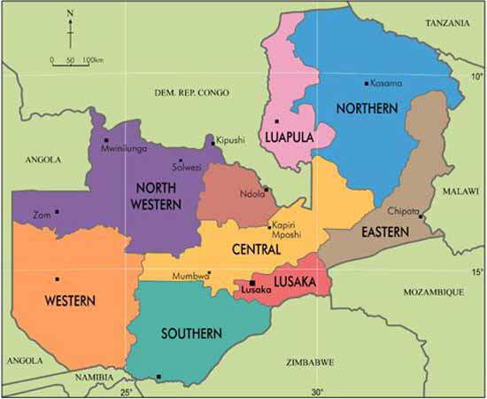
NSOAP Aim
Mission Statement: To provide equitable access to cost effective, quality health services as close to the family as possible
Vision: A Nation of Healthy and Productive People
Overall Goal: To improve the health status of people in Zambia in order to contribute to socio-economic development
Notes:
Zambia
First championed the effort at the WHA to prioritize emergency and essential services,
Then translated into efforts to strengthen the surgical system from paper to policy by embarking on a process to create a NSOASP

Slide 7
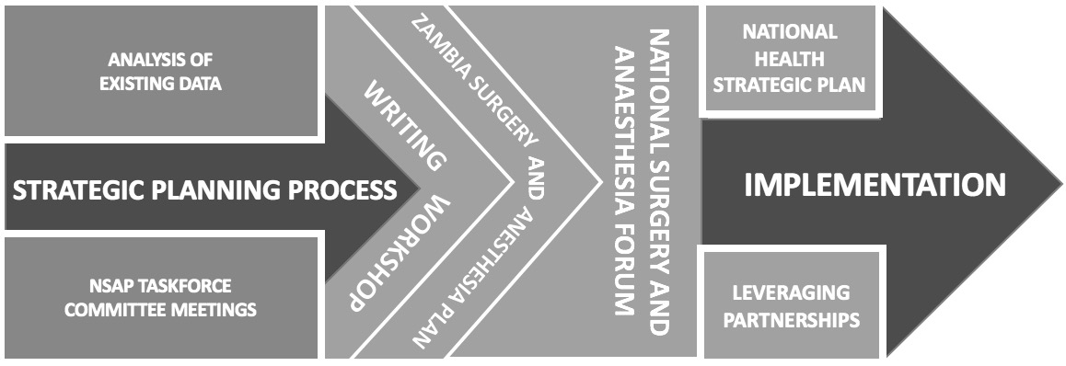
Overview of Process
Feb – April 2016
May 2016
September 2016
Notes:
One of the priorities of the NSOASP was to be able to integrate this plan within Zambia’s overall National Health Strategic Plan (NHSP), which was set to renew for 2017-2021.
Creating a NSOASP as a component of a country’s NSHP was an unprecedented process, requiring innovation, initiative, and strong support from a wide variety of stakeholders, especially the central leadership role of the Ministry of Health

Slide 8
Baseline Assessment
Evaluate baseline surgical indicators
  Reviewed data from the previous 5 years
    Health Management Information System
    Institute for Health Metrics and Evaluation
  Key informant interviews
Analyzed in collaboration with PGSSC

Slide 9
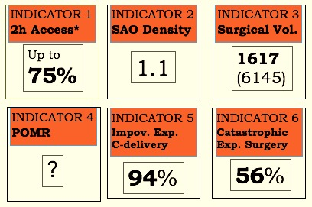
Baseline Assessment
Notes:
Impoverishing expenditure

Slide 10
Baseline Assessment
Implications:
  Initiated conversations around surgical system development in an evidence-based manner
  Highlighted the need to focus on skilled workforce development, referral systems, facility services, and institution of financial protection mechanisms
Notes:
Indicators define baseline

Slide 11
Ministry Support
  Request for NSOAP Development to the MOH
    Presented baseline information
  Key Champions identified at Ministry
    Dr. Peter Mwaba, Permanent Secretary of Zambia
    Dr. Kennedy Lishimpi, Director Clinical Care and Diagnostic Medicine
Notes:
MOH plays critical role
Improves the political architecture for health decisions
Centralizes the policy dialogue on health sector priorities
Discourages fragmentation of the health sector

Slide 12
Overview of Process
February – April 2016
May 2016
September 2016

Slide 13





Identify Key Stakeholders
  Clinical providers
  Professional and civil societies
  Academic institutions
  Funding Bodies
  Implementers
  MOH, MOF, MOE
Notes:
Broad stakeholder engagement brings Broad spectrum of expertise
Unique experience and insights to guide process

Slide 14
Committees
Technical Working Group
Workforce
Service Delivery and Infrastructure
Financing, Information Management and Technology
Technical Review Panel
Notes:
Ministry of Health-led, stakeholder driven, contextually appropriate solutions
Three committees:
1) Healthcare Delivery & Infrastructure
2) Workforce
3) Finance, Information Management & Technology

Slide 15
Committees
    Healthcare Delivery and Infrastructure
  CO-CHAIRS:
    Dr. Yusef Ahmed, UTH, Consultant Obstetrician
    Dr. Penias Tembo, UTH, Consultant Surgeon
  GROUP MEMBERS:
    Dr. Chabwela Shumba, Deputy Director of Mobile Health Services
    Dr. Robert Zulu, UTH, Consultant Surgeon
    Dr. Crispin Moyo, Clinical Care Specialist
    Dr. Feruza Ismailova, UTH, Head of Department, Anesthesia
    Mr. Gilbert Musonda, Medical Equipment Specialist
    Ms. Nchebe Sindaza Chitashi, Chief Medical Imaging Officer
    Ms. Mary Nambao, Deputy Director for Maternal Health
    Dr. Muhumpu Kafwanfwa, Deputy Director of Emergency Health Services
    Dr. Charles Mutemba, UTH, Head of Adult Medical Emergency Unit
    Dr. Mutina Chilala, Chongwe District Medical Officer
    Dr. Gideon Zulu, Lusaka District Medical Officer
    Ms. Clare Tembo, Ministry of Health
    Dr. Mumpanshya Hazel, Senior Registrar Anesthesia
    Dr. Evans Chinkoyo, Family Doctor
Notes:
MOH plays critical role
Improves the political architecture for health decisions
Centralizes the policy dialogue on health sector priorities
Discourages fragmentation of the health sector

Slide 16
Committees
    Workforce
  CO-CHAIRS:
    Mr. Fred Mwila, Deputy Director of Human Resources and Administration
    Dr. Belington Vwalika, UTH, Head of Department, OBS/GYN
  GROUP MEMBERS:
    Dr. Fastone Goma, University Teaching Hospital, Dean
    Mr. Wisdom Chelu, National Anesthesia Coordinator
    Dr. John Kachimba, Medical Superintendent, Levy Mwanwansa Hospital
    Dr. James Munthali, UTH, Head of Department, Surgery
    Ms. Emily Chipaya, Deputy Director of Nursing Services
    Dr. Mary Zulu, Health Professions Council of Zambia, Registrar
    Mr. Christopher Sinkala, Biomedical Engineer Technologist
    Mr. Roy Chihinga, Chief Human Resources Development Officer
    Dr. Gundumure Tshuma, OBGYN
    Dr. Daniel Banda, School of Anesthesia
    Ms. Maluba Tmara Mlenga, Chief Human Resources Officer – Planning
    Dr. Jane Kabwe, Department of Anaesthesia and Critical Care
    Dr. Papari Deka, UTH, Consultant Anaesthetist
    Dr. Peter Hart, UNZA/UTH, Visiting Lecturer in Anaesthesia
Notes:
MOH plays critical role
Improves the political architecture for health decisions
Centralizes the policy dialogue on health sector priorities
Discourages fragmentation of the health sector

Slide 17
Committees
    Financing, Information Management and Technology
  CO-CHAIRS:
    Reverend Charles Banda, Health Information Officer
    Dr. Kennedy Lishimpi, Director of Clinical Care and Diagnostic Services
  GROUP MEMBERS:
    Mr. Mubita Luwabelwa, Deputy Director of Planning and Budgeting
    Mr. Henry Kansembe, Chief Specialist of Technical Support Services
    Dr. Jabulani Munalula, Fairview Hospital, Surgeon
    Mr. Chipalo Kaliki, Deputy Director of Monitoring & Evaluation
    Dr. Kevin Kalombo, Chief Specialist in Monitoring & Evaluation
    Ms. Rachel Lungwebungu, Specialist of QA/QI
    Mr. Tsibu Bbuku, Medical Equipment Consultant
    Dr. Jackson Mwanza, Chongwe District Medical Officer
    Dr. Kennedy Malama, Lusaka Provincial Medical Officer
    Mr. Philip Sikazwe, Senior Account Officer
    Dr. Ushma Patel, Senior Registrar in Anesthesia
    Dr. Christopher Chanda, Consultant Anaesthetist
Notes:
MOH plays critical role
Improves the political architecture for health decisions
Centralizes the policy dialogue on health sector priorities
Discourages fragmentation of the health sector

Slide 18
Committees
    Each Committee met bi-weekly for 2 months
      Utilized a “Terms of Reference” to guide discussions (now called “Discussion Framework”)
        Defined the goals of each committee and priorities
        Reviewed baseline indicators and assessments
            Identified major gaps for the domain
        Consensus building on priorities moving forward
Notes:
MOH plays critical role
Improves the political architecture for health decisions
Centralizes the policy dialogue on health sector priorities
Discourages fragmentation of the health sector

Slide 19
Timeline
March 16: TWG First Meeting
March 23: Committee meetings
April 6: Committee meetings
April 20: Committee meetings
April 27: TWG Chairs present to Technical Review Panel
May 2-7: Writing Workshop
May 11: National Surgical Forum (TWG + TRP)

Slide 20
Technical Review Panel
Workforce
Service Delivery and Infrastructure
Financing, Information Management and Technology
Purpose:
  Critically review draft outputs from each committee
Members:
  Led by Permanent Secretary
  USAID, CHAI, DFID, General Nursing Council, General Health Council, THET, etc.
Technical Review Panel

Slide 21
Committees
Lessons Learned:
Priorities and goals of the surgical care system must be prioritized through consensus, usually through recurring committee meetings and working groups
Working groups must include both proponents and opponents of the process, to facilitate conversation and increase uptake
Development of the plan should be transparent and without bias

Slide 22
Overview of Process
February – April 2016
May 2016
September 2016

Slide 23
Writing Workshop
Purpose
  Formalize discussions from committee meetings
Primary aim
  Compose, clarify and address key initiatives in terms of feasibility, impact, and priority
Participants
  Representatives from each committee, and new members of MOH to facilitate appropriate language and structure
Notes:
Week long writing workshop
Purpose
Aim

Slide 24
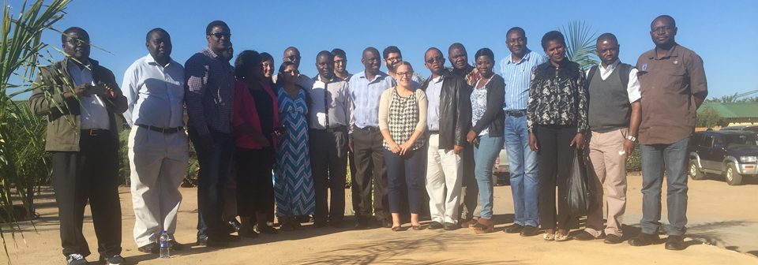
Workforce
Service Delivery
Financing
Infrastructure
Information Management and Technology
Stakeholders
Writing Workshop
Notes:
Workshop participants split up again into the 5 domains of a NSOAP, went over the materila again from the committee meetings
Plans were synthesized by each of the sub-committees and reported out to the entire group for further discussion and refinement.
Milestones and metrics were developed to be included within the upcoming National Health Strategic Plan, a five-year plan for 2017-2021.

Slide 25
A few Initiatives within the Plan
Service Delivery
Trauma and injuries
  WHO checklist/ Lifebox training
  Safe Obs, Safe Peds
  ATLS course
  Prehospital emergency services
Pediatric cases
  Peds surgical emergencies
  Neonatal screening programs
  RHD prevention
Genito-urinary conditions
Orthopedic services
Workforce
Providers
  Provide positions to meet demand for services
  Equitable distribution
Improve conditions of services, bonding, and retention mechanisms
Curriculum reviews, standards of education for training programs

Slide 26
A few Initiatives within the Plan
Infrastructure
Standardize infrastructure across facilities
  Annual maintenance inspections
  Rehabilitate existing facilities to meet new standards
Revise standard list of equipment
  Procure appropriate imaging and laboratory equipment
Capnography, ECG, pulse oximetry, and ventilators at all facilities
Information Management
Include Lancet Indicators in monthly HMIS reports
Implement electronic registers to all hospitals
Expand Electronic Health Information Systems to include surgical, obstetric, and anesthesia care
Computerize the surgery, obstetrics, and anesthesia service provision

Slide 27
A few Initiatives within the Plan
Finance
Social Health Insurance
Electronic accounting systems
Patient interviews and cashier interviews along with system costs to determine true cost of services
Yearly surveys on effectiveness of financing mechanisms
Budget lines for surgery, obstetrics, and anesthesia at first level hospitals
Increase allocation to level 2 and 3 hospitals budget lines for surgery, obstetrics, and anesthesia

Slide 28
NSOAP Writing
Lessons Learned:
Measures for implementation (monitoring and evaluation) must be included in the plan
Policy writers are crucial to provide strength to the plan’s language
Key stakeholders must continue to be involved throughout the process to ensure continued engagement, relevance, and commitment to implementation (clinical providers, funders, etc.)

Slide 29
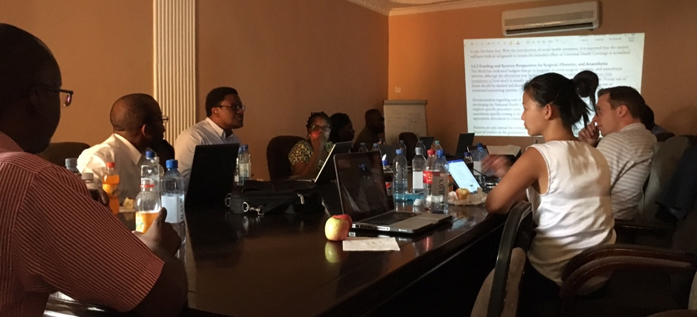
Costing
Total Cost Summary
 | Cost (ZMW)
Service Delivery | 531,559,290
Human Resources | 630,889,823
Medical Products and Infrastructure | 1,875,173,997
a) Infrastructure | 964,466,037
b) Equipment | 643,300,057
c) Supplies | 267,407,902
Health Information and Research | 71,684,928
a) Health Information | 69,045,313
b) Research | 806,475
c) Data Quality and Improvement | 1,833,140
Financing | 3,811,475
Leadership and Governance | 218,500
TOTAL COST (ZMW) | 3,113,338,013
Costing Workshop
  Similar structure as writing workshop
  Estimated costs for each part of the plan was discussed
  Based on initial costing, each committee prioritized strategies that could be implemented given financial, workforce, and resource constraints
  Efforts made to coordinate with existing plans within the MOH
332,977,327.60 USD

Slide 30
Costing
Lessons Learned:
Costing process highlights the value of different components of the plan
Evaluation of cost and impact ensures the best use of resources
Consultative process addresses concerns of feasibility, impact, and priority

Slide 31
Governance Plan
MOH
Surgical Coordinator
Anesthesia Coordinator
Obstetric Coordinator
Emergency Health Services
Quarterly coordination meetings
Monthly meetings of the subcommittee on surgical, obstetric, and anesthesia of the service delivery technical working group

Slide 32
Zambia NSOAP
Notes:
May 2017 plan signed, presented

Slide 33
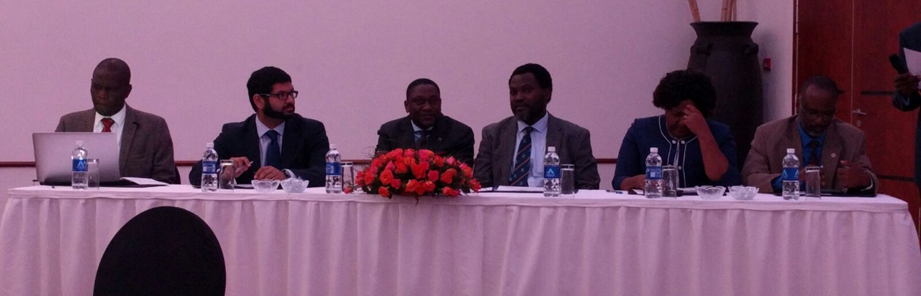
Dissemination
National Surgical, Obstetric, and Anesthesia Forum
Disseminate findings and goals of the plan
Over 50 members of government, advocacy, and professional societies, as well as members of the committees engaged in discussion
Panel members included professional society leaders, MOH, civil society, and PGSSC
Increased buy-in from clinical providers
Opportunity to engage funders, media, and ministry
Notes:
Workshop participants split up again into the 5 domains of a NSOAP, went over the materila again from the committee meetings
Plans were synthesized by each of the sub-committees and reported out to the entire group for further discussion and refinement.
Milestones and metrics were developed to be included within the upcoming National Health Strategic Plan, a five-year plan for 2017-2021.

Slide 34


Further Dissemination
Presented at WHA May 2017
World Congress of Surgery
COSECSA
Open access, available on PGSSC website

Slide 35

Implementation
Current Priorities and Initiatives
District/Level 1 Hospitals
Essential and Emergency Surgery
Obstetrics
Anesthesia

Slide 36
Questions?

