Slide 1
Financing NSOAP
Kee B. Park, MD
Consultant, Emergency and Essential Surgical Care Programme
World Health Organization

Slide 2
Baseline
NSOAP
Implementation
Targets

Slide 3
Maternal Health
NCDs
Injuries
Workforce
CDs
Surgery, Obstetrics, Anesthesia

Slide 9
Global Fund, PEPFAR
Infrastructure
Medications
Workforce

Slide 10
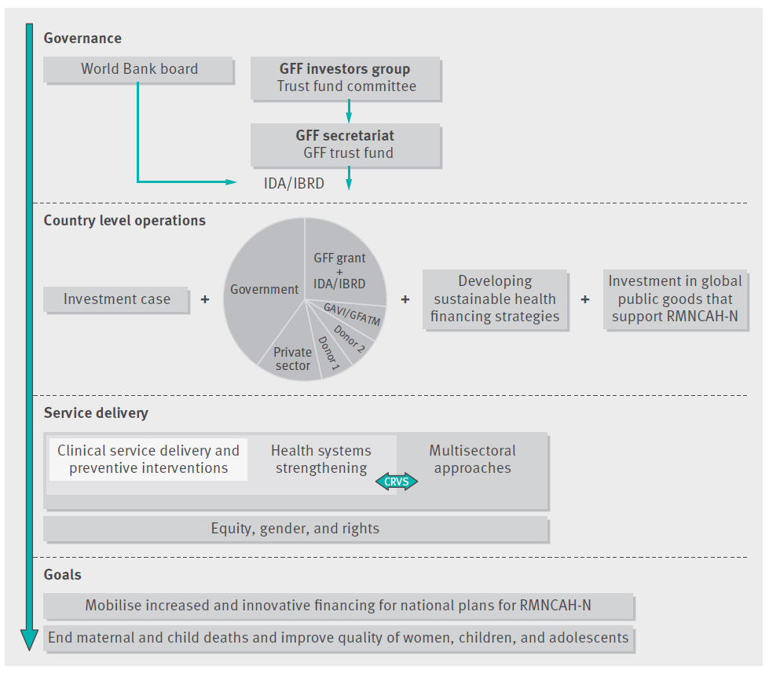
NSOAP Team
GFF Team
Investment Case
Source: Fernandes Genevie, Sridhar Devi. World Bank and the Global Financing Facility BMJ 2017; 358 :j3395

Slide 11
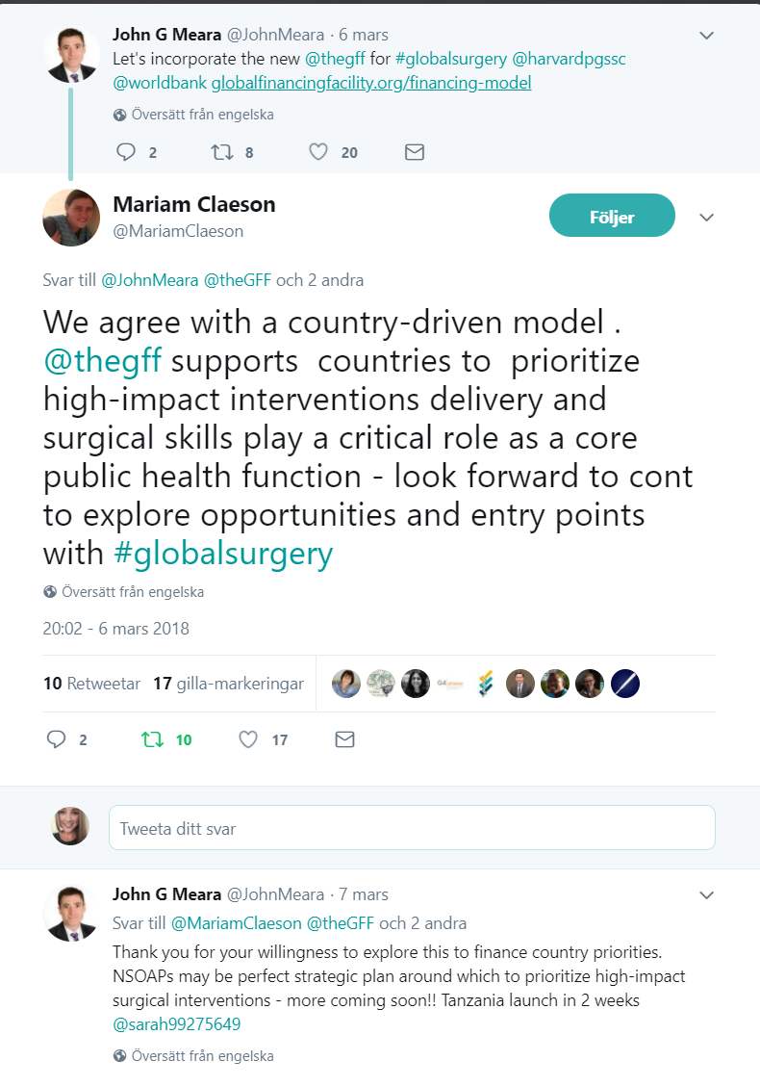
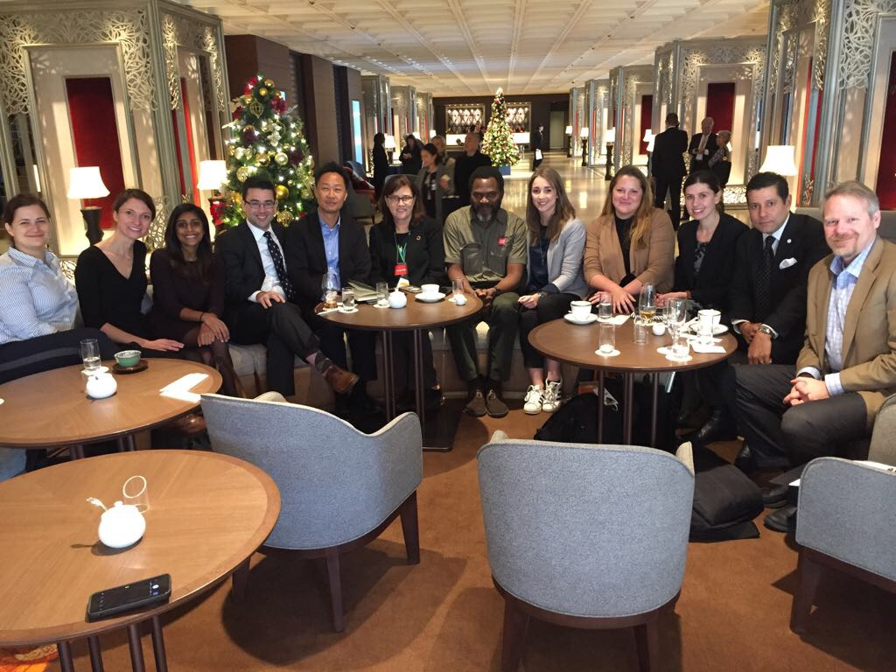
A future for GFF and Surgery
Notes:
Despite the clear need for surgery to address many RMNCAHN issues, the GFF has not yet focused on surgical care
Those times are changing:
screenshot Miriam tweet - “GFF is ready”
mention meetings in Tokyo and DC?
Everyone else is working with GFF: GAVI, GF, etc
We will lag behind if we don’t
Now is the time.
Surgical community is ready: NSOAPs = country level investment cases
Here’s are some possibilities:

