Slide 1
The Role of Obstetrics in NSOAP
Lauri Romanzi, M.D., FACOG
March 21st, 2018

Slide 2
Investment in Obstetrical Care is Essential to Achieve the SDGs
SDG 3: Good health and wellbeing
3.1 Reduce the global maternal mortality ratio to less than 70 per 100 000 live births.
3.2 Reduce neonatal mortality to at least as low as 12 per 1000 live births
SDG 5: Achieve gender equality and empower all women and girls
End all forms of discrimination and violence against all women and girls.
Eliminate all harmful practices such as female genital mutilation.
Ensure universal access to sexual and reproductive health and reproductive rights

Slide 3
LCoGS Key Messages And Targets Are Intricately Related To Maternal Health
Indicator 1: 2 hour access to care
Time to mortality from untreated post-partum hemorrhage
Indicator 2: SOA workforce density
Correlated with reduced maternal mortality
Indicators 5 & 6: Catastrophic and impoverishing expenditure
Cesarean Section as the index surgical procedure
Bellwether procedures
Cesarean Section
Three Delays Framework

Slide 4
Collaboration between Maternal and Neonatal Care and Emergency and Essential Surgical Care
Infrastructure, equipment, supplies
Human resources
Research and quality improvement
Finance and resource mobilization

Slide 5
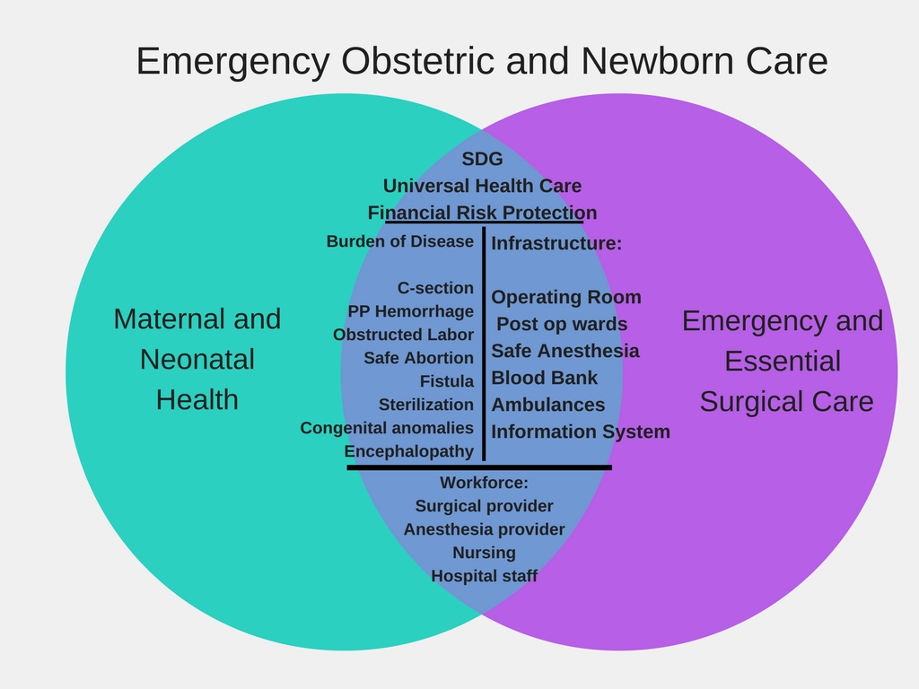

Slide 6
1. Infrastructure, Equipment, Supplies
Overlap of Infrastructure, equipment and supplies between CEmONC and emergency and essential care
Cesarean sections are most common surgery performed in LMIC
Upgrade existing infrastructure to perform other essential surgical procedures
Promote efficient use of resources via collaboration
i.e. Blood banks

Slide 7
2. Human Resources
Safe obstetrics requires safe anesthesia
Expansion of CEmONC services must include expansion of anesthesia providers
Overlap in specialists’ skills and allied health professional support needed to perform C-section and other emergency surgical services
Academic and professional societies role to train specialized surgical workforce and provide continuous professional development
COSECSA and ECSACOG
West African College of Surgeons

Slide 8
3. Research and Quality Improvement
Baseline surgical indicator collection
Maternal mortality rate and neonatal mortality already reported in many countries
Expand to include POMR from all surgical conditions
C-section rates widely available
Expand to include ALL surgical volume
Collaboration between SOA to build research capacity

Slide 9
4. Finance and Resource Mobilization
Efficient distribution of resources by coordinating financing of maternal health and surgery initiatives as access to safe surgery is essential to reduce maternal mortality.
World Bank’s Global Financing Facility support of Every Woman Every Child
Create awareness among funders of overlap between maternal and care to demand co-ordination to magnify impact on surgical systems strengthening

Slide 10
Leveraging Maternal Health Services to Strengthen Surgical Care
Maternal and child health are part of most national health plans
High priority in most countries
Leverage existing plans and funding to strengthen surgical systems
Use existent advocacy groups and resources from maternal health to strengthen surgical systems
Learn from existing maternal health processes and expand to broader surgical and anesthetic systems

Slide 11
Leveraging Surgical Services to Strengthen Maternal and Womens’ Care
Expand maternal care beyond skilled birth attendants and antenatal health care to include comprehensive high quality obstetrical and gynecologic care
Promote collaboration of Obstetrics with Surgery and Anesthesia to develop strong surgical systems that prevent and treat:
Obstetrical and Iatrogenic Fistula
Gynecological cancer
Pelvic floor disorders e.g prolapse, incontinence, etc

Slide 12
Conclusion
Investment in obstetrical care is essential to achieve the SDGs
Areas for collaboration between Maternal and Neonatal Care and Emergency and Essential Surgery Care include:
Infrastructure
Human Resources
Research and Quality Improvement
Finance and Resource Mobilization
Collaboration between Obstetrics, Surgery and Anesthesia in NSOAP is essential to improve maternal and neonatal care while strengthening surgical systems
between Maternal and Neonatal

