Slide 1
National Surgical, Obstetric and Anesthesia Planning
John G Meara MD DMD MBA
Kletjian Professor of Global Surgery
Program in Global Surgery and Social Change, Harvard Medical School

Slide 2
NSOAP components
Infrastructure
Workforce
Service Delivery
Financing
Information Management
Notes:
What are the key components of an NSOAP

Slide 3
When and Where?

Slide 4


Slide 5


Slide 6

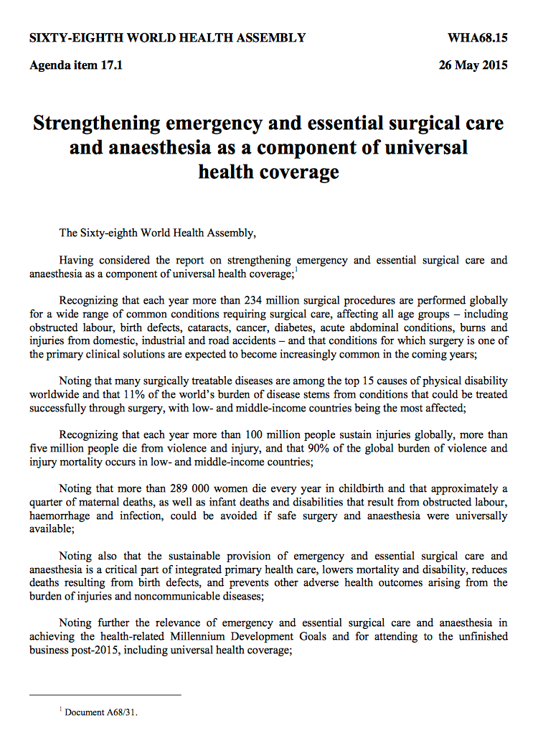

Why, and why now?

Slide 7
NSOAPs and UHC
Notes:
Why this is a good time
The link to UHC (SDG3.8)

Slide 8
Surgery complex – from piecemeal to NSOAP
Service Delivery
Health Workforce
Health Information Systems
Access to Essential Medicines
Financing
Leadership / Governance
Notes:
Surgery, anaesthesia and obstetrics (SOA) are complex interventions requiring a strong health system across each of the six domains of the WHO building blocks. Given the complexity and co-dependence of these domains, vertical condition-specific programs or programs aimed at a single domain, for example infrastructure, are unlikely to have a sustained impact on capacity or quality

Slide 9
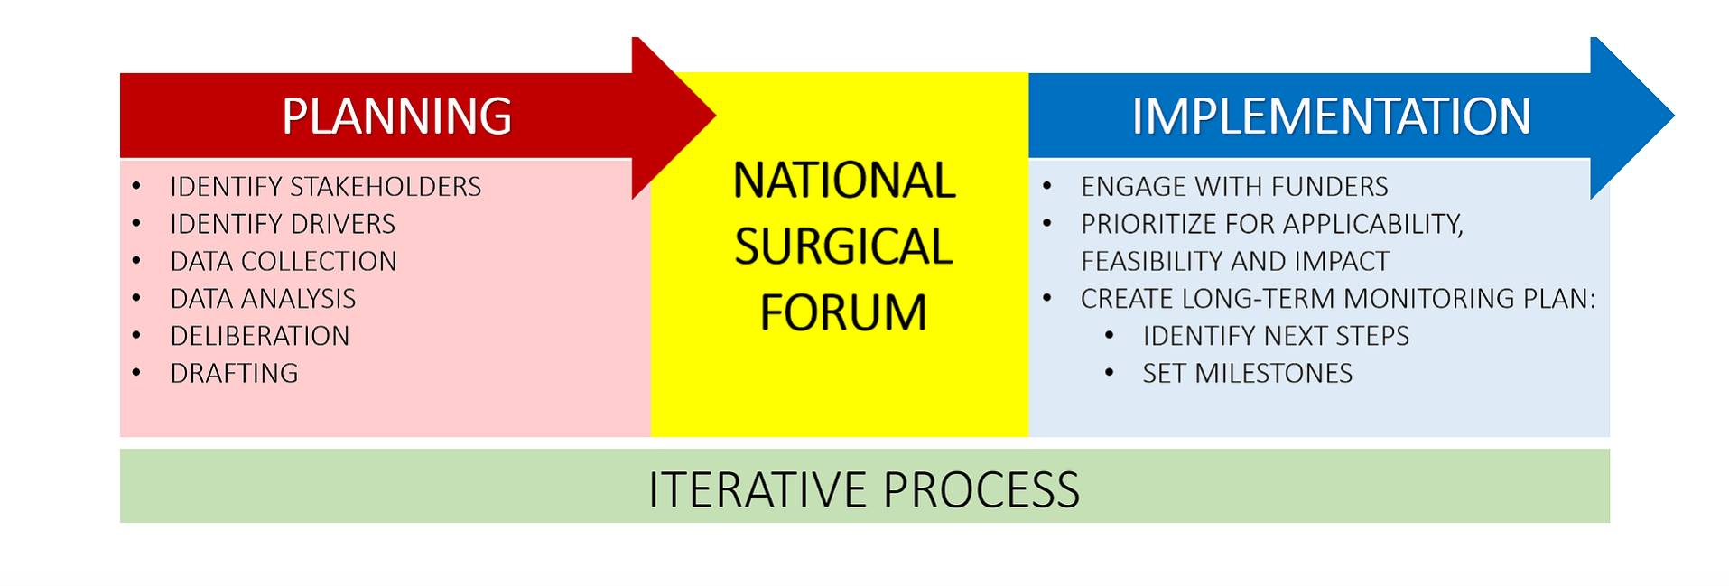
NSOAP process

Slide 10
Benefits of NSOAPs
Visibility and Accountability
National Participatory Priority Setting
Efficiency and Coordination

Slide 11
NSOAP platform for international & domestic investment
Improved coordination of investments
Improved efficiency of spending
Improved transparency
Platform to attract additional funds
Attractive investment case
Notes:
By improving coordination of investment of both national and international resources, between funding agencies and between building blocks of the plan, National surgical plans improve efficiency of spending of domestic resources. Improved efficiency of domestic resource funding will be crucial if the projected x billion dollar funding gap if the SDG targets are to be met.
Plans can help be a platform for new donation. In addition to improving efficiency of current resources the National plan makes an attractive platform to attract additional funding. A strong rationale for certain activities, along with a clear, costed implementation plan makes an attractive investment case for these activities.

Slide 12

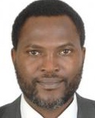
Need for champions
Notes:
Crosscutting nature of surgical care serving many diseases such as cancer, heart disease, tuberculosis, trauma and obstetrics makes definition and advocacy challenging
However, investment in surgical care has benefits well beyond surgery as laboratory, imaging, laundry, blood, critical care services prioritised in any NSOAP, are also crucial to the functioning of the wider health system
This further adds to the cost effectiveness of investment in surgical care and makes it an appealing vehicule for broader health systems strengthening

Slide 13
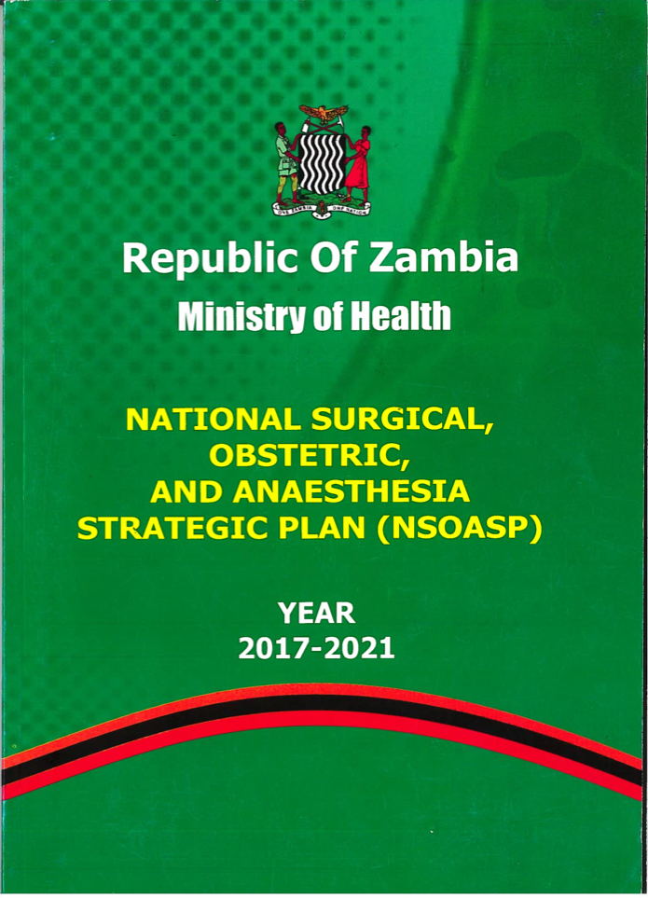
Zambia
Notes:
The first country that has gone through a comprehensive NSOAP process already is Zambia – and implementation is underway. Another country is Ethiopia. The important part of costing and budgeting is crucial to achieve implementation

Slide 14
Need for budgeting - Tanzania
Domain | Implementation cost per Fiscal Year (Costs TZS; 1000s) |  |  |  |  |  |  | Cost per domain (TZS) | Cost per domain (USD)
 | FY 2018/19 | FY 2019/20 | FY 2020/21 | FY 2021/22 | FY 2022/23 | FY 2023/24 | FY 2024/25
Service Delivery | 644,348 | 940,209 | 2,271,394 | 2,733,400 | 2,947,029 | 3,190,844 | 3,713,424 | 17,244,941 | 7,691,767
Infrastructure | 14,144,242 | 75,529,387 | 162,062,015 | 143,113,859 | 111,459,714 | 95,134,276 | 17,362,174 | 618,805,668 | 276,006,096
Human Resource | 25,348,207 | 32,445,908 | 43,063,465 | 55,551,415 | 62,112,857 | 72,751,255 | 94,880,662 | 386,153,769 | 172,236,293
Information Management and Technology | 1,172,071 | 3,848,739 | 2,702,933 | 3,549,224 | 2,565,856 | 3,561,152 | 2,680,111 | 20,080,087 | 8,956,328
Finance | 183,895 | 776,885 | 268,385 | 251,885 | 72,535 | 251,885 | 72,895 | 1,878,365 | 837,808
Governance | 470,514 | 347,520 | 389,149 | 383,124 | 383,124 | 347,520 | 435,514 | 2,773,251 | 1,236,954
Total (TZS) | 41,963,277 | 113,888,648 | 210,757,341 | 205,582,908 | 179,541,116 | 175,236,931 | 119,144,781 | 1,046,936,080 | 466,965,245
Total (TZS) @ 7.5% inflation | 41,963,277 | 122,430,296 | 243,556,452 | 255,395,004 | 239,771,620 | 251,575,278 | 183,876,322 | 1,338,568,247
Total (USD) @ 7.5% inflation | 18,716,894 | 54,607,625 | 108,633,565 | 113,913,918 | 106,945,415 | 112,210,204 | 82,014,417 | 597,042,037

Slide 15
Need for data - 6 LCoGS Indicators
Notes:
M&E of system for baselining and follow-up important
Nod to next speaker Emi Suzuki as she will talk about surgical indicators

Slide 16

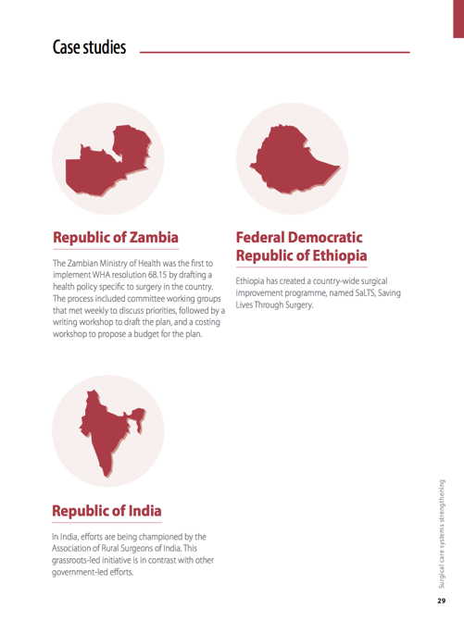
Monograph
Case Reports:
  Zambia
  Ethiopia
  Madagascar
  Uganda
  South Pacific
  Viet Nam
  Brazil
  India
Notes:
Last year a monograph of case studies from 8 countries highlighting success stories and lessons from surgical system strengthening was published jointly by WHO and Harvard

Slide 17
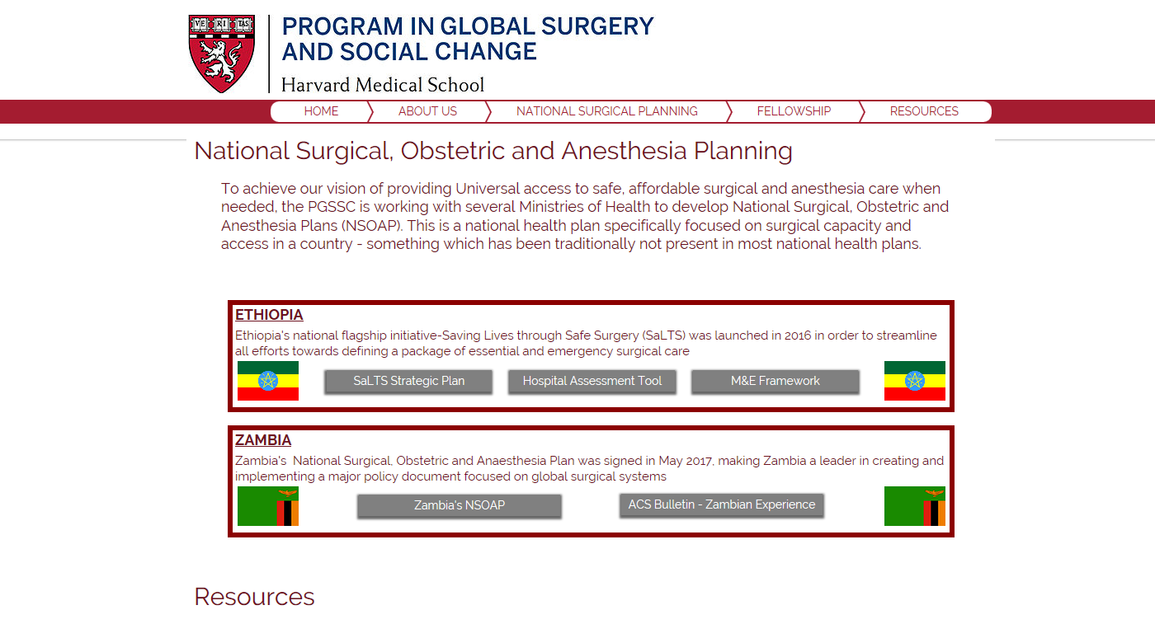
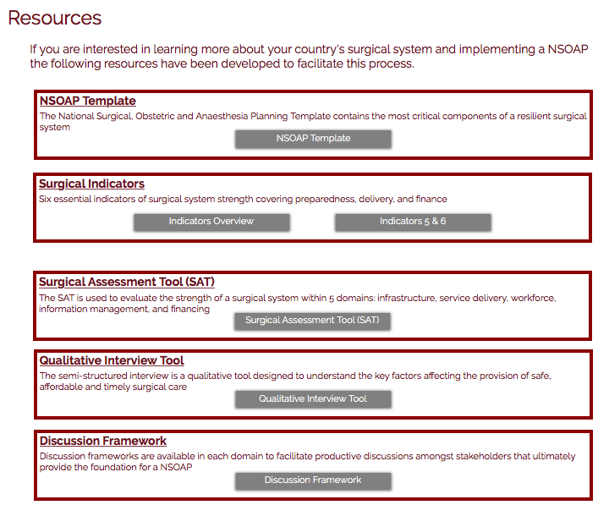
Open access NSOAPs and tools
http://www.pgssc.org/national-surgical-planning
Notes:
So how is this best organized going forward? Our role: organize, advise in regards to the process, (not actual activities..) encourage, and support. Technical

Slide 18
The goals for this meeting
Co-Create and disseminate the knowledge, skills and tools to develop NSOAPs
Build a support network (community) of technical advisors and countries for NSOAP

Slide 19
What must we do?
Advocacy: Champion NSOAPs in your countries
Data: Include surgical data collection, send to World Bank
Funding: Make NSOAPs a funding priority via your governments
Collaboration: Commit to creating an NSOAP community
Communication:
  Create a mechanism for communication amongst yourselves – national NSOAP leaders – that is ongoing
  Publish your work in a wide range of venues

