Slide 1
NSOAP Drafting and Costing: Zambia
Dr. Mzaza Nthele
Director Clinical Care and Diagnostic Services
Ministry of Health
Rep. of Zambia
Notes:
Zambia
First championed the effort at the WHA to prioritize emergency and essential services,
Then translated into efforts to strengthen the surgical system from paper to policy by embarking on a process to create a NSOASP

Slide 2
Outline
Draft compilation
Costing strategy
Lessons learned
Notes:
Outline of the presentation.
Discuss how the draft was created, how the plan was costed and throughout discuss lesson learned along the way, advise to others.

Slide 3
Key Principles
NSOAP Draft
Compilation and prioritization of the committee discussions
Reflection of the evidence-based approach
Aligns with the priorities of the MOH
Not a duplication of other MOH efforts
Fits within the objectives of the overall national health strategic plan
Notes:
First, key principles of creating an NSOAP draft.
Must be a reflection of the committee meeting and stakeholders discussions
Must align with the baseline assessemtents and situational anlaysis that was discussed
Given the need for

Slide 4
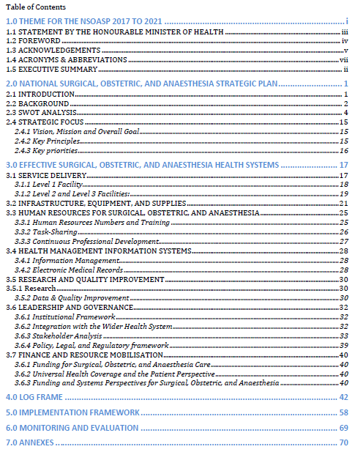
NSOAP Layout
Situational Analysis and Baseline Assessment
Main objectives, activities, and M&E plan for each domain
Costing plan
NSOAP Draft

Slide 5
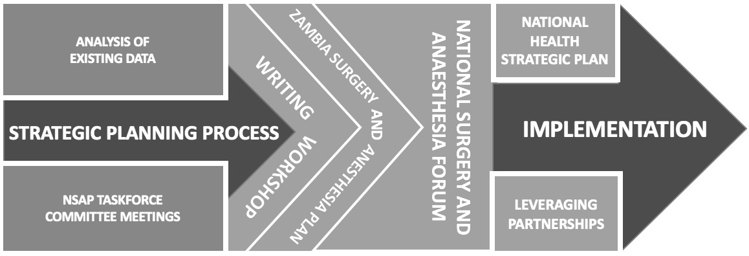
Overview of Developmental Process
February – April 2016
May 2016
September 2016
Notes:
Just a reminder of our process, the majority of the draft writing occurred during writing workshop which was a week long event with all major stakeholders.

Slide 6
Drafting Process
Technical Working Group
Workforce
Service Delivery and Infrastructure
Financing, Information Management and Technology
Writing Workshop
Technical Review Panel
Notes:
But the material for the workshop came from the entire process,
Starting with our original technical work group that was split up into three committees, the multiple meetings that led to a compilation of reports that was sent to the
Technical review panel, that made sure each committee output aligned with the priorities of the MOH, and then that was re-evaluated again at the writing workshop with each domain being critically discussed
That led to the final compilation of the draft.

Slide 7
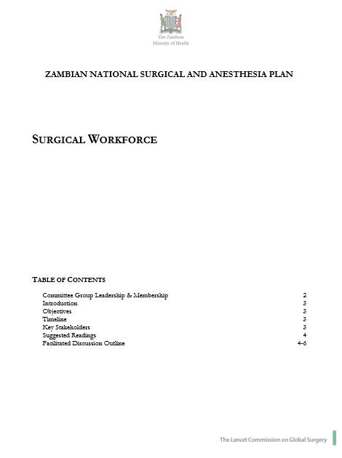
Example: Workforce
Committee Meetings
Main objective: create a report to be reviewed by the Technical Review Panel
Report to Include:
Outline of baseline assessments
Actionable recommendations stratified in a tiered fashion to ensure implementation of the highest priority interventions
Key metrics to monitor success
Indicators and methods of monitoring success at 1,3 and 5 year timeframes
Notes:
To discuss the drafting process, will quickly go through how this was done for service delivery as an example

Slide 8
Example: Workforce
Utilized a Discussion Framework (previously called Terms of Reference) as a guide
Key Indicators
Baseline Assessments
Recommendations and M&E Plan
Notes:
Utilized a discussion framework to guide these discussions and stay on task.
Example of work force discussion framework.
Identify the key indicators relevant to this topic
Baseline assessment / current situation
Decide upon recommendations and M& E plan

Slide 9
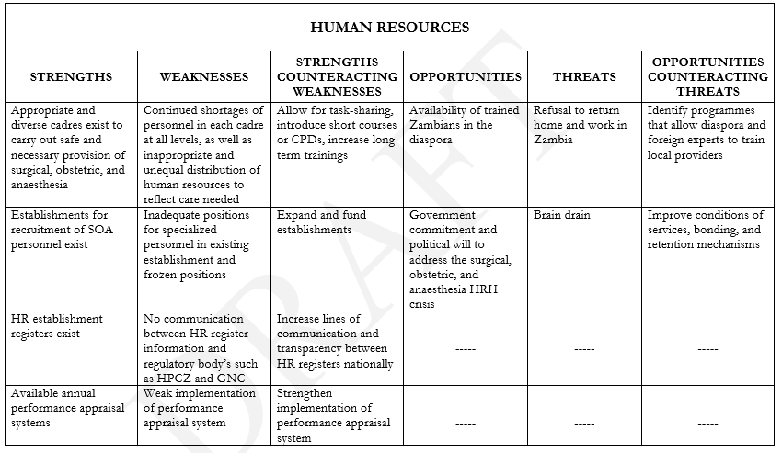
Example: Workforce
Report from Committee Meetings
Baseline Assessment and SWOT Analysis

Slide 10
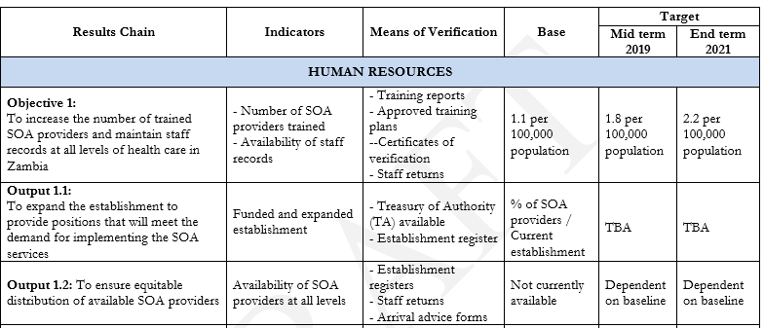
Example: Workforce
Recommendations and M&E Plan
Notes:
Example of some of the recommendations and M & E Plan

Slide 11
Drafting Process
Technical Working Group
Workforce
Service Delivery and Infrastructure
Financing, Information Management and Technology
Writing Workshop
Technical Review Panel
Notes:
Next step, was the TRP

Slide 12
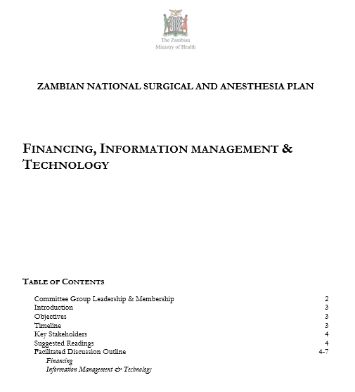
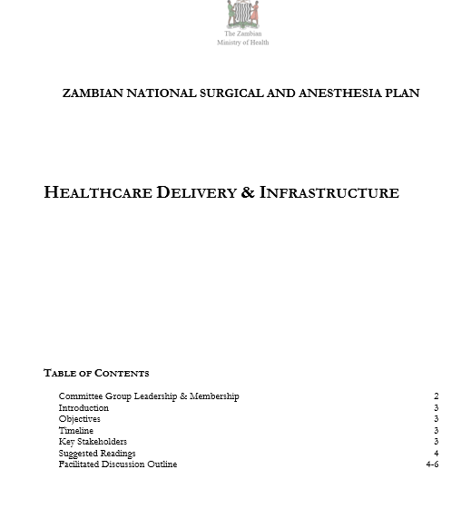
Technical Review Panel
Reviewed each report
Edited based on priorities of MOH and current initiatives
Notes:
Feel free to give examples

Slide 13
Writing Workshop
Main Aim: Compose, clarify and address key initiatives in terms of feasibility, impact and priority
7 day event
All major stakeholders and new members of MOH to facilitate appropriate language and structure
Split up stakeholders again by domain
Reviewed all initiatives, reported to large group
Final SWOT analysis for accepted initiatives and objectives
Development of Monitoring and Evaluation plan
Workforce
Service Delivery
Financing
Infrastructure
Information Management and Technology
Stakeholders
Notes:
Workshop participants split up again into the 5 domains of a NSOAP, went over the material again from the committee meetings
Plans were synthesized by each of the sub-committees and reported out to the entire group for further discussion and refinement.
Milestones and metrics were developed to be included within the upcoming National Health Strategic Plan, a five-year plan for 2017-2021.

Slide 14
Writing Workshop
NSOAP Draft Organization
Introduction
Vision and overall goals of plan
Chapter on each domain (infrastructure, service delivery, workforce, finance, information management, governance)
Tables
M&E plan with indicators
Costing
Notes:
Workshop participants split up again into the 5 domains of a NSOAP, went over the materila again from the committee meetings
Plans were synthesized by each of the sub-committees and reported out to the entire group for further discussion and refinement.
Milestones and metrics were developed to be included within the upcoming National Health Strategic Plan, a five-year plan for 2017-2021.

Slide 15
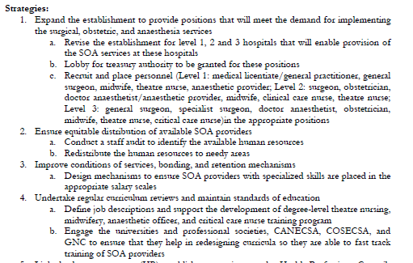
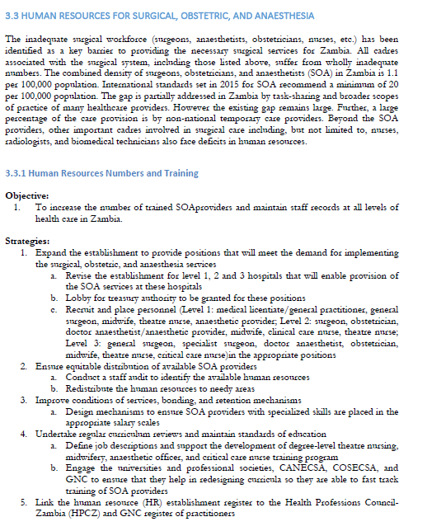
Workforce Example
Workforce Chapter
Notes:
Final product, Each domain with background info, an objective, strategy.
Using workforce as the example, Here are a few of the strategies or activities that we came up with.
Expand the establishment to provide positions……
Ensure equitable distribution of available SOA providers
Improve conditions of services, bonding, and retention mechanisms
Undertake regular curriculum reviews and maintain standards of education

Slide 16
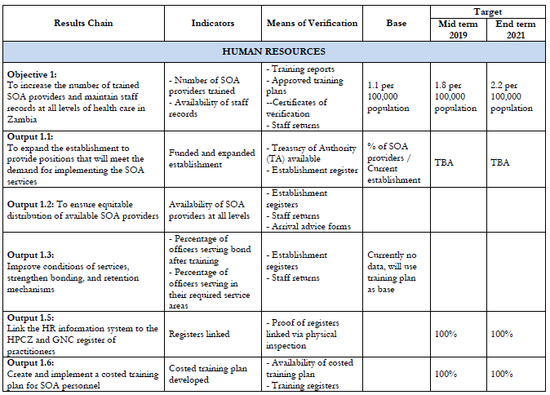
Workforce Example
Final Indicators, M&E
Notes:
Here is how we organized what ind

Slide 17
Writing
Lessons Learned:
Determining activities must be in the context of known baseline
Measures for implementation (indicators, monitoring and evaluation plan) must be discussed and agreed upon
Involvement of policy writers fluent in the language of MOH documents to ensure ease of incorporation into national health plan
Important for implementers to be part of the process to provide expertise in feasibility and execution of activities

Slide 18
Costing Workshop
Main Aim: “Explore the art, science, and magic of connecting financial resources to the proposed activities.”
Similar structure to writing workshop (organized by domain)
Included Ministry of Finance specifically and other stakeholders
Each activity of the plan was costed
Based on initial costing, attendants prioritized strategies given the financial, workforce, and resource constraints
Notes:
Costing should be performed for the whole Plan.
Strategic and thoughtful costed plan will also aide in discussions with funding bodies, implementation partners, and create more aid advocacy and appropriate utilization.

Slide 19
Costing
How to Cost:
Assemble available costing information
Define the cost objects and the quantities
Determine the cost base
Validate Results
Key stakeholders:
Government officials including NSOAP sponsors
Policy experts, budget experts, technicians and costing experts
Clinicians, health system administrators, professional organization representatives
NGO/CSO actors, private sector representatives, and outside consultants

Slide 20
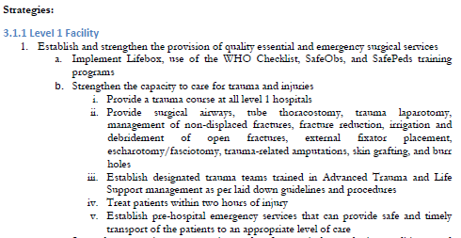
Costing Example: Service Delivery
Notes:
Now will use a strategy from our service delivery domain to discuss how we costed our plan.
One of our activites is to
“establish and strengthen the provision of quality essential and emergency surgical services
Plan to do through:
- implementing lifebox, WHO checklist, SafeObs, and SafePeds training programs
“ strengthen the capacity to care for trauma and injuries
- provide a trauma course at all level 1 hospitals
- provide surgical airways, tube thoracostomy, trauma laparotomy, management of non-displaced fractured, fracture reduction, irrigation and debridement of open fractures, external fixator placement

Slide 21
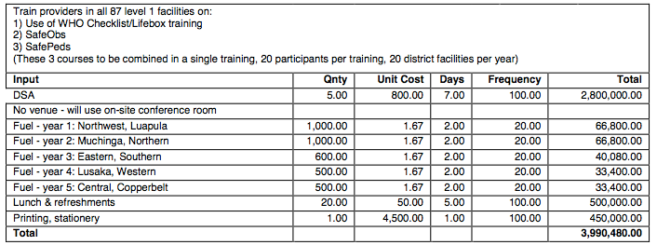
Costing: By Inputs

Slide 22
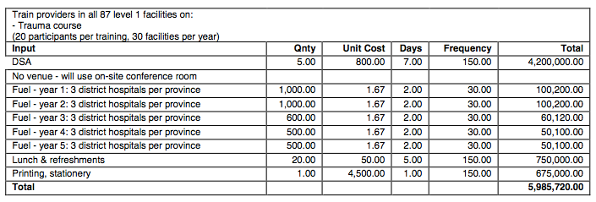
Costing: By Inputs

Slide 23
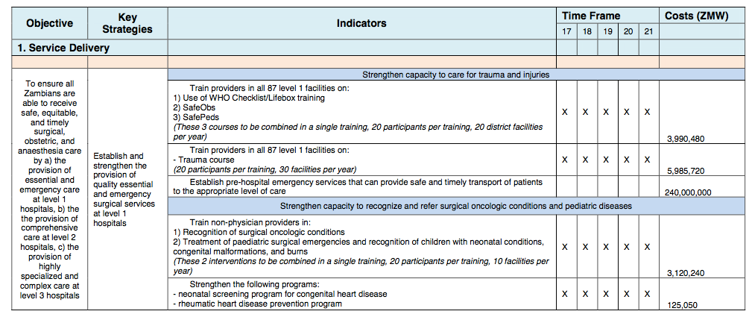
Costing: Final Form

Slide 24
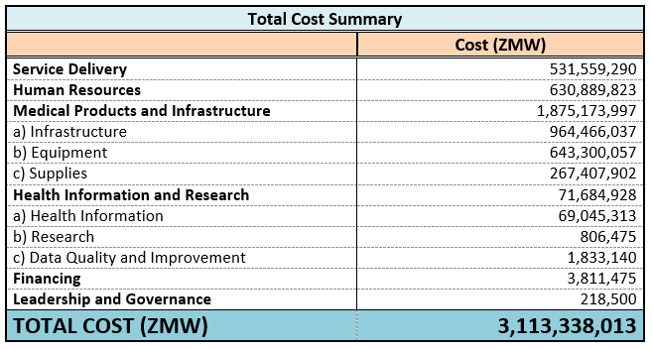
Costing Summary
332,977,327.60 USD

Slide 25
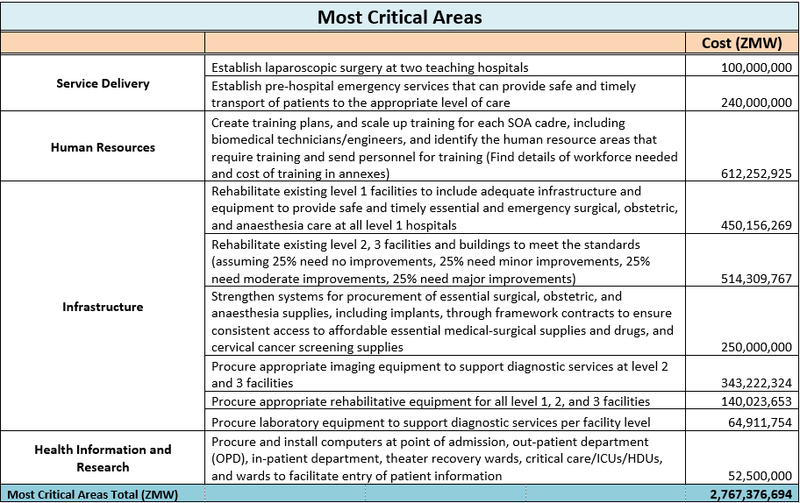
Costing: Most Critical Areas

Slide 26
Costing
Lessons Learned:
Costing process highlights the value of different components of the plan
Evaluation of cost and impact ensures the best use of resources
Consultative process addresses concerns of feasibility, impact and priority

Slide 27
Dissemination
Local Level:
Promote transparency
Increase buy-in from clinical providers who are implementing the plan
Provides an opportunity for continued engagement and advocacy
Opportunity to engage funders, media and ministry
International Level:
Sharing of ideas and innovations for improvement
Problems similar, discussion of successful implementation strategies
Accountability
Indicator collection and progress
Consensus building
Standards, guidelines
Notes:
We chose to have a National Surgical Forum with a panel in order to create full transparency and further engagement by clinical providers and hospital staff

Slide 28
Dissemination
National Surgical, Obstetric, and Anesthesia Forum
Disseminated findings and goals of the plan
Over 50 members of government, advocacy, and professional societies, as well as members of the committees engaged in discussion
Panel members included professional society leaders, MOH, civil society and PGSSC
Increased buy-in from clinical providers
Opportunity to engage funders, media and ministry

Slide 29
Questions?

