Slide 2
Role of professional societies & colleges in NSOAP process
Prof Pankaj G Jani
Dept of surgery
Uni. Of Nbi.
President, COSECSA
Vice Chair board G4A
NSOAP Workshop
Dubai, 22nd March 2018

Slide 3
Professional Societies and Colleges
International
Regional
National
World Health Organization
Surgical Society of Ethiopia
College of Surgeons of East, Central, and Southern Africa (COSECSA)
The Pan African Association of Surgeons (PAAS)
Ethiopian Society of Obstetricians & Gynecologists
The United States President’s Emergency Plan for AIDS Relief (PEPFAR)
World Federation of Societies of Anaesthesiologists (WFSA)

Slide 4
Int. professional Societies
WFNS: have Local Champions with plan on how to address needs in N.S.
(N.S. training at Mbarara and Mombasa)
WFSA: Have immense amount of Data that can assist

Slide 5
Role
Be a deeply involved partner IE be a KEY Partner: Why and How?
Need to use strengths of all stakeholders
Champions important

Slide 6
COSECSA
College of Surgeons of East Central and Southern Africa
12 Member countries
Training 506 in 19 countries
Pop. Covered approx. >350M

Slide 7
7 Satellite countries Niger, Gabon, Cameroon, Sudan, Somaliland, Lesotho & DRC

Slide 8
COSECSA operation
COSECSA is a “College without Walls”
We use national resources to train:
Established training institutions (Uni.s)
Health care delivery institutions (Regional public, Faith based, and Private Hosps.)
TRAINERS:
-- Practitioners and employed educators deliver training
TRINEES:
-- Employees engaged by health delivery systems
The whole country is a training ground
Students do not need to be relocated to main cities in order to train

Slide 9
Strategic plan

Slide 10
Growth in Graduate Numbers

Slide 11
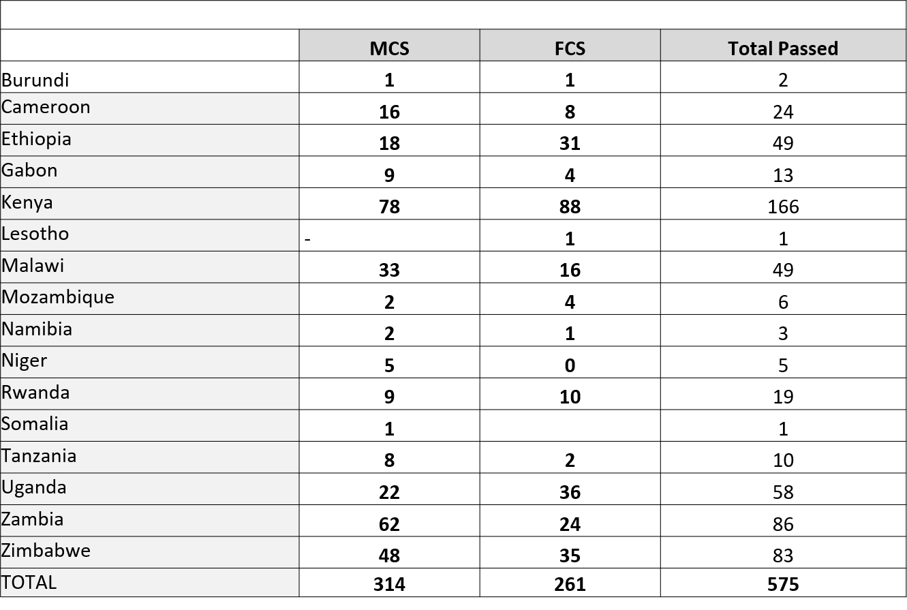
Total qualified

Slide 12
Surgical workforce in region
Total number of surgeons and trainees in ECSA Region approx. – 2500
Total number of surgeons trained by COSECSA (261) and trainees (507) in COSECSA – 768
Today approx. 30% of the Surgical force in the ECSA region is from COSECSA
Approx. 30% of Surgical trainees in the ECSA region are COSECSA Trainees

Slide 13
COSECSA - training
Surgical training institution with a network of 106 accredited hospitals in the region
Active training in 66 hospitals
Huge advocacy effect

Slide 14
Competency based training
Cognitive domain: knowledge
Psychomotor domain: skills
Affective domain: attitude

Slide 15
Knowledge
Lectures, Discussions, M&M’s, Journal Clubs
Wd Rounds, Clinics Teaching, Theatre teaching, Skills labs
Confs., W/Shops, Seminars
+++ E-Learning: BSSc modular training with formative assessments

Slide 16
Skills
Psychomotor (Skills lab)
Communication (actors/simulated pts. etc)
Clinical decision making (Case Studies)

Slide 17
Skills training
Easy, Minor, Simple, ------ To ------- Complex Skills training
Low Dose High Frequency

Slide 18
Skills labs - psychomotor
LOCAL:
in each hospital for basic surgical skills
CENTRAL

Slide 19
Attitude
Affective Domain of the brain
Role Modelling, Mentoring, Tutoring
Simulated Pts. (Actors)

Slide 20
Improve competency
Monitor Formative assessments thro E- Platform
Trainee rotations to “Best” centers
Local Visiting Faculty, using capable surgeons
More in-hospital skills labs training

Slide 21
Entrustable Professional Activities - basic
(To assess competency)
Two competencies are foundational to all of the EPAs because they are required for any entrustment decision:
1) trustworthiness and
2) self-awareness of limitations that leads to appropriate help-seeking behaviour

Slide 22
Service Delivery
Log book data:
--- Surgical Volume
--- can add great value to planning

Slide 23
Curriculum revision
Meeting in April, Addis

Slide 24
Infrastructure
Data on 106 hospitals accredited for training:
--- Surgical Facilities
---- Blood availability
---- Facility operationalisation

Slide 25
COSECSA admin. capacity
Increased financial management capacity - recruitment of financial officer in November 2017.
Increased local capacity and local linkages with Secretariat - recruitment of country coordinators throughout 2017.

Slide 26
Research
Recruitment of ECAJS Assistant Editor
Published data on high retention rates of surgeons trained in the region

Slide 27
Secretariat and support
CEO
Finance officer
Senior Programs Officer
Exams and training officer
Research officer
2 Country Reps. + Senior Members
1 Country Coordinator.

Slide 28
COSECSA: Workforce
 | COUNTRY | POPULATION (MILLION) | D/H PRESENT | D/H REQUIRED | SURGEONS REQUIRED IN 10 YRS (2 PER D/H) | SURGEONS REQUIRED PER YEAR | TRAINING HOSPITALS REQUIRED ( 3 PER YR) | ACCREDITED HOSPITALS | SURGEONS TRAINED IN COSECSA PER YR | SURGEONS TRAINED IN UNI PER YR | NO. OF DR.’S GRADUATING | NO. OF DR.’S GRADUATING REQUIRED TO DO SURGERY | GENERAL SURGEONS PRESENT
1 | KENYA | 49 | 257 | 245 | 514 | 52 | 17 | 14 | 25 | 35 (3) | 750 | 8% | 500
2 | ZAMBIA | 17 | 85 | 70 | 170 | 17 | 6 | 13 | 30 | 71 | 200 | 15% | 85
3 | RWANDA | 12 | 42 | 50 | 84 | 9 | 3 | 4 | 2 | 10 | 80 | 15% | 60

Slide 29
Surgical capacity study
Plan to carry out a Surgical capacity study in Kenya

Slide 30
COSECSA in Kenya - workforce
Plans to establish training strategy based on population and needs of country
Kenya: VISION
257 D.Hosps. --- Plan to train 2 Gen. surgs. Per DH.(Coll.)
25 County Ref. Hosps. --- Plan to train 5 Sp. Surgs Per CRH.(Uni.)
8 Regional Ref. Hosps. --- Plan to train 7 Sp. Surgs Per RRH.(Uni.)
2 National Ref. Hosps. --- Plan to train all sp. Surgs reqd. ( Uni.)

Slide 31
Workforce
 | COUNTRY | POPULATION (MILLION) | D/H PRESENT | D/H REQUIRED | SURGEONS REQUIRED IN 10 YRS (2 PER D/H) | SURGEONS REQUIRED PER YEAR | TRAINING HOSPITALS REQUIRED ( 3 PER YR) | ACCREDITED HOSPITALS | SURGEONS TRAINED IN COSECSA PER YR | SURGEONS TRAINED IN UNI PER YR | NO. OF DR.’S GRADUATING | NO. OF DR.’S GRADUATING REQUIRED TO DO SURGERY | GENERAL SURGEONS PRESENT
4 | TANZANIA | 55 | 169 | 275 | 338 | 34 | 12 | 6 | 4 | 20 | 1100 | 5% | 180
5 | UGANDA | 42 | 139 | 190 | 278 | 29 | 10 | 6 | 3 | 40 | 200 | 20% | 240
6 | ZIMBABWE | 16 | 92 | 80 | 184 | 19 | 7 | 8 | 10 | 23 | 230 | 12% | 140

Slide 32
Workforce
 | COUNTRY | POPULATION (MILLION) | D/H PRESENT | D/H REQUIRED | SURGEONS REQUIRED IN 10 YRS (2 PER D/H) | SURGEONS REQUIRED PER YEAR | TRAINING HOSPITALS REQUIRED ( 3 PER YR) | ACCREDITED HOSPITALS | SURGEONS TRAINED IN COSECSA PER YR | SURGEONS TRAINED IN UNI PER YR | NO. OF DR.’S GRADUATING | NO. OF DR.’S GRADUATING REQUIRED TO DO SURGERY | GENERAL SURGEONS PRESENT
7 | MOZAMBIQUE | 29 | 128 | 145 | 256 | 26 | 9 | 3 | 3 | 20 | 200 | 20% | 70
8 | ETHIOPIA | 102 | 215 | 510 | 430 | 43 | 15 | 13 | 20 | 20 | 3000 | 2% | 470
9 | MALAWI | 18 | 28 | 90 | 56 | 6 | 2 | 4 | 5 | 1 | 80 | 10% | 35
Mozambique: Language issue
Malawi: Dr’s NOT taking up surgery as a profession

Slide 33
COSECSA
COSECSA’s value in sharing experience between African Countries
COSECSA has particular expertise in certain key areas to bring to the Planning Process/Implementation (workforce)
COSECSA can supply important and accurate data

Slide 34
COSECSA – Political buy-in
COSECSA has the political by-in in most member countries
Kenyan DMS at HMC Pre-Conf. on 19/3/18 reaffirmed expansion of COSECSA training centers
MP&DB in Kenya talking about possibility of COSECSA mounting a common examination for the 4 post-grad training programs – possibility of spreading to the region

Slide 35
INVITATION TO OUR COSECSA MEETING Dec.,3rd to 8th Kigali Rw.

Slide 36
ASANTE SANA
president@cosecsa.org
pjani53@gmail.com

Slide 38
7 SATELITE COUNTRIES – NIGER, CAMEROON, GABON, LESOTHO, SOMALILAND, DRC, SUDAN.

Slide 40
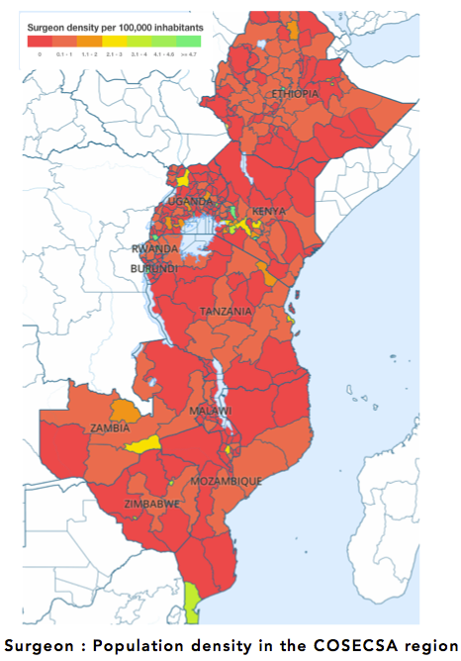
106 ACCREDITED TRAINING HOSPITALS
66% of COSECSA accredited training hospitals are based outside capital cities.

Slide 41
Professional Societies & Colleges
Collective Interest
Shared Vision
Clinical Training
Technical Expertise
Crossing Borders
Notes:
Represent the collective interests of surgical, obstetric, and anesthesia providers
Shared vision for the field of surgical delivery
Clinical training
Technical expertise
Resource-pooling across country borders

Slide 42
Role of Professional Societies & Colleges in NSOAP
Dr. Pankaj Jani
COSECSA President

Slide 43
INNOVATIVE TRAINING METHODS FOR SURGERY (COSECSA a disruptive/innovative Model of training Surgeons For RURAL Hospitals)
Prof Pankaj Jani
President COSECSA
Pre-Conf. Health Ministers Conf.,
Dubai 22nd March, 2018

Slide 44
WACS – A Regionalized Approach
Regionalized approach to SOAP
WACS objectives:
The promotion, organization and conduct of postgraduate education and training in surgery, related disciplines and specialties in West Africa
The fostering and coordination of education and research in surgery and related disciplines
WACS 58th Scientific Conference
Global Surgery Implementation for West Africa

Slide 45
Pan African Association of Surgeons
Aims
Address/identify the surgical problems in Africa
Coordinate surgical training and research
Capetown, South Africa, 2014
PAAS calls upon policy makers and governments to:
Include the providers of surgical care in all planning for the delivery of sustainable and comprehensive health care.
Create mechanisms to promote and ensure the development of human resources by facilitating access to training opportunities
Ensure that the provision of surgical infrastructure is made mandatory in all planning at the level of the District Health Service
2017 Global Surgery Implementation Conference

Slide 46
COSECSA ACHIEVEMENTS
Graduated 261 specialist surgeons
550 Current surgical trainees
290 Trainers of whom 28 are Master Trainers
1128 Members and Fellows
106 Accredited training hospitals
Regional suite of short courses
Comprehensive e-learning platform
Bespoke surgical electronic logbook
Advocacy for essential surgery in Africa
Establishment of Women in Surgery Africa

Slide 47
COSECSA – A Training Example
Vision: to be a leading organisation in surgical training, standards and research, in our region and beyond
Mission: to increase accessibility of surgical services, especially to African rural populations by standardising and widening access to surgical training, skills and knowledge
Mandate:
To promote the honour and dignity of the surgical profession and patients
To promote and encourage postgraduate education, training and research in surgery
To advance the science and practice of surgery in the region
A training example
Common surgical training programme with a common examination and an internationally recognised surgical qualification
Centered postgraduate training opportunities within first-level hospitals
Essential Surgical Training for Non-Surgeons

Slide 48
COSECSA
College of Surgeons of East Central and Southern Africa
12 Member countries
Training 500 in 19 countries
Pop. Covered approx. >350M

Slide 49
ASANTE SANA
president@cosecsa.org
pjani53@gmail.com

Slide 50
Regional bodies
As we learn, we must the involve the execs. of such regional bodies from the outset
They have a lot to contribute
Success will be greater if we seek inroads in areas of their expertise

Slide 51
Mission
The Mission of
COSECSA is:
To promote access to and excellence in Surgical Care, Training and Research.

Slide 52
Manpower
Close to one third of the surgeons in the region are COSECSA Members/Fellows
COSECSA has well established communications channels

Slide 53
COSECSA
Standardized competency based curriculum and
Standardized examinations
Plans to establish training and education strategy based on population and needs of country

