Slide 1

Tanzania Case Study
Dr Sarah Maongezi MD MPH
Acting Assistant Director Non Communicable Diseases
MOHCDGEC Tanzania

Slide 2


Tanzania NSOAP Overview
NSOAP Process
  Directive from Permanent Secretary in November 2016
  Completed January 2018
  Launch March 2018
  ~18 months
Approx. total cost of plan development:
  <$40,000 USD excl. MOH/PGSSC staff time
Technical, Management and Financial assistance from SafeSurgery2020 (GE Foundation)
THE UNITED REPUBLIC OF TANZANIA
MINISTRY OF HEALTH, COMMUNITY DEVELOPMENT, GENDER, ELDERLY AND CHILDREN

Slide 3
Tanzania Context
Population: ~ 56 million
5 zones
3 Main hospitals (1 public, 2 PPP)
Devolved government
  MOHCDGEC (Ministry Of Health, Community Development, Gender, Elderly And Children )
    Policy development
    National, Zonal and Regional Hospitals
    National Budget
  President’s Office of Regional and Local Government (PORALG)
    Policy implementation
    District hospitals and below
    Facility and council budgets

Slide 4
Tanzania Context: WDI Surgical Indicators
SPECIALIST SURGEON, ANAESTHESIOLOGIST AND OBSTETRICIAN
PER 100,000 POPULATION
SURGICAL VOLUME
PER 100,000 POPULATION
0.46
484
Target : 5000/100,000
Target: 20/100,000

Slide 5
Tanzania Context: WDI Surgical Indicators
% PPN. AT RISK OF CATASTOPHIC EXPENDITURE FROM SURGERY
% PPN. AT RISK OF IMPOVERISHING EXPENDITURE FROM SURGERY
65.8%
85.5%
Target 0%
Target 0%

Slide 6
Tanzania Context: WDI Surgical Indicators
%PPN. WITH ACCESS TO SOA CARE WITHIN 2 HOURS
PERI-OPERATIVE MORTALITY RATE
Not Collected
Not Collected
Target: Begin collection with ASA status
Target: 80% coverage by 2030

Slide 7
>200 DIVERSE STAKEHOLDERS CONSULTED FROM ALL ZONES
CLINICIANS
SURGEONS
ANAESTHESIOLOGISTS
OBSTETRICIANS
RADIOLOGISTS
NURSES
ANESTHETISTS
BIOMEDICAL ENGINEERS
MIDWIVES
LABORATORY TECHNICIANS
…
TECHNICAL WORKSHOP
70+ PARTICIPANTS
2 DAYS
5 GROUPS
CIVIL SOCIETY, NGO and END USER
TSA
AGOTA
SATA
MAT
APHFTA
CSSC
TOUCH FOUNDATION
SEED
SIKIKA
WHITE RIBBON ALLIANCE
…
WRITING GROUP
FINAL DRAFT
SYSTEMATIC LITERATURE REVIEW
COSTING
GOVERNMENT
CURATIVE SERVICES
POLICY AND PLANNING
HUMAN RESOURCES
PREVENTATIVE SERVICES
TRAINING
PROCUREMENT
PORALG
RMNCH
…
NOV 2016 – MARCH 2017
APRIL 2017
SEPT 2017
NOV 2017
DEC 2017

Slide 8
Conveners
Process led by MOHCDGEC
Directive from Permanent Secretary Mpoki
  Plan Champion
  Anesthesiologist
Department of Curative Services
Cancer Coordinator
MOHCDGEC
Permanent Secretary
Department of Curative Services

Slide 9
Integration into National Health Plan
Integration of a specific SOA statement into revision of National Health Strategy

Slide 10
Stakeholder Identification
Snowball
  Begun within MOHCDGEC
  Then major professional associations within capital
  These entities each recommended other entities and individuals to contact--> Snowball
Stratified
  In addition to those identified to snowball targeted certain key strata
  Ensure each zone represented
  Systematic targeting of different allied health professionals included
  Systematic targeting of different levels of care

Slide 11
Initial engagement
1:1 interviews using interview guides for standardization
  Key themes from interviews recorded to inform situational analysis and adaptation of discussion frameworks
Focus groups
  At certain hospitals a cross section of staff interviewed as a focus group
  At larger hospitals position specific groups e.g nurses, nurse anaesthesiologists interviewed.
Process took 4 months

Slide 12
Key Stakeholders
Professional associations
  Medical Association of Tanzania
  Tanzanian Surgical Association
  Association of Gynaecologists and Obstetricians of Tanzania (AGOTA)
  Society of Anaesthesiologists of Tanzania (SATA)
  Tanzania Orthopaedic Association (TOA)
Educational organisations
  Ifakara
  KCMC
  MUHAS
Provider organisations
  Christian Social Services Commission
  Association of Private Health Facilities of Tanzania

Slide 13
Key Stakeholders (2)
Clinicians and allied health professionals from all zones of Tanzania
  Surgeons
  Anesthesiologists
  Obstetricians
  Radiologists
  Nurses
  Anesthetists
  Biomedical engineers
  Midwives
  Laboratory technicians
Funders, Implementer, CSOs
  Sikika (Patient advocates)
  White Ribbon Alliance
  CCBRT
  Touch foundation
  SEED global health
  WHO
  USAID
Industry
    GE
    Medtronic
    Gradian

Slide 14
Deeper engagement- Technical Workshop
80 people
2 days in capital
Launch by Chief Medical Officer
Policy briefs and existing policy mapping summarising situational assessment circulated 2 weeks ahead of meeting
5 Groups of approx. 8-10 people with cross sectional representation
  Group moderator/chair
  Group Scribe/secretary
Systematic completion of discussion framework during session to ensure what was being recorded reflected their views.
3 cross over sessions for each group to present to other groups and ensure cohesion across domains

Slide 15
Press Coverage

Slide 16
Outputs from the meeting
Completed discussion framework consensus
Discussion frameworks is what was then converted into the zero draft
  Priorities
  Strategic objective
  Outputs
  Metrics
  Targets
Good group cohesion to continue with the next steps of plan
Certain individuals identified as champions for core NSOAP working group

Slide 17
Plan Summary
$1.7 USD per capita per year
3.28 % of health spend
The final NSOAP is
  Ambitious
    31 strategic objectives and >150 individual activities
  Attainable
    < 1.7 USD per capita per year
    3.28% of current health spend
  Inclusive
    Directly reflects the priorities of stakeholders

Slide 18
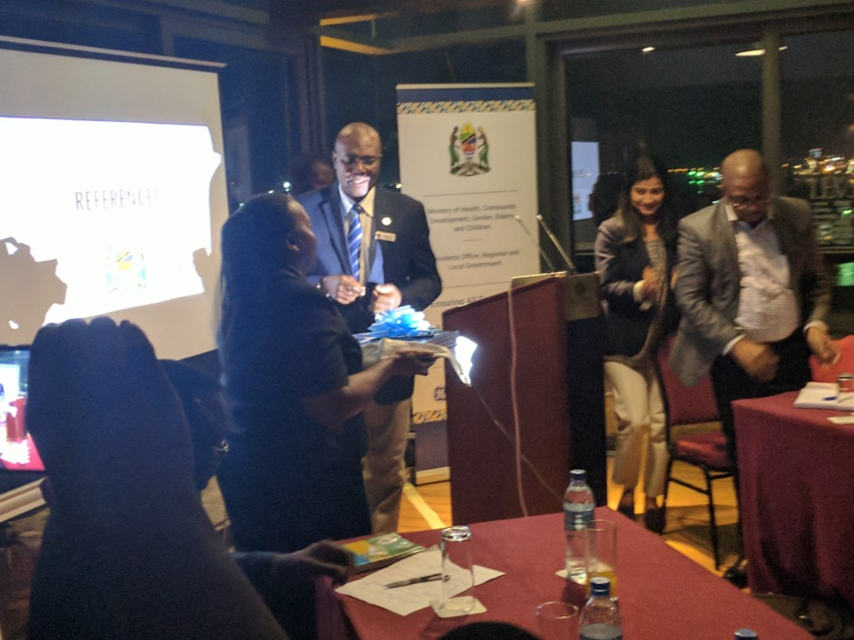
Launch
Launch 19th March 2018
Declaration of Commitment from Permanent Secretary
Plan presented to Ministers of Health from 6 countries
Commitment from Professional Societies
Support from ECSA

Slide 19
Implementation Plans
Implementation
Financing
  Domestic
  External

Slide 20
Conclusion
SOA services are a high priority
There is a proven commitment from the Government of Tanzania
Tipping point to start implementation
Finance
Strong partnership with professional associations

