Slide 1
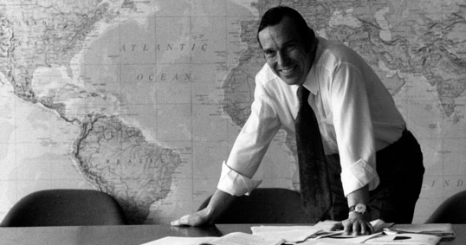
“the vast majority of the world’s population has no access whatsoever to skilled surgical care and little is being done to find a solution.
I beg of you to give serious consideration to this most serious manifestation of social inequity in health care”
Dr Halfdan Mahler (1980)

Slide 2
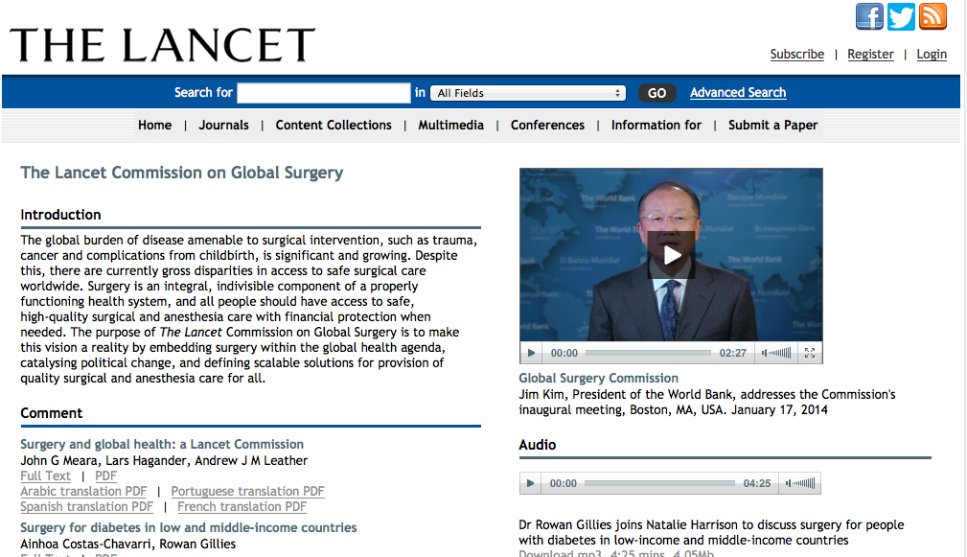
Link to Video

Slide 3
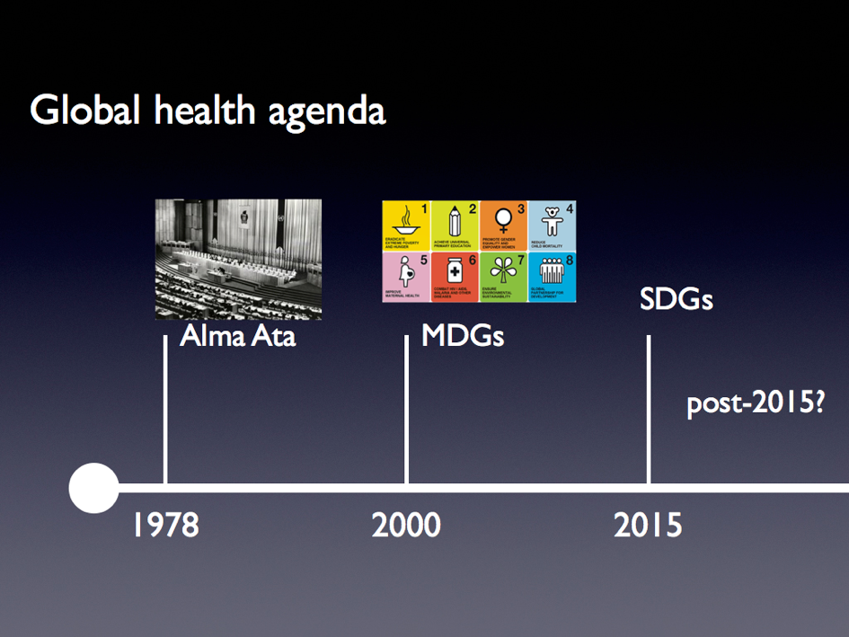

Slide 4
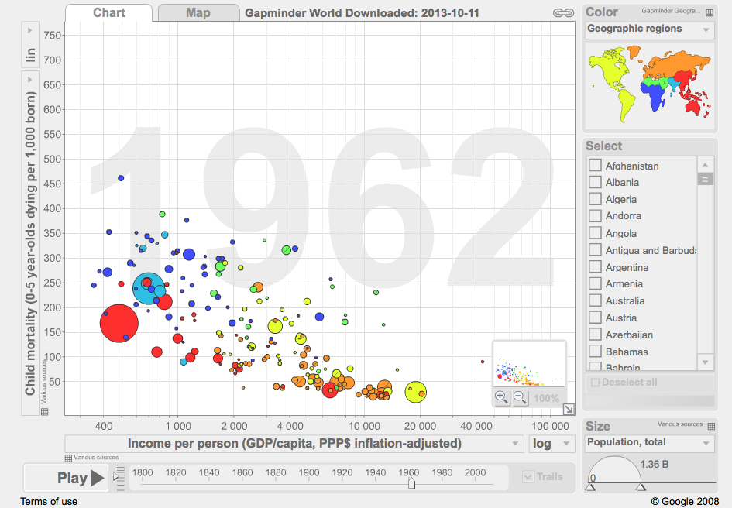
www.gapminder.org

Slide 5
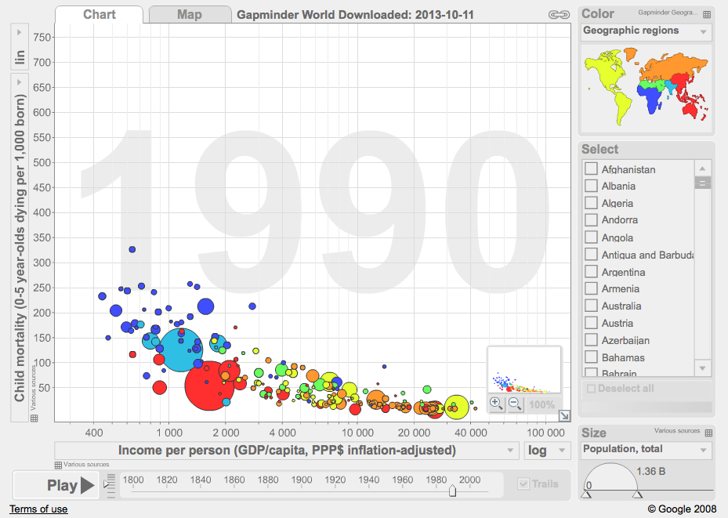

Slide 6
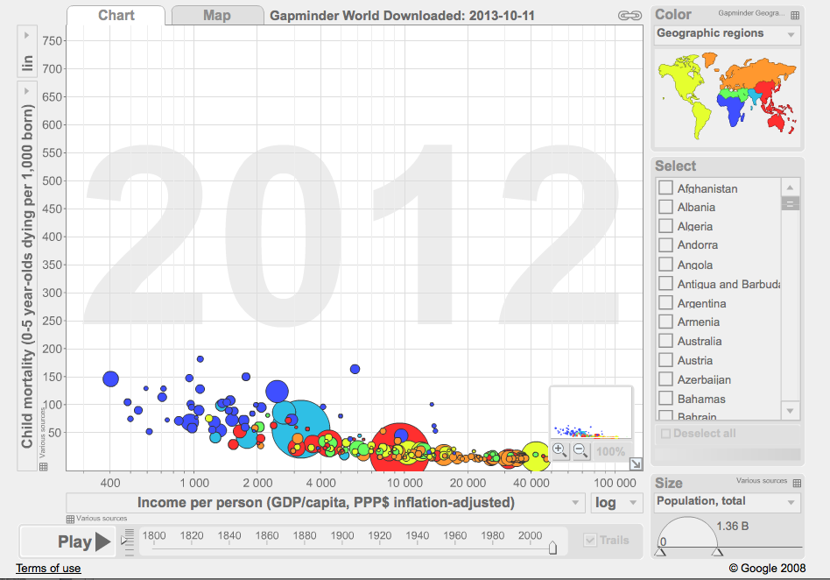

Slide 7

Global surgery data?

Slide 8
Myths about surgery and public health
Surgery is not a global health concern
Surgery is not cost-effective
Surgery is not safe

Slide 9
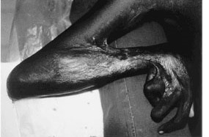
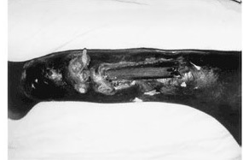
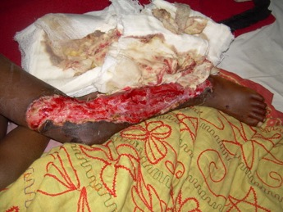
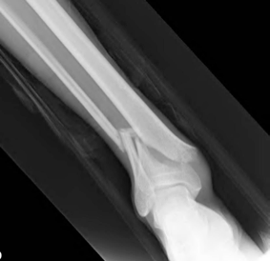
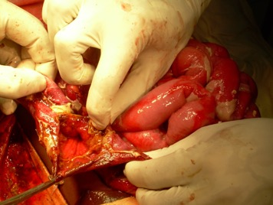
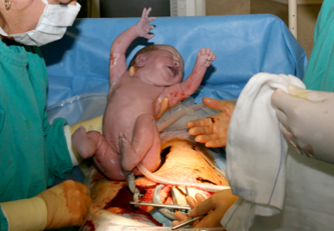

Slide 10
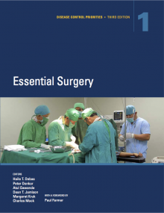
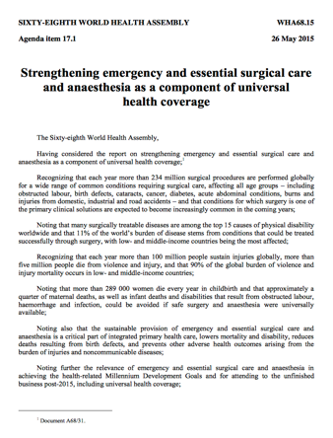
Notes:
2015 was a great year – our community came together and accomplished a tremendous amount strategically
And this is not an exhaustive list – Bangkok and Amsterdam declarations, original Bellagio Working Group and many others….

Slide 11


The Lancet Commission on Global Surgery

Slide 12
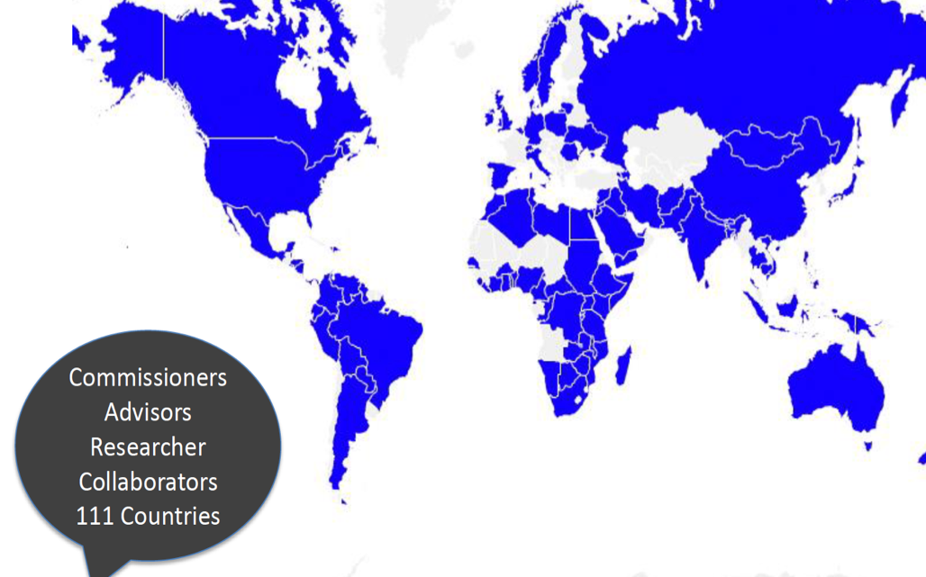

Slide 13
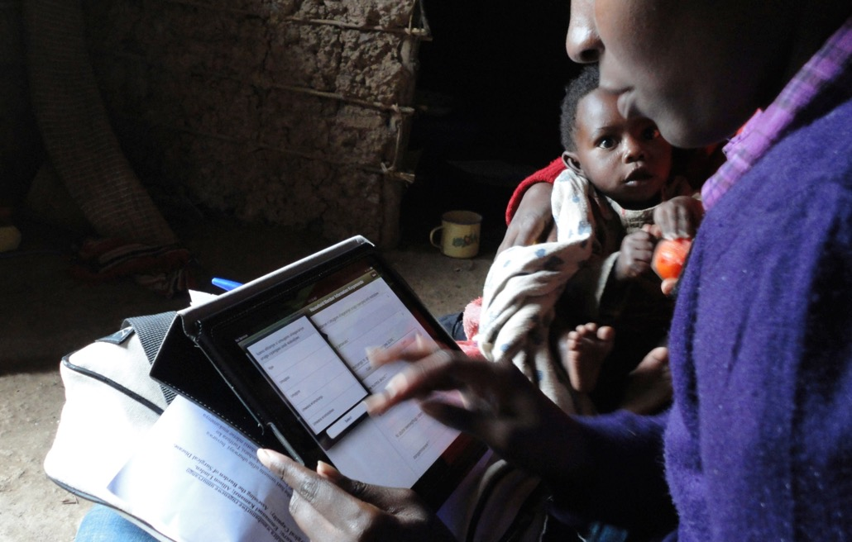

Slide 14



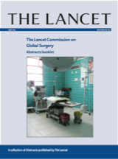
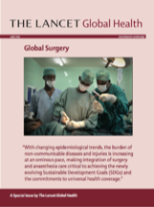
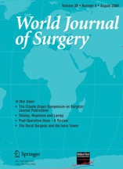

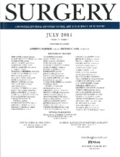


100+ publications/abstracts/teaching cases
Notes:
LCoGS has had many academic partners…

Slide 15


Slide 16

KM1
5 BILLION
cannot access
safe surgery
when needed

Slide 17
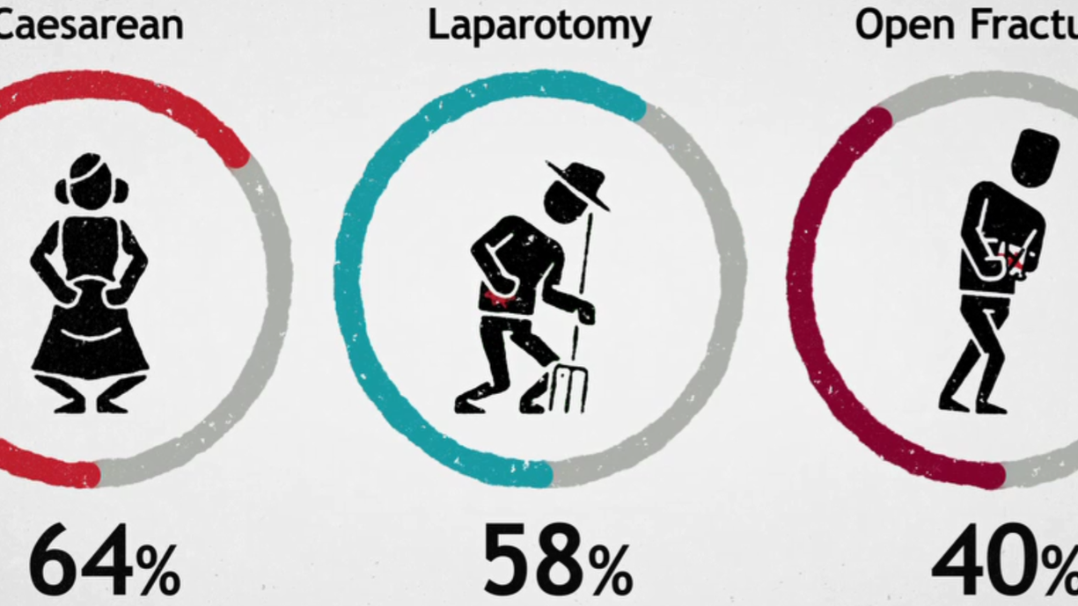

Slide 18
Yes
Access
Yes
Affordable
Yes
Safety
No
No Access
Yes
Capacity
No
_{Patient}
No Access
Timely
No
No Access
No
No Access
p(Access) = p(T∩C∩S∩A)
Probability of access is the joint probability of timely care, surgical capacity, safe surgery, and affordability
Notes:
Berätta att first delay inte ens är med
Gå in på varje cirkel, för åtgärder

Slide 20

KM2
143 million
more procedures
needed annually
at minimum
The poorest third of the world’s population
receives 6.3% of all procedures

Slide 21
KM2
143 million
more procedures
needed annually
at minimum
The poorest third of the world’s population
receives 6.3% of all procedures

Slide 26
Notes:
Based on a slide by Tom Weiser, with updated numbers.
Show the 6.7% to the third, and that the bar needs to go through the roof.

Slide 27
KM3
33 million
individuals face catastrophic expenditures
paying for surgery
+ 48 million = 81 million
Notes:
We did not have any key message regarding safety and quality, because there was simply not enough data.

Slide 28
KM3
33 million
individuals face catastrophic expenditures
paying for surgery
+ 48 million = 81 million

Slide 29

Notes:
Patients are struck by avertable mortality, morbidity, or financial catastrophe

Slide 30
KM4
Investing in surgery
is affordable,
saves lives,
& promotes economic growth

Slide 31


Slide 32
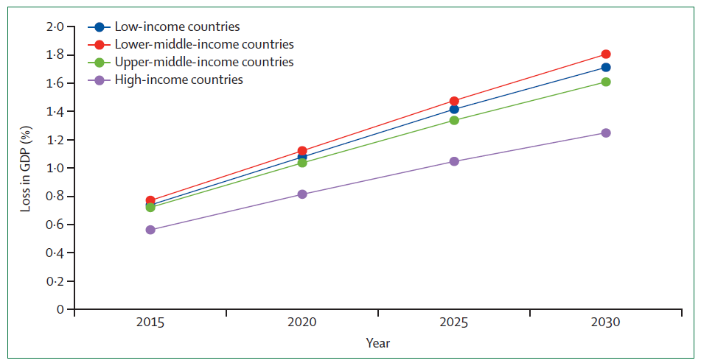
Annual value of lost GDP due to surgical conditions
Alkire BC, et al. Global economic consequences of selected surgical diseases: a modelling study. Lancet Glob Health 2015; 3: S21–27.

Slide 33
KM5
Surgery
is an indivisible,
indispensable
part of health care

Slide 34
KM5
Surgery
is an indivisible,
indispensable
part of health care

Slide 35
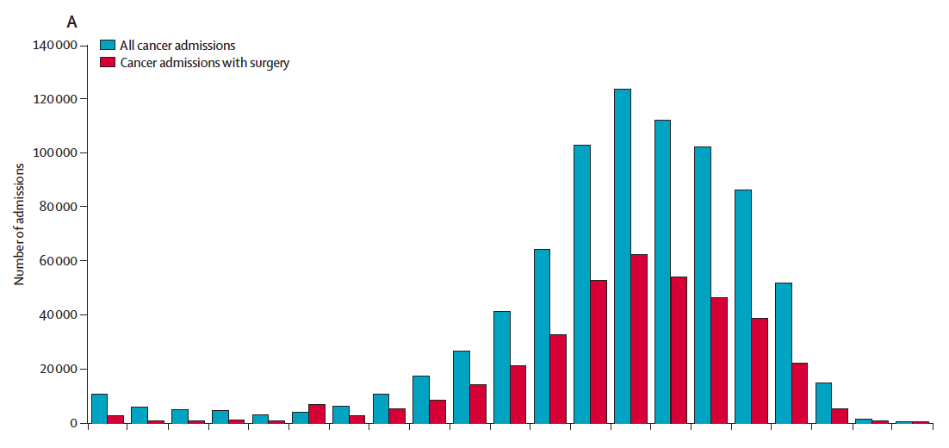
Surgery and admissions for cancer

Slide 36
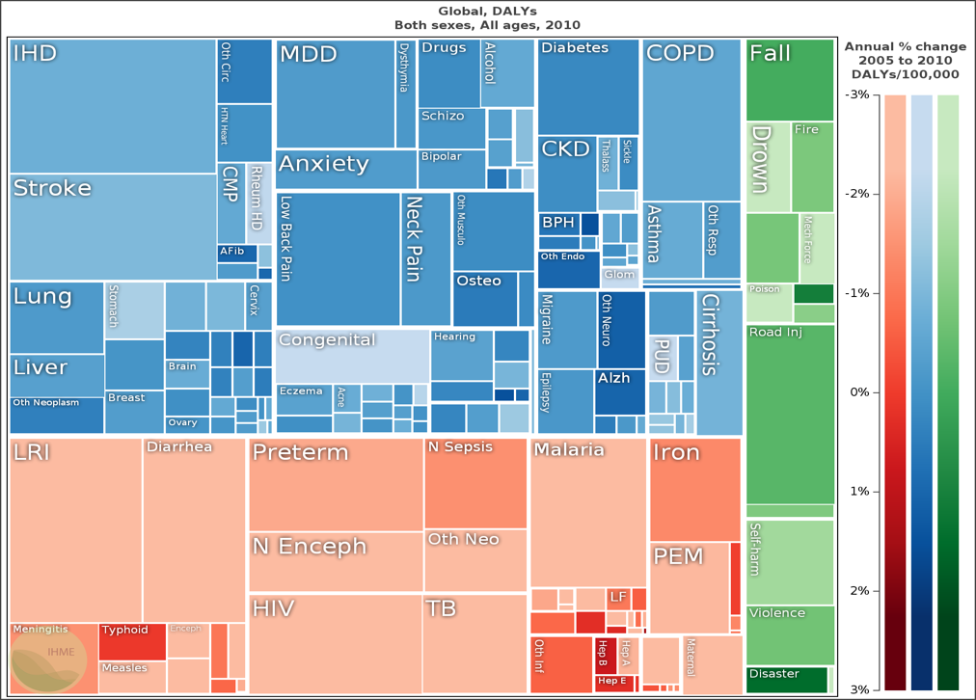
IHME, GBD

Slide 37
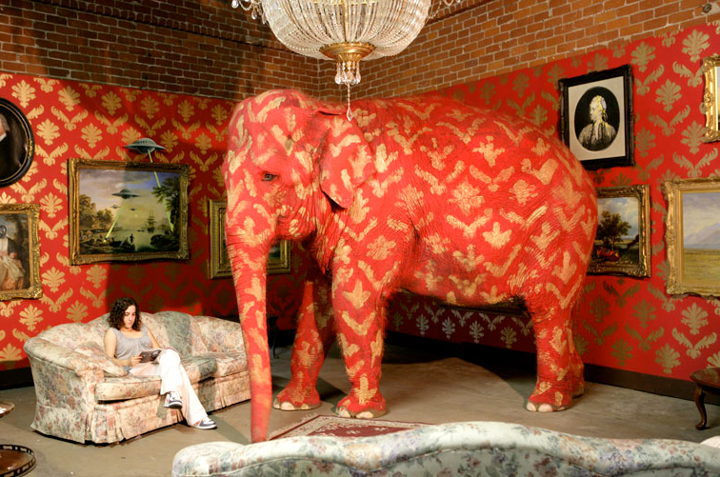

Slide 38
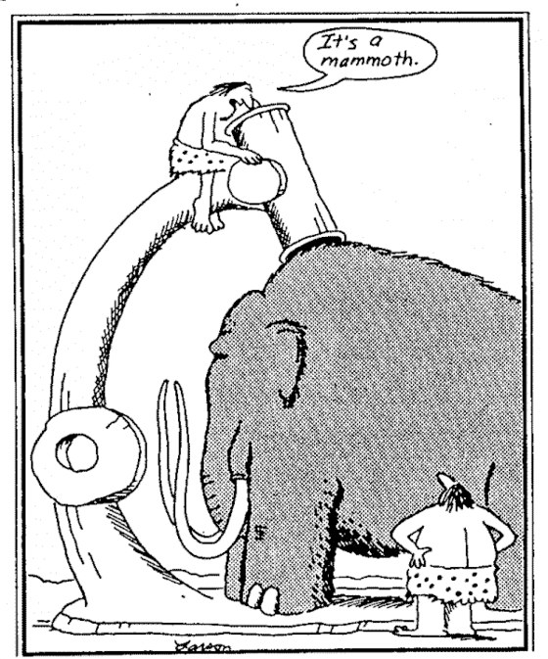


Slide 39


Slide 40
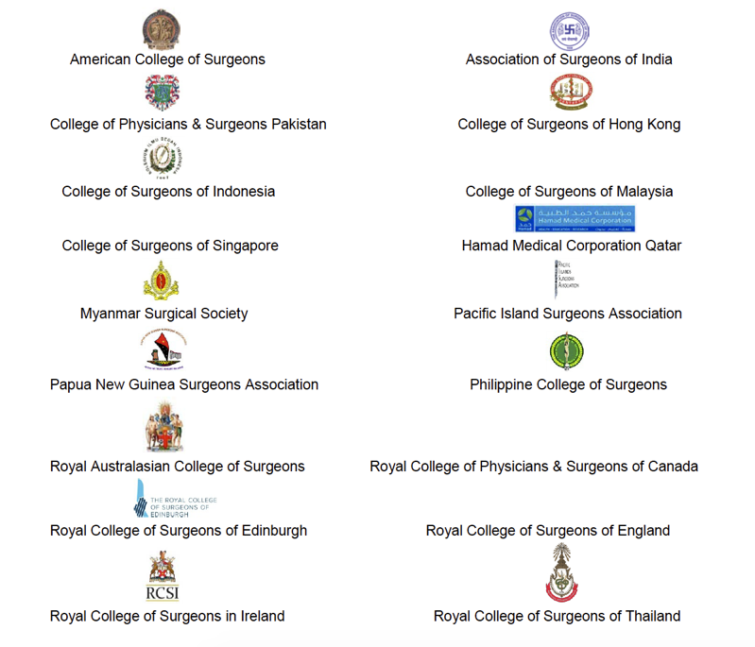

Slide 41
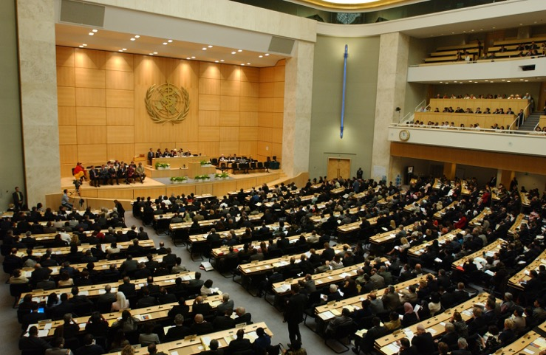
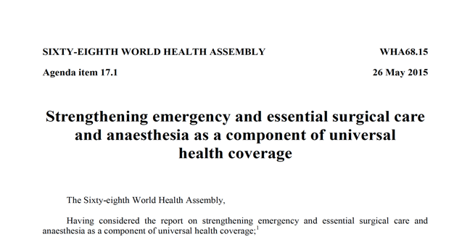
The World Health Assembly

Slide 42
Lancet Commission
Indicators
Notes:
Our group was a driving part of the Lancet Commission on Global Surgery which up to the launch of a report in 2015 performed major research to put forward these six indicators; the 2 hour access to essential surgery, the provider density, the surgical volume, the POMR and the two financial risk protection indicators

Slide 43
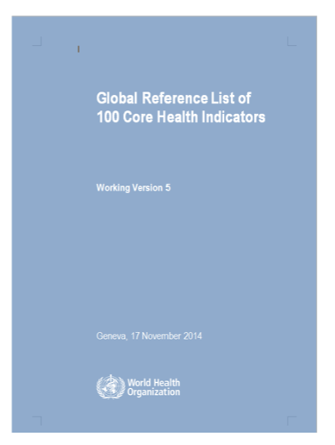


Slide 44
Lancet Commission
National Surgical Plan
Infrastructure
Workforce
Service Delivery
Financing
Information Management
Notes:
After the groundwork - The strongest single tool for national scaling up of surgery service delivery is the creation of a National surgery, obstetrics and anesthesia plan (NSOAP). This lays the foundation
Harvard Program in Global Surgery has been directly involved in many of the planning processes and we have participated in developing a toolbox for scaling up global surgery service delivery - you can find the documents online
The domains that this plan is overviewing on a national level are…

Slide 45
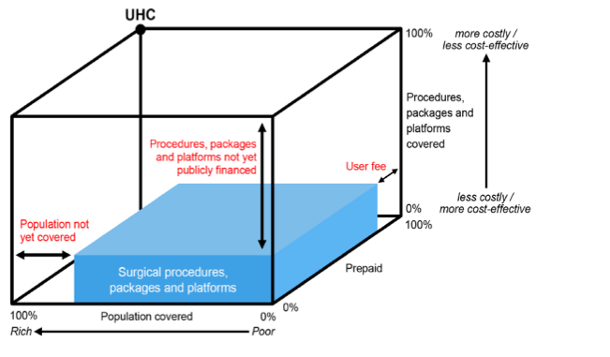
Lancet Commission
National Surgical Plan
Infrastructure
Workforce
Service Delivery
Financing
Information Management

