Slide 1
Establishing a Baseline and Conducting Health Facility Assessments
Katherine Albutt, MD MPH
Global Surgery Fellow

Slide 2
Background
Little is known about unmet surgical need and the capacity to deliver surgical services in much of the world
In the context of NSOAP, situation analysis and baselining are key initial steps to provide a framework for priority setting and initiatives
The World Health Organization (WHO) defines a health-specific situation analysis as “an assessment of the current health situation ... [that] is fundamental to designing and updating national policies, strategies and plans.”
Rajan. Strategizing national health in the 21st century: a handbook. 2016

Slide 3
Situation Analysis
Ideally, a health situation analysis should aim to:
  Realistically assess the current health-sector situation, with all its strengths, weaknesses opportunities and threats, including their root causes and effects
  Provide an evidence-informed basis for responding to health sector needs and expectations of the population
  Provide an evidence-informed basis for formulating future strategic directions for the health sector
  Be inherently participatory and inclusive of all relevant stakeholders
  Be analytical, relevant, comprehensive, and evidence-based

Slide 4
Why Perform a Situation Analysis?
Situation analysis is a crucial step in the health-sector planning cycle, which requires an adequate base of information, data, and evidence on the current state of surgery in the country
Situation analysis gives a voice and a platform to all health-sector stakeholders, including the population. Buy-in facilitates implementation of a national surgical, obstetric, and anesthesia plan (NSOAP) and a wide range of expertise and viewpoints leads to better-designed surgical policy and programming
Situation analysis increases accountability and transparency. It also contributes to concretizing roles and responsibilities in NSOAP implementation
Situation analysis supports and strengthens monitoring and evaluation (M&E). Further, it serves as a baseline to inform future M&E rounds
Situation analysis helps to establish consensus on the status of surgery in the country
Notes:
A situation analysis is essential to capture a realistic snapshot of the strengths and weaknesses of a country’s surgical system (see Box 4-1).
Data are often scarce regarding the current state of infrastructural, service delivery, workforce, financial and information management systems for the provision of quality, safe, and affordable surgical services
This includes assessing current surgical capacity, understanding barriers to surgical care delivery, and determining the country’s surgical needs.
A thorough situation analysis addresses this data void, it allows an evidence-informed response to the actual health needs of the population, and it provides a foundation for priority setting
Not only is it a crucial step in the policy and planning cycle, it is an important platform for giving a voice to stakeholders, for obtaining buy-in, and for ensuring mutual accountability
Furthermore, in the context of sparse existing data and information, a situation analysis can serve as a baseline against which future data can be compared.

Slide 5
How to Conduct a Situation Analysis
Define what information is needed
Review existing information
Perform a comprehensive situation assessment
Conduct a strengths, weaknesses, opportunities, and threats (SWOT) analysis

Slide 6
How To
Define what information is needed
  What information is needed and why
    Quantitative and qualitative
  Necessary contextual information
  Essential to identify existing surgical needs and demands within the population, not only to assess the supply side of surgical care delivery
Review existing information
  National population and housing census
  National/provincial health facility assessments
  Nationwide surveys, such as:
    Service Availability and Readiness Assessment (SARA)
    Demographic and Health Survey (DHS)
    Service Provision Assessment (SPA)
    Personnel, Infrastructure, Procedure, Equipment and Supplies (PIPES)
    Living Standards Measurement Study (LSMS)
  Performance reports
  National health-sector strategic plans
  Health-sector management and information system (HMIS) and other administrative sources
  Published literature
  Programmatic/policy reporting
Notes:
Define what information is needed
What information (quantitative and qualitative) is needed and why
Necessary contextual information for NSOAP
Not adequate to merely assess the supply of surgical care delivery, but also essential to identify existing surgical needs and demands within the population

Slide 7
Comprehensive Situation Assessment
To aid in data collection, WHO and PGSSC developed a surgical assessment tool (SAT)
Validated mixed-methods tool is designed to collect information on surgical service provision at the facility level
  Quantitative portion: combination of hospital walk-throughs, retrospective reviews of operative logbooks, and interviews with hospital directors and surgical providers
    Assesses the five domains of NSOAP: infrastructure, service delivery, workforce, information management, and financing.
  Qualitative portion: in-person semi-structured interviews with key stakeholders (including hospital directors and administrators, surgeons, obstetricians, and principal nursing officers) to understand the strengths and challenges in the provision of safe, timely, and affordable surgical care
    Facilitates an enhanced understanding of the complexities and nuances embedded within the surgical system.
Notes:
To date, the SAT has been used for data collection in Cape Verde, Ethiopia, India, Rwanda, and Uganda. In each of these countries, the SAT has been modified to fit that context and the NSOAP team’s strategic objectives. In Ethiopia, the SAT was modified in order to examine specific objectives of their NSOAP. In Rwanda, where the majority of care is received from the public sector, all district hospitals were surveyed. In Uganda, both the private and public-sector hospitals were surveyed. In some cases, a sample of representative hospitals can be surveyed for efficiency. However, the overarching aim is to have a better understanding of the surgical system in order to identify strengths and shortfalls.
Things to note:
The importance of partnership in undertaking such data collection cannot be underestimated
Involvement of critical stakeholders helps ensure a comprehensive evaluation, access to facilities, and applicability and accessibility of results at the country level
This is a resource- and time-intensive process. Directly measuring and accessing surgical metrics through hospital site visits requires large amounts of upfront planning and communication, adequate time to travel and conduct the assessment, and the financial and personnel resources necessary to support these activities.
SAT has significant areas of overlap with other systematically used data collection tools (i.e., SPA and SARA). Where possible, a good option is to leverage the cycle of existing systematic assessments to streamline surgical baselining with the addition of focused questions on surgery, obstetrics, and anesthesia. When feasible, integration of the SAT into ongoing national/regional data collection will avoid duplication of effort. Collaboration is underway to expand the surgery and anesthesia components in facility-based surveys to streamline and systematize this process
In situations where on-the-ground facility assessments are not feasible, a remote survey of facility administrators and directors by email, phone, or post is a possibility. Although less resource intensive, utilizing this strategy may compromise data completeness and validity.

Slide 8
SWOT Analysis
Useful analytic method to explore existing internal capabilities (strengths and weakness) and potential extrinsic factors (opportunities and threats)
Sets stage for strategic planning
Zambia SWOT Analysis

Slide 9
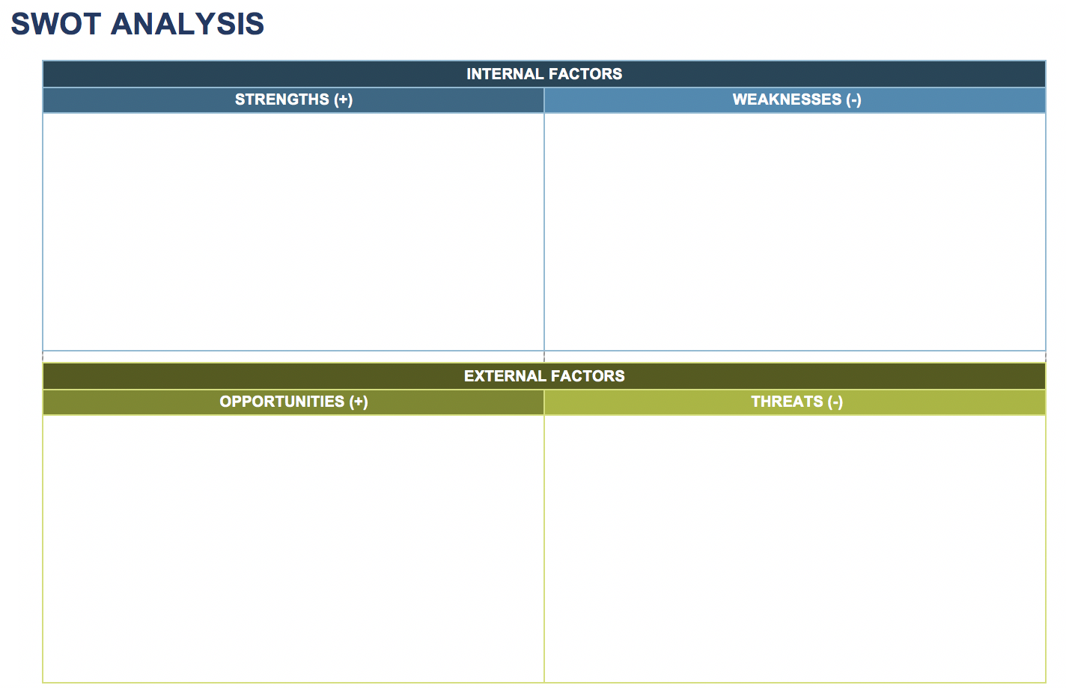
SWOT – An Exercise

Slide 10
Establish a Baseline
Notes:
In order to measure the future impact of policy and programmatic interventions, it is essential to be able to establish a baseline.
In 2015, the Lancet Commission on Global Surgery (LCoGS) convened to assemble evidence on the state of surgical care worldwide and to develop strategies for improving access. The Commission recommended all countries collect core surgical indicators as measures of the strength of their surgical system (see Table 4-3). The six indicators measure three aspects of surgical care: preparedness for delivering surgical services, volume and outcomes of service, and financial risk.
It is recommended that countries collect and analyze information that allows for monitoring, at minimum, these core six surgical indicators, although more detailed data collection is recommended and beneficial for NSOAP planning. These indicators reflect the interaction between need for and provision of surgical services. While they are not exhaustive, they provide a scaffold to begin this process. Subsequent development of an informational system that can monitor these indicators and other metrics over time is the next logical step. Results of baselining can serve as advocacy tools, metrics for M&E, and a starting point against which future data points can be compared.

Slide 11
Data in Global Surgery
WHA Resolution 68.15
  Member States to collect and compile data on number, type and indications of surgical procedures, referrals and perioperative mortality
WHA Resolution 69.11
  Report every 2-years on progress towards Strengthening Emergency and Essential Surgical Care
Global Surgery and Anesthesia Statistics
  Working group
  Recommendations on global surgery and anaesthesia statistics as compiler manual
  UN Statistical Commission
Notes:
2015 the WHA resolution 68.15 urged Member States to collect and compile data on number, type and indications of surgical procedures, referrals and perioperative mortality in their respective countries, and to share such data as appropriate. This resolution further called upon the Director General to establish mechanisms to collect emergency and essential surgical and anesthesia case log data, to devise relevant, meaningful and reliable measures of access to and safety of surgical and anesthesia care, and to collect, assess and report related cost data on the delivery of emergency and essential surgical care.

